Slide 1
CS435/535, Computer Graphics
Jingyuan(Alex) Zhang
Office: 3413 SEC (Science and Engineering Complex)
Phone: 348-9516
Email: zhang@cs.ua.edu
Office Hours: 12:30-1:30pm Tuesdays
12:30-2:30pm Thursdays

Slide 2
What is Computer Graphics?
Computer graphics deals with all aspects of creating images with a computer
  Hardware
  Software
  Applications

Slide 3
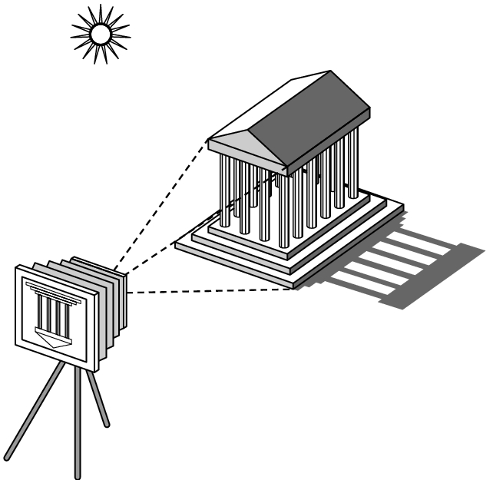
Image Formation

Slide 4
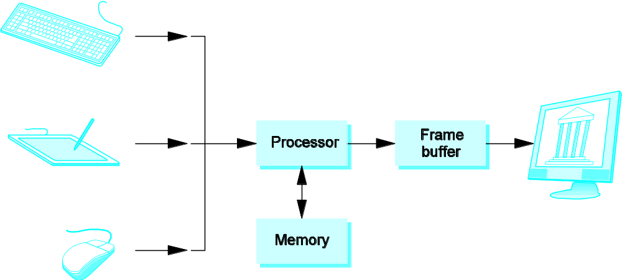
A Graphics System

Slide 5
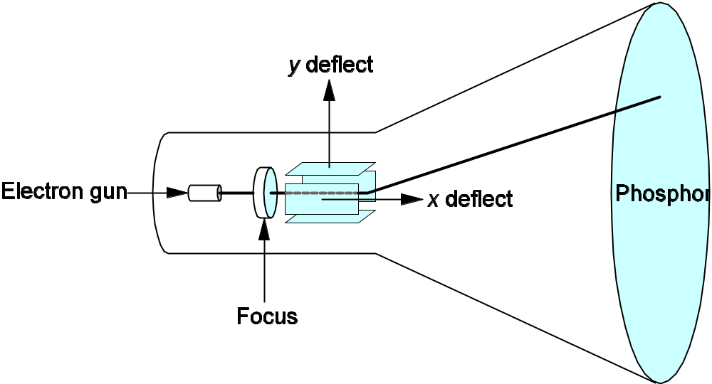
CRT (Cathode-Ray Tube)

Slide 6
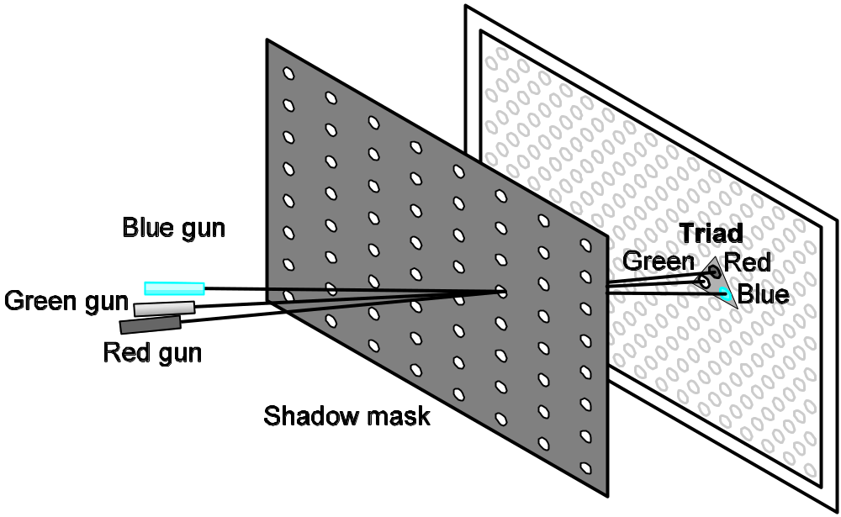
Color CRT

Slide 7
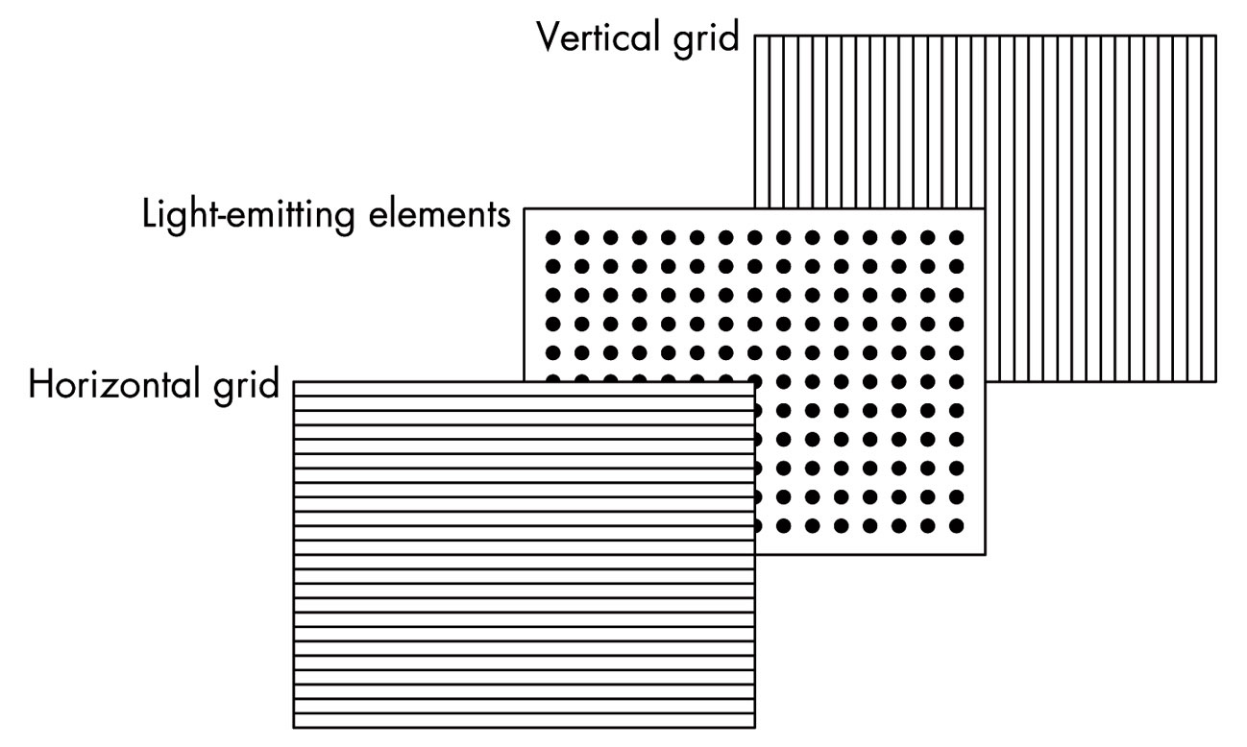
Flat Panel Display

Slide 8
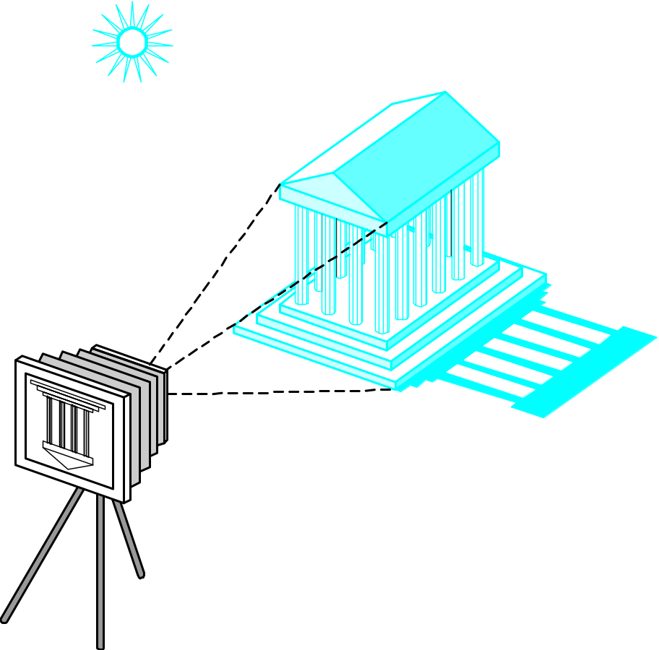
Taking a Picture

Slide 9

Modeling

Slide 10
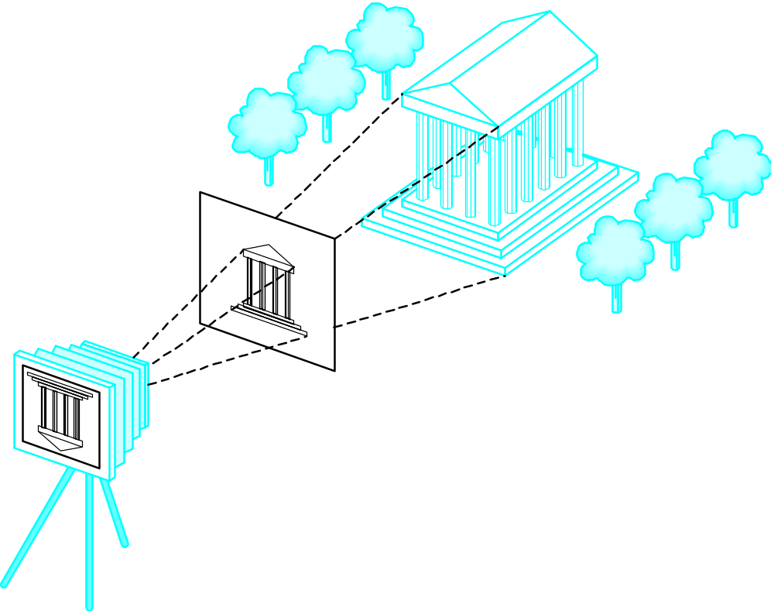
Placing the camera

Slide 11
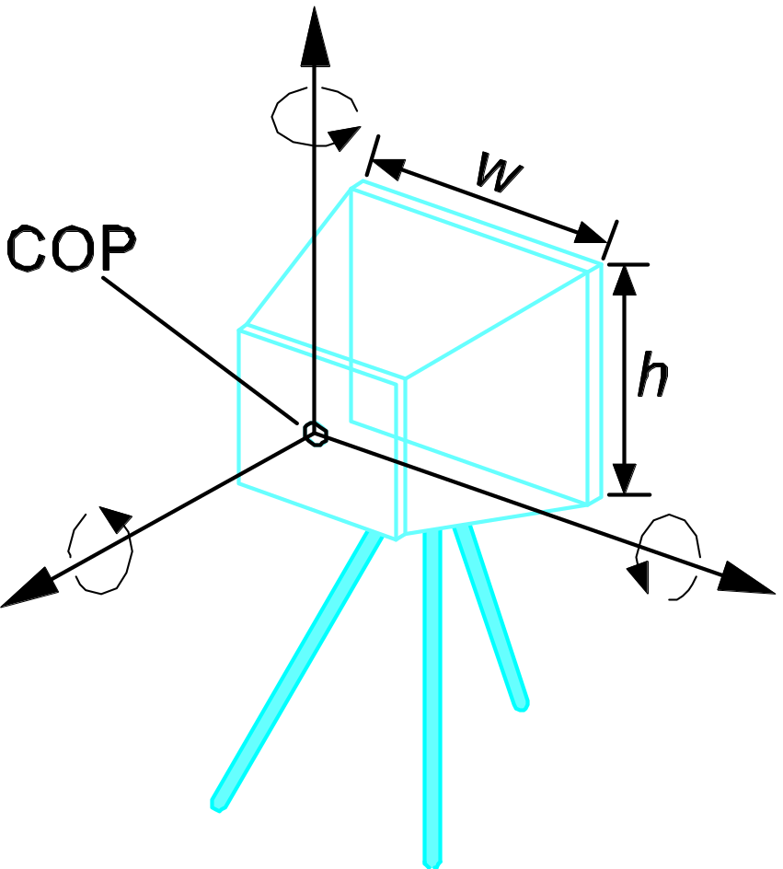
Camera Specification (Perspective)

Slide 12
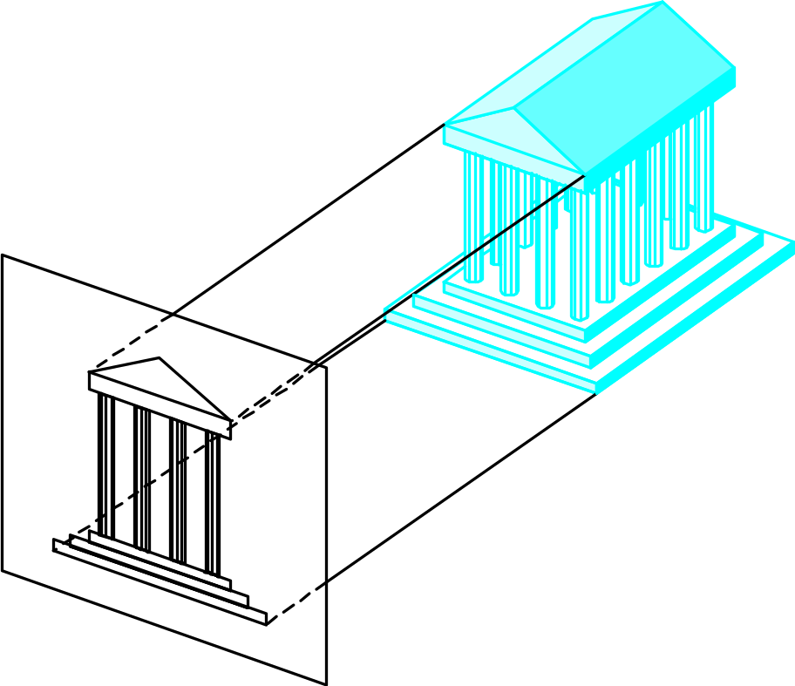
Projection

Slide 13
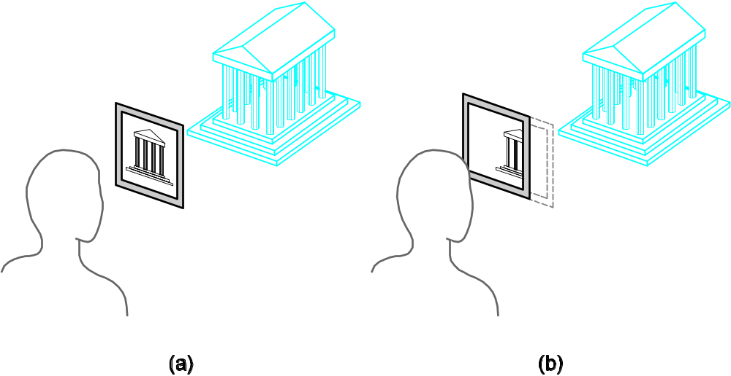
Clipping

Slide 14
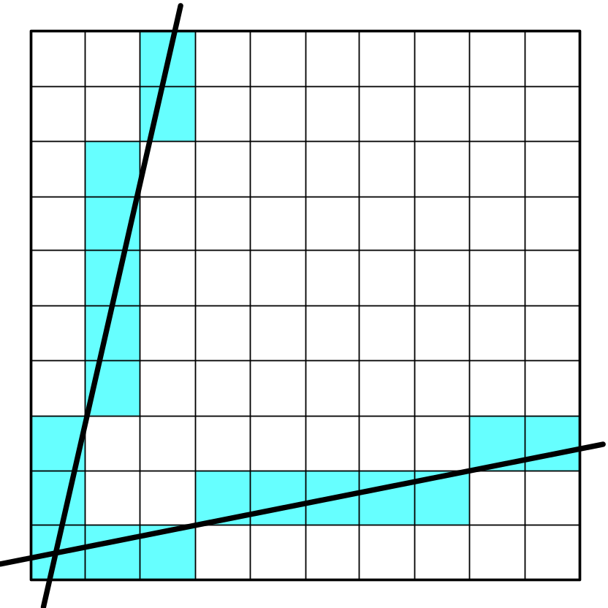
Rasterization

Slide 15
Graphics Pipeline

Slide 16
Shading Language
Vertex Shader
Fragment Shader

Slide 17
Misc
Course Info: Blackboard
Syllabus
Attendance sheet

Slide 18
Assignment (no credit)
Find a web browser that supports HTML5 (Chrome, Firefox, Safari, Internet Explorer).
Go to http://www.cs.unm.edu/~angel/BOOK/INTERACTIVE_COMPUTER_GRAPHICS/SEVENTH_EDITION/CODE/, and download angelCommon.zip under the Common directory, and extract all files. Change the angelCommon directory name to Common.
Download angelChap2.zip under the 02 directory, and extract all files. Test gasket1.html with your web browser.

