Slide 1
First WebGL Program

Slide 2
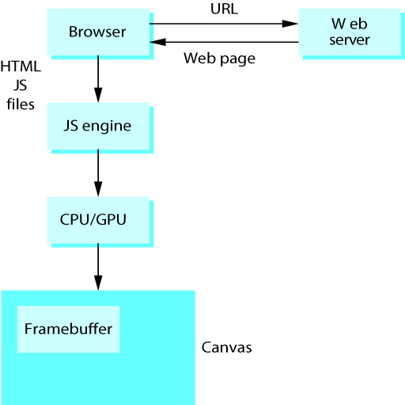
WebGL Organization

Slide 3
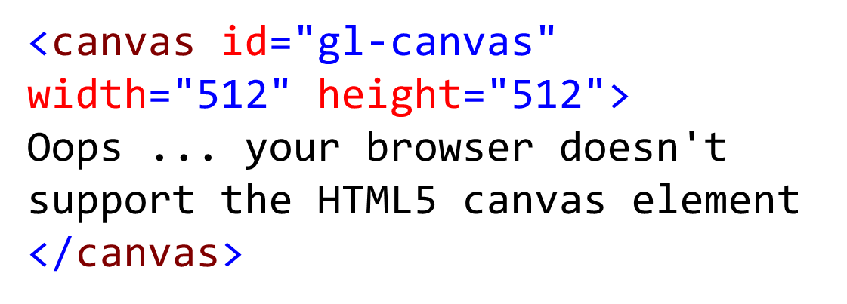
Canvas

Slide 4
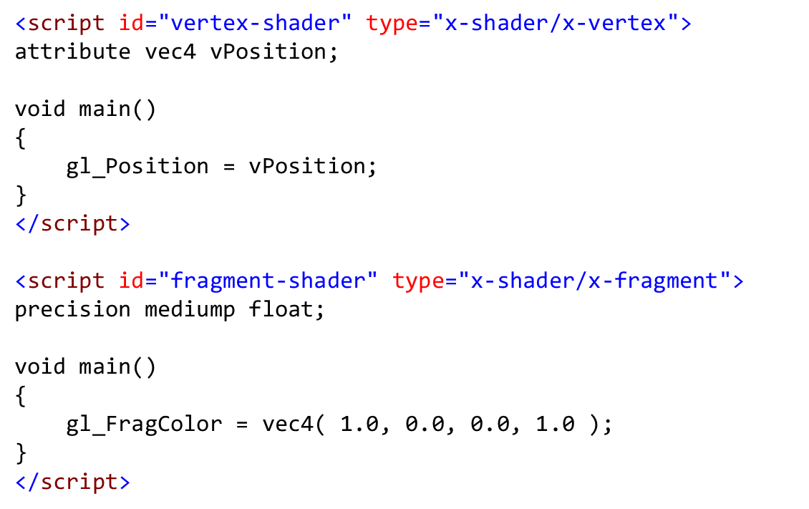
Vertex and Fragment Shaders

Slide 5
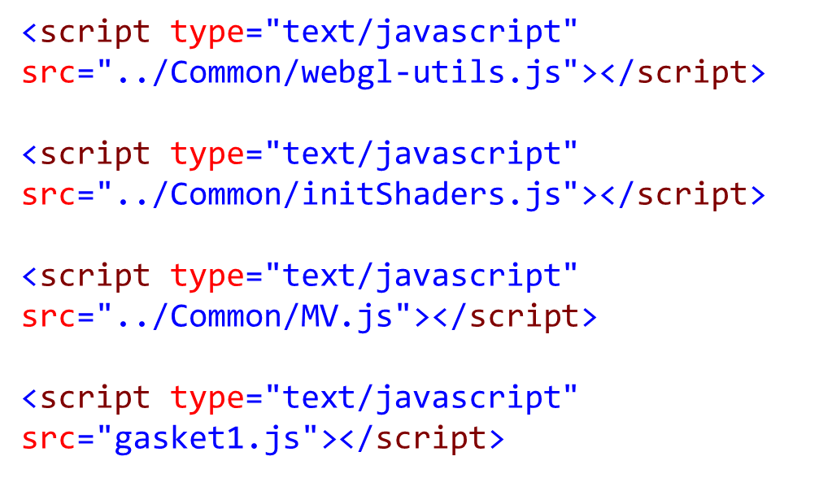
WebGL Application

Slide 6

WebGL context: a JavaScript object that contains all the WebGL functions and parameters.
var canvas = document.getElementById( "gl-canvas" );
var gl = WebGLUtils.setupWebGL( canvas );

Slide 7
InitShaders.js
V Shader in String
F Shader in String
gl.shaderSource
gl.createShader
Shader Source
Shader Source
gl.compileShader
Shader Object
Shader Object
gl.attachShader
Gl.createProgram
Shader Program
gl.linkProgram
Executable Shader Program
gl.useProgram

Slide 8
MV.js
vec2, vec3, vec4
mat2, mat3, mat4
Basic Transformation Matrix
ModelView Matrix
Projection Matrix

Slide 9
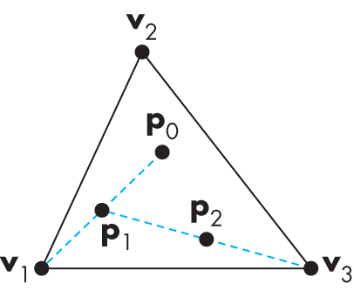
Sierpinski Gasket
( 0.0, 1.0 )
( -1.0, -1.0 )
( 1.0, -1.0 )

Slide 10
Send Data to the GPU
var bufferId = gl.createBuffer();
gl.bindBuffer( gl.ARRAY_BUFFER, bufferId );
gl.bufferData( gl.ARRAY_BUFFER, flatten(points), gl.STATIC_DRAW );

Slide 11
Communication between WebGL Application and Vertex Shader
var vPosition = gl.getAttribLocation( program, "vPosition" );
gl.vertexAttribPointer( vPosition, 2, gl.FLOAT, false, 0, 0 );
gl.enableVertexAttribArray( vPosition );

Slide 12
Rendeirng
function render()
{
gl.clear( gl.COLOR_BUFFER_BIT );
gl.drawArrays( gl.POINTS, 0, points.length );
}

Slide 13
Event Handling
// the onload event occurs when the page // including all the script files, is loaded.
window.onload = function init()
{
var canvas = document.getElementById( "gl-canvas" );
gl = WebGLUtils.setupWebGL( canvas );
……
}

