Slide 1





SMART INDIA HACKATHON 2026
  Problem Statement ID – SIH26124
  Problem Statement Title- AI-Powered Mobile Urban Intelligence Platform Using Public Transport Fleet
  Theme- Smart Automation
  PS Category- Software
  Team ID - P96
  Team Name (Registered on portal)- Drishti

Slide 2



















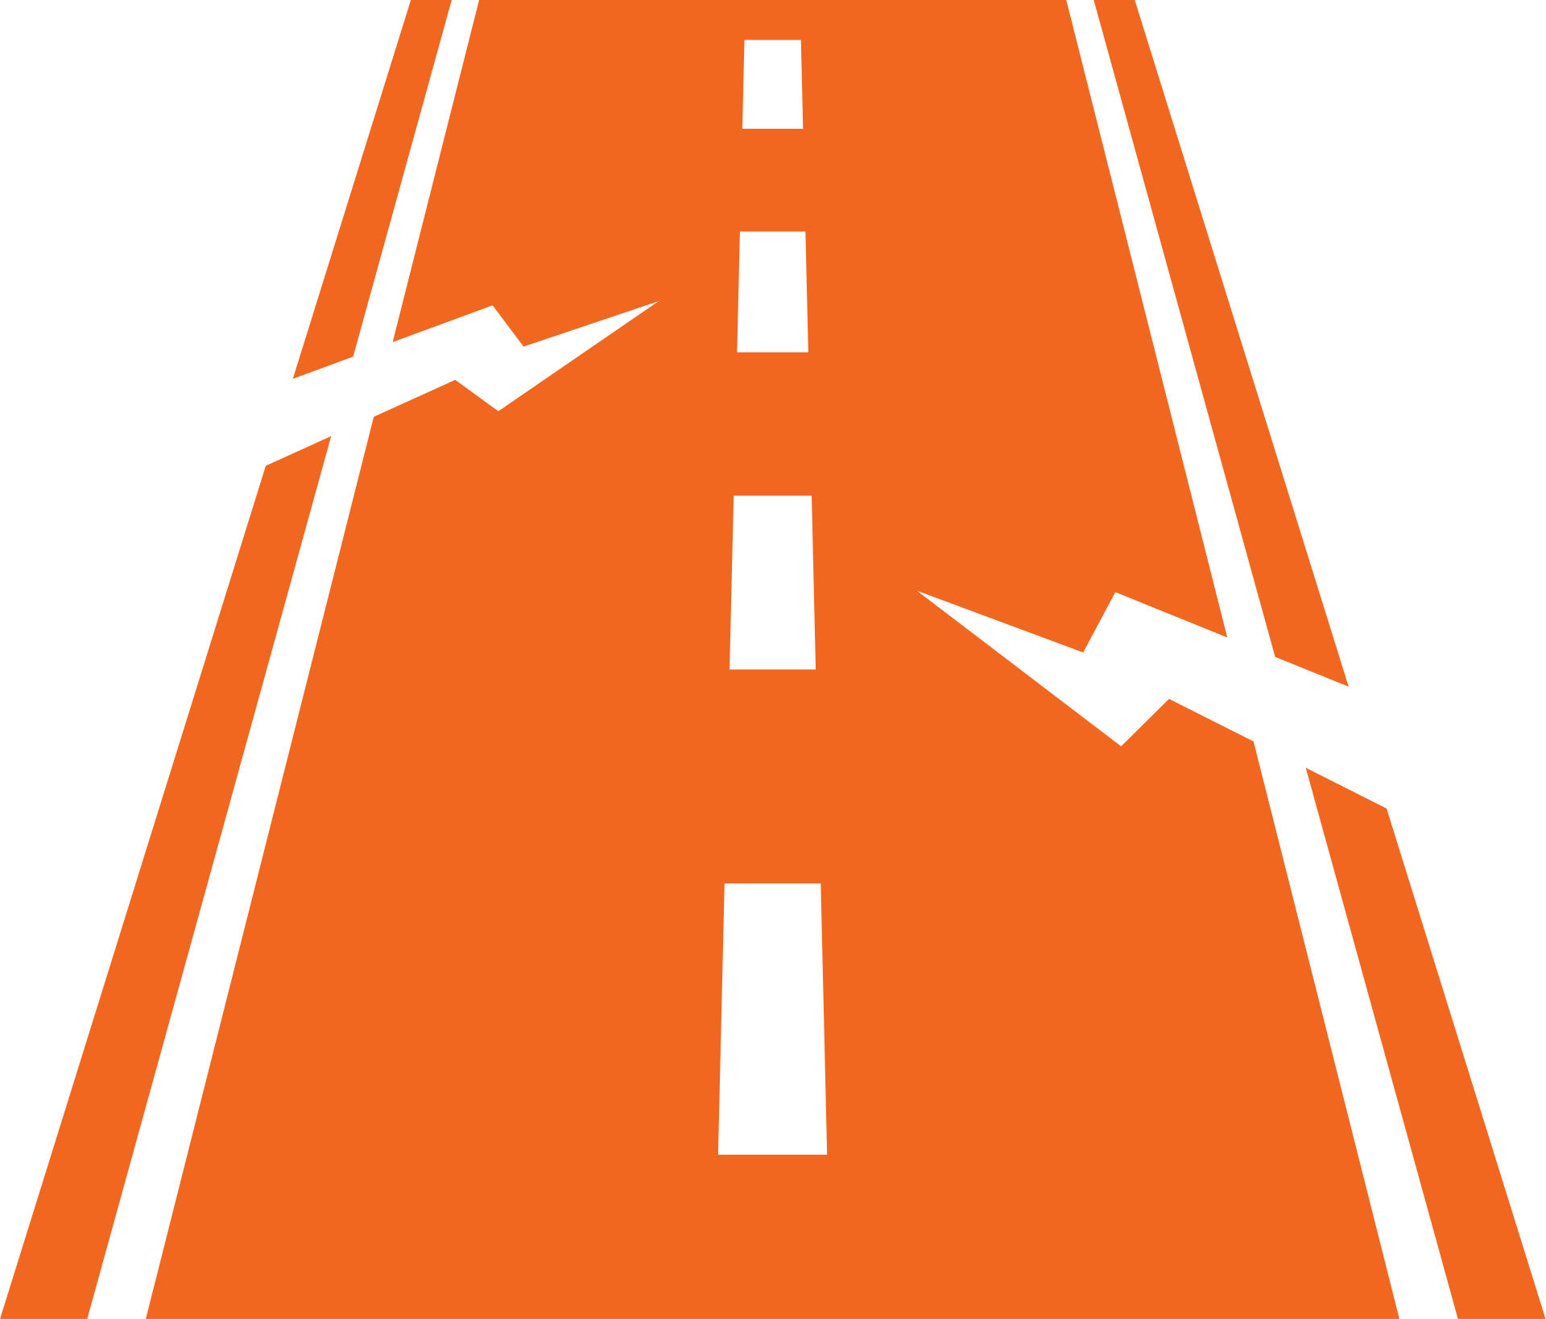






















DRISHTI
TURNING EVERY BUS INTO A SENSOR FOR SMARTER CITIES
l
t
PROBLEMS TODAY
OUR SOLUTION : DRISHTI
WHY DRISHTI IS BETTER
Surveillance Gaps & Blind Spots:
Poor Urban Planning Decisions:
AI extracts intelligence → securely sends → our platform turns it into actionable insights.
Citywide & Mobile Coverage:
Fixed CCTV: only covers
<10-15% of roads.
Wrong roads get closed or opened.
Buses go where CCTV cannot.
Continuous, citywide sensing.
Criminals, incidents exploit areas without coverage.
Poor construction timelines → traffic chaos, longer delays, underused detour routes.
Bus Cameras
(On-Board)
Edge AI
Processing
Secure Data
Transmission
Central Platform & Analytics
Actionable
Insights
Real-time & Proactive:
Detects & predicts issues in real time.
Enables action before problems escalate.
Hit & Run Evading Vehicles:
No Early Warning for Hazards:
What does Drishti deliver?
Wanted persons/vehicles:
travel fast across city.
Waterlogging, congestion build-up, unsafe pedestrian situations → unnoticed until its too late.
t
Municipal Operations
Citizen Mobility
Platform
Strict Role-Based Access Control:
Police Command &
Control
Secure siloing of police, municipal, and citizen access at the software level to avoid privacy violations.
Hard to track last known location and movement.
Vehicle Classification & ANPR
Road Defect Detection
Live Traffic & Congestion
Track wanted vehicles across the city
Potholes, cracks, waterlogging
Real time density and speed
Cost-Effective at Scale:
Roads Deteriorate Before Action:
Unreliable Traffic Information:
Watchlist Matching
Infrastructure Monitoring
Road Conditions & Hazards
Uses existing bus fleet infrastructure.
No necessity for new camera networks.
Potholes, cracks, and waterlogging worsen gradually.
Lack of real-time, city-wide visibility → wrong route choices, longer delays, wasted fuel.
Missing persons / flagged vehicles
Missing signs, dividers, zebra crossings
AI-detected + citizen reports
Live Alerts & Incident Detection
Deterioration Prediction
Smart Route Suggestions
Collisions, rash driving, suspicious events
AI tracks condition trends of roads/infra before failure
Fastest / less congested routes
Late detection → accidents, higher repair costs.
GIS Map & Movement Trail
Repair Verification
Public Transport Status
One Platform, Many Benefits
Last seen location & movement
history
Verify repairs and close only when
fixed
Bus location, delays, route status
One intelligent platform serving the police, municipality,
and citizens.
Missing / Unsafe Infrastructure:
Lack of Timely & Trustworthy Info:
Evidence Viewer
Traffic & Route Analytics
Alerts & Updates
Missing dividers, faded zebra crossings, damaged signs → increase risk for pedestrians
No accurate, real-time updates on roads, hazards, public transport status.
Videos, images, and timelines
Density, congestion, bottlenecks, and OD patterns
Incidents, road blocks, hazards
Case Management & Support
Urban Planning & What-If
Simulator
Actionable & Data-Driven
Organize, assign, investigate
Simulate road closures, construction timelines, alternate routes, and impact
Accurate, real-time data powers decision making,
planning, and more efficient resource usage.
2
Notes:
2

Slide 3













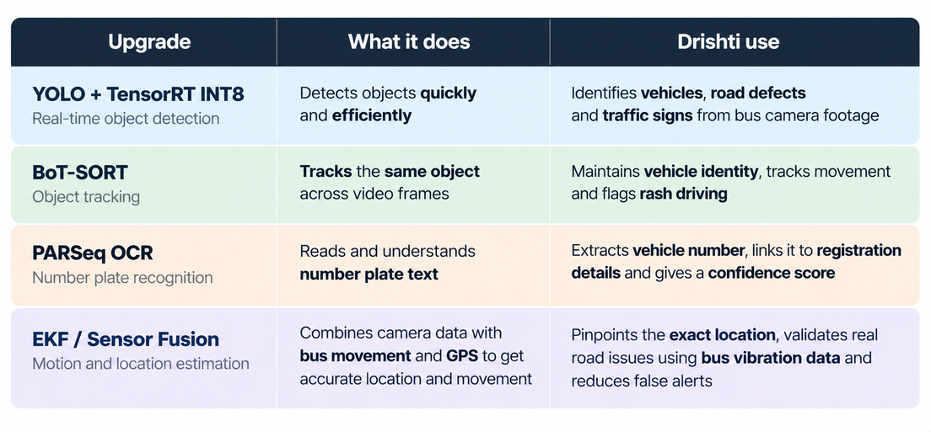














TECHNICAL APPROACH
UNDERSTAND
VERIFY & DELIVER
CENTRAL INTELLIGENCE
END USERS
CAPTURE
Detection + Tracking
Evaluate YOLO on relevant road data → track objects, use multi-frame consensus
Cellular Uplink
HTTPS / MQTT over TLS → send event metadata + redacted frame / short clip
Cameras on bus
Direct CSI/USB connection to Jetson-One camera pilot, expand after testing
PostgreSQL + PostGIS
Candidates, observations + geospatial state;
Issues, assignments, reviews + audit records
FastAPI service boundary
Authenticate new users & requests;
Backend RBAC + department/jurisdiction
Evidence access enforced server-side
Location estimation
GNSS / IMU + calibrated camera geometry, defect location is not simply bus GPS
Authenticated ingestion
Device identity + schema/payload checks, reject unauthorized/malformed uploads
GNSS + IMU
ESP32 for timestamped IMU, synchronized sensor and timer clocks so that backend can determine independent observations of same physical event
Object storage
Redacted images/clips; evidence references
Restricted originals → only when authorized
Police/Municipal Access
React + Leaflet operational workspaces
Scoped review, assignment, & field updates
Privacy Gate
Mask plates and faces before upload; OCR only for authorized plate use cases
Durable queue
Acknowledge only after durable acceptance
Worker retries + dead-letter handling with HITL
Event Envelope
Stable event ID + Source device/bus +
Capture time + model version / provenance + estimated location + spatial uncertainty + evidence reference + integrity checksum
Persistent Event Buffer
Encrypted, bounded local disk storage, replay unacknowledged events on reconnect
Validate & Deduplicate
Idempotent processing by event ID,
cross-bus spatial/temporal correlation
Citizen API + public map
Only approved road conditions are published
No plates, faces, watchlists, or bus IDs
No internal confidence scores/raw reports
Ultralytics
OpenCV
PostgreSQL
PostGIS
FastAPI
React
Typescript & JavaScript
Leaflet & OpenStreetMap
Amazon S3
TECH STACK
Image Detection & Recognition
Database
API Endpoint Testing
Frontend UI & Functionalities
Map & Location Display
Storage
3
Notes:
3

Slide 4





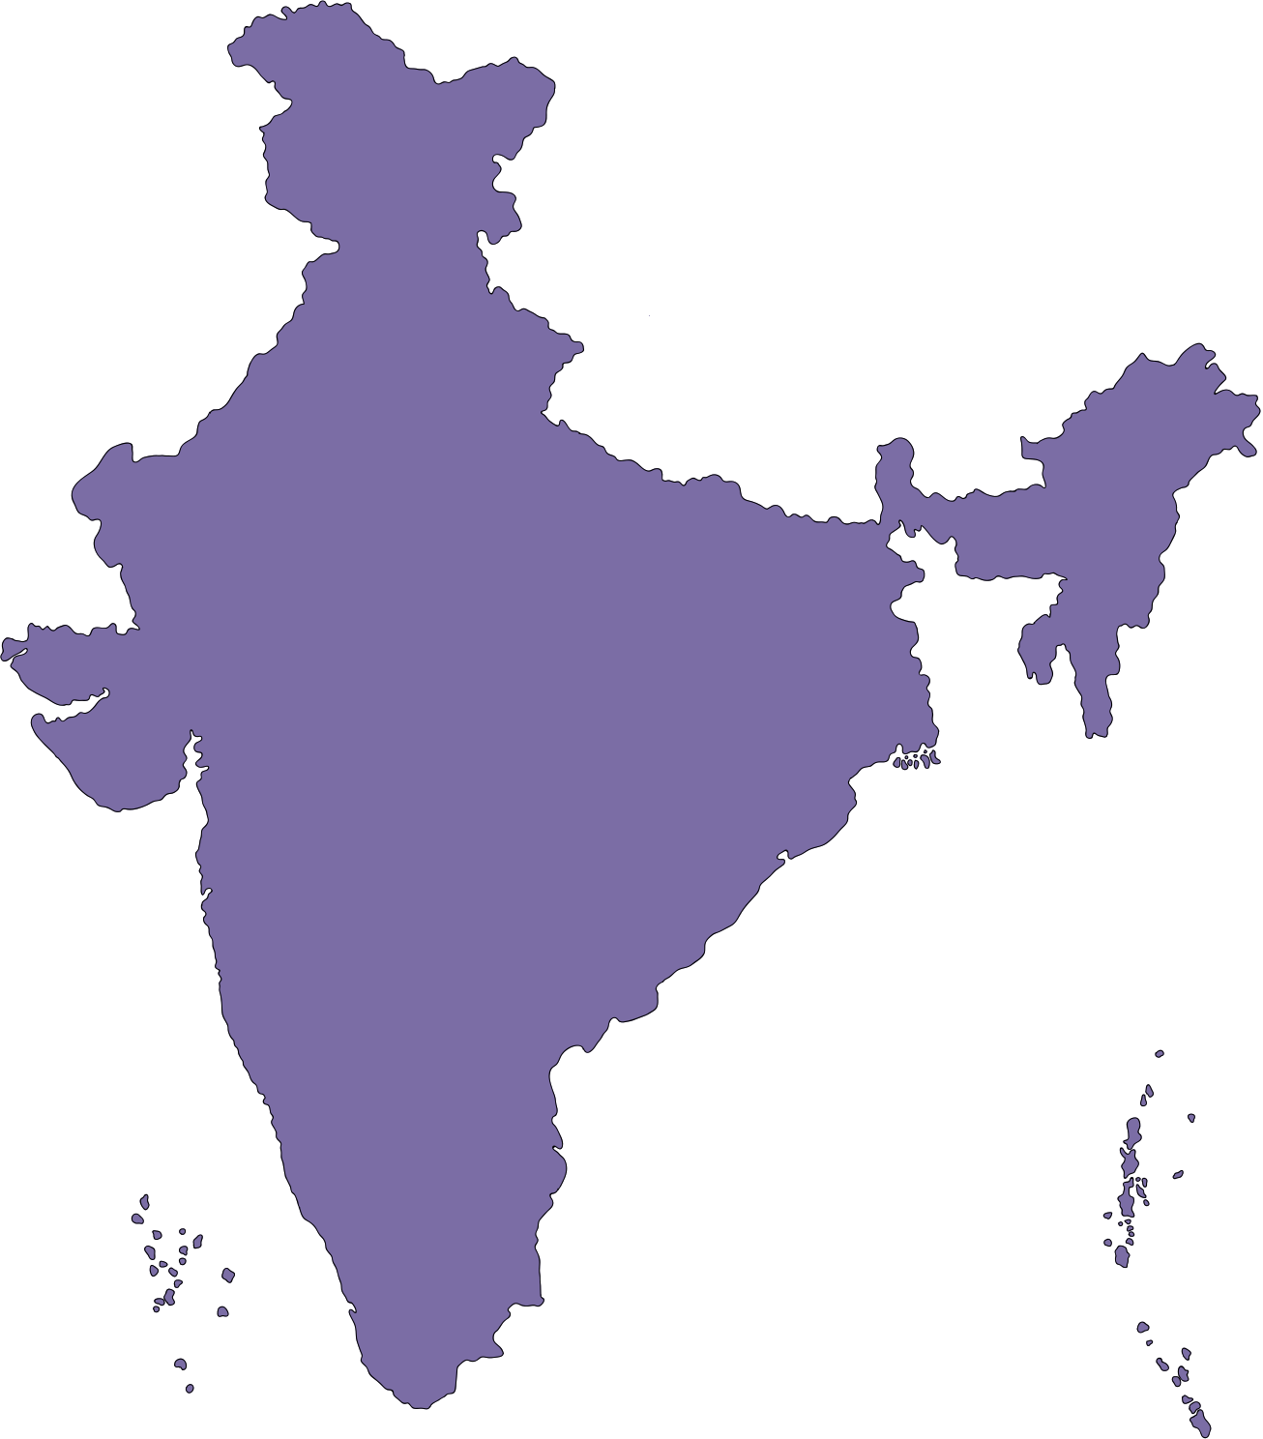


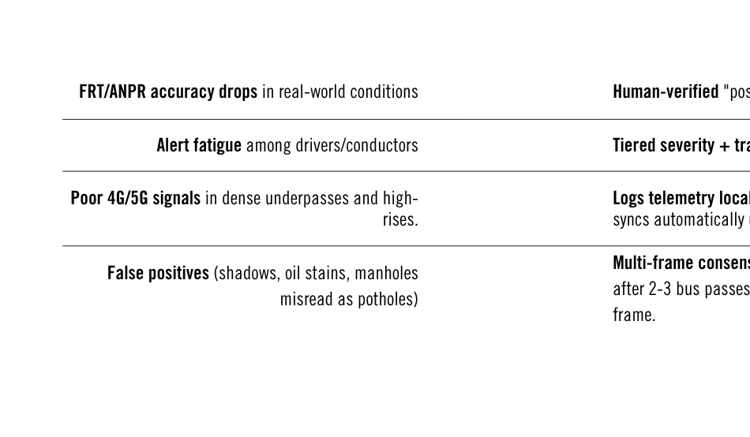
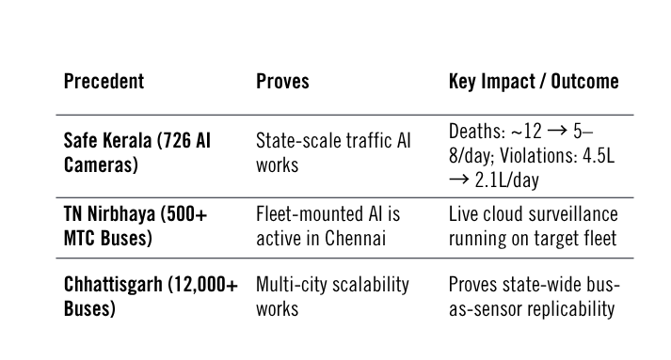








FEASIBILITY AND VIABILITY
l
l
QUANTIFIED IMPACT
FEASIBILITY
VIABILITY
  Potholes cause ~2,300 deaths every year in India.
  Every minute saved cuts emergency death risk by 5–17%; Drishti alerts dispatch in under 90 seconds.
  Early detection saves ₹6–₹10 on reconstruction for every ₹1 spent on timely fixes.
  Delivers 5x surveillance than static CCTVs at 1/10th of the cost.
Viability
Proven Edge-AI Tech — Jetson-class boards
Govt Appetite Proven: Project exists at this scale
Fleet Reach: ~3,400 buses, 668 routes, 3,929 km²
4 Cameras/Bus give full coverage
Metadata-first transmission keeps 4G load low
Scalable: Replicable beyond Chennai
Scale Achievable in Phases — ~3,400-bus fleet
Sustainable Opex: Funded via existing per-km GCC contracts.
l
PROOF POINTS
CHALLENGES AND MITIGATION
4
Notes:
4

Slide 5

FEASIBILITY AND VIABILITY
l
QUANTIFIED IMPACT
4
Notes:
4

Slide 6
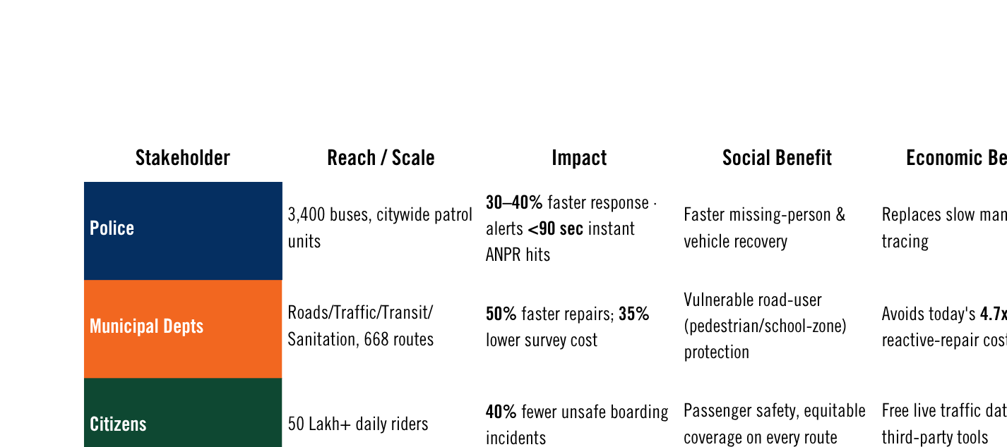





IMPACT AND BENEFITS
Sources: MTC ridership/fleet data · Tamil Nadu Nirbhaya Safe City CCTV/MNVR project · Kerala "Safe Kerala" AI camera outcomes · Bengaluru Safe City project cost data · GHMC pothole repair cost reports · SANRAL pavement maintenance studies · MoRTH road-accident GDP-loss estimates

Slide 7
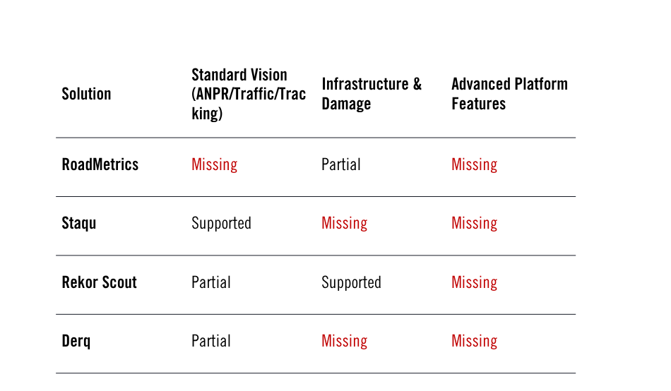

RESEARCH AND REFERENCES
Research Papers
  RDD2022: A Multi-national Image Dataset for Automatic Road Damage Detection – Arya et al., Geoscience Data Journal (Wiley), 2024 [Link] (Road defects & potholes)
  Deep Learning for Intelligent Transportation Systems: A Survey – Wang et al., IEEE Transactions on Intelligent Transportation Systems, 2019 [Link] (Traffic congestion, vehicle analytics, incident detection)
  PaddleOCR 3.0 Technical Report – Cui et al., arXiv, 2025 [Link] (Number plate recognition & OCR)
Government Applications
  AI-Powered Dashcam Analytics Services (DAS) – NHAI – AI-based highway monitoring using vehicle-mounted cameras. [Link]
  Integrated Command and Control Centre (ICCC) – Smart Cities Mission, Govt. of India – Integrated traffic monitoring & GIS command platform. [Link]
l
6
Notes:
6

