Slide 1
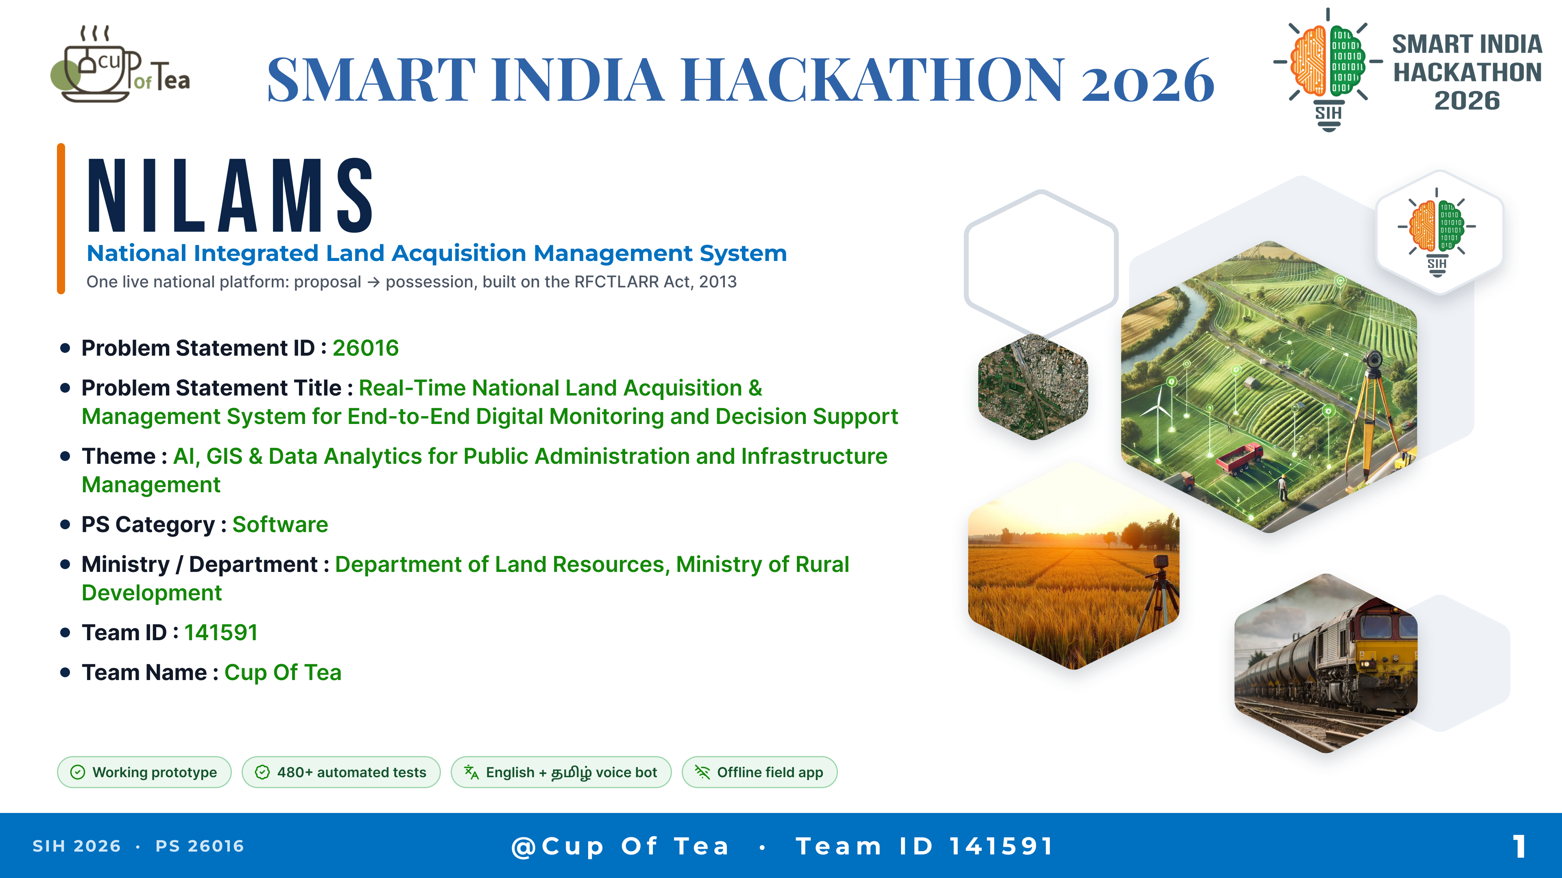
SMART INDIA HACKATHON 2026
Notes:
SMART INDIA HACKATHON 2026
NILAMS — National Integrated Land Acquisition Management System
One live national platform: proposal → possession, built on the RFCTLARR Act, 2013
Problem Statement ID: 26016
Problem Statement Title: Real-Time National Land Acquisition & Management System for End-to-End Digital Monitoring and Decision Support
Theme: AI, GIS & Data Analytics for Public Administration and Infrastructure Management
PS Category: Software
Ministry / Department: Department of Land Resources, Ministry of Rural Development
Team ID: 141591
Team Name: Cup Of Tea
Working prototype · 480+ automated tests · English + Tamil voice bot · Offline field app

Slide 2
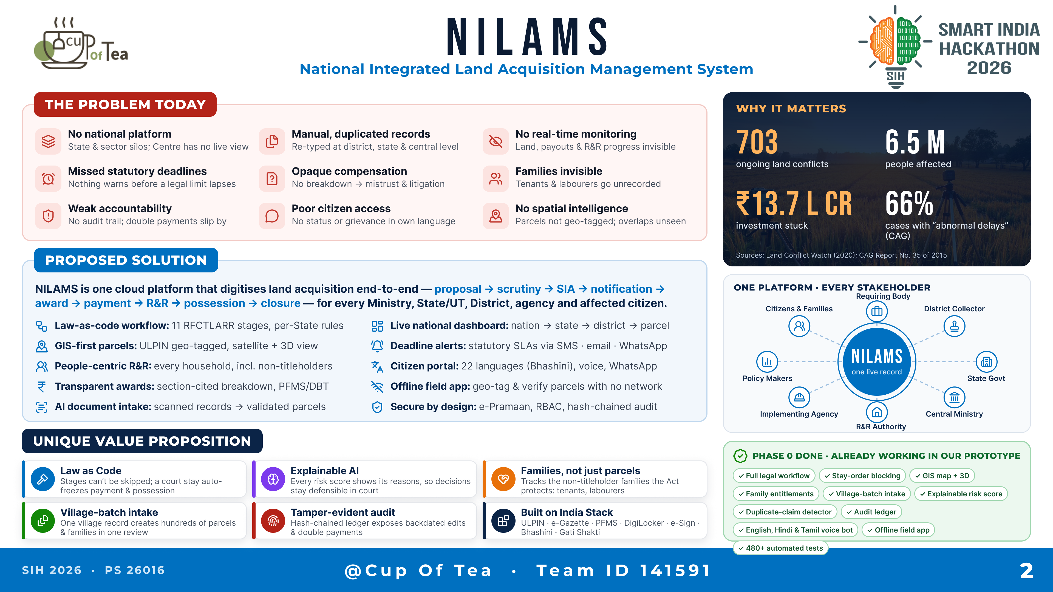
NILAMS
Notes:
NILAMS — National Integrated Land Acquisition Management System
THE PROBLEM TODAY
- No national platform: State & sector silos; Centre has no live view
- Manual, duplicated records: re-typed at district, state & central level
- No real-time monitoring: land, payouts & R&R progress invisible
- Missed statutory deadlines: nothing warns before a legal limit lapses
- Opaque compensation: no breakdown → mistrust & litigation
- Families invisible: tenants & labourers go unrecorded
- Weak accountability: no audit trail; double payments slip by
- Poor citizen access: no status or grievance in own language
- No spatial intelligence: parcels not geo-tagged; overlaps unseen
WHY IT MATTERS: 703 ongoing land conflicts · 6.5 M people affected · ₹13.7 lakh crore investment stuck · 66% cases with "abnormal delays" (CAG). Sources: Land Conflict Watch (2020); CAG Report No. 35 of 2015.
PROPOSED SOLUTION
NILAMS is one cloud platform that digitises land acquisition end-to-end — proposal → scrutiny → SIA → notification → award → payment → R&R → possession → closure — for every Ministry, State/UT, District, agency and affected citizen.
- Law-as-code workflow: 11 RFCTLARR stages, per-State rules
- GIS-first parcels: ULPIN geo-tagged, satellite + 3D view
- People-centric R&R: every household, incl. non-titleholders
- Transparent awards: section-cited breakdown, PFMS/DBT
- AI document intake: scanned records → validated parcels
- Live national dashboard: nation → state → district → parcel
- Deadline alerts: statutory SLAs via SMS · email · WhatsApp
- Citizen portal: 22 languages (Bhashini), voice, WhatsApp
- Offline field app: geo-tag & verify parcels with no network
- Secure by design: e-Pramaan, RBAC, hash-chained audit
ONE PLATFORM · EVERY STAKEHOLDER: Requiring Body, District Collector, State Govt, Central Ministry, R&R Authority, Implementing Agency, Policy Makers, Citizens & Families.
UNIQUE VALUE PROPOSITION
- Law as Code: stages can't be skipped; a court stay auto-freezes payment & possession
- Explainable AI: every risk score shows its reasons, so decisions stay defensible in court
- Families, not just parcels: tracks the non-titleholder families the Act protects
- Village-batch intake: one village record creates hundreds of parcels & families in one review
- Tamper-evident audit: hash-chained ledger exposes backdated edits & double payments
- Built on India Stack: ULPIN · e-Gazette · PFMS · DigiLocker · e-Sign · Bhashini · Gati Shakti
PHASE 0 DONE · ALREADY WORKING IN OUR PROTOTYPE: full legal workflow, stay-order blocking, GIS map + 3D, family entitlements, village-batch intake, explainable risk score, duplicate-claim detector, audit ledger, Tamil + English voice bot, offline field app, 480+ automated tests.

Slide 3
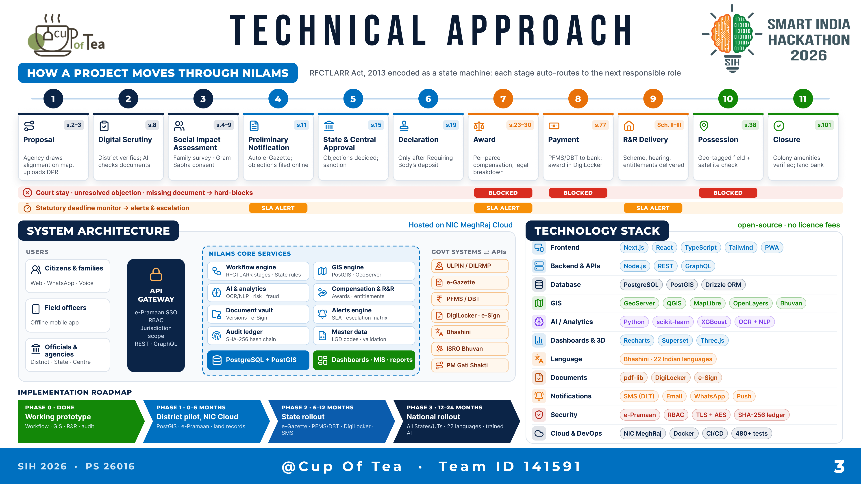
TECHNICAL APPROACH
Notes:
TECHNICAL APPROACH
HOW A PROJECT MOVES THROUGH NILAMS (RFCTLARR Act, 2013 encoded as a state machine)
1 Proposal (s.2–3): agency draws alignment on map, uploads DPR
2 Digital Scrutiny (s.8): district verifies; AI checks documents
3 Social Impact Assessment (s.4–9): family survey · Gram Sabha consent
4 Preliminary Notification (s.11): auto e-Gazette; objections filed online
5 State & Central Approval (s.15): objections decided; sanction
6 Declaration (s.19): only after Requiring Body's deposit
7 Award (s.23–30): per-parcel compensation, legal breakdown
8 Payment (s.77): PFMS/DBT to bank; award in DigiLocker
9 R&R Delivery (Sch. II–III): scheme, hearing, entitlements delivered
10 Possession (s.38): geo-tagged field + satellite check
11 Closure (s.101): colony amenities verified; land bank
Court stay · unresolved objection · missing document → hard-blocks Award, Payment, Possession.
Statutory deadline monitor → alerts & escalation at Notification, Award, R&R.
SYSTEM ARCHITECTURE (hosted on NIC MeghRaj Cloud)
Users: citizens & families (web · WhatsApp · voice), field officers (offline mobile app), officials & agencies (District · State · Centre)
API Gateway: e-Pramaan SSO, RBAC, jurisdiction scope, REST · GraphQL
NILAMS core services: workflow engine, GIS engine, AI & analytics, compensation & R&R, document vault, alerts engine, audit ledger (SHA-256 hash chain), master data (LGD codes, validation); PostgreSQL + PostGIS; dashboards · MIS · reports
Govt systems via APIs: ULPIN/DILRMP, e-Gazette, PFMS/DBT, DigiLocker · e-Sign, Bhashini, ISRO Bhuvan, PM Gati Shakti
IMPLEMENTATION ROADMAP
Phase 0 · Done: working prototype (workflow, GIS, R&R, audit)
Phase 1 · 0–6 months: district pilot on NIC Cloud (PostGIS, e-Pramaan, land records)
Phase 2 · 6–12 months: State rollout (e-Gazette, PFMS/DBT, DigiLocker, SMS)
Phase 3 · 12–24 months: national rollout (all States/UTs, 22 languages, trained AI)
TECHNOLOGY STACK (open-source, no licence fees)
Frontend: Next.js, React, TypeScript, Tailwind, PWA · Backend & APIs: Node.js, REST, GraphQL · Database: PostgreSQL, PostGIS, Drizzle ORM · GIS: GeoServer, QGIS, MapLibre, OpenLayers, Bhuvan · AI/Analytics: Python, scikit-learn, XGBoost, OCR + NLP · Dashboards & 3D: Recharts, Superset, Three.js · Language: Bhashini (22 Indian languages) · Documents: pdf-lib, DigiLocker, e-Sign · Notifications: SMS (DLT), Email, WhatsApp, Push · Security: e-Pramaan, RBAC, TLS + AES, SHA-256 ledger · Cloud & DevOps: NIC MeghRaj, Docker, CI/CD, 480+ tests

Slide 4
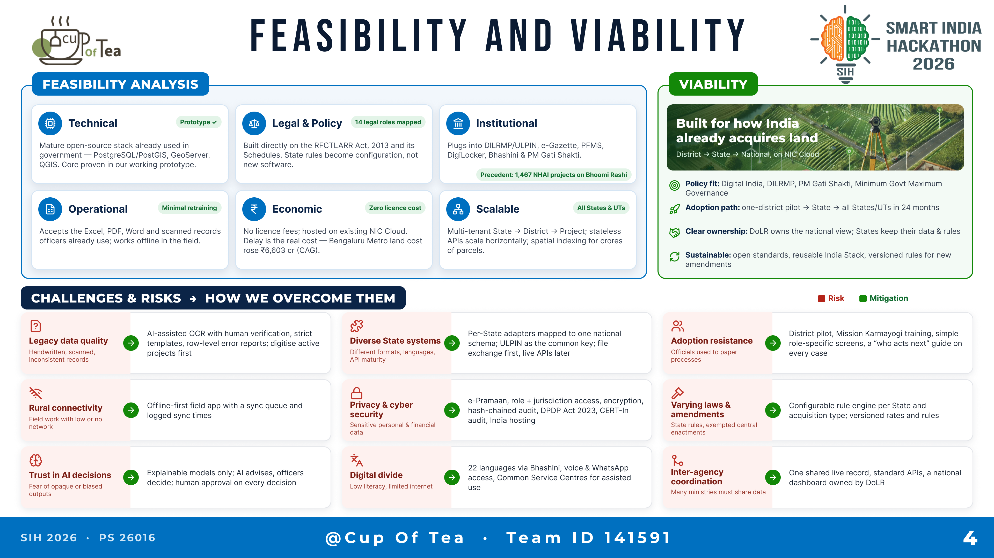
FEASIBILITY AND VIABILITY
Notes:
FEASIBILITY AND VIABILITY
FEASIBILITY ANALYSIS
- Technical: mature open-source stack already used in government (PostgreSQL/PostGIS, GeoServer, QGIS); core proven in our working prototype.
- Legal & Policy: built directly on the RFCTLARR Act, 2013 and its Schedules; State rules become configuration, not new software. 14 legal roles mapped.
- Institutional: plugs into DILRMP/ULPIN, e-Gazette, PFMS, DigiLocker, Bhashini & PM Gati Shakti. Precedent: 1,467 NHAI projects on Bhoomi Rashi.
- Operational: accepts the Excel, PDF, Word and scanned records officers already use; works offline in the field. Minimal retraining.
- Economic: no licence fees; hosted on existing NIC Cloud. Delay is the real cost — Bengaluru Metro land cost rose ₹6,603 cr (CAG).
- Scalable: multi-tenant State → District → Project; stateless APIs scale horizontally; spatial indexing for crores of parcels.
VIABILITY — built for how India already acquires land (District → State → National, on NIC Cloud)
- Policy fit: Digital India, DILRMP, PM Gati Shakti, Minimum Government Maximum Governance
- Adoption path: one-district pilot → State → all States/UTs in 24 months
- Clear ownership: DoLR owns the national view; States keep their data & rules
- Sustainable: open standards, reusable India Stack, versioned rules for new amendments
CHALLENGES & RISKS → HOW WE OVERCOME THEM
- Legacy data quality → AI-assisted OCR with human verification, strict templates, row-level error reports; digitise active projects first
- Diverse State systems → per-State adapters mapped to one national schema; ULPIN as the common key; file exchange first, live APIs later
- Adoption resistance → district pilot, Mission Karmayogi training, role-specific screens, a "who acts next" guide on every case
- Rural connectivity → offline-first field app with a sync queue and logged sync times
- Privacy & cyber security → e-Pramaan, role + jurisdiction access, encryption, hash-chained audit, DPDP Act 2023, CERT-In audit, India hosting
- Varying laws & amendments → configurable rule engine per State and acquisition type; versioned rates and rules
- Trust in AI decisions → explainable models only; AI advises, officers decide; human approval on every decision
- Digital divide → 22 languages via Bhashini, voice & WhatsApp access, Common Service Centres for assisted use
- Inter-agency coordination → one shared live record, standard APIs, a national dashboard owned by DoLR

Slide 5
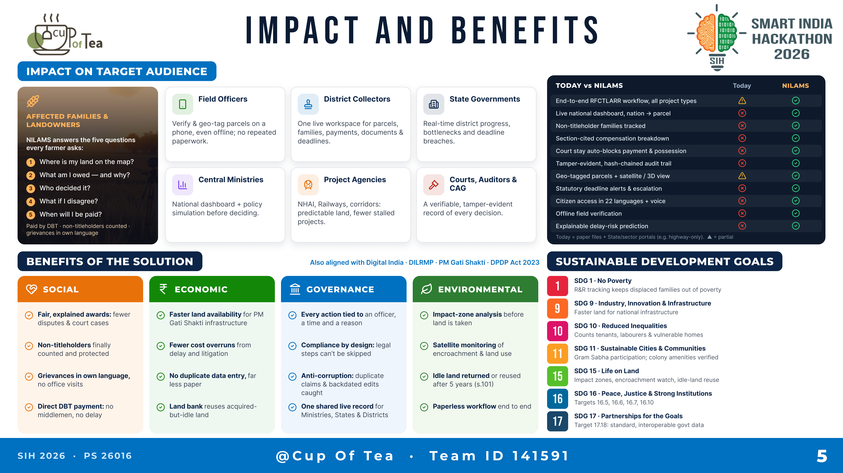
IMPACT AND BENEFITS
Notes:
IMPACT AND BENEFITS
IMPACT ON TARGET AUDIENCE
- Affected families & landowners: NILAMS answers the five questions every farmer asks — Where is my land on the map? What am I owed and why? Who decided it? What if I disagree? When will I be paid? Paid by DBT; non-titleholders counted; grievances in own language.
- Field officers: verify & geo-tag parcels on a phone, even offline; no repeated paperwork.
- District Collectors: one live workspace for parcels, families, payments, documents & deadlines.
- State Governments: real-time district progress, bottlenecks and deadline breaches.
- Central Ministries: national dashboard + policy simulation before deciding.
- Project agencies (NHAI, Railways, corridors): predictable land, fewer stalled projects.
- Courts, auditors & CAG: a verifiable, tamper-evident record of every decision.
TODAY vs NILAMS (today = paper files + State/sector portals): end-to-end RFCTLARR workflow for all project types (partial today); live national dashboard; non-titleholder families tracked; section-cited compensation breakdown; court stay auto-blocks payment & possession; tamper-evident audit trail; geo-tagged parcels + satellite/3D (partial today); statutory deadline alerts; citizen access in 22 languages + voice; offline field verification; explainable delay-risk prediction — all delivered by NILAMS.
BENEFITS
- Social: fair, explained awards; non-titleholders counted and protected; grievances in own language; direct DBT payment.
- Economic: faster land availability for PM Gati Shakti infrastructure; fewer cost overruns; no duplicate data entry; land bank reuses idle acquired land.
- Governance: every action tied to an officer, time and reason; compliance by design; anti-corruption checks; one shared live record.
- Environmental: impact-zone analysis; satellite monitoring of encroachment; idle land returned or reused after 5 years (s.101); paperless workflow.
Also aligned with Digital India · DILRMP · PM Gati Shakti · DPDP Act 2023.
SUSTAINABLE DEVELOPMENT GOALS: SDG 1 No Poverty; SDG 9 Industry, Innovation & Infrastructure; SDG 10 Reduced Inequalities; SDG 11 Sustainable Cities & Communities; SDG 15 Life on Land; SDG 16 Peace, Justice & Strong Institutions (targets 16.5, 16.6, 16.7, 16.10); SDG 17 Partnerships (target 17.18).

Slide 6
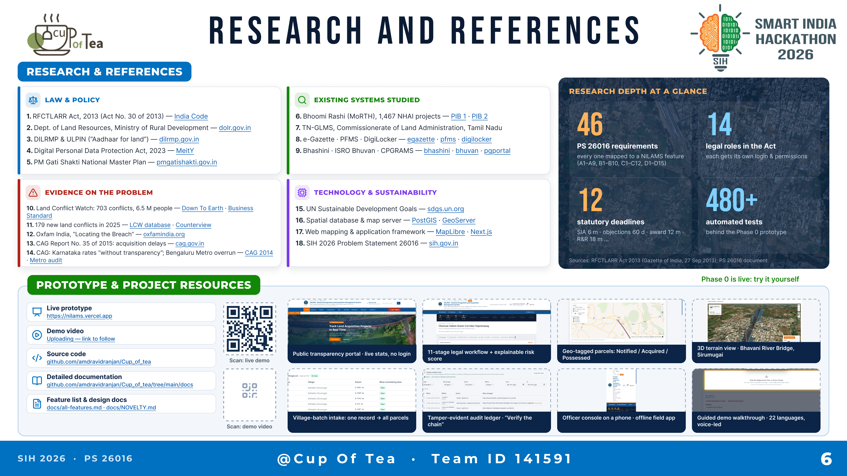
RESEARCH AND REFERENCES
Notes:
RESEARCH AND REFERENCES
LAW & POLICY
1. RFCTLARR Act, 2013 (Act No. 30 of 2013) — https://www.indiacode.nic.in
2. Department of Land Resources, Ministry of Rural Development — https://dolr.gov.in
3. DILRMP & ULPIN — https://dilrmp.gov.in
4. Digital Personal Data Protection Act, 2023 — https://www.meity.gov.in
5. PM Gati Shakti National Master Plan — https://pmgatishakti.gov.in
EXISTING SYSTEMS STUDIED
6. Bhoomi Rashi (MoRTH), 1,467 NHAI projects — https://www.pib.gov.in/PressReleaseIframePage.aspx?PRID=1988572 · https://www.pib.gov.in/PressReleaseIframePage.aspx?PRID=1809062
7. TN-GLMS, Commissionerate of Land Administration, Tamil Nadu
8. e-Gazette https://egazette.gov.in · PFMS https://pfms.nic.in · DigiLocker https://www.digilocker.gov.in
9. Bhashini https://bhashini.gov.in · ISRO Bhuvan https://bhuvan.nrsc.gov.in · CPGRAMS https://pgportal.gov.in
EVIDENCE ON THE PROBLEM
10. Land Conflict Watch: 703 conflicts, 6.5 M people — https://www.downtoearth.org.in/environment/land-conflict-affects-more-than-6-5-million-people-across-india-report-69502 · https://www.business-standard.com/article/economy-policy/ongoing-land-conflicts-affecting-lives-livelihoods-of-over-6-5-mn-people-120031700149_1.html
11. 179 new land conflicts in 2025 — https://www.landconflictwatch.org/all-conflicts · https://www.counterview.net/2026/03/ngo-research-documents-179-land.html
12. Oxfam India, "Locating the Breach" — https://www.oxfamindia.org/knowledgehub/workingpaper/locating-breach-mapping-nature-land-conflicts-india
13. CAG Report No. 35 of 2015: acquisition delays — https://cag.gov.in/uploads/download_audit_report/2015/Union_Performance_Civil_CAPF_Report_35_2015_chap_3_0.pdf
14. CAG: Karnataka rates "without transparency" — https://cag.gov.in/uploads/download_audit_report/2014/Karnataka_housing_sector_6_2014_chapter_3_exe_summ.pdf ; Bengaluru Metro overrun — https://thenewsmill.com/2026/08/cag-audit-finds-overestimated-ridership-and-land-acquisition-delays-in-bangalore-metro-phases-1-and-2/
TECHNOLOGY & SUSTAINABILITY
15. UN Sustainable Development Goals — https://sdgs.un.org/goals
16. PostGIS https://postgis.net · GeoServer https://geoserver.org
17. MapLibre https://maplibre.org · Next.js https://nextjs.org
18. SIH 2026 Problem Statement 26016 — https://www.sih.gov.in
RESEARCH DEPTH: 46 PS 26016 requirements mapped to NILAMS features; 14 legal roles in the Act; 12 statutory deadlines; 480+ automated tests.
PROTOTYPE & PROJECT RESOURCES
Live prototype: <add deployment URL> · Demo video: <add YouTube link> · Source code: https://github.com/amdravidranjan/Cup_of_tea · Detailed documentation: <add link> · Feature list & design docs: <add link>
Screenshots: public transparency portal; 11-stage workflow + explainable risk score; geo-tagged parcels; 3D terrain view (Bhavani River Bridge, Sirumugai); village-batch intake; tamper-evident audit ledger; offline field app; bilingual voice assistant in Tamil.

