Slide 1

SMART INDIA HACKATHON 2026
NILAMS
National Integrated Land Acquisition Management System
Problem Statement ID – 26016
Problem Statement Title – Real-Time National Land Acquisition & Management System for End-to-End Digital Monitoring and Decision Support
Theme – AI, GIS & Data Analytics for Public Administration and Infrastructure Management
PS Category – Software
Team ID – [Enter Team ID]
Team Name – [Enter Team Name registered on portal]
Notes:
NILAMS - National Integrated Land Acquisition Management System. Smart India Hackathon 2026 idea submission for Problem Statement 26016 (Real-Time National Land Acquisition & Management System for End-to-End Digital Monitoring and Decision Support), software category. Land acquisition is the legal process by which the government takes private land for public projects such as highways, railways, dams and industrial corridors, pays fair compensation and resettles affected families under the RFCTLARR Act, 2013. NILAMS puts that entire journey on one national digital platform.

Slide 2
NILAMS
National Integrated Land Acquisition Management System
Your Team Name
Proposed Solution: one cloud-based national platform that digitises land acquisition end-to-end — proposal → scrutiny → SIA → notification → approvals → award → compensation → R&R → possession → closure — for Central Ministries, States/UTs, District Collectors, Land Requiring Bodies, R&R Authorities, implementing agencies and affected citizens.
THE PROBLEM TODAY
HOW NILAMS SOLVES IT
INNOVATION & UNIQUENESS
Fragmented systems: state-specific processes; sector portals (e.g. Bhoomi Rashi) cover only highways
Manual & duplicated data: records re-typed at District, State and Centre; no common format
Delays in approvals: files move physically; statutory deadlines missed silently
No real-time monitoring: leaders can't see land acquired, compensation paid, possession or R&R
Opaque compensation: no breakdown → mistrust, objections, litigation
Families invisible: parcels tracked, people (tenants, labourers) not
Weak audit trail: double payments and backdated edits go undetected
No spatial view & poor citizen access in local languages
Law-driven digital workflow — 12-step RFCTLARR lifecycle + 6-step R&R, configurable per State; automated routing & status tracking
Online submission, scrutiny & approval — Agency → District → State → Centre, role-based
GIS parcel intelligence — every parcel geo-tagged (ULPIN), satellite map, alignment, impact buffer, 3D terrain
Families register — titleholders + non-titleholders; Second & Third Schedule entitlements tracked
Transparent compensation — each component with its legal section; paid via PFMS/DBT
Real-time national dashboard — land proposed/acquired, notifications, awards, compensation, possession, R&R, affected & displaced families, timelines; nation → parcel drill-down
Standard data & master databases — uniform templates, validation, LGD codes for all States/UTs
Smart intake & document vault — one village record creates all parcels & families; versioned notices, awards, maps
Alerts & MIS — pending approvals, delays, deadlines, payments; custom reports, trends, comparisons
Predictive analytics — delay risk, fair land rate, encroachment & duplicate-claim detection
Citizen portal & field app — status, grievances, voice assistant in 22 languages; offline mobile verification
Law as code: stages can't be skipped; a court stay auto-blocks payment & possession
Explainable AI: every score shows its formula — defensible in audit & court
People-centric: tracks non-titleholder families the law protects
Tamper-evident ledger: hash-chained audit, reason required for every edit
Fraud detection: same family compensated twice is flagged
Built on India Stack: ULPIN, e-Gazette, PFMS, DigiLocker, Bhashini, Gati Shakti
Citizen-first: “What is my land worth, why, who decided, how to object?”
✅ Working prototype already built
Full workflow · GIS map & 3D · families & compensation · village-batch intake · audit ledger · bilingual voice assistant · offline field app · 480+ automated tests
Land Conflict Watch: 703 ongoing land conflicts affecting 6.5 million people & ₹13.7 lakh crore investment; CAG: “abnormal delays” in 66% of audited acquisition cases.
Notes:
IDEA: NILAMS, the National Integrated Land Acquisition Management System. PROBLEM: land acquisition in India runs on fragmented, state-specific and paper-based systems. Data is typed again at district, state and central level, approvals are delayed, statutory deadlines are missed without warning, decision-makers lack real-time information on compensation, possession and rehabilitation, compensation is opaque, affected families (especially tenants and labourers without title) are not recorded, and there is no tamper-proof audit trail. SOLUTION: one cloud platform that digitises the whole lifecycle defined by the RFCTLARR Act 2013, with online submission and multi-level approval, GIS geo-tagging of every parcel, a register of every affected family and their entitlements, a transparent compensation engine, a real-time national dashboard, standard data formats for all States and UTs, bulk document intake, automated alerts, MIS reports, predictive analytics, a citizen portal in Indian languages and an offline field app. UNIQUENESS: the law is enforced in code (for example a court stay automatically blocks payment), every AI output is explainable, families are first-class records, the audit ledger is tamper-evident, and it plugs into existing national platforms such as ULPIN, e-Gazette, PFMS, DigiLocker and Bhashini. A working prototype of the core already exists.

Slide 3




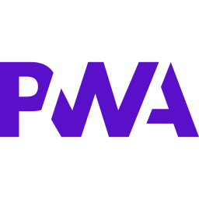














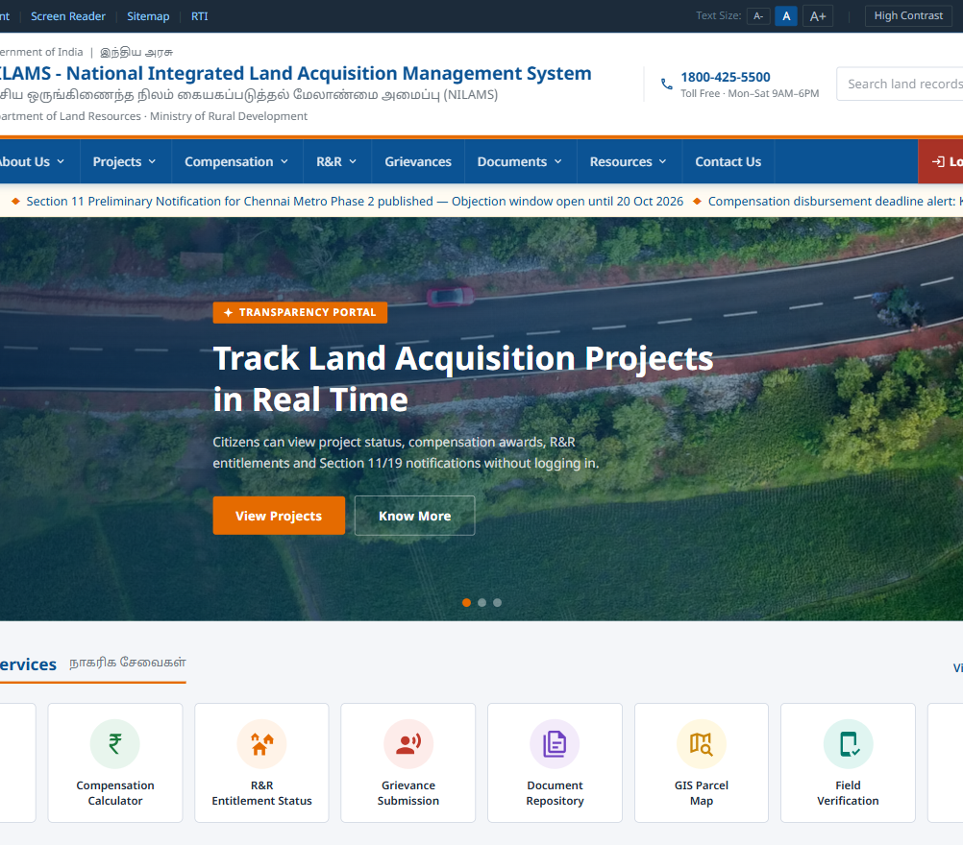
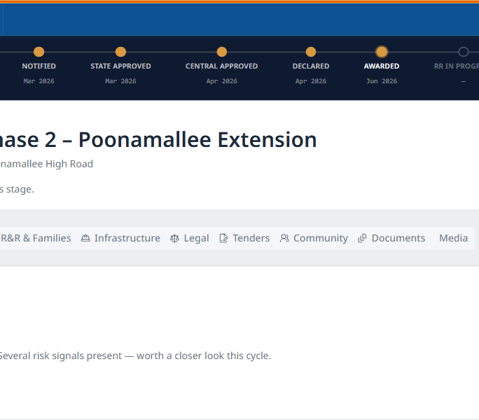
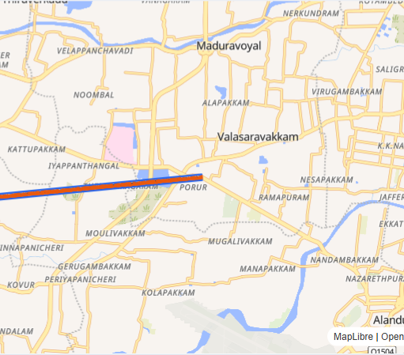
TECHNICAL APPROACH
Your Team Name
TECHNOLOGIES TO BE USED
WORKFLOW — LAND ACQUISITION LIFECYCLE ENFORCED BY NILAMS
Frontend · Web + Mobile (PWA)
1 Proposal
& DPR
2 Digital
Scrutiny
3 Social Impact
Assessment
4 s.11
Notification
5 State
Approval
6 Central
Approval
Next.js
React
TypeScript
Tailwind
PWA
7 s.19
Declaration
8 Award &
Compensation
9 PFMS/DBT
Payment
10 R&R
Delivery
11 Possession
(field-verified)
12 Closure
Backend · APIs · Database
⛔ Auto-blocks: court stay · unresolved objection · missing document ⏰ Deadline monitor: alerts & escalation at every statutory time limit
SYSTEM ARCHITECTURE
Node.js
REST/GraphQL
PostgreSQL+PostGIS
Drizzle ORM
GIS · Maps · 3D
USERS
Citizens / families
Field officers
District Collectors
State Govt
Central Ministry
Agencies / R&R Authority
PLATFORM
API Gateway + RBAC
Workflow Engine
GIS Engine
AI & Analytics
Compensation & R&R
Document Vault
Alerts Engine
Audit Ledger
QGIS
Leaflet/MapLibre
OpenStreetMap
Three.js
AI · Analytics
DATA
PostgreSQL + PostGIS
Master data (LGD, rates)
Object storage
Dashboards & MIS
INTEGRATIONS
Land records / ULPIN
e-Gazette
PFMS / DBT
DigiLocker / e-Sign
Bhashini
Bhuvan / Gati Shakti
Python
scikit-learn
DevOps · Notifications · Testing
METHODOLOGY & IMPLEMENTATION
WORKING PROTOTYPE (PHASE 0)
Study: map the Act, State rules & current workflows; find manual steps, duplication, bottlenecks
Standardise: one national data model, master data, templates, validation
Encode law: tested, configurable workflow engine + RBAC
Integrate & add AI: government APIs; explainable models, then trained on pilot data
Docker
CI/CD
WhatsApp
Vitest
Government platforms & cloud
NIC MeghRaj Cloud
GeoServer
ISRO Bhuvan
ULPIN / DILRMP
e-Gazette
PFMS / DBT
DigiLocker
e-Sign
e-Pramaan SSO
Phase 0 ✅
Prototype
Phase 1
District pilot
0–6 m
Phase 2
State rollout
6–12 m
Phase 3
National
12–24 m
Bhashini (22 lang.)
SMS Gateway
PM Gati Shakti
Public portal
Stage tracker + AI risk score
GIS parcel map
Notes:
TECHNICAL APPROACH. Technologies: a Next.js + React + TypeScript web application that also works as an installable mobile app (PWA); Node.js REST and GraphQL APIs; PostgreSQL with the PostGIS spatial extension; GIS with GeoServer, QGIS, Leaflet/MapLibre and OpenStreetMap plus ISRO Bhuvan imagery; Three.js for 3D; Python and scikit-learn for analytics; Docker and CI/CD on NIC MeghRaj cloud; notifications through SMS gateway, email, push and WhatsApp. It integrates with government platforms: ULPIN/DILRMP land records, e-Gazette, PFMS/DBT, DigiLocker, e-Sign, e-Pramaan login and Bhashini for 22 Indian languages. Workflow: 1 proposal and project report, 2 digital scrutiny, 3 social impact assessment with Gram Sabha consultation, 4 Section 11 preliminary notification with online objections, 5 state approval, 6 central approval, 7 Section 19 declaration, 8 award and compensation calculation, 9 direct bank payment through PFMS, 10 rehabilitation and resettlement, 11 field-verified possession, 12 closure after resettlement infrastructure is complete. A court stay, unresolved objection or missing document automatically blocks the next step, and a deadline monitor raises alerts. Architecture: users reach an API gateway with role-based access; behind it sit the workflow engine, GIS engine, AI and analytics, compensation and R&R engine, document vault, alerts engine and a tamper-evident audit ledger, all storing data in PostgreSQL/PostGIS and connected to government systems. Methodology: study the law and current workflows, standardise data, encode the law as a tested workflow engine, integrate government APIs and add explainable AI. Implementation: Phase 0 prototype (done), Phase 1 district pilot in 0-6 months, Phase 2 state rollout in 6-12 months, Phase 3 national rollout in 12-24 months. Screenshots show the working prototype: public portal, 11-stage project tracker with explainable risk score, and GIS parcel map.

Slide 4
FEASIBILITY AND VIABILITY
Your Team Name
ANALYSIS OF THE FEASIBILITY OF THE IDEA
Technical
Legal & Policy
Institutional
Operational
Economic
Scalable
Proven open-source stack used in government (PostgreSQL/PostGIS, GeoServer, QGIS). Core already working in our prototype.
Built directly on RFCTLARR Act 2013 & its Schedules. State rules become configuration, not new code.
Fits DILRMP, ULPIN, e-Gazette, PFMS, DigiLocker, Bhashini, Gati Shakti. Precedent: Bhoomi Rashi (1,467 NHAI projects).
Accepts Excel / PDF / Word records officers already use; offline field app; bilingual UI → minimal retraining.
No licence fees; runs on existing NIC Cloud. Delay costs are huge — CAG: ₹6,603 cr extra land cost on Bengaluru Metro.
Multi-tenant State → District → Project design; horizontally scalable APIs; spatial indexing for crores of parcels.
POTENTIAL CHALLENGES & RISKS
STRATEGIES FOR OVERCOMING THEM
1. Legacy land records: handwritten, scanned, inconsistent
AI-assisted OCR + human verification; strict templates; row-level error reports; digitise active projects first
2. Diverse State systems: different formats, languages, API maturity
Adapter per State onto one national schema; ULPIN as common key; file exchange first, live APIs later
3. Adoption resistance: officers used to paper
District pilot; Mission Karmayogi training; simple role-based screens; “who acts next” on every case
4. Rural connectivity: field work without network
Offline-first mobile app with sync queue and logged sync time
5. Privacy & cyber security: sensitive family & payment data
e-Pramaan login, role + jurisdiction access, encryption, hash-chained audit, DPDP Act 2023, CERT-In audit, NIC hosting
6. Changing laws & State rules: amendments, urgency clause
Configurable rule engine; versioned rates and rules
7. Trust in AI outputs: fear of black-box decisions
Explainable models only; AI advises, officers decide; human approval mandatory
8. Digital divide & coordination: low literacy; many agencies
22 languages, voice & WhatsApp, CSC assisted access; one shared live record for all agencies
Notes:
FEASIBILITY AND VIABILITY. Technical: mature open-source technology already used in government, and the core has been proven in our working prototype. Legal: designed directly on the RFCTLARR Act 2013 and its schedules; state rules are configuration. Institutional: fits existing national programmes (DILRMP, ULPIN, e-Gazette, PFMS, DigiLocker, Bhashini, PM Gati Shakti); MoRTH's Bhoomi Rashi portal already digitised highway land acquisition notifications for 1,467 NHAI projects, proving government appetite. Operational: works with the files officers already have and offline in villages. Economic: no licence fees and hosted on NIC cloud, while acquisition delays are very costly (CAG found Bengaluru Metro land costs rose by 6,603 crore rupees). Scalable: multi-tenant design for every State and UT. Risks and strategies: legacy records - OCR with human checks and strict templates; different state systems - adapters onto one national schema with ULPIN as the common key; adoption - district pilot and training; connectivity - offline-first app; privacy and security - e-Pramaan login, role and jurisdiction access, encryption, tamper-evident audit, DPDP Act compliance and CERT-In audit; changing laws - configurable rule engine; trust in AI - only explainable models with humans deciding; digital divide and coordination - 22 languages, voice and WhatsApp access, Common Service Centres and one shared record for all agencies.

Slide 5
IMPACT AND BENEFITS
Your Team Name
IMPACT ON TARGET AUDIENCE
BENEFITS OF THE SOLUTION
SUSTAINABLE DEVELOPMENT GOALS
Affected families & landowners
See status, compensation breakdown & entitlements; paid straight to bank; grievances tracked in own language; non-titleholders counted
SOCIAL
Fair, explainable compensation → fewer disputes
Displaced families tracked till resettled
Inclusion: 22 languages, voice, WhatsApp
SDG
1
No Poverty
R&R entitlements protect displaced families
Field officers
Verify & geo-tag parcels on phone, even offline; no repeat paperwork
SDG
9
Industry, Innovation & Infrastructure
Faster land for infrastructure
ECONOMIC
Faster approvals & land handover → less cost overrun
No duplicate data entry, less paper
Direct PFMS/DBT payment, no middlemen
SDG
10
Reduced Inequalities
Tenants & vulnerable households counted
District Collectors / Acquiring Authorities
One live workspace for parcels, families, payments, deadlines; bulk data intake
SDG
11
Sustainable Cities & Communities
Participatory planning; resettlement amenities
State Governments
Real-time district progress, bottlenecks and deadline breaches
ENVIRONMENTAL
Impact-zone mapping for less damaging alignments
Land bank reuses acquired-but-idle land
Paperless process; encroachment monitoring
SDG
15
Life on Land
Impact zones, encroachment checks, land reuse
Central Ministries & policymakers
National dashboard; simulate policy changes before deciding
Peace, Justice & Strong Institutions
16.5 anti-corruption · 16.6 accountability · 16.10 access to info
SDG
16
Land Requiring Bodies & agencies (NHAI, Railways)
Predictable land availability; fewer stalled projects
GOVERNANCE
Transparency: public portal & open data
Accountability: tamper-evident audit trail
Legal compliance & anti-corruption by design
Inter-agency coordination on one live record
SDG
17
Partnerships for the Goals
17.18 standardised, interoperable data
R&R Authorities, courts & CAG
Entitlement delivery tracked; tamper-evident record of every decision
Also aligned with: Digital India · DILRMP · PM Gati Shakti · DPDP Act 2023
Notes:
IMPACT AND BENEFITS. Affected families and landowners can see their status, compensation breakdown and entitlements, get paid directly into their bank account and track grievances in their own language, and non-titleholders are finally counted. Field officers verify and geo-tag parcels on a phone even offline. District Collectors get one live workspace. State governments see district progress and deadline breaches in real time. Central ministries and policymakers get a national dashboard and can simulate policy changes. Implementing agencies get predictable land availability. R&R authorities, courts and the CAG get a tamper-evident record of every decision. Social benefits: fair explainable compensation, fewer disputes, families tracked until resettled, inclusion through languages and voice. Economic benefits: faster approvals, lower cost overruns, no duplicate data entry, direct payment. Environmental benefits: impact-zone mapping, reuse of idle acquired land, paperless process and encroachment monitoring. Governance benefits: transparency, accountability, legal compliance, anti-corruption and inter-agency coordination. Sustainable Development Goals: SDG 1 No Poverty, SDG 9 Industry Innovation and Infrastructure, SDG 10 Reduced Inequalities, SDG 11 Sustainable Cities and Communities, SDG 15 Life on Land, SDG 16 Peace Justice and Strong Institutions (targets 16.5, 16.6, 16.10), SDG 17 Partnerships (target 17.18).

Slide 6
RESEARCH AND REFERENCES
Your Team Name
PROTOTYPE, DEMO & PROJECT DOCUMENTS
▶ Prototype demo: [add deployed URL]
🎬 Demo video: [add YouTube / Drive link]
💻 Source code: github.com/amdravidranjan/Cup_of_tea
📄 Documentation: [add Drive link — design spec, feature list, novelty, PS coverage matrix]
LAW, POLICY & PROBLEM STATEMENT
EXISTING SYSTEMS & PLATFORMS STUDIED
RESEARCH & EVIDENCE
RFCTLARR Act, 2013 (Act 30 of 2013) — India Code
indiacode.nic.in
Department of Land Resources, MoRD
dolr.gov.in
DILRMP & ULPIN (Bhu-Aadhaar)
dilrmp.gov.in
SIH 2026 Problem Statement 26016
sih.gov.in
Digital Personal Data Protection Act, 2023 — MeitY
meity.gov.in
PM Gati Shakti National Master Plan
pmgatishakti.gov.in
UN Sustainable Development Goals
sdgs.un.org/goals
Bhoomi Rashi portal — 1,467 NHAI projects (PIB)
pib.gov.in/PressReleaseIframePage.aspx?PRID=1…
Bhoomi Rashi — digitised NH land acquisition (PIB)
pib.gov.in/PressReleaseIframePage.aspx?PRID=1…
TN-GLMS, Commissionerate of Land Administration, Govt. of Tamil Nadu
e-Gazette of India
egazette.gov.in
PFMS — Public Financial Management System
pfms.nic.in
DigiLocker
digilocker.gov.in
Bhashini — National Language Translation Mission
bhashini.gov.in
ISRO Bhuvan geoportal
bhuvan.nrsc.gov.in
Land Conflict Watch: 6.5 million people affected (Down To Earth)
downtoearth.org.in/environment/land-conflict-…
Land Conflict Watch — conflicts database
landconflictwatch.org/all-conflicts
179 land conflicts, 3.6 million people in 2025
counterview.net/2026/03/ngo-research-document…
Oxfam India — Locating the Breach: land conflicts
oxfamindia.org/knowledgehub/workingpaper/loca…
CAG Report 35 of 2015 — delays in 66% of cases
cag.gov.in/uploads/download_audit_report/2015…
CAG — non-transparent compensation rates (Karnataka)
cag.gov.in/uploads/download_audit_report/2014…
CAG — Bengaluru Metro ₹6,603 cr land cost rise
thenewsmill.com/2026/08/cag-audit-finds-overe…
PostGIS · GeoServer · Next.js documentation
postgis.net
KEY RESEARCH INSIGHTS THAT SHAPED NILAMS
◆ Only highways have a national LA portal (Bhoomi Rashi) → one cross-sector platform for all projects
◆ Infrastructure projects affect 3M+ of the 6.5M people in land conflicts → transparency & grievance tracking
◆ CAG: long delays & non-transparent rates → statutory-deadline alerts + explainable compensation
◆ RFCTLARR protects non-titleholders too → a people-centric family & entitlement register
Notes:
RESEARCH AND REFERENCES. Prototype demo link, demo video, source code on GitHub and documentation are listed at the top. Law and policy: RFCTLARR Act 2013, Department of Land Resources, DILRMP and ULPIN, SIH Problem Statement 26016, DPDP Act 2023, PM Gati Shakti, UN SDGs. Existing systems studied: MoRTH Bhoomi Rashi portal, Tamil Nadu TN-GLMS, e-Gazette, PFMS, DigiLocker, Bhashini, ISRO Bhuvan. Evidence: Land Conflict Watch reports (6.5 million people affected by 703 conflicts; 3.6 million people in 2025), Oxfam India research, and CAG audit reports on acquisition delays, non-transparent compensation rates and cost overruns.

