Slide 1
UCS3513 SYSTEM DESIGN LABORATORY | MINI PROJECT | PROBLEM STATEMENT 6
Scalable Human Resource Management System
Gateway + 3 HR nodes + 4 MongoDB shards + Redis, with 8 system-design components
Dravid Ranjan A.M
Guhanesh M.L
Hansika N.M
Saisaravanan S
3122245001046
3122245001049
3122245001052
3122245001310
SSN College of Engineering | B.E. CSE, V Semester | October 2026

Slide 2
PROBLEM AND GOALS
An HRMS that keeps working as the organisation grows
• Workload read-heavy lookups, daily check-in bursts, month-end payroll
• Growth attendance grows as employees x days
• Concurrency several servers create records at the same time
• Outside data job listings from external portals
• Availability must survive a server or a database failing
What we built
• Employees, attendance, leave, payroll, recruitment, performance, notifications
• 3 roles: HR admin, manager, employee
• 10,000 synthetic employees across 4 shards
• Evaluated at 10 / 50 / 200 users against a single-server baseline
• Node and shard failure, node and shard scaling
Scalable HRM System | UCS3513 System Design Lab
2

Slide 3
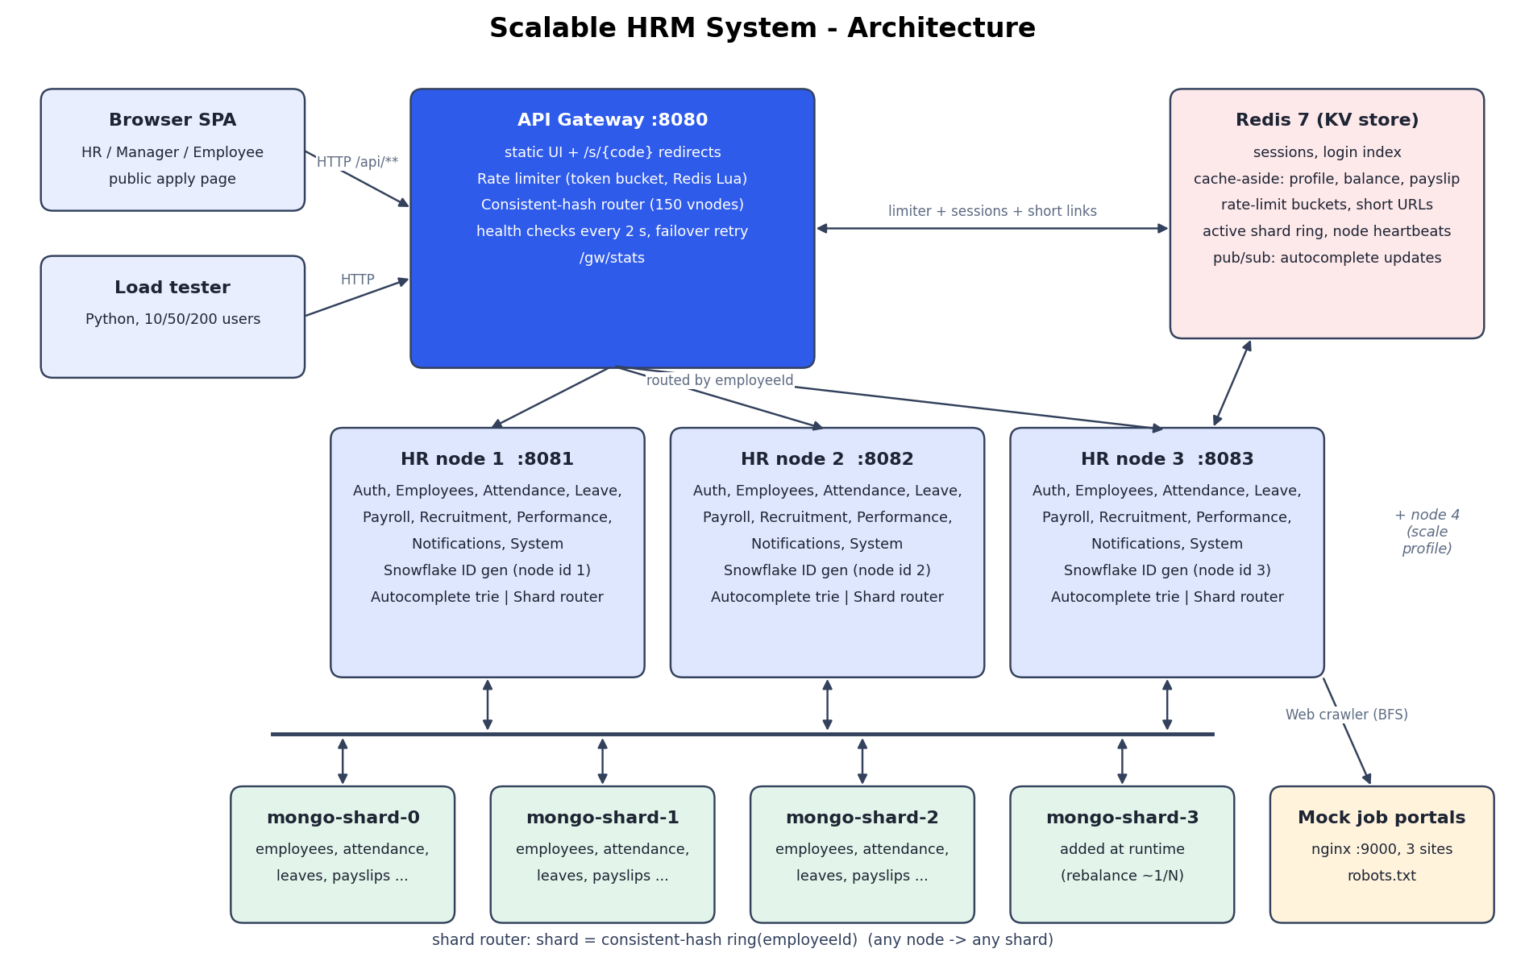
DELIVERABLE 2
Architecture
Scalable HRM System | UCS3513 System Design Lab
3

Slide 4
DELIVERABLE 1
Eight components, each with a real HR job
Component | Used for | Design
Unique ID generator | IDs for every record, from 3 nodes at once | Snowflake: 41-bit time, 10-bit node, 12-bit seq
Sharding | All employee-owned data co-located by employeeId | App-level hash sharding over 4 MongoDB
Consistent hashing | Gateway -> node, employeeId -> shard | MurmurHash3 ring, 150 virtual nodes
Key-value store | Sessions, cache, limiter, short links, shard map | Redis cache-aside + TTL, pub/sub
Rate limiter | Login brute force, payroll runs, all APIs | Token bucket, atomic Redis Lua
Autocomplete | Employee and job search as you type | Trie with cached top-10 per prefix
URL shortener | Public job links, expiring payslip links | Base62(Snowflake), Redis TTL, 302
Web crawler | Import jobs from 3 portals | BFS, robots.txt, 200 ms politeness, dedup
Scalable HRM System | UCS3513 System Design Lab
4

Slide 5
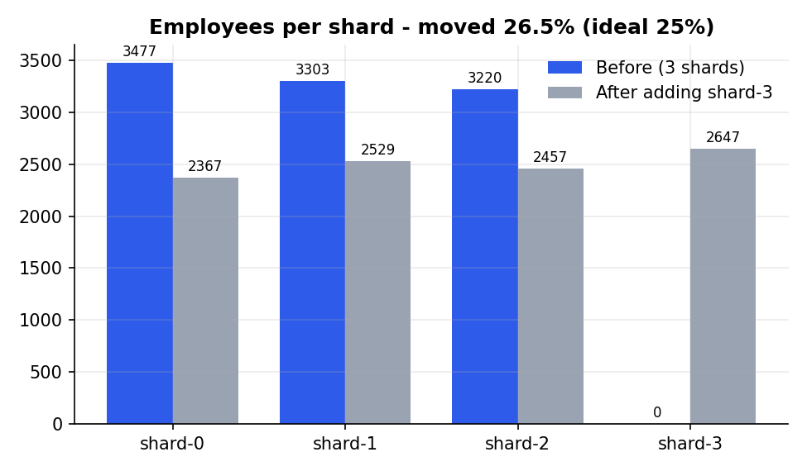
REQUEST FLOW AND SHARDING
One request, one node, one shard
• Browser -> gateway :8080 with session token
• Rate limiter: token bucket in Redis (429 if empty)
• Node ring picks the HR node for this employee; retry on next node if it fails
• Node checks session and role (Redis)
• Cache hit -> answer from Redis; miss -> shard ring -> MongoDB -> cache
• All of an employee's data is on one shard, so most requests touch one shard
Adding shard-3 moved 26.5% of employees (53,581 documents) in 6.7 s
Scalable HRM System | UCS3513 System Design Lab
5

Slide 6
SNOWFLAKE + URL SHORTENER
Unique IDs and short links
3.8 M/s
0
192,273
IDs per second, one generator
collisions in 300k IDs from 3 nodes
collisions if all nodes share an ID
id = (ms since 2026-01-01) << 22 | nodeId << 12 | sequence
• Short code = Base62 of a Snowflake ID, served at /s/{code}
• Redis holds code -> URL with a TTL (payslip 24 h, offer 7 d); MongoDB keeps a durable copy
• Redirect: 9.1 ms average, p95 12.9 ms, 500/500 correct 302s
Scalable HRM System | UCS3513 System Design Lab
6

Slide 7
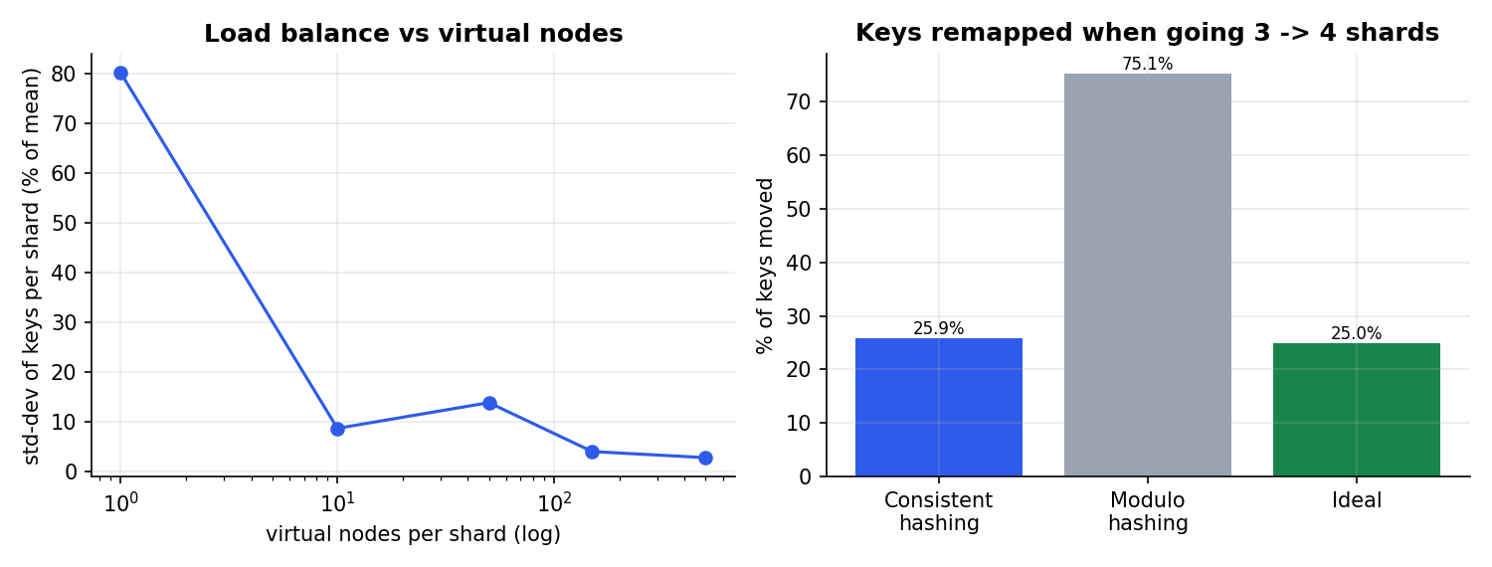
CONSISTENT HASHING + REBALANCING
Consistent hashing: even spread, minimal movement
25.9%
keys moved 3 -> 4 shards
75.1%
with hash mod N
3.9%
std-dev of load, 150 virtual nodes
Scalable HRM System | UCS3513 System Design Lab
7

Slide 8
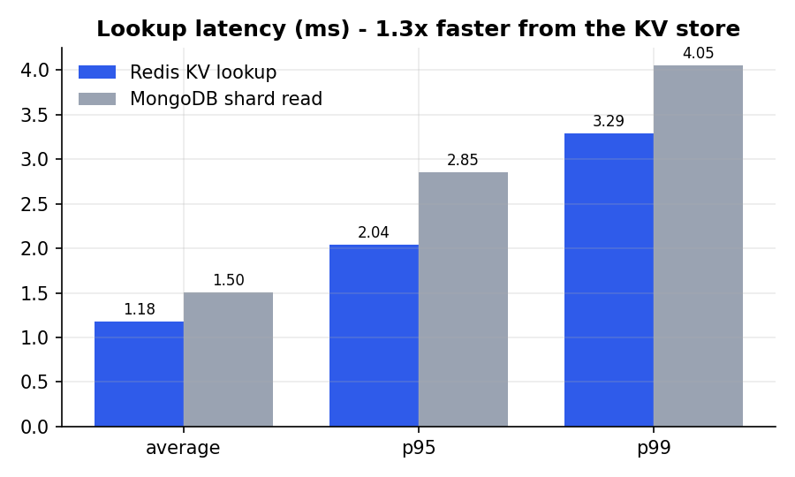
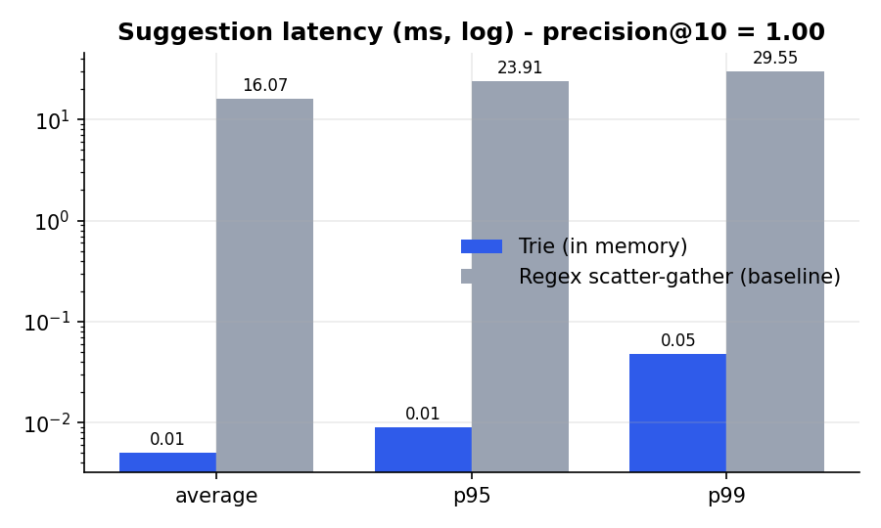
KEY-VALUE STORE + AUTOCOMPLETE
Redis and the trie take the reads off MongoDB
• Cache hit ratio 99.7% under live traffic; MongoDB CPU 297% (baseline) -> 27% (proposed) at the same request rate
• Trie 0.005 ms vs regex across shards 16.1 ms (over 3,000x), precision@10 = 1.00
Scalable HRM System | UCS3513 System Design Lab
8

Slide 9
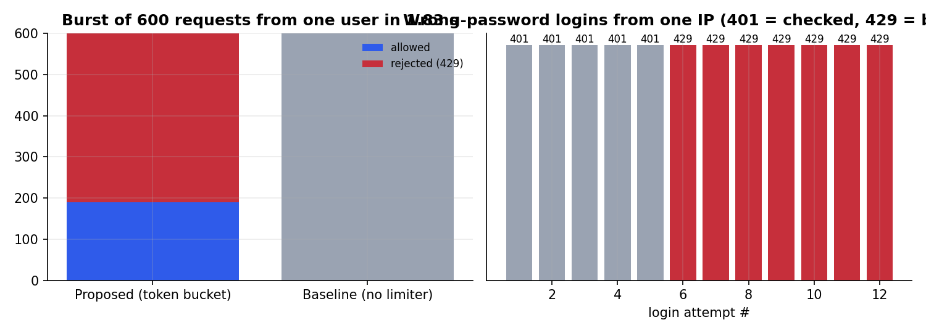
RATE LIMITER + WEB CRAWLER
Rate limiter and web crawler
Crawler (3 portals)
• Pages 136 at 5.00/s
• Jobs 102 unique
• Duplicates 18 dropped
• robots.txt 2 pages skipped
• Failures 0
• BFS, depth 3, 200 ms politeness per host
• Burst of 600: 189 allowed (theory ~191), 68.5% rejected with 429
• Login brute force: 7 of 12 attempts blocked after 5 failures
Scalable HRM System | UCS3513 System Design Lab
9

Slide 10
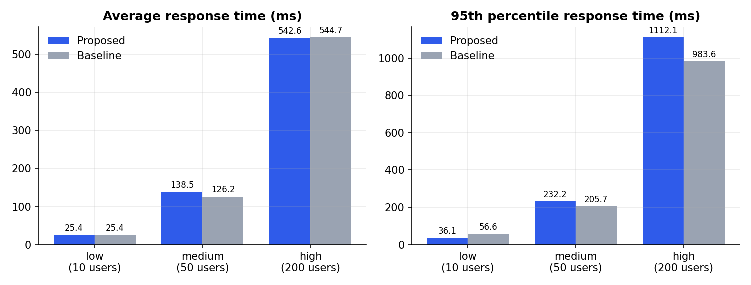
DELIVERABLE 4
Load test: proposed vs baseline
Load | Req/s | p95 ms | OK | Mongo CPU %
10 users | 395 / 394 | 36 / 57 | 100% | 27 / 290
50 users | 362 / 397 | 232 / 206 | 100% | 27 / 305
200 users | 361 / 364 | 1112 / 984 | 100% | 26 / 296
proposed / baseline
• 100% success at every level, for both systems
• Throughput is flat (~360-395 req/s): all 10 containers and the load generator share one laptop CPU; latency grows with users as Little's law predicts
• The real gain is database headroom: MongoDB CPU about 11x lower thanks to the cache and the trie
Scalable HRM System | UCS3513 System Design Lab
10

Slide 11
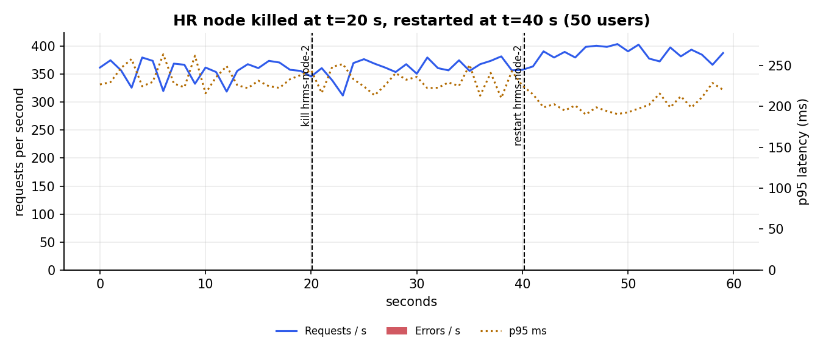
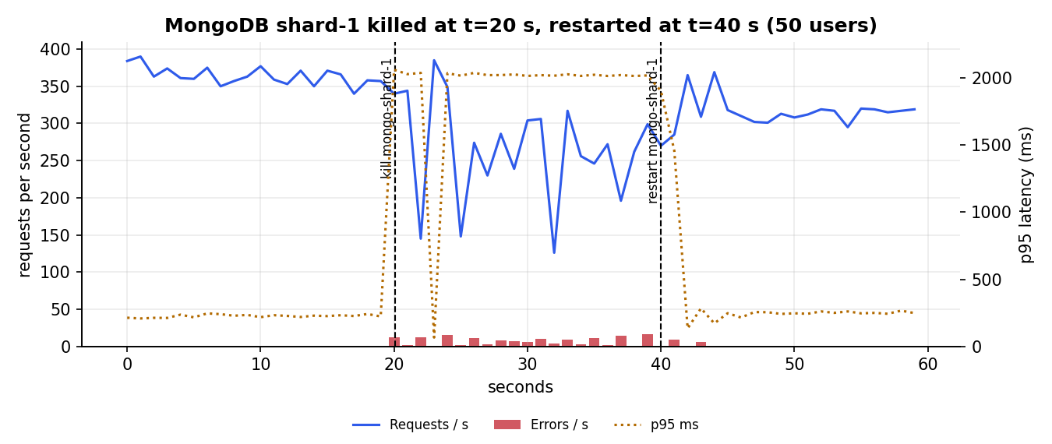
DELIVERABLE 5
Failure scenarios
• HR node killed 100% success, p95 224 ms
• Gateway retries on the next node; health check removes it in 2 s; sessions in Redis
• Shard killed 99.13% success
• 503 only for users whose data is on that shard (check-in, payslips, notifications)
• Cached reads and autocomplete never failed; recovered on restart
Scalable HRM System | UCS3513 System Design Lab
11

Slide 12
WRAP-UP
Trade-offs, limitations and live demo
• App-level sharding full control, but the app routes every query
• Cache-aside less DB load, stale for up to the TTL
• Redis shared state makes nodes stateless, but is one point of failure
• Gateway retry hides node failures, but needs idempotent requests
• Limitations one machine; no replica sets; synthetic data only
Live demo
• Admin dashboard, shards and serving node
• Employee search with autocomplete
• Leave apply -> manager approve -> balance
• Payroll run, payslip short link
• Crawl job portals, public apply
• docker stop hrms-node-2: app keeps working
• Add node 4; add shard-3 and rebalance
Scalable HRM System | UCS3513 System Design Lab
12

