Slide 1
Pima Indians Diabetes Database
Predict the onset of diabetes based on diagnostic measures.
Data Mining ( 3160714 )
Guide By:-
Dr. Vimalkumar Vaghela
Made By:-
Mehta Preet ( 180280107051)
Shah Deep ( 180280107097 )

Slide 2
Inspiration: Can you build a machine learning model to accurately predict whether or not the patients in the dataset have diabetes or not?
Dataset Features:
Pregnancies: Number of times pregnant ( Number )
Glucose: Plasma glucose concentration a 2 hours in an oral glucose tolerance test ( Number )
Blood Pressure: Diastolic blood pressure (mm Hg) ( Number )
Skin Thickness: Triceps skin fold thickness (mm) ( Number )
Insulin: 2-Hour serum insulin (mu U/ml) ( Number )
BMI: Body mass index (weight in kg/(height in m)^2) ( Number – Float )
DiabetesPedigreeFunction: Diabetes pedigree function ( Number – Float )
Age: Age(years) ( Number )
Outcome: Class variable (0 or 1) ( Number )

Slide 3
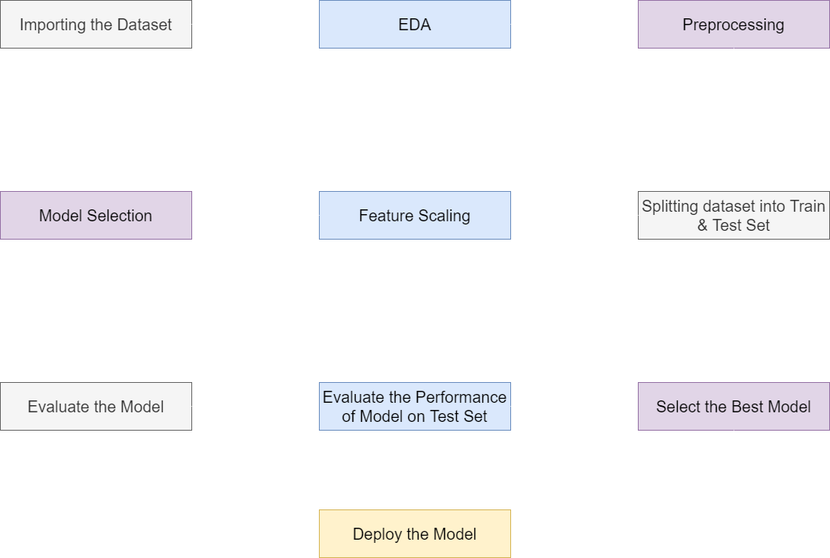
Process:-

Slide 4
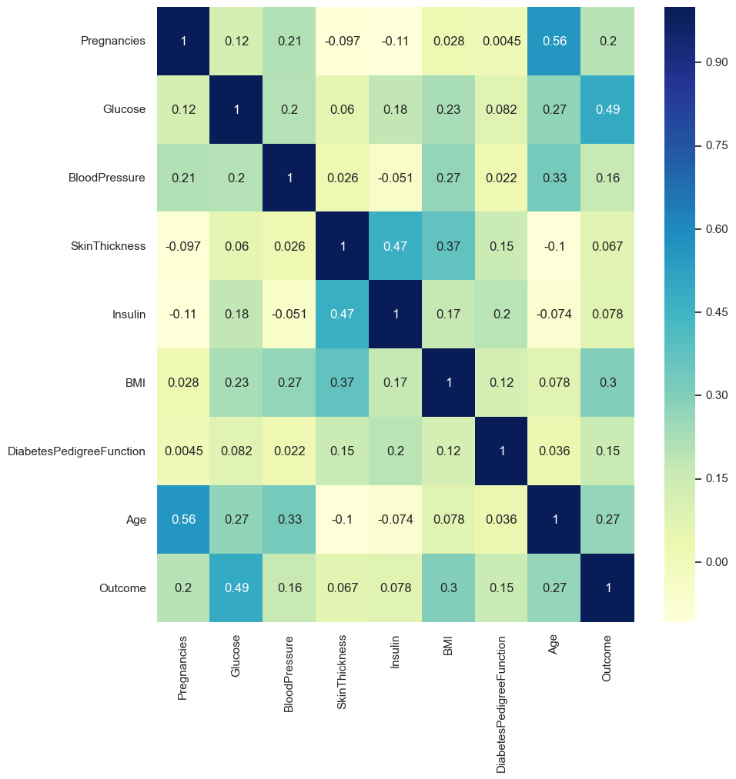
Heat Map Correlation of Dataset:-

Slide 5
EDA Insights:-
Number of Diabetes in the dataset: Healthy: 65.1% & Diabetic: 34.9%.
The Glucose level for a Normal Adult is around 120-130mg/dl anything above it means that the person is likely suffering from pre-diabetes and diabetes.
There is less healthy people who have high Blood Pressure.
Diabetic people increase as the levels of insulin gradually increases. There are more healthy people around insulin levels 0-100.
As BMI increases the person likely being healthy decreases and being diabetic increases.
Diabetes Pedigree Function increase the diabetic people increases, showing that the diabetes could be hereditary for that individual.
There are more healthy people around 20-25 age but as the age gradually increases so does the people being diabetic, this shows that age and diabetes go hand in hand.

Slide 6
Preprocessing:-
Outlier: After Detecting outlier, we are using Medium Imputation to take of outliers.
Splitting the Dataset into Train and Test Set:-
Using sklearn.model.train_test_split converting dataset into training and test set. ( Training Set: 80% & Test Set: 20% )
Feature Scaling:-
Using sklearn.preprocessing.StandardScalar standardizes a feature by subtracting the mean and then scaling to unit variance.

Slide 7
Implementing the models:-
Model Name | ROC AUC Score | Accuracy Score | AUC
Logistic Regression | 0.857 | 0.779 | 0.858
K Neighbors | 0.807 | 0.766 | 0.808
SVC | 0.862 | 0.798 | 0.862
Gaussian NB | 0.848 | 0.759 | 0.848
Bernoulli NB | 0.785 | 0.727 | 0.785
Decision Tree | 0.676 | 0.707 | 0.676
Random Forest | 0.864 | 0.812 | 0.864
Extra Trees | 0.856 | 0.798 | 0.856
Ada Boost | 0.837 | 0.746 | 0.837
Gradient Boost | 0.828 | 0.798 | 0.828
Random Forest, Extra Trees and SVC are models which are best fit for our dataset.

Slide 8
Thank You 😊

