Slide 1
Medical Cost Personal Datasets
Insurance Forecast by using Regression.
Data Mining ( 3160714 )
Guide By:-
Dr. Vimalkumar Vaghela
Made By:-
Het Gandhi ( 180280107030 )
Patel Parth ( 180280107075 )

Slide 2
Inspiration: Can you build a machine learning model to accurately predict Individual medical costs billed by health insurance?
Dataset Features:
Age: Age of a primary beneficiary ( Number )
Sex: Insurance contractor Gender ( female / male ) ( Categorical )
BMI: Body mass index, providing an understanding of body, weights that are relatively high or low relative to height, objective index of body weight (kg / m ^ 2) using the ratio of height to weight, ideally 18.5 to 24.9 ( Number – Float )
Children: Number of children covered by health insurance / Number of dependents ( Number )
Smoker: Smoking ( yes / no ) ( Categorical )
Region: The beneficiary's residential area in the US, northeast, southeast, southwest, northwest.( northeast / southeast / southwest / northwest ) ( Categorical )
Charges: Individual medical costs billed by health insurance ( Number – Float )

Slide 3
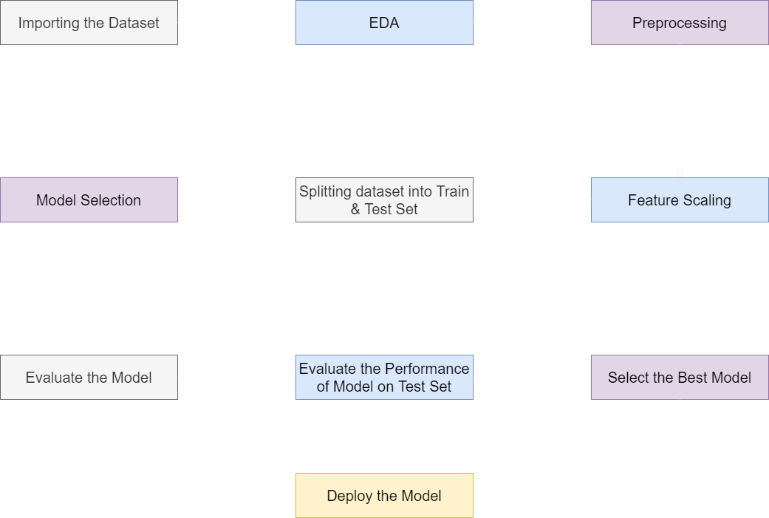
Process:-

Slide 4
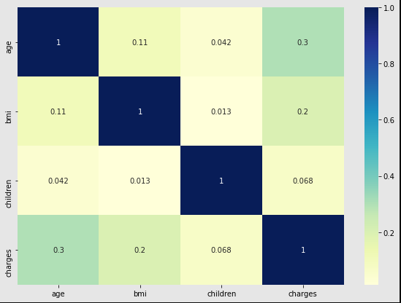
Heat Map Correlation of Dataset:-

Slide 5
EDA Insights:-
Normal BMI ( 18.5 – 24.9 ), Overweight BMI ( 25 – 29.9 ), Obese BMI ( 30 and above). As the BMI
increases the charges of the insurance, People having normal BMI have low charges of insurance
and are healthy.
There is more possibility of high insurance charges as the age greater than 50
It is seen that Having more than 4 No. of children's / dependents have less insurance charges.
31.4% of data in dataset have charges greater than average charges.
52.6% are men and 47.4% are women of data having charges greater than mean charges.
52.69% of data have BMI higher than average BMI in the dataset out of which 17.64% have insurance higher than average insurance.

Slide 6
Preprocessing:-
Encoding the Categorical Features ( Sex, Region, Smoker ): Using sklearn.preprocessing.OneHotEncoder and sklearn.compose.ColumnTransformer encoded the categorical features.
Feature Scaling:-
Using sklearn.preprocessing.StandardScalar standardizes a feature by subtracting the mean and then scaling to unit variance.
Splitting the Dataset into Train and Test Set:-
Using sklearn.model.train_test_split converting dataset into training and test set. ( Training Set: 80% & Test Set: 20% )

Slide 7
Implementing the models:-
Model Name | R^2 Score | Mean Absolute Error | Root Mean Squared Error
Polynomial Regression | 0.73 | 3534.287 | 6449.480
Multiple Linear Regression | 0.78 | 4207.251 | 5802.983
Decision Tree Regression | 0.75 | 2979.543 | 6186.863
Random Forest Regression | 0.86 | 2524.627 | 4601.035
Random Forest Regression is the best fit model for our dataset.

Slide 8
Thank You 😊

