Slide 1
Meet Potential Donors at Chambers ST

Slide 2
What Happened on Dec 8th, 2017, 3 PM to 7 PM at 34 ST Herald SQ?

Slide 3
What Happened on Dec 8th, 2017, 3 PM to 7 PM at 34 ST Herald SQ?

Slide 4
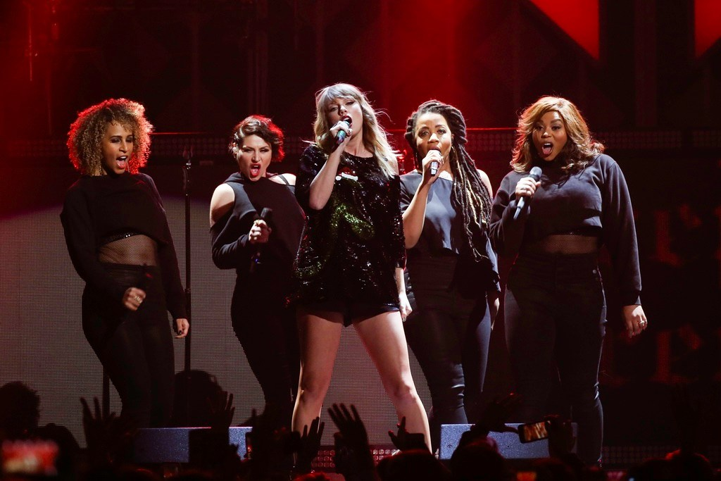

What Happened on Dec 8th, 2017, 3 PM to 7 PM at 34 ST Herald SQ?

