Slide 1

Project Benson
Benjamin, Chun, Meena, Nazim

Slide 2
How Do We Maximize Ticket Distribution?
What if we have one week?
Notes:
WomenTechWomenYes (WTWY) has an annual gala at the beginning of the October. We need to fill event space with individuals passionate about increasing the participation of women in technology, and concurrently build awareness and reach.
We don’t have much time, we have 1 week to distribute tickets for the gala.
We have one marketing team at our disposal which can only go to one station a day.
Our aim is to maximise ticket distribution to individuals passionate about women in tech,
To do this we must identify the omptimal combinatoin of stations to positon the marketing team throughout the week.
Group 2 Problem Statement: We have one week before Oct 1 to distribute the tickets for the gala. We are dividing each day into 3 4hour shifts. In each of these 7 days, we are able to position our street team in the stations that maximise our ticket distribution. To do this, we will use MTA Turnstile data in combination with other data sources for our analysis.

Slide 3
How Do We Maximize Ticket Distribution?
What if we have one week?
What if we only have 4 hours?
Notes:
WomenTechWomenYes (WTWY) has an annual gala at the beginning of the October. We need to fill event space with individuals passionate about increasing the participation of women in technology, and concurrently build awareness and reach.
We don’t have much time, we have 1 week to distribute tickets for the gala.
We have one marketing team at our disposal which can only go to one station a day.
Our aim is to maximise ticket distribution to individuals passionate about women in tech,
To do this we must identify the omptimal combinatoin of stations to positon the marketing team throughout the week.
Group 2 Problem Statement: We have one week before Oct 1 to distribute the tickets for the gala. We are dividing each day into 3 4hour shifts. In each of these 7 days, we are able to position our street team in the stations that maximise our ticket distribution. To do this, we will use MTA Turnstile data in combination with other data sources for our analysis.

Slide 4
Approach
Data Collection
Data Cleaning
Analysis
Visualization
http://web.mta.info/developers/turnstile.html
Notes:
Brainstorm what type of information we need to gain insights.
Identify potential data sources.
We decided to use MTA Turnstile data for 4 of the most recent weeks. This was so that we could get a representation of the current traffic flows of the station without overfitting (e.g if we just used one week.)
Collect data using pandas.
Additionally, obtained demographic data from ?
Input the data into a dataframe to gain insight into the type of data.
Noticed that there were many numbers which were unrealistic. Set filters to remove all data where net entries and net exits which were negative or greater than 10,000 in a 4 hour period.
Added datetime columns and a column which kept track of the day of the week
Entry and exit data were summed to get total station traffic. Traffic was compared with different stations, days and times to see which stations would be best for each day.
The most popular stations were then found for each day.
Most popular time slots were found for each day.
Demographic data could be found by applying the zip code of the popular stations.
Insights were then plotted on various bar charts to communicate our findings.

Slide 5
What Time Slots Should We Pick
M
T
W
Th
F
Sa
Su
Notes:
We then plotted the net traffic for all stations over an entire week and found that the results were similar to those we found on Monday.
For all days including weekends, 4pm to 8pm is the time of maximum traffic.
For weekdays 8am to 12pm is the second highest and then 12pm to 4pm.
For weekends this is reversed, 12pm to 4pm is second highest followed by 8am to 12pm.
Since these three 4 hour time shifts are the have the most traffic, we decide to focus on only these times for our further analysis.

Slide 6
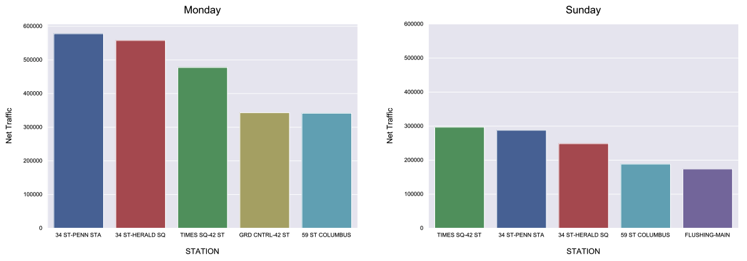
Which Stations Should We Pick

Slide 7
Chosen Stations
Day of the Week | Station
Monday | 34 St – Penn Station
Tuesday
Wednesday
Thursday
Friday | 34 St – Herald Square
Saturday | Times Square – 42 St
Sunday

Slide 8
Chosen Stations
Day of the Week | Station
Monday | 34 St – Penn Station
Tuesday | 34 St – Herald Square
Wednesday | 59th Street–Columbus Circle
Thursday | Grand Central–42nd Street
Friday | 47th–50th Streets–Rockefeller Center
Saturday | Times Square – 42 St
Sunday

Slide 9
Meet Potential Donors at Chambers St

Slide 10
Chosen Stations
Day of the Week | Station
Monday | 34 St – Penn Station
Tuesday | 34 St – Herald Square
Wednesday | 59th Street–Columbus Circle
Thursday | Grand Central–42nd Street
Friday | Chambers ST
Saturday | Times Square – 42 St
Sunday

Slide 11
Dec 8th, 2017, 3 PM to 7 PM at 34 ST Herald SQ
Maximize Exposure with Local Events

Slide 12
Dec 8th, 2017, 3 PM to 7 PM at 34 ST Herald SQ
Maximize Exposure with Local Events

Slide 13


Maximize Exposure with Local Events

Slide 14
Recommendation
Day of the Week | Station
Monday | 34 St – Penn Station
Tuesday | 34 St – Herald Square
Wednesday | 59th Street–Columbus Circle
Thursday | Grand Central–42nd Street
Friday | Chambers ST
Saturday | Times Square – 42 St
Sunday
One Week Plan:

Slide 15

Recommendation
One Day Plan:
Optimize Decision with Local Events

Slide 16
Maximizing reach and turnout
Future Work
 | REACH
STATION | 5% | 10% | 15% | 20%
34 ST-PENN STA | 256,065 | 512,129 | 768,194 | 1,024,259
34 ST-HERALD SQ | 242,918 | 485,836 | 728,754 | 971,673
TIMES SQ-42 ST | 233,060 | 466,120 | 699,180 | 932,240
59 ST COLUMBUS | 154,669 | 309,339 | 464,008 | 618,677
GRD CNTRL-42 ST | 148,527 | 297,054 | 445,580 | 594,107
59 ST | 134,267 | 268,534 | 402,801 | 537,068
FLUSHING-MAIN | 125,818 | 251,637 | 377,455 | 503,274
CHAMBERS ST | 121,907 | 243,815 | 365,722 | 487,630
47-50 STS ROCK | 117,726 | 235,452 | 353,178 | 470,904
42 ST-PORT AUTH | 116,394 | 232,787 | 349,181 | 465,575
TOTAL | 1,651,352 | 3,302,703 | 4,954,055 | 6,605,406
ASSUME REACH | 5%
ASSUMED TURNOUT | 1%
PARTICIPATION | 16,514

Slide 17
Acknowledgments
Our fantastic instructors!!!
Adam and Jonathan
Our amazing TAs!!!
Jenn and Nick
Everyone else!!! You guys are awesome!!!

Slide 18
Appendix

Slide 19
Avoid Duplicate Stations on Weekdays

Slide 20
Avoid Duplicate Stations on Weekdays

