Slide 1
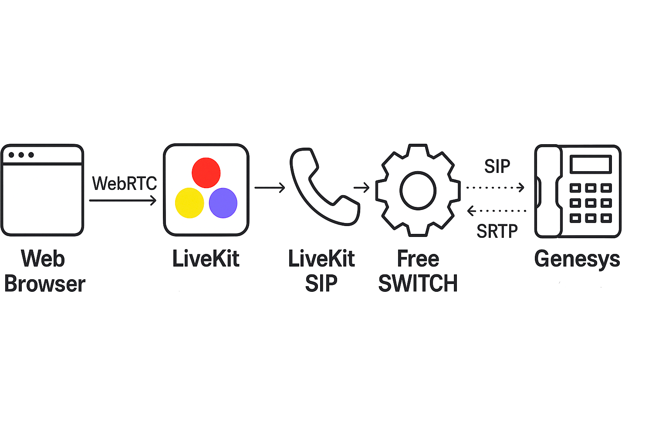
SIP Registration
3. LiveKit SIP Gateway
Role: SIP bridge between WebRTC and SIP
Protocols:
SIP (UDP) to FreeSWITCH
SRTP to FreeSWITCH
Limitations: Does not support SIP registration
Purpose: Initiates SIP INVITEs to bridge media from WebRTC to SIP world.
4. FreeSWITCH
Role: SIP B2BUA (Back-to-Back User Agent)
Protocols:
SIP (UDP) & SRTP from LiveKit SIP
SIP (TLS) & SRTP to Genesys Cloud
Connects to: Genesys Cloud SIP trunk
Purpose:
Terminates and relays SIP signaling.
Performs SIP registration on behalf of LiveKit SIP.
Bridges media securely using SRTP.
1. JavaScript App
Role: End-user client
Protocol: WebRTC (audio/video)
Connects to: LiveKit Server
Purpose: Provides user interface for initiating/receiving calls.
2. LiveKit Server
Role: SFU (Selective Forwarding Unit)
Protocol: WebRTC (to browser), SIP (via LiveKit SIP Gateway)
Connects to: LiveKit SIP Gateway
Purpose: Manages media and signaling for WebRTC clients and bridges to SIP via LiveKit SIP.

