Slide 1
Version Control with Git and GitHub
Presented by: Alex Meade
Date: Dec 4th, 2012

Slide 2






Slide 3
Version Control?

Slide 4
Git

Slide 5
Installing git
Linux
$ apt-get install git-core
OR
$ yum install git-core
Mac
http://code.google.com/p/git-osx-installer
From latest stable release
http://git-scm.com/downloads
Windows
http://msysgit.github.com

Slide 6
Configuring Git
Who you are
$ git config --global user.name "John Doe"
$ git config --global user.email “john.doe@rackspace.com”
More config settings
http://www.arthurkoziel.com/2008/05/02/git-configuration/

Slide 7
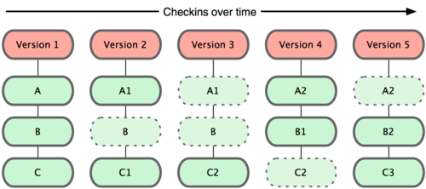
Git Repositories

Slide 8
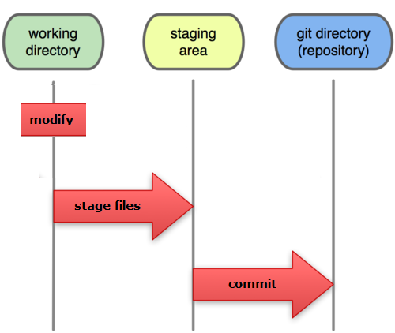
Tracking Changes

Slide 9
Tracking Changes
Modify
$ vim README
$ git diff # View uncommitted changes
$ git status # View status of working tree
Stage
$ git add README # Notifies Git of changes to be committed
Commit
$ git commit # Commits currently staged changes
$ git commit –a # Stages all changes and then commits
$ git diff HEAD^ # View previously committed changes

Slide 10
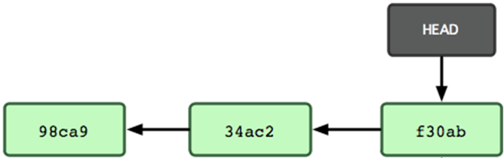
The HEAD Pointer

Slide 11
Undoing Changes
Reset
$ git reset HEAD README # unstage changes
$ git reset HEAD –hard # remove changes
$ git checkout README # reset README to previous state
$ git reset HEAD^ # uncommit changes but keep them
Remove files
$ git rm README --cached # stop tracking README

Slide 12

GitHub

Slide 13
Your GitHub account
Who you are
$ git config --global user.name "John Doe"
$ git config --global user.email john.doe@rackspace.com
SSH Keys
$ ssh-keygen –t rsa –C “John.Doe@rackspace.com”
https://help.github.com/articles/generating-ssh-keys

Slide 14
Setting up your repo
Initialize
$ git init
Make changes
$ vim README
Commit
$ git add README
$ git commit -m 'initial project commit'

Slide 15
Putting changes on GitHub
Make new GitHub Repo
Push changes to GitHub
$ git remote add origin git@github.com:<username>/<repo>.git
$ git push origin

Slide 16
Existing Repositories
Fork Repo
Clone Repo
$ git clone <URL> # will automatically add <URL> as origin remote
Push/Pull changes
$ git push <REMOTE> <BRANCH> EX: $ git push origin master
$ git pull <REMOTE> <BRANCH> EX: $ git pull origin master
Pull request

Slide 17

References & Further Reading
Pro Git by Scott Dracon (free online)
http://git-scm.com/book
*Diagrams in this book were used
and modified in this presentation
https://help.github.com
$ git help <command>

