Slide 1
PYTHON CRASH COURSE WEEK 6
Visual Studio Code and code testing
Summer 2022

Slide 2
Visual Studio Code
Application that can edit and run code in several languages
Python, Java, C++, HTML, etc.
Built-in support for Jupyter Notebook
Very professional and widely used in the industry
Built-in Python debugger
Overall must-have for any Python programmer

Slide 3
Downloading Visual Studio Code
You can download VS Code at the following web address:
https://code.visualstudio.com/
Click on “Download for Windows” and following the installation guidelines
Make sure to leave all the options as default
When/if prompted, select the “community” edition (not the professional edition)

Slide 4

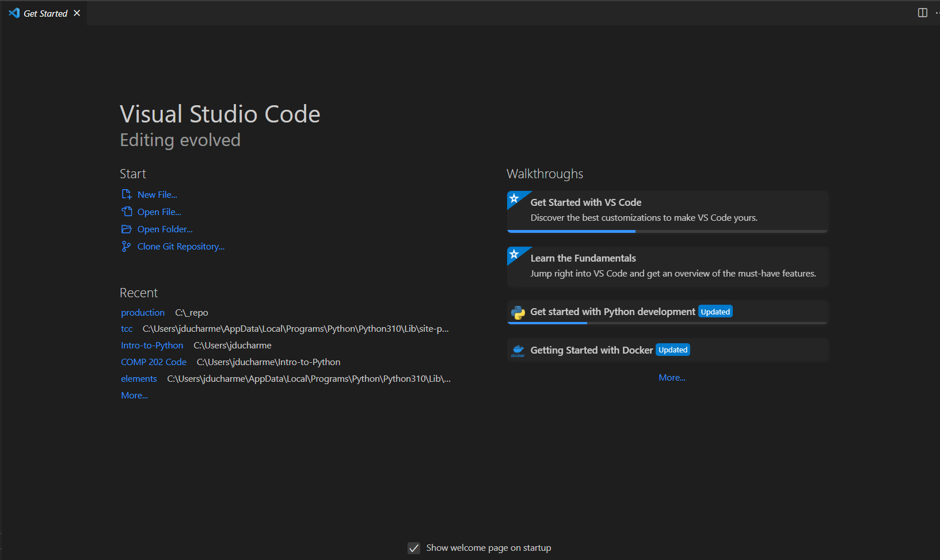
VS Code startup page
When opening VS Code for the first time, you will see a window like this

Slide 5
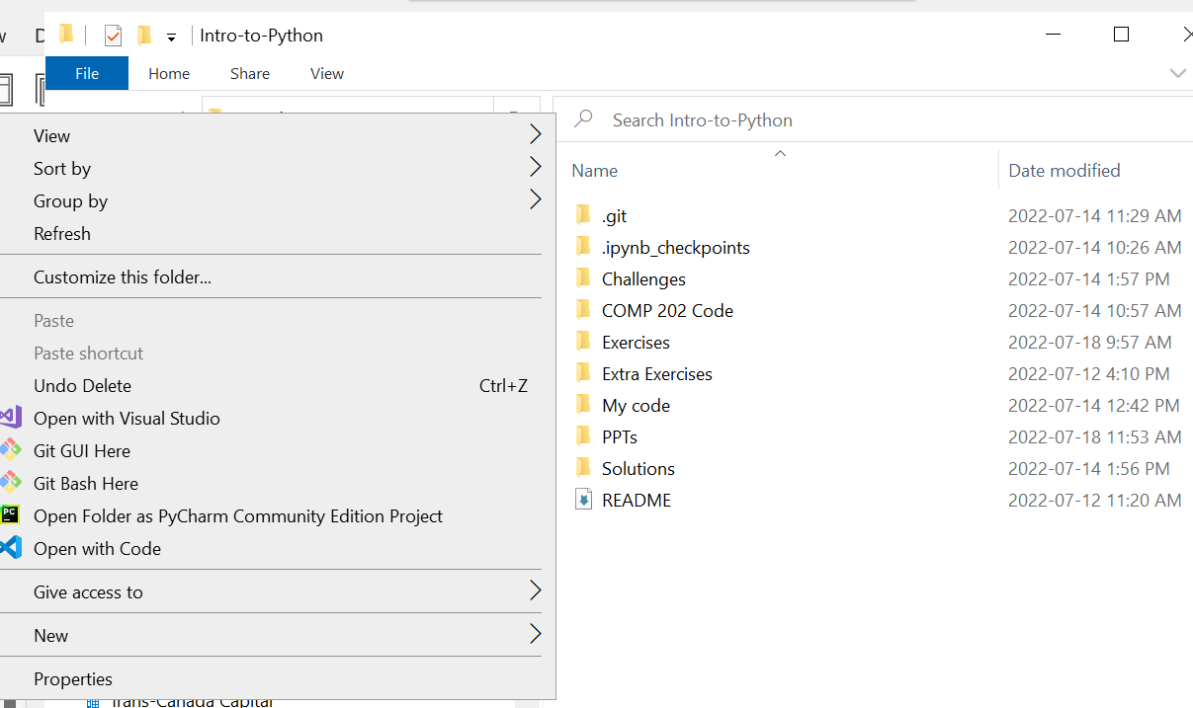
Before jumping in…
Before opening and working with VS Code, we’ll follow our usual steps to pull the latest changes from GitHub
Navigate to your “Intro-to-Python” folder in the file explorer
Right click and select “Git bash here”
Type in
git pull upstream main

Slide 6
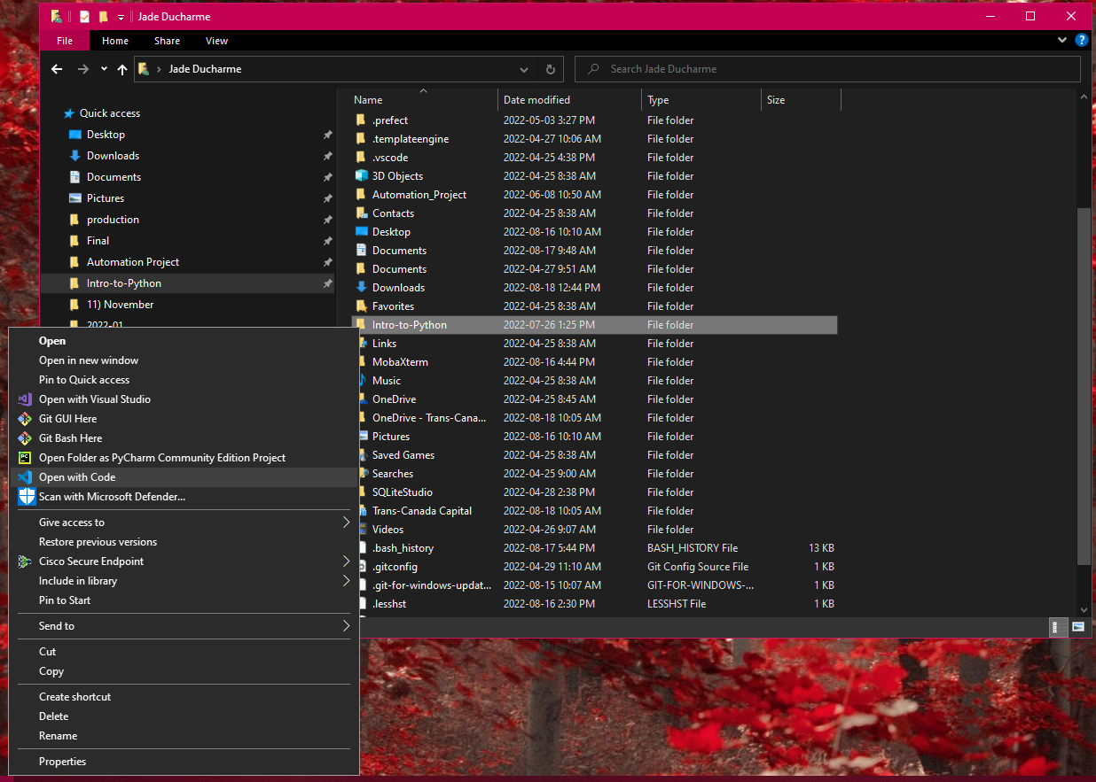
Opening Intro-to-Python in VS Code
Navigate to your Intro-to-Python folder in the File Explorer
Right click on the Intro-to-Python folder and select “Open with Code”

Slide 7
Exercises
We’ll work on Exercises 1-3 to get used to the VS Code interface!

Slide 8
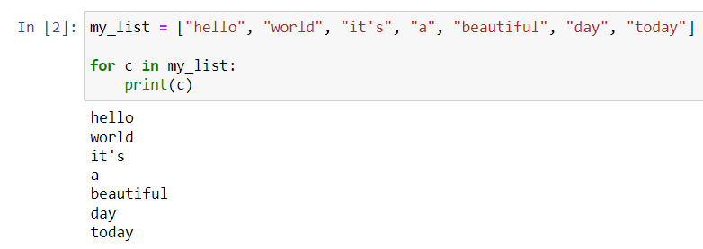
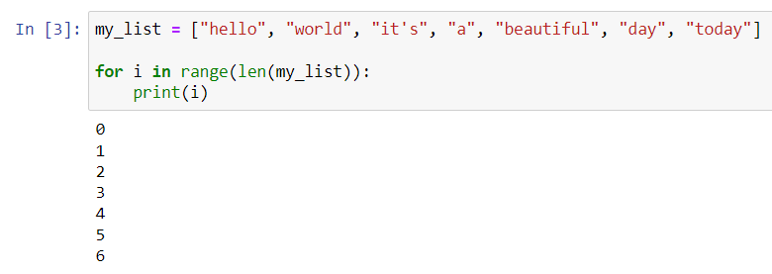
Enumerate function
We’ve seen how for loops iterate through list elements as follows:
We’ve also seen that for loops can iterate through list indices instead of elements:

Slide 9
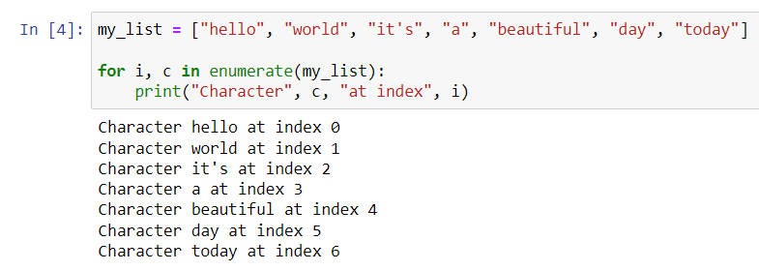
Enumerate function (cont.)
However, in some cases it may be useful to know both a list’s element and index as we’re iterating in a for loop
This is most efficiently done via the built-in enumerate function:

Slide 10
Exercises
Let’s work through Exercises 4-5 to practice the enumerate function

Slide 11
try and except blocks
Try and except blocks are a way of safeguarding your code against unintended uses
The “try” statement allows you to ask the computer to try running a piece of code that is potentially faulty/bugged/liable to raising an error
The “except” statement allows you to specify what to do when the code encounters an error in the try statement

Slide 12
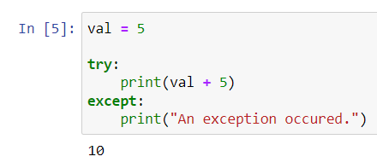
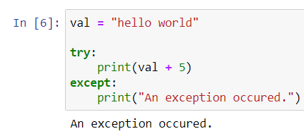
try and except blocks (cont.)
Here, the “try” block runs without any issues, so the “except” block is never executed
Here, the “try” block encounters an error, so the except block is executed instead

Slide 13
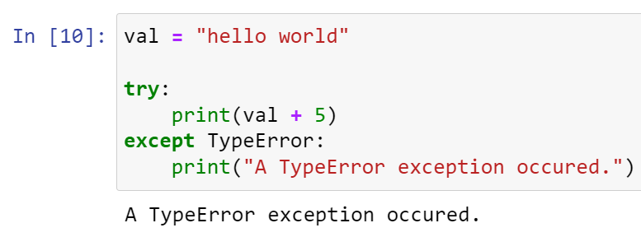
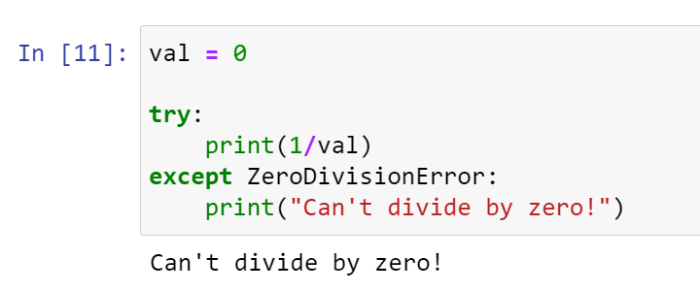
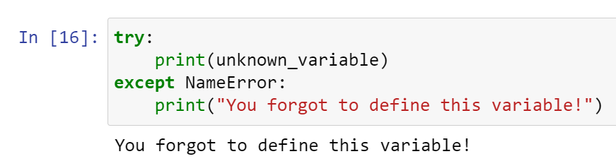
try and except blocks (cont.)
It is possible to specify exactly the type of error you are trying to catch:

Slide 14
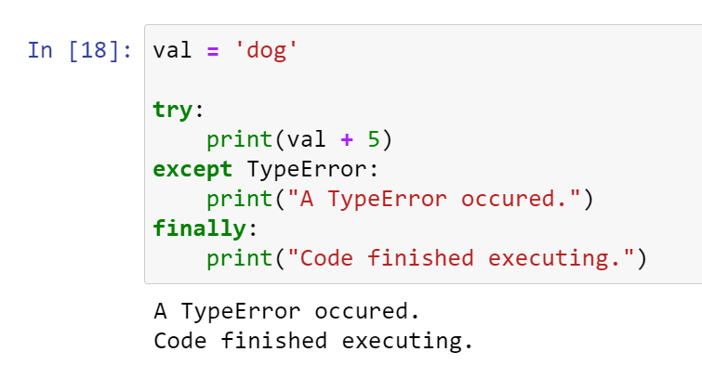
try, except, and finally
You can use a finally statement to specify code that should run regardless of whether the code encounters an exception in the try/except block

Slide 15
Exercises
We’ll practice try and except blocks in Exercises 6-7

Slide 16
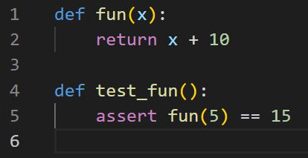
Testing Python code
In order to test code, it is common to use specialized packages such as pytest
pytest allows you to write functions that test certain functions in your code, like this:

Slide 17
pytest
Here are the general guidelines for testing code using pytest:
The name of your test function should start with test
The name of your Python test file should also start with test
You need to know what your code should produce given at least one specific input
Your code’s output is measured against the expected result using the assert statement

Slide 18
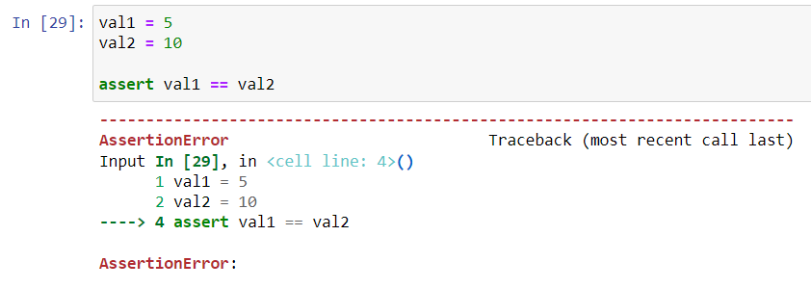
assert statement
The Python assert statement is used to compare two quantities between a double equality sign
E.g. assert a == b
If the two quantities are not equal, an AssertionError is raised and the code crashes

Slide 19
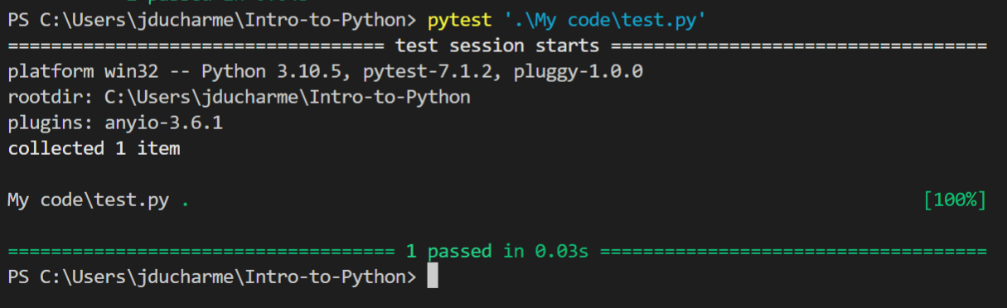
pytest (cont.)
pytest uses the assert statement to mark each test with a pass or fail
In order to run the tests, you need to call pytest from the command line, specifying the test file, for example:
pytest test_functions.py

Slide 20
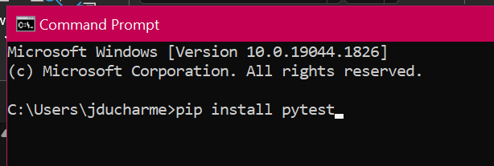
pytest (cont.)
Of course, in order for this to work, you first need to install pytest on your computer!
Open up the command prompt and type in the following:
pip install pytest

Slide 21
pytest (cont.)
pytest automatically detects all functions whose name starts with test and runs them
It marks them as pass or fail depending on the result of the assert statement

