Slide 1

PYTHON CRASH COURSE WEEK 4
functions and packages
Summer 2022

Slide 2
Recap from Last Week
Last week was busy! We worked on…
Lists
For Loops
While Loops
If Statements
Error Codes
We worked on several exercises together, but try and take a look at the extra (homework) exercises
They will be more challenging, but will help with your overall comprehension
There are also shorter, easier ones in the “Extra Exercises” folder

Slide 3
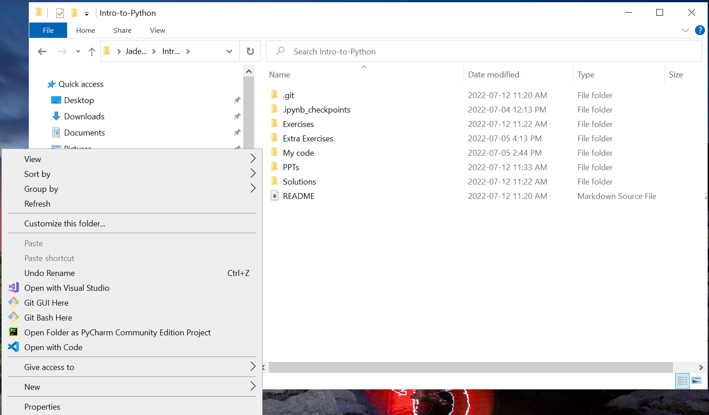
Git Pull
As always, we’ll start by pulling the changes to the repo
Navigate to your Intro-to-Python folder in the File Explorer, then right click and select “Git Bash Here”

Slide 4
Git Pull (cont.)
Type the following command in the Git Bash:
git pull upstream main
This specifies to pull the changes from the “main” directory in the “upstream” repo

Slide 5
Recall
Instructor’s repo
[remote]
upstream
My forked repo
[remote]
main
Fork
Push
Fetch
Pull
My local repo
[local]
origin
Pull

Slide 6
Functions
Functions are used in Python when…
Pieces of code are used and re-used in several different places
Similar operations need to be performed on different variables with different values
Functions allow you to…
Define “local” variables which are isolated from the “global” variables we have worked with until now (more on this later)
“Call” your function (i.e. run your function) at any point in the code after it has been defined

Slide 7
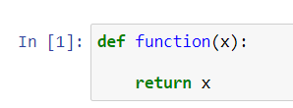
Function Syntax
Functions are defined using the following syntax:
The keyword “def” tells Python we are defining a function
The name of the function can be whatever you like
Here I simply call it “function”
Define some “local” variables between the parentheses
Use the “return” statement to specify the function’s output

Slide 8
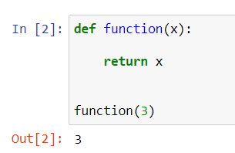
Function examples
Important fact #1: Defining a function doesn’t run it! To run the function, you must “call” it like this:
Here, I pass the value of 3, meaning that I am stating that my local variable x is equal to 3
All the function does is return x, in this case 3

Slide 9
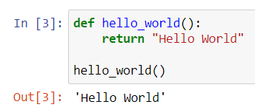
Function examples (cont.)
A function doesn’t need local variables! Here’s an example:
Variables are only useful when you need to pass a specific input to the function

Slide 10
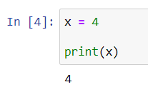
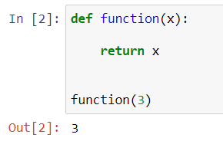
Local variables vs. global variables
“Global” variables are variables defined in the “body” of the code and whose value usually doesn’t change
Here’s an example:
“Local” variables are variables defined in functions, whose value is only defined when you call the function
For example:

Slide 11
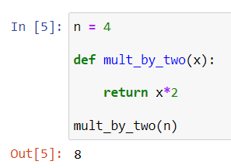
Local variables vs. global variables (cont)
It is of course possible to mix the two, like this:
I first define a global variable n
Then I define a function containing a local variable x
I tell the function to multiply x by 2
I run the function using the global variable n as input

Slide 12
This week’s exercises…
Let’s open up Jupyter Notebook by running the following command in the Command Prompt:
jupyter notebook
Or, if that doesn’t work, run this instead:
python –m notebook
Navigate to your Intro-to-Python folder and copy-paste the Week3 exercises into your My Code folder
And open it!

Slide 13
Functions
Let’s work on Exercises 1 through 4 to practice functions!

Slide 14
Python Packages
It is possible to import packages in Python which contain useful functions
These functions can include…
Functions to perform complex math operations (derivatives, integrals, least square fitting, …)
Functions to plot data in graphs
Functions to store data in an Excel-ish format and perform column-wise operations
… And many more!
The first package we will work with is called numpy
This stands for “numerical python”

Slide 15
numpy
numpy is an essential tool for any Python programmer
It allows us to perform a number of mathematical operations, including
Square roots
Factorials
Operations on complex numbers
Etc
More importantly, it allows us to perform element-wise operations on lists

Slide 16

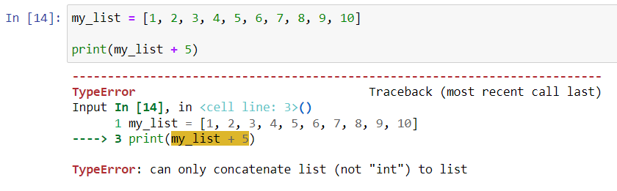
numpy (cont.)
For example, let’s say I have a list of values:
Let’s say I want to add 5 to every element in the list
The following does not work
Solution: transform my list into a numpy array object!

Slide 17
numpy arrays
Arrays are very similar to lists, with the important distinction that you can perform element-wise operations
Defining an array works as follows:
This calls the “array” function from the numpy package and creates an array

Slide 18
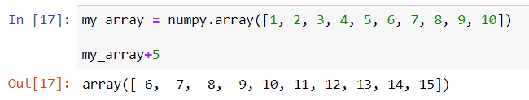
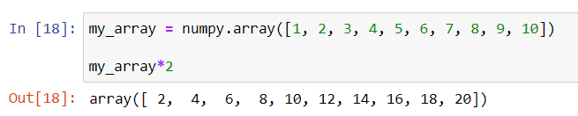
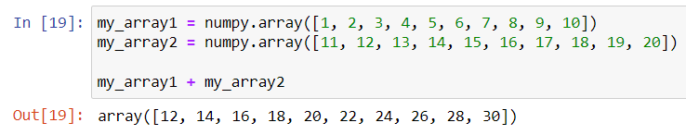
numpy arrays (cont.)
Here are some examples of what arrays can do!
Adding 5 to every element:
Multiplying every element by 2
Adding two arrays (must have same length)

Slide 19
Installing numpy
In order to use numpy, we first need to install it
This is actually very easy!
Launch the Command Prompt and type in the following command:
pip install numpy
That’s it! Now we’re ready to use it

Slide 20
Aside: installing matplotlib
Along with numpy, matplotlib is one of the most important Python packages out there
It allows you to plot data in graphs, histograms, 3D plots, heat maps, etc.
We won’t really be using matplotlib, but let’s go ahead and install it just in case:
pip install matplotlib

Slide 21
Extra packages
While we’re at it, let’s go ahead and install a few packages that will be useful in the long run
pip install tqdm
pip install scipy
pip install pandas

Slide 22


Importing numpy
In order to use numpy, we then need to import it in our code file
This is done via the following syntax:
It is also possible (and in fact standard) to import numpy with an alias
This is done like this:
Now, every time we write “np” in the code, it refers to numpy

Slide 23
Exercises – numpy
Let’s work on Exercises 5 through 7 to practice numpy!

Slide 24
Git add, commit, push
As always, we want to save our changes at the end of every week
Navigate to your Intro-to-Python folder in your File Explorer, right click and select “Git Bash Here”
Run the following commands:
git status
git add <modified_files>
git commit –m “A meaningful commit message”
git push origin main

