Slide 1

PYTHON CRASH COURSE WEEK 2-3
error codes, loops, if statements, and lists
Summer 2022

Slide 2
Recap From Last Week
Last week, we…
Installed Python
Installed Jupyter Notebook
Installed git and created a GitHub account
Cloned the Intro-to-Python GitHub repository on our computer
Wrote our first pieces of code
Used the print statement to output Hello World
Differences between strings, integers, and floats
Combined different objects in a print statement

Slide 3
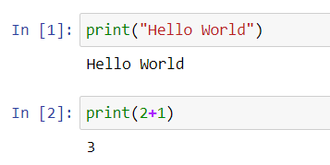
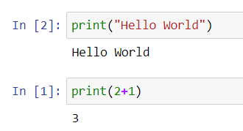
Jupyter Notebook Functionalities
Each cell can run independent pieces of code
The In [ ]: index on the left tells you in what order the cells were run
You can run cells in whichever order you like!

Slide 4
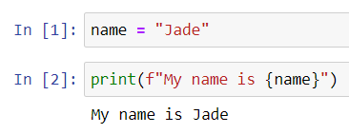
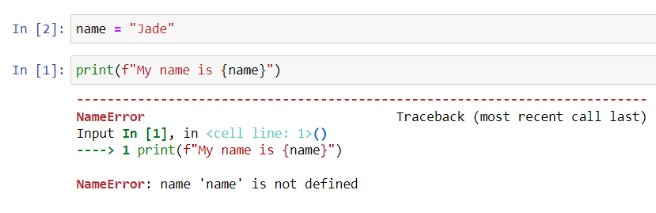
Jupyter Notebook Functionalities (Cont)
Jupyter “remembers” variables from cells it already ran. Meaning I can run something like this:
But I need to make sure to run the cells in the right order!

Slide 5


Jupyter: Code cells vs. Markdown cells
An incredibly useful Jupyter Notebook feature is the ability to use markdown cells:
Markdown cells are cells where you can just write down normal text
Notice the absence of the In [ ]: index on the left
Code cells are cells used to write Python code in

Slide 6
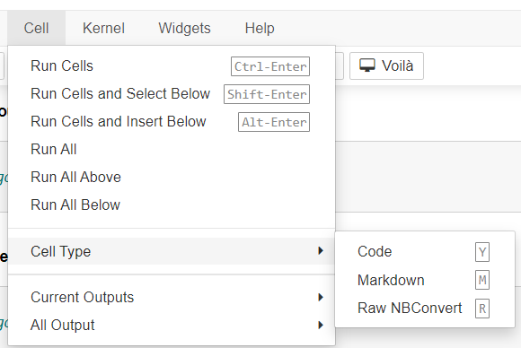
Jupyter: Code cells vs. Markdown cells (cont)
You can switch between cell types by selecting the cell and hitting “m” for markdown or “y” for code
Alternatively, you can click on the “Cell” button on the toolbar and click on “Cell Type”:

Slide 7
Pull Remote Changes Using Git
We need to “pull” changes from the instructor’s repository on GitHub to access latest version each week
Type the following commands in the Git Bash:
git remote add upstream https://github.com/baron-de-montrouge/Intro-to-Python.git
git fetch upstream
git rebase upstream/main
git push –f origin main

Slide 8
Git terminology
Instructor’s repo
[remote]
upstream
My forked repo
[remote]
main
Fork
Push
Fetch
Pull
My local repo
[local]
origin
Pull

Slide 9
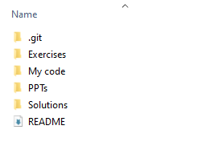
!! Important !!
Here I explain how to fix the merge conflict you are probably getting at the git fetch upstream part (watch the recording if unsure)
This is my mistake, I forgot something important last week!
You will need to create a separate folder in Intro-to-Python, call it for example “My code”
Your Intro-to-Python directory should now look like this:

Slide 10
!! Important !! (cont)
From now on, whenever you pull from upstream, you will need to copy and paste new files into your “My code” folder
Otherwise, git pull upstream will attempt to overwrite your changes every time!

Slide 11
Pull Remote Changes Using Git (Cont)
We successfully established a link between the “upstream” copy (instructor’s version) and the “origin” copy (our own local copy) via the “rebase” command
In the future, pulling changes from upstream will only require the following command:
git pull upstream main

Slide 12
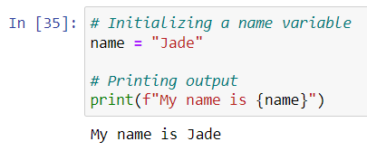
Python Comments
Text preceded by a # symbol in a code cell will not compile
These are called comments!
Comments are very useful to explain complicated bits of code to potential readers

Slide 13
Python Errors – How to Debug Faulty Code
Python has a lot of different types of errors which include:
NameError
Occurs when trying to use a variable that hasn’t been defined yet (see previous slide)
SyntaxError
Occurs when you forget a parentheses, a square bracket, a comma, a quotation mark…
TypeError
Occurs when trying to run operations on incompatible object types (e.g. multiplying two strings)
… And many, many more (https://docs.python.org/3/library/exceptions.html)
When in doubt, always Google your error messages
Someone has certainly already had the same error, and someone else has certainly already solved it!

Slide 14
Exercise 1: Debugging Faulty Code
Let’s open up Jupyter Notebook and practice debugging!
Open up the command prompt
Click on the Windows Start menu
Type in “Command Prompt”
Hit enter
Type in the following:
jupyter notebook
(If typing in jupyter notebook doesn’t work, try the following):
python –m notebook
Navigate to your copy of Intro-to-Python and open up the Week2.ipynb file!

Slide 15
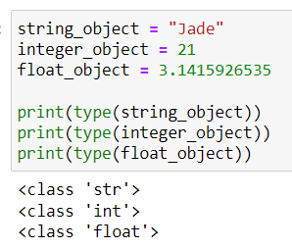
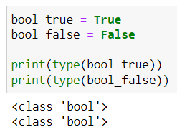
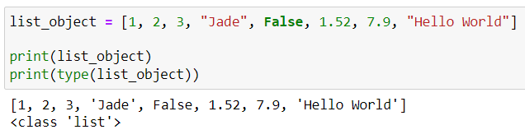
Python objects: Booleans and Lists
Last week, we saw…
Strings
Integers
Floats
Booleans
Two possible values: True or False
More on their uses later
Lists
Useful to store many different objects
Can list strings, integers, floats, Booleans, or a mix of everything!

Slide 16


Python lists
The syntax to construct a list in Python is as follows:
The list must be enclosed in square brackets [ ]
List elements are separated by commas
To access the first element in the list:
The second element:
Lists have indices!
my_list has the following indices:
0, 1, 2, 3, 4, 5
Important: indices start at zero!
And so on!

Slide 17

Python lists (cont)
Let’s say I want to print out the first and second list element
I would write the following:
String indexer syntax:
my_list[start:stop]
If start or stop is not included, it defaults to start = 0 and stop = last element in the list
Stop is excluded! So if stop = 2, it prints out indices 0 and 1.

Slide 18
Exercises 2 and 3: Concerning lists
Your turn to practice strings in Exercises 2 and 3!

Slide 19
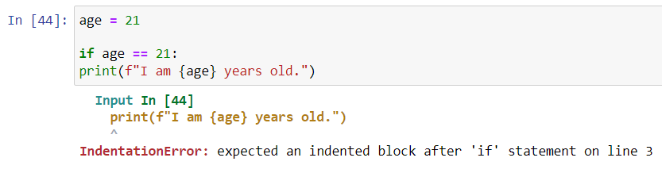
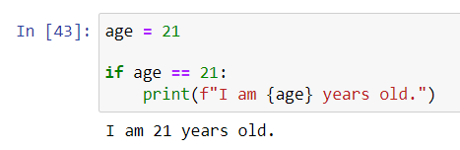
The “if” Statement
The if statement allows you to run a piece of code only if a certain condition is met
The syntax is:
if <condition>:
<run code>
Indentation is very important in Python!
This will not:
For example, this will run:

Slide 20


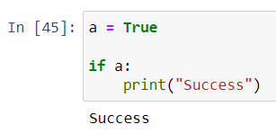
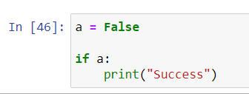
If statement syntax
To verify that a condition is met, use double equality signs
E.g.
May also want to verify that a number is bigger or smaller
E.g. Or
Booleans can also serve as conditions!
A True Boolean will execute the code after the if statement:
While a False Boolean will not:

Slide 21
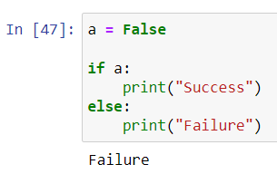
Else statement
An if statement can be accompanied by an else statement to specify code that should be run when the “if” condition is not met
E.g.

Slide 22
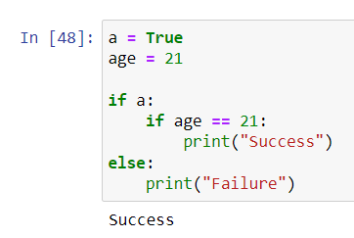
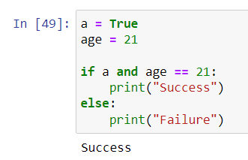
Nested “if” statements vs. “and”
Sometimes, it may be necessary to check two conditions
There are two methods to do this
Method 1: Nested “if” statements
Method 2: “and”

Slide 23
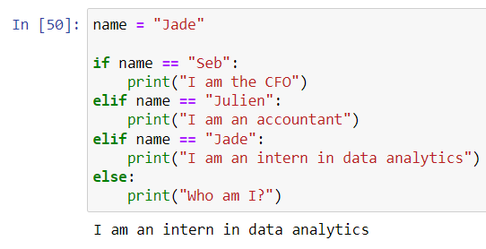
if, elif, else
There is a third piece we can add to an if/else block: an elif statement
Allows to check for multiple conditions on the same variable

Slide 24
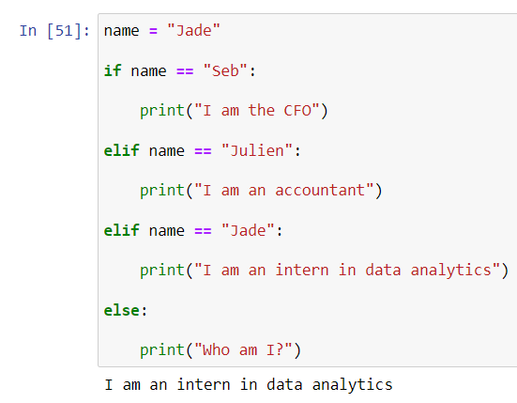
Note on spacing
In Python, you can add as many blank lines between statements as you want
The only important thing is to respect indentation
More spacing can make the code more legible

Slide 25
Exercise 4: The if statement
We’ll practice the if statement in more detail in Exercise 4!

Slide 26
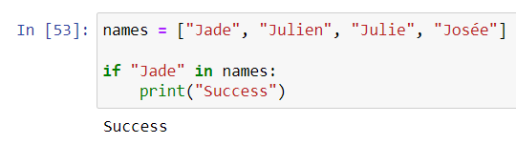
If statements and lists
Given a list, it may be useful to verify whether a specific element is in the list or not
This is done via an “in” condition in the if statement

Slide 27
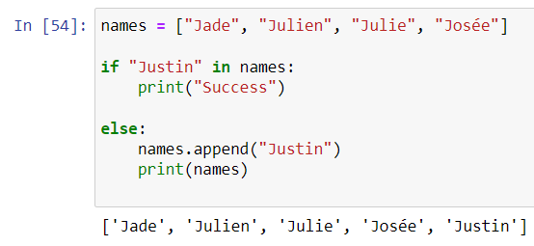
If statements and lists (Cont)
Let’s say we want to add an element to a list after it has already been initialized
This is done via the append method

Slide 28
Exercise 5: if statements and lists
Let’s practice combining lists and if statements in Exercise 5!

Slide 29
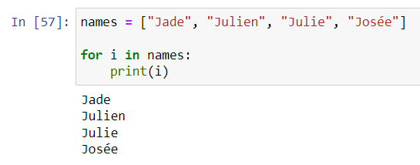
The “for” Loop
In Python, the “for” loop allows you to loop through elements in a list
In the following example, we loop through every list element and print it out
Syntax:
for i in:
<run code>
The i can be replaced by anything
Mapping function that maps every element in the list to the letter i, whose value is updated at each iteration

Slide 30
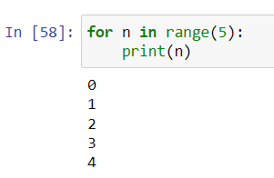
For loop examples
We can also loop through a range of numbers using the range function
Just like with list indices, range starts at 0

Slide 31
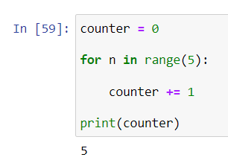
For loops and counters
It is often useful to initialize a counter variable whose value we want to update at each iteration in the for loop
counter += 1 is equivalent to counter = counter + 1
It sets the value of counter to 1 + its previous value

Slide 32
Exercises 6, 7 and 8: For loops
We will practice for loops in Exercises 6, 7, and 8!

Slide 33
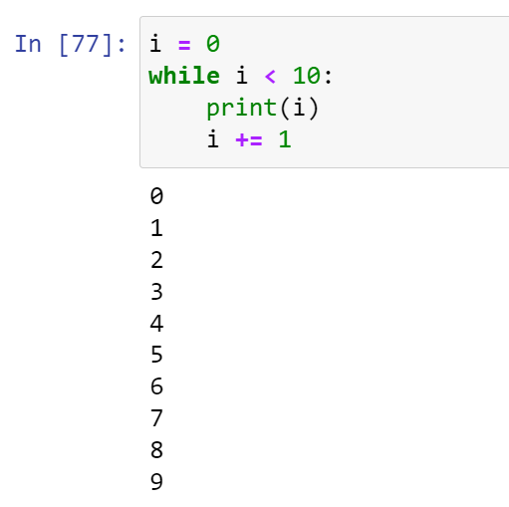
While loops
A while loop is another type of loop that will keep looping until its condition is satisfied
For example
While loops are almost exclusively used in combination with a counter
In the example shown, the counter is the i variable
Its value is updated at each iteration
If we forget to update i at each iteration, the while loop turns into an infinite loop!

Slide 34
Exercise 9: While loops
We’ll practice while loops in Exercise 9

Slide 35
“Pushing” local changes to remote
After modifying the code locally, you will want to push it to your remote GitHub repo
This is done via the following steps:
Open up your file explorer and navigate to your local Intro-to-Python folder
Right click and select “Git Bash Here”
Type in the following (hitting enter after each line):
git status
git add <modified files>
git commit –m “commit message”
git push origin main
Replace <modified files> by the files you changed
git status allows you to see all modified files
Replace “commit message” with a meaningful commit message

Slide 36
Git push breakdown
Add:
Specifies which files to add to the commit
Lets you purposely omit files you do not wish to commit
Commit:
It’s in the name: you are “committed” to the changes you made
Git commit saves a copy of your files at the moment of the commit
Allows you to return to previous versions if need be
Push:
Pushes the committed files to the remote directory
Now, if you log into GitHub in the browser, you will see the modified files appearing in your repo!

