Slide 1
PYTHON CRASH COURSE WEEK 6
pandas and file import/export
Summer 2022

Slide 2
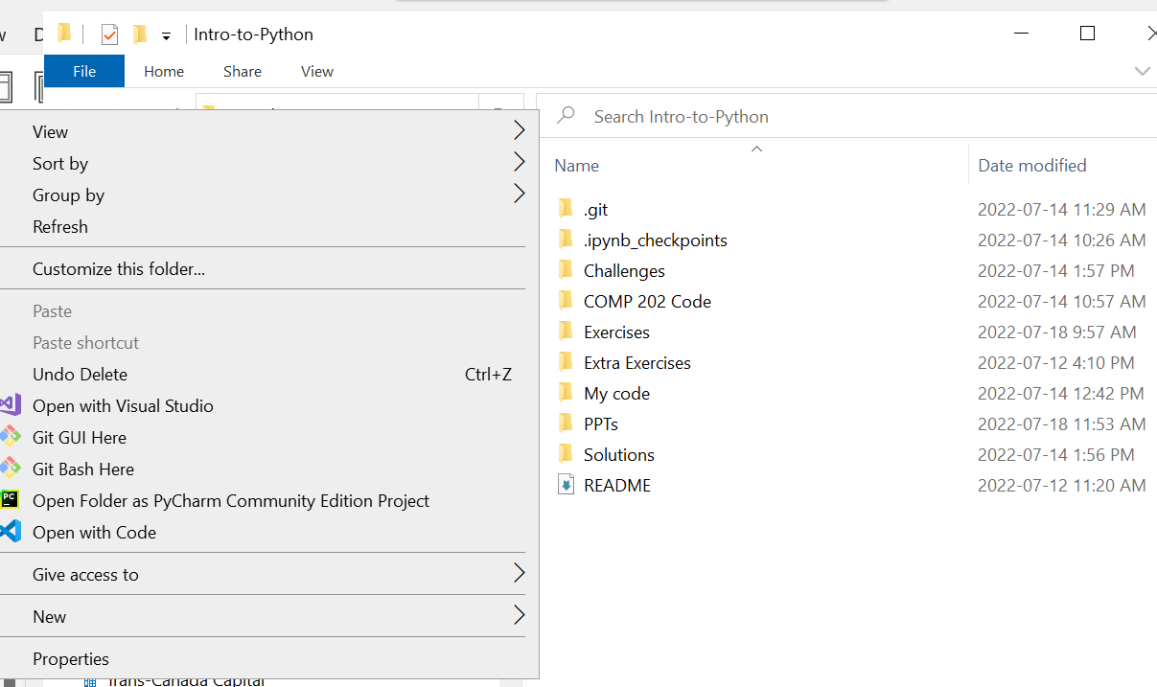
Pulling changes from GitHub
Let’s pull the latest changes from GitHub by navigating to our Intro-to-Python folder, right-clicking, and selecting “Git Bash Here”
Type in
git pull upstream main

Slide 3
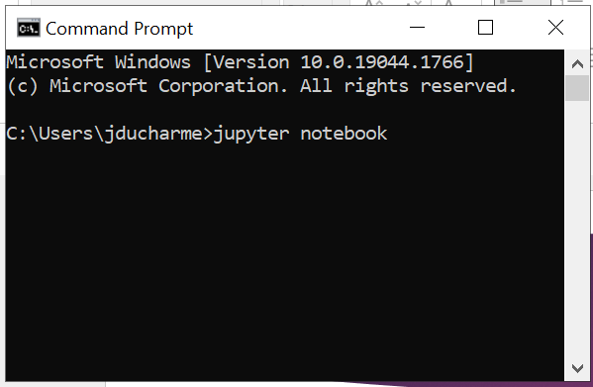
Opening Jupyter Notebook
Open up Jupyter Notebook by opening the Command Prompt and typing either
jupyter notebook
Or
python –m notebook

Slide 4
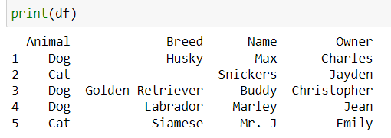
pandas
pandas is a popular Python package that allows us to store data as labelled rows and columns
For example:
Here, I defined a “df” object (not shown) containing 5 rows and 4 columns, and added some data

Slide 5
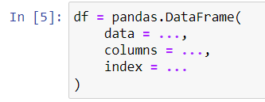
pandas DataFrame objects
The object I showed in the previous slide is a “DataFrame”, a special class of object accessible via pandas
To initialize a DataFrame object, use the following syntax:
DataFrames are super simple objects that only require some data, column names, and row names (index)

Slide 6
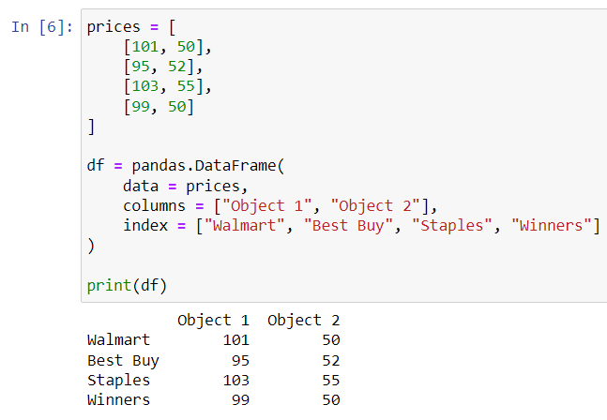
DataFrame objects (cont.)
DataFrame objects are useful because their rows and columns are actually numpy arrays, meaning we can easily perform row-wise and column-wise operations
Consider a DataFrame containing two columns showcasing the price of two objects, Object 1 and Object 2, for a variety of different stores:

Slide 7
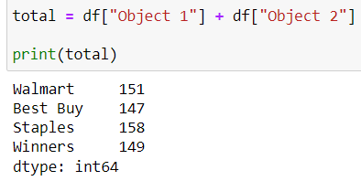
DataFrame objects (cont.)
Let’s say I want to add a third column that shows the total price for both objects
To calculate the total, use the following syntax:

Slide 8
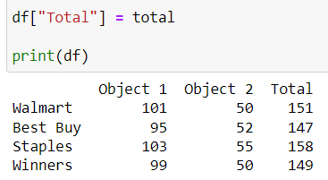
DataFrame objects (cont.)
To create a new column containing this total, use the following syntax:

Slide 9
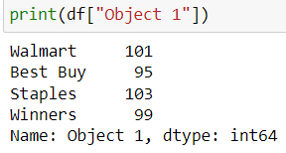
DataFrame indexing
DataFrame indexing is easier than list or array indexing because you can index directly using the row and column names (instead of numbers)
To access a particular column, use square brackets df[col_name]:

Slide 10
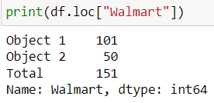

DataFrame indexing (cont.)
To access a particular row, use the df.loc[row_name] method:
To access a particular value, use the df.loc[row_name, col_name] method:

Slide 11
DataFrame practice!
Open up your copy of the Week 6 exercises in your My Code folder
We’ll work on Exercises 1 through 3 to practice working with DataFrames

Slide 12
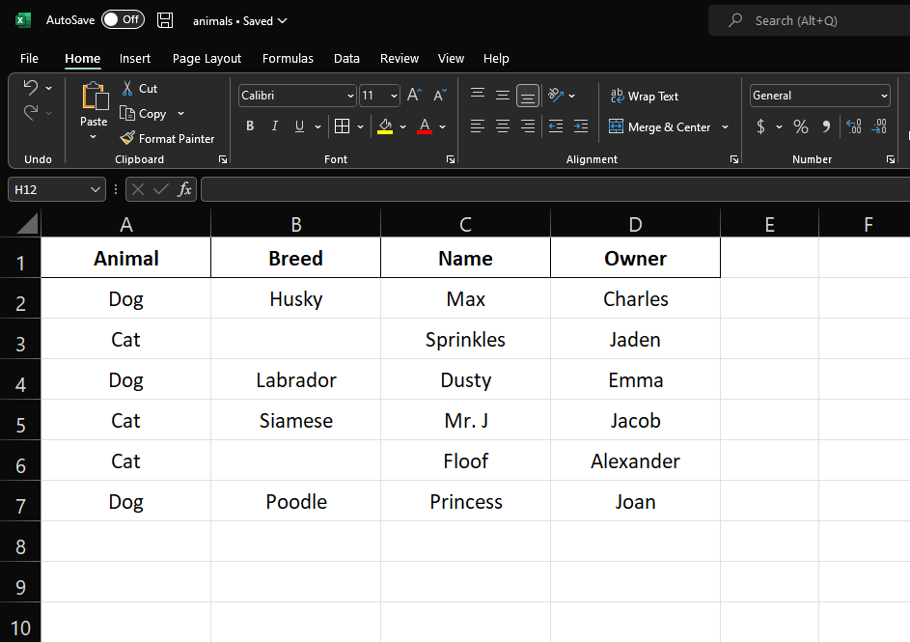
File Import
An incredibly useful pandas functionality is the ability to import files as DataFrame objects
For example, it is possible to import an Excel file that looks like this…

Slide 13
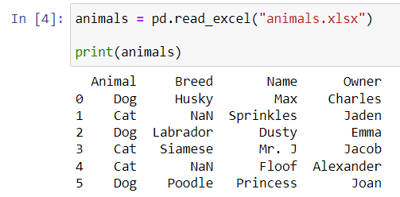
File Import (cont.)
… into a pandas DataFrame object using the pandas.read_excel(filename) function
pandas automatically labels the columns using the first row in the Excel files
Rows are indexed by default using integers starting from 0

Slide 14
File Import (cont.)
In order to use pandas.read_excel(filename), you have to make sure that…
The file exists on your computer (can be on your C drive or other drive)
You know the exact file path
E.g. “F:\TCC\Funds\02) TCC Master Multi-Strategy Fund\02) Accounting\2022\01 2022\02) MSF_NAV approval, Assets allocation & Fees calculation”
You have permissions to view this file (the file isn’t locked)

Slide 15

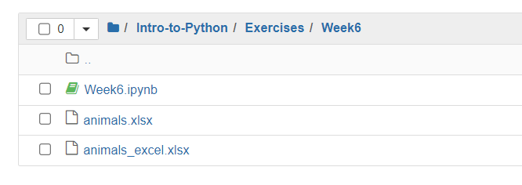
File Export
Let’s say you performed some calculations on a DataFrame and you want to publish those results as an Excel workbook
The easiest way to do so is via the df.to_excel(filename) method:

Slide 16
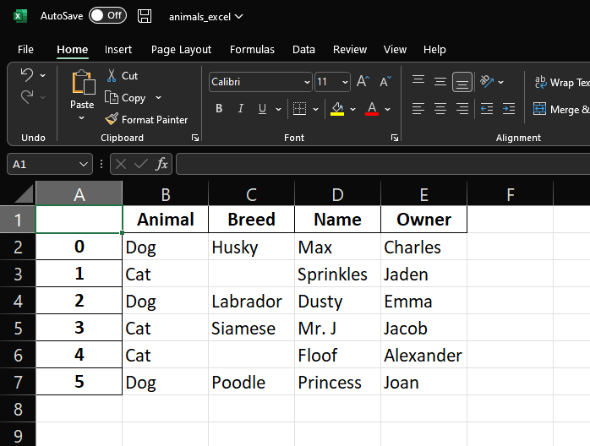
File Export (cont.)
This publishes your DataFrame as an Excel Workbook without any formatting
It can look pretty ugly sometimes!
As you can see, pandas adds an extra column with the DataFrame index labels

Slide 17
File Export (cont.)
In order to use the df.to_excel(filename) method, you need to make sure…
The file path you write actually exists
You can write directly to the F drive as long as it’s been mapped correctly!
You have permissions to write to that file path
i.e. make sure the folder/drive isn’t protected/restricted

Slide 18
File Import/Export practice!
We’ll work on Exercises 4 to 6 now!

Slide 19
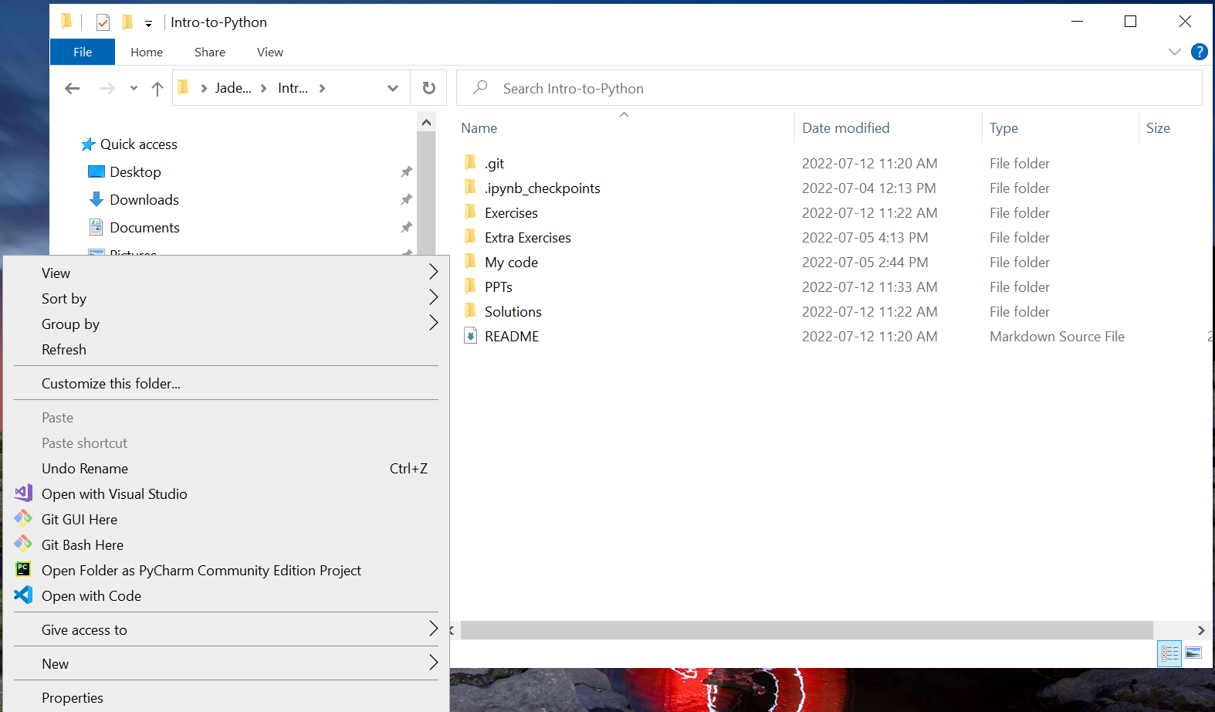
Git add, commit, push
As always, we want to save our changes at the end of every week
Navigate to your Intro-to-Python folder in your File Explorer, right click and select “Git Bash Here”
Run the following commands:
git status
git add <modified_files>
git commit –m “A meaningful commit message”
git push origin main

