Slide 1
PYTHON CRASH COURSE WEEK 5
Midterm review
Summer 2022

Slide 2
What we learned so far…
We’re already halfway through the course!
We’ll take some time to review what we did so far…
Objects:
Strings
Represent specific text enclosed in quotation marks
E.g. name = “Jade”
Integers
Round numbers (no decimal places)
E.g. 42
Floating point numbers (float)
Numbers with decimal places
E.g. 42.0

Slide 3
What we learned so far…
Objects (cont.)
Lists
Used to store several objects
E.g. [“hello”, “world”, 24, 8.2]
Arrays
From numpy package
Similar to lists, but can also perform element-wise operations
Booleans
Two possible values, True or False

Slide 4
What we learned so far…
Statements
if statement
Specifies code to run if a certain condition is met
Can be accompanied by an elif or else statement
for loop
Runs a specific code a determinate number of times
Code loops until all elements specified in the for statement have been iterated through
while loop
Runs a specific code an indeterminate number of times
Code loops until condition specified in while statement is met

Slide 5
What we learned so far…
Built-in Python functions
print()
Prints out whatever is between the parentheses
int()
Transforms a string or float to an integer
If the float is not a round number, int() rounds down
E.g. int(4.9) = 4
string()
Transform what is between the parentheses into a string
float()
Transform what is between the parentheses into a floating point number

Slide 6
What we learned so far…
Built-in Python functions (cont.)
type()
Returns the object type
E.g. type(12) = int
E.g. type(“hello”) = str
len()
Returns the length of the list (number of elements in the list)
Does NOT work on numpy arrays
E.g. len([1, 2, 3, 4]) = 4
round(n)
Rounds a floating point number to n decimal places
E.g. round(3.141593, 2) = 3.14

Slide 7
What we learned so far…
Basic Operations
Addition
+
Subtraction
-
Multiplication
*
Division
/
Powers
**
Advanced operations (using numpy)
Square root
numpy.sqrt()
Natural exponential
numpy.exp()
Mean of an array
numpy.mean()
Standard deviation of an array
numpy.std()
Variance of an array
numpy.var()

Slide 8
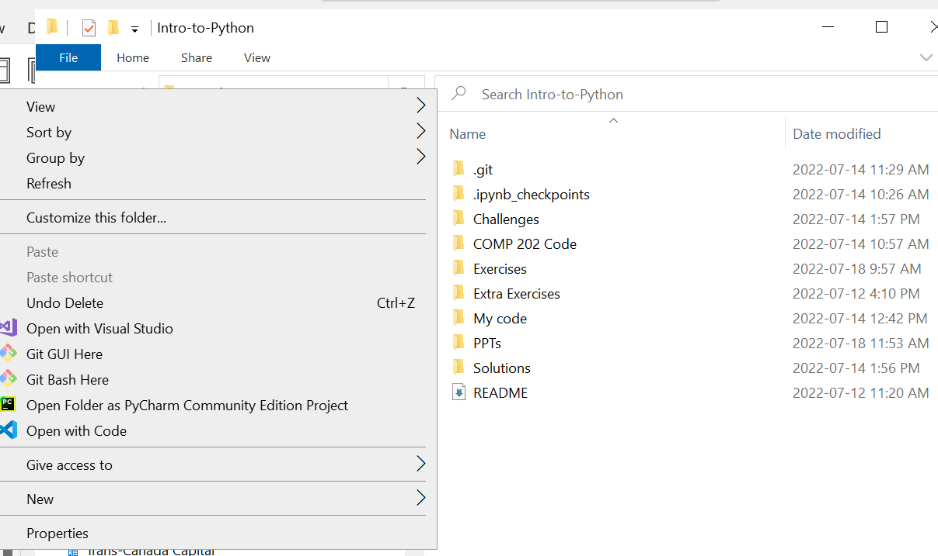
Pulling changes from GitHub
We’ll work on some review exercises!
Let’s pull the latest changes from GitHub by navigating to our Intro-to-Python folder, right-clicking, and selecting “Git Bash Here”
Type in
git pull upstream main

Slide 9
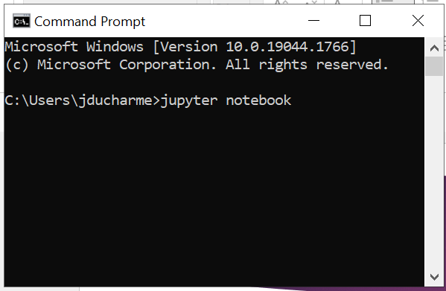
Opening Jupyter Notebook
Open up Jupyter Notebook by opening the Command Prompt and typing either
jupyter notebook
Or
python –m notebook

Slide 10
Review Exercises
Let’s work through all the exercises for Week 5 today!

