Slide 1
PYTHON CRASH COURSE WEEK 5
Midterm review
Summer 2022

Slide 2
What we learned so far…
We’re already halfway through the course!
We’ll take some time to review what we did so far…
Objects:
Strings
Represent specific text enclosed in quotation marks
E.g. name = “Jade”
Integers
Round numbers (no decimal places)
E.g. 42
Floating point numbers (float)
Numbers with decimal places
E.g. 42.0

Slide 3
What we learned so far…
Objects (cont.)
Lists
Used to store several objects
E.g. [“hello”, “world”, 24, 8.2]
Arrays
From numpy package
Similar to lists, but can also perform element-wise operations
Booleans
Two possible values, True or False
NoneType
Object returned by default when you forget to include a return statement in your function
Functionally useless

Slide 4
What we learned so far…
Statements
if statement
Specifies code to run if a certain condition is met
Can be accompanied by an elif or else statement
for loop
Runs a specific code a determinate number of times
Code loops until all elements specified in the for statement have been iterated through
while loop
Runs a specific code an indeterminate number of times
Code loops until condition specified in while statement is met

Slide 5
What we learned so far…
Statements (cont.)
return statement
Included in a function’s definition
Specifies the output of the function
A function without a return statements will return None

Slide 6
What we learned so far…
Built-in Python functions
print()
Prints out whatever is between the parentheses
int()
Transforms a string or float to an integer
If the float is not a round number, int() rounds down
E.g. int(4.9) = 4
string()
Transform what is between the parentheses into a string
float()
Transform what is between the parentheses into a floating point number

Slide 7
What we learned so far…
Built-in Python functions (cont.)
type()
Returns the object type
E.g. type(12) = int
E.g. type(“hello”) = str
len()
Returns the length of the list (number of elements in the list)
Does NOT work on numpy arrays
E.g. len([1, 2, 3, 4]) = 4
round(n)
Rounds a floating point number to n decimal places
E.g. round(3.141593, 2) = 3.14

Slide 8

Quick note on Python methods
A method is similar to a function, but it is called using a different syntax
Consider a “hello_world” function and a “hello_world” method
To call the function, we would type in something like:
This calls on the hello_world function, using the variable “obj” (a given object) as input
The function then presumably acts on obj (performs some sort of operation or calculation on obj) and returns an output

Slide 9

Quick note on Python methods (cont.)
In contrast, to call the hello_world method, we would use this syntax:
This uses the hello_world method on “obj” (a given object)
The method acts directly on obj and doesn’t necessarily produce an output
i.e. It can directly change the value of obj
See next slide for example

Slide 10
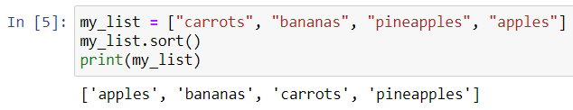
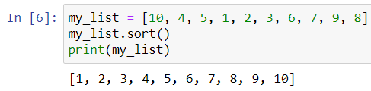
Built-in Python methods
A few useful built-in methods include:
sort
sorts a list in alphanumerical order
E.g.

Slide 11
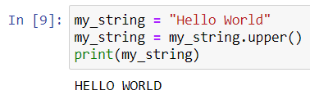
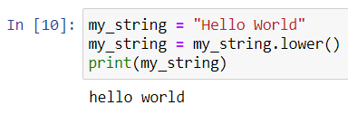
Built-in Python methods (cont.)
upper
Capitalizes a string
E.g.
lower
Lowercases a string
E.g.

Slide 12

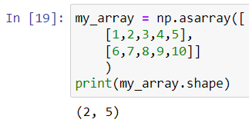
Useful NumPy methods
Numpy has a LOT of useful methods you can use on arrays
These include…
size
Returns the number of elements in your array
shape
Returns the shape of an n-dimensional array (array of arrays)
i.e. the number of rows and columns

Slide 13
What we learned so far…
Basic Operations
Addition
+
Subtraction
-
Multiplication
*
Division
/
Powers
**
Advanced operations (using numpy)
Square root
numpy.sqrt()
Natural exponential
numpy.exp()
Mean of an array
numpy.mean()
Standard deviation of an array
numpy.std()
Variance of an array
numpy.var()
Factorial
numpy.math.factorial()

Slide 14
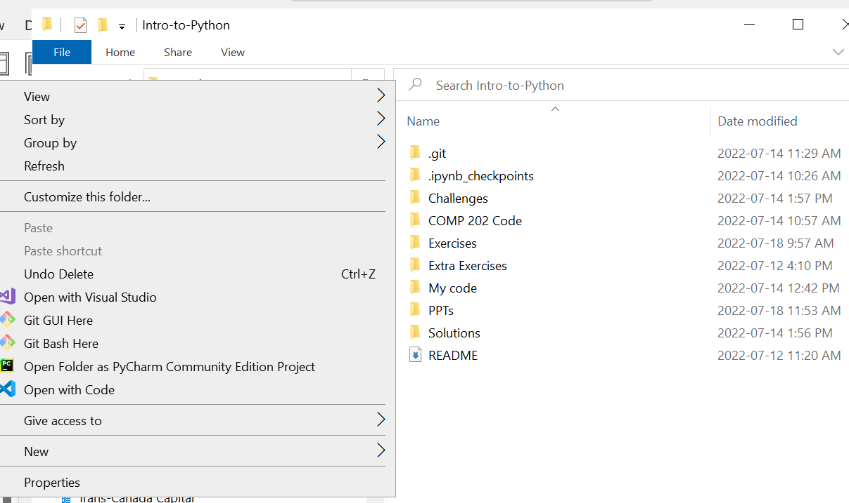
Pulling changes from GitHub
We’ll work on some review exercises!
Let’s pull the latest changes from GitHub by navigating to our Intro-to-Python folder, right-clicking, and selecting “Git Bash Here”
Type in
git pull upstream main

Slide 15
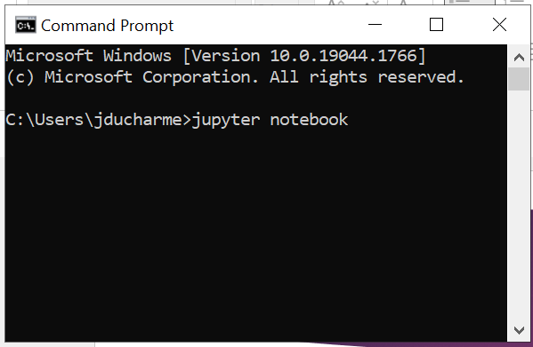
Opening Jupyter Notebook
Open up Jupyter Notebook by opening the Command Prompt and typing either
jupyter notebook
Or
python –m notebook

Slide 16
Review Exercises
Let’s work through all the exercises for Week 5 today!

