Slide 1
RL Cooperative Transportation using fixed-wings drones
RL Project
Part of thesis

Slide 2
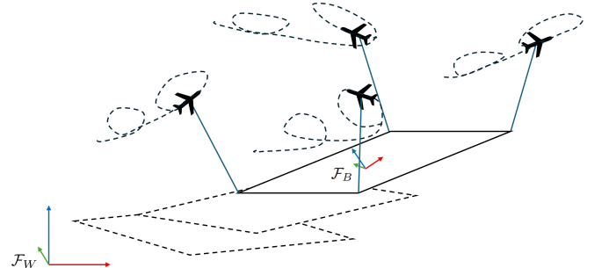
Residual MARL: Problem Definition
Four non-stopping carriers cooperatively carrying a load
Centralized controller already exists
It calculates 𝑓(𝑡) = 𝑓_{𝑔}(𝑡)+ 𝑓_{𝜆}(𝑡) ∈ R¹²
𝑓_{𝑔}(𝑡) forces applied on load
𝑓_{𝜆}(𝑡) internal forces cancelled between the carriers (hence, they need to be coordinated). Their purpose is to keep the carriers moving to prevent stall
Each carrier calculates its reference position and velocity from the assigned force slice 𝑓_{i}(𝑡) using kinematic equations

Slide 3
Residual MARL: Problem Definition
Our goal is to make this system decentralized
The centralized controller uses global information on all the carriers
Global carrier information is reconstructed using load state and the total applied force 𝑓(𝑡)
We can deploy the same controller on each carrier separately, each carrier can calculate the full force 𝑓(𝑡) and apply its part 𝑓_{i}(𝑡).
However, once we have disagreements on the load state and the applied force (due to noise and delays/desynchronization), the reconstructed global information becomes completely corrupted and unreliable.

Slide 4
Residual MARL: Proposed Solution
Train a residual policy that corrects the controller action
The goal is to find a policy that can still maintain reasonable load tracking and coordinated carrier trajectories despite:
Noisy and asynchronous load state measurements
Unreliable estimates of global information

Slide 5
Residual MARL
Action Space: δ𝑓 ∈ R¹²
Keep wrench controller and optimizer. Run decentralized
𝑓 (𝑡) = 𝑓_{𝑔}(𝑡)+ 𝑓_{𝜆}(𝑡) + δ𝑓(t)
Better learning when decomposed
𝑓 (𝑡) = G(t)† · (w_{d}(t) + δw(t)) + N(t) · (λ(t) + δλ(t))
δw ∈ R⁶ , δλ ∈ R⁴
where G(t) is the Grasp matrix, † denotes its pseudo-inverse.
N(t) is in the Null space of G(t) and λ(t) is a function that is designed to shape the internal forces that redistribute cable tensions without affecting the load wrench.
All these variables are part of the centralized controller that we don’t touch

Slide 6
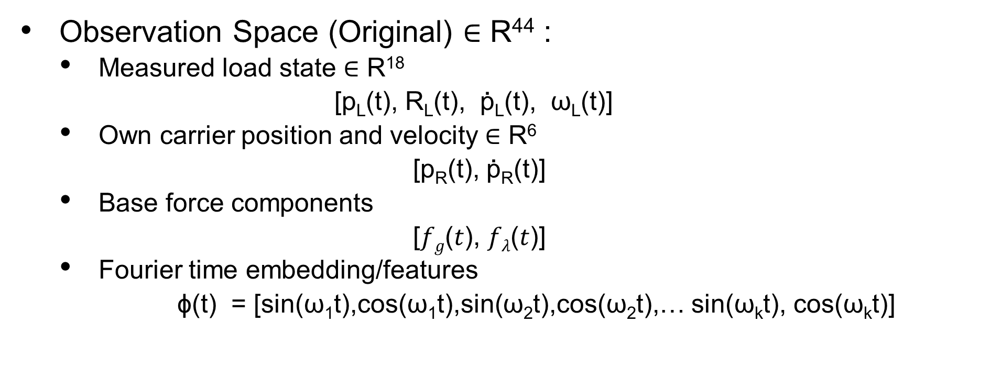
Residual MARL
Observation Space (Original) ∈ R⁴⁴ :
Measured load state ∈ R¹⁸
[p_{L}(t), R_{L}(t), $\text{p}\text{̇}$_{L}(t), ω_{L}(t)]
Own carrier position and velocity ∈ R⁶
[p_{R}(t), $\text{p}\text{̇}\text{R}$(t)]
Base force components
[𝑓_{𝑔}(𝑡), 𝑓_{𝜆}(𝑡)]
Fourier time embedding/features
ϕ(t) = [sin(ω₁​t),cos(ω₁​t),sin(ω₂​t),cos(ω_{2​}t),… sin(ω_{k}t), cos(ω_{k}t)]

Slide 7
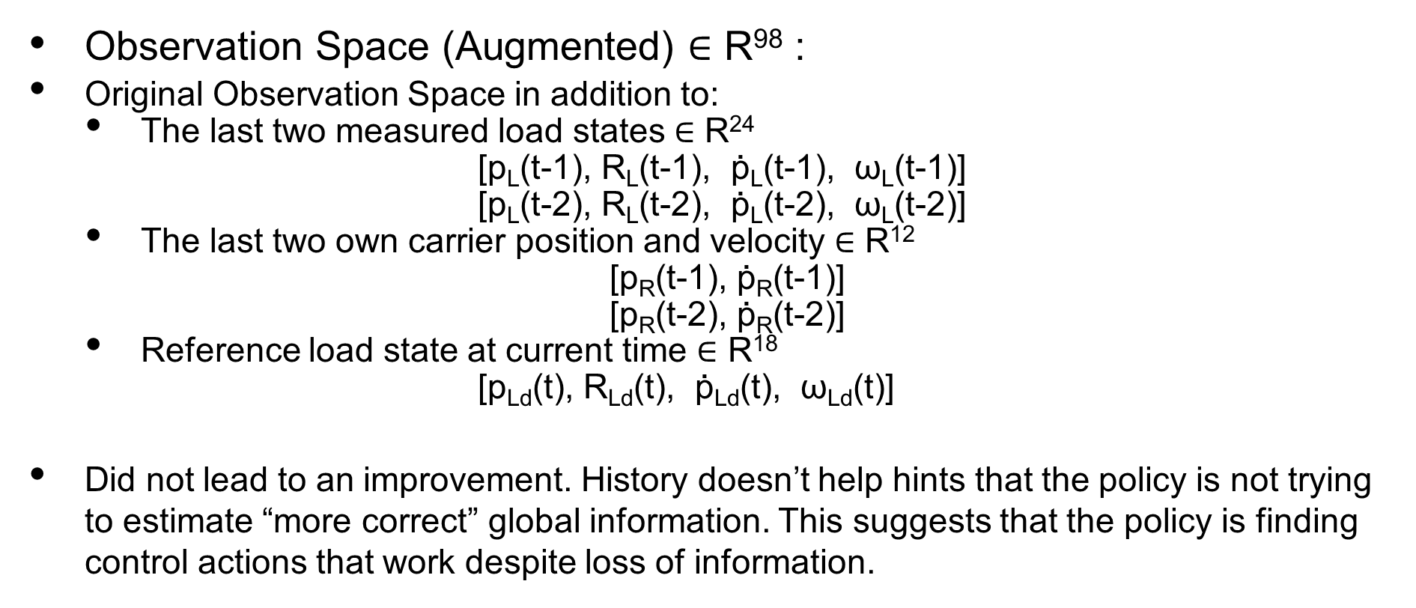
Residual MARL
Observation Space (Augmented) ∈ R⁹⁸ :
Original Observation Space in addition to:
The last two measured load states ∈ R²⁴
[p_{L}(t-1), R_{L}(t-1), $\text{p}\text{̇}$_{L}(t-1), ω_{L}(t-1)]
[p_{L}(t-2), R_{L}(t-2), $\text{p}\text{̇}$_{L}(t-2), ω_{L}(t-2)]
The last two own carrier position and velocity ∈ R¹²
[p_{R}(t-1), $\text{p}\text{̇}\text{R}$(t-1)]
[p_{R}(t-2), $\text{p}\text{̇}\text{R}$(t-2)]
Reference load state at current time ∈ R¹⁸
[p_{Ld}(t), R_{Ld}(t), $\text{p}\text{̇}$_{Ld}(t), ω_{Ld}(t)]
Did not lead to an improvement. History doesn’t help hints that the policy is not trying to estimate “more correct” global information. This suggests that the policy is finding control actions that work despite loss of information.

Slide 8
Residual MARL: Implementation Details
Multi-Agent Proximal Policy Optimization (MAPPO)
Implemented MARL environment using PettingZoo
Centralized Training Decentralized Execution (CTDE)
Shared/Centralized critic with access to global state with a Parameter-Shared decentralized Actor
Wrapped FMU generated by Simulink of the system model inside Gymnasium environment

Slide 9
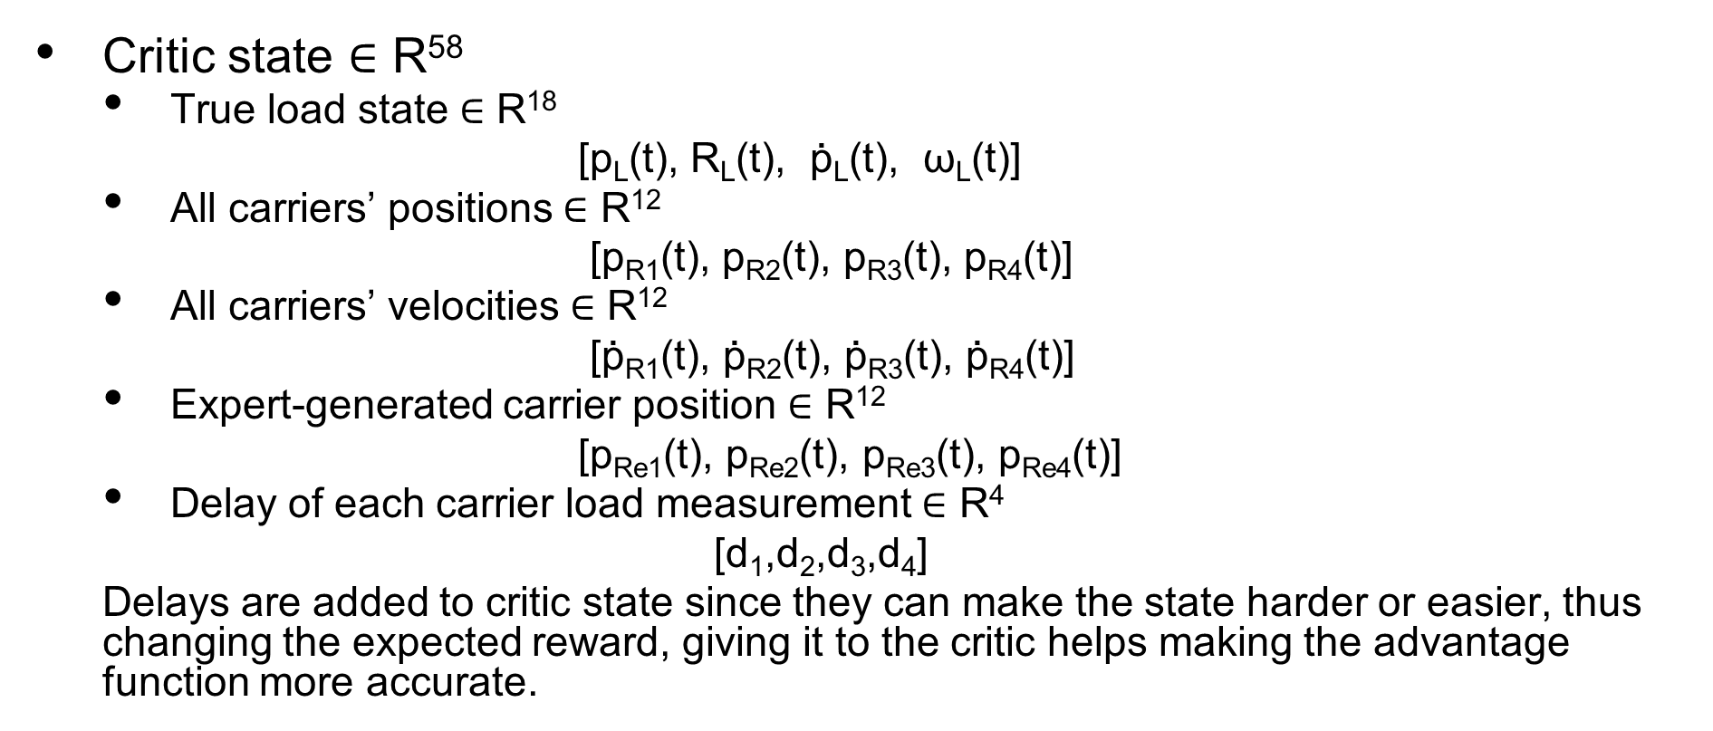
Residual MARL
Critic state ∈ R⁵⁸
True load state ∈ R¹⁸
[p_{L}(t), R_{L}(t), $\text{p}\text{̇}$_{L}(t), ω_{L}(t)]
All carriers’ positions ∈ R¹²
[p_{R1}(t), p_{R2}(t), p_{R3}(t), p_{R4}(t)]
All carriers’ velocities ∈ R¹²
[$\text{p}\text{̇}\text{R}\text{1}$(t), $\text{p}\text{̇}\text{R}\text{2}$(t), $\text{p}\text{̇}\text{R}\text{3}$(t), $\text{p}\text{̇}\text{R}\text{4}$(t)]
Expert-generated carrier position ∈ R¹²
[p_{Re1}(t), p_{Re2}(t), p_{Re3}(t), p_{Re4}(t)]
Delay of each carrier load measurement ∈ R⁴
[d₁,d₂,d₃,d₄]
Delays are added to critic state since they can make the state harder or easier, thus changing the expected reward, giving it to the critic helps making the advantage function more accurate.
Notes:
Preferire un carattere sans serif come Arial, Helvetica o Verdana. Font consigliabile da 30 a 40 pt.
Allineare i testi a sinistra, non giustificarli.
Utilizzare non più di tre blocchi di informazione di massimo 2/3 righe ciascuno.
Per evidenziare titoli o parole chiave, prediligere l’uso del grassetto a corsivo o colori.
Prediligere testo nero su sfondo bianco.
Evitare ombre, sfumature e gradazioni di grigio.
Secondo le linee guida sull’accessibilità, prestare attenzione ai contrasti tra i colori di sfondo e il testo.

Slide 10
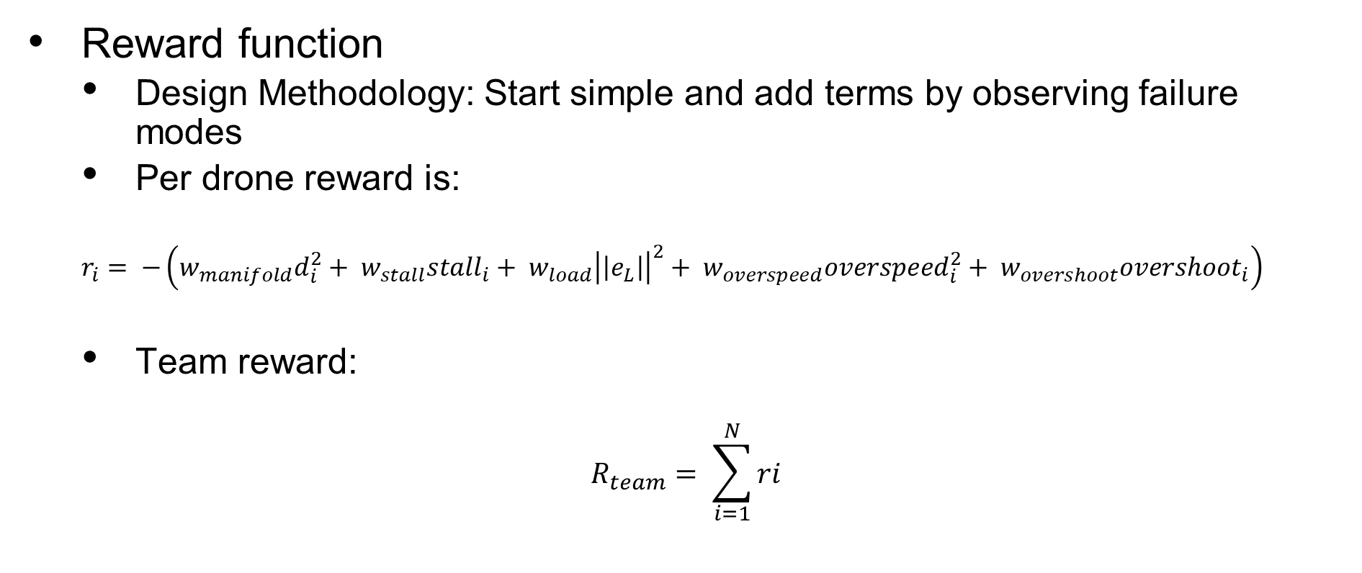
Residual MARL
Reward function
Design Methodology: Start simple and add terms by observing failure modes
Per drone reward is:
$$r_{i}= −\left(w_{manifold}d_{i}^{2}+ w_{stall}stall_{i}+ w_{load}{\left|\left|e_{L}\right|\right|}^{2}+ w_{overspeed}overspeed_{i}^{2}+ w_{overshoot}overshoot_{i}\right)$$
Team reward:
$$R_{team}= \sum_{i=1}^{N}{ri}$$
Notes:
Preferire un carattere sans serif come Arial, Helvetica o Verdana. Font consigliabile da 30 a 40 pt.
Allineare i testi a sinistra, non giustificarli.
Utilizzare non più di tre blocchi di informazione di massimo 2/3 righe ciascuno.
Per evidenziare titoli o parole chiave, prediligere l’uso del grassetto a corsivo o colori.
Prediligere testo nero su sfondo bianco.
Evitare ombre, sfumature e gradazioni di grigio.
Secondo le linee guida sull’accessibilità, prestare attenzione ai contrasti tra i colori di sfondo e il testo.

Slide 11

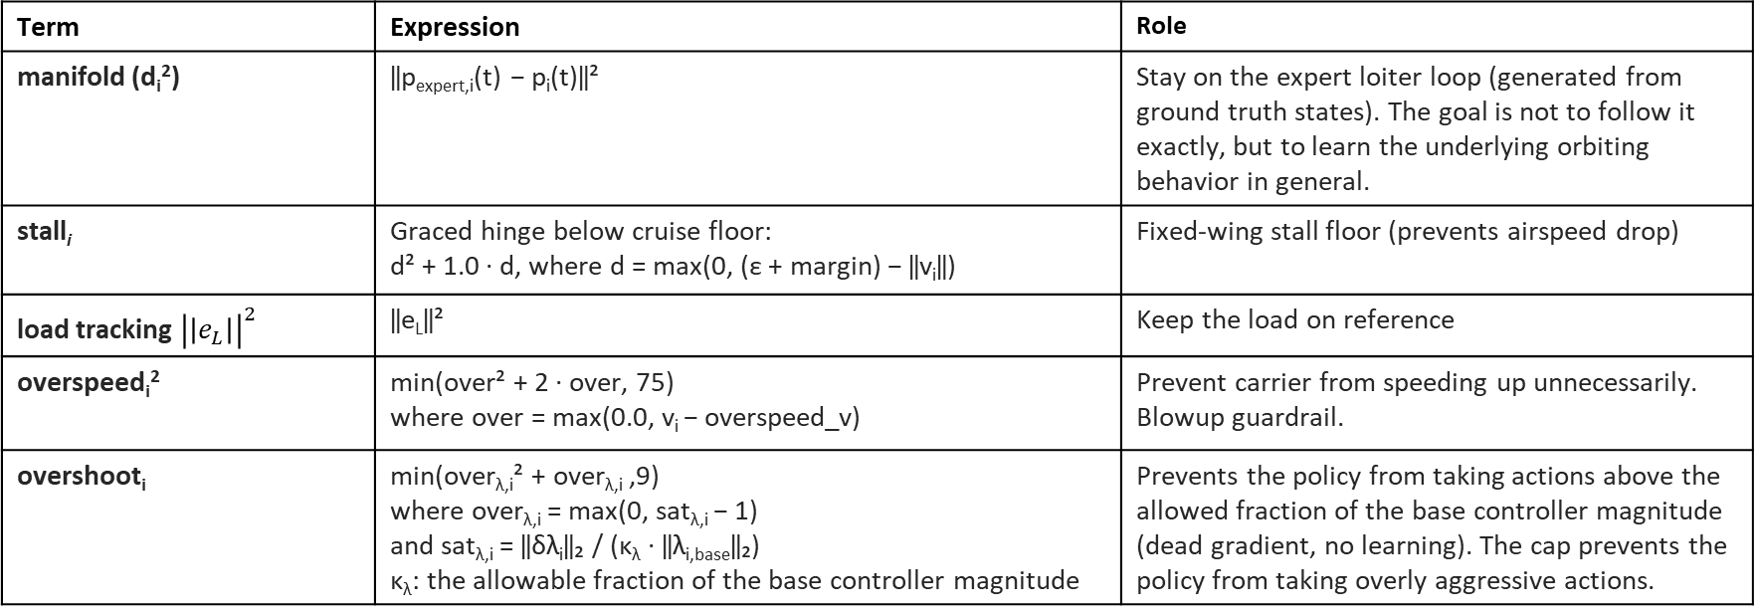
Residual MARL
Reward function terms breakdown:
$$r_{i}= −\left(w_{manifold}d_{i}^{2}+ w_{stall}stall_{i}+ w_{load}{\left|\left|e_{L}\right|\right|}^{2}+ w_{overspeed}overspeed_{i}^{2}+ w_{overshoot}overshoot_{i}\right)$$
Truncation Condition: A one-shot penalty of −100 is triggered on a guard-truncated step if speed exceeds v_{blowup} = 100.
Term | Expression | Role
manifold (d_{i}²) | ‖p_{expert,i}(t) − p_{i}(t)‖² | Stay on the expert loiter loop (generated from ground truth states). The goal is not to follow it exactly, but to learn the underlying orbiting behavior in general.
stall_{i} | Graced hinge below cruise floor: d² + 1.0 · d, where d = max(0, (ε + margin) − ‖v_{i}‖) | Fixed-wing stall floor (prevents airspeed drop)
load tracking ${\left|\left|e_{L}\right|\right|}^{2}$ | ‖e_{L}‖² | Keep the load on reference
overspeed_{i}² | min(over² + 2 · over, 75) where over = max(0.0, v_{i} − overspeed_v) | Prevent carrier from speeding up unnecessarily. Blowup guardrail.
overshoot_{i} | min(over_{λ,i}² + over_{λ,i} ,9) where over_{λ,i} = max(0, sat_{λ,i} − 1) and sat_{λ,i} = ‖δλ_{i}‖₂ / (κ_{λ} · ‖λ_{i,base}‖₂) κ_{λ}: the allowable fraction of the base controller magnitude | Prevents the policy from taking actions above the allowed fraction of the base controller magnitude (dead gradient, no learning). The cap prevents the policy from taking overly aggressive actions.
Notes:
Preferire un carattere sans serif come Arial, Helvetica o Verdana. Font consigliabile da 30 a 40 pt.
Allineare i testi a sinistra, non giustificarli.
Utilizzare non più di tre blocchi di informazione di massimo 2/3 righe ciascuno.
Per evidenziare titoli o parole chiave, prediligere l’uso del grassetto a corsivo o colori.
Prediligere testo nero su sfondo bianco.
Evitare ombre, sfumature e gradazioni di grigio.
Secondo le linee guida sull’accessibilità, prestare attenzione ai contrasti tra i colori di sfondo e il testo.

Slide 12
Training Loop + Environment Step
① Collect experience (multiple episodes)
② Update Policy
Actor πθ
decentralized
observation → [dλ4, dw6]
sample action
Per carrier observation
Action
Environment Step
per-drone internals
(expanded below)
Rollout buffer
observation, action, logp of action, critic state, value, reward
Critic Vφ
privileged state (58)
→ value V
Critic state
GAE
per-drone advantages
+ returns (returns averaged across drones for critic target)
PPO update
8 epochs
r = 0.2
Go to next Iteration
Environment step
Base controller
→ λ_base, w_d
Add residual/policy action + clip
‖dλ‖ ≤ cap_lam·‖λ_base‖
‖dw‖ ≤ cap_w·‖w_d‖
Assemble force per carrier
f = f_base
+ G⁺·dw
+ N·dλ
FMU plant step
desync:
sensor noise
+ delay
Reward
manifold + stall + load
+ overspeed
+ λ-overshoot
Next per-drone observations
load estimate + own carrier state
+ base forces + Fourier time embeddings
+ history + reference
Do these three steps one time per each carrier then apply full force vector to the plant
Notes:
Preferire un carattere sans serif come Arial, Helvetica o Verdana. Font consigliabile da 30 a 40 pt.
Allineare i testi a sinistra, non giustificarli.
Utilizzare non più di tre blocchi di informazione di massimo 2/3 righe ciascuno.
Per evidenziare titoli o parole chiave, prediligere l’uso del grassetto a corsivo o colori.
Prediligere testo nero su sfondo bianco.
Evitare ombre, sfumature e gradazioni di grigio.
Secondo le linee guida sull’accessibilità, prestare attenzione ai contrasti tra i colori di sfondo e il testo.

Slide 13
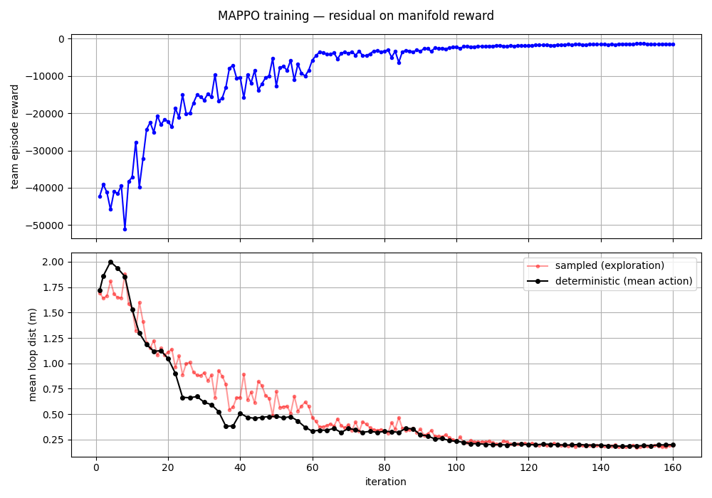
Sample Results
Mean loop distance refers to the average distance between the carrier position and the expert noise free position (Term 1 in the reward).
It is the most affected/degraded metric and is usually a good indicator on the overall health of the system
Notes:
Preferire un carattere sans serif come Arial, Helvetica o Verdana. Font consigliabile da 30 a 40 pt.
Allineare i testi a sinistra, non giustificarli.
Utilizzare non più di tre blocchi di informazione di massimo 2/3 righe ciascuno.
Per evidenziare titoli o parole chiave, prediligere l’uso del grassetto a corsivo o colori.
Prediligere testo nero su sfondo bianco.
Evitare ombre, sfumature e gradazioni di grigio.
Secondo le linee guida sull’accessibilità, prestare attenzione ai contrasti tra i colori di sfondo e il testo.

Slide 14
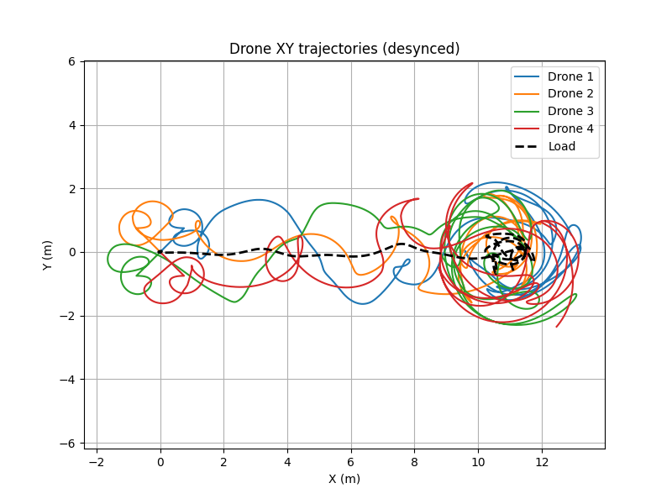
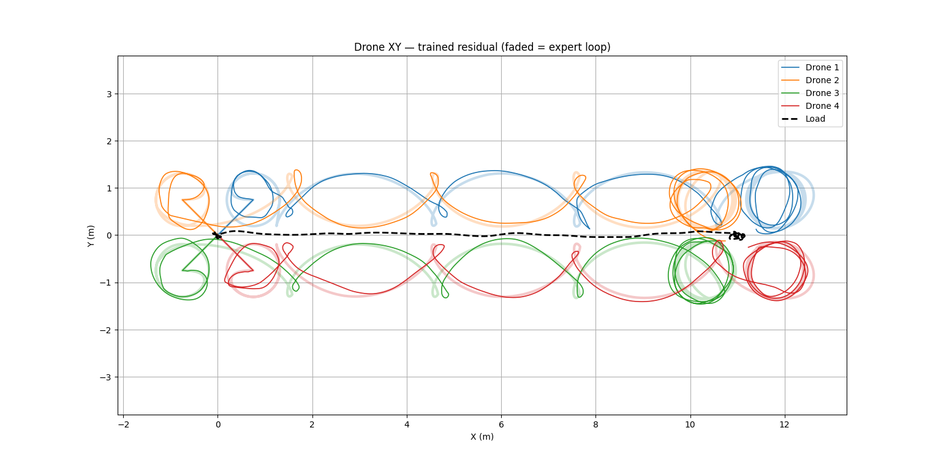
Sample Results: Trajectory 1: From training data
With learned policy residual(left) vs. Base (no residual, right)
Notes:
Preferire un carattere sans serif come Arial, Helvetica o Verdana. Font consigliabile da 30 a 40 pt.
Allineare i testi a sinistra, non giustificarli.
Utilizzare non più di tre blocchi di informazione di massimo 2/3 righe ciascuno.
Per evidenziare titoli o parole chiave, prediligere l’uso del grassetto a corsivo o colori.
Prediligere testo nero su sfondo bianco.
Evitare ombre, sfumature e gradazioni di grigio.
Secondo le linee guida sull’accessibilità, prestare attenzione ai contrasti tra i colori di sfondo e il testo.

Slide 15
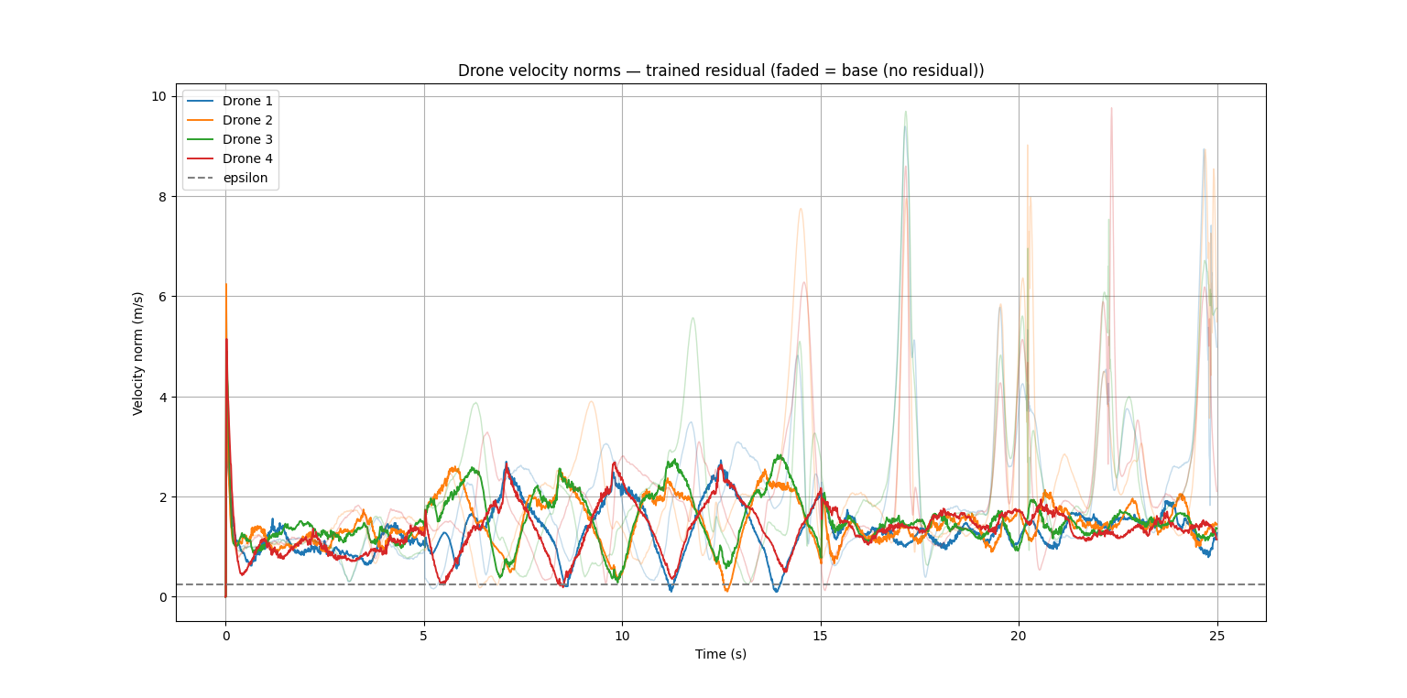

Slide 16
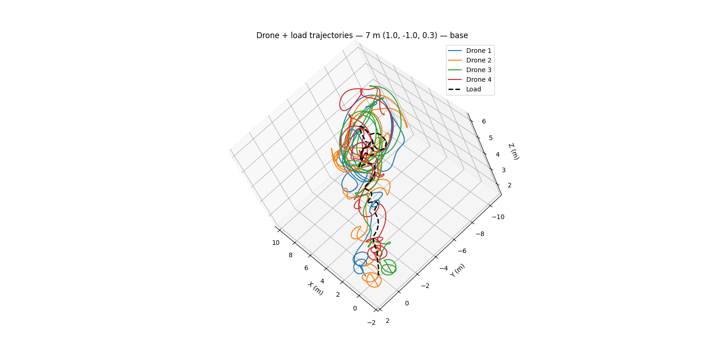
Trajectory 2: Unseen during training
Magnitude: 7 meters
Episode length: 27s
Direction:
[1.0, -1.0,0.3]

Slide 17
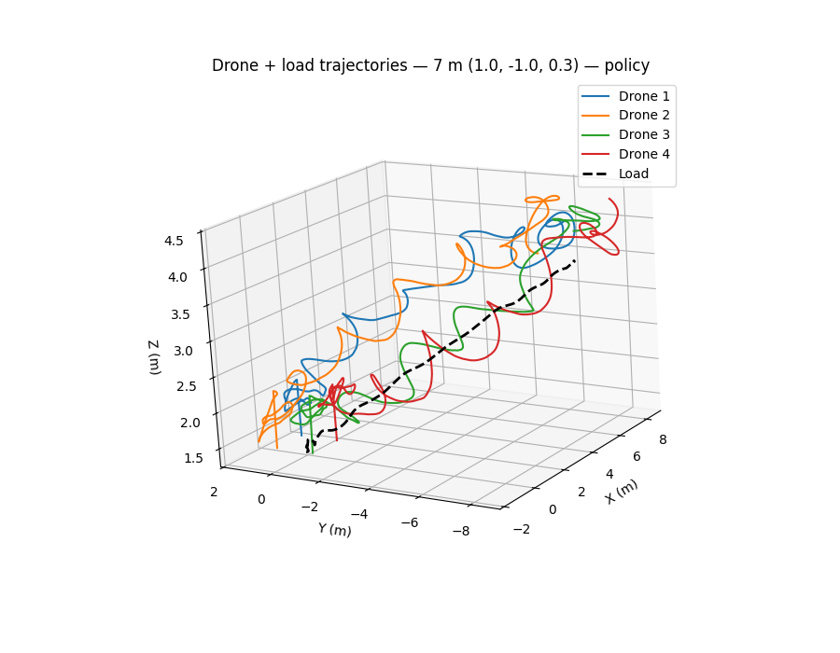

Slide 18
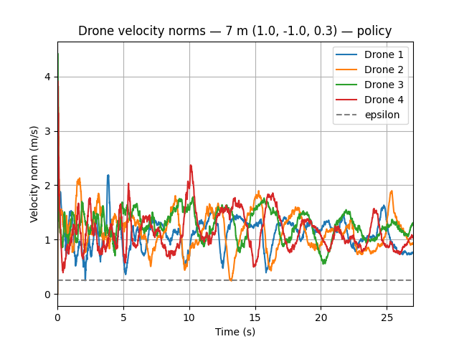
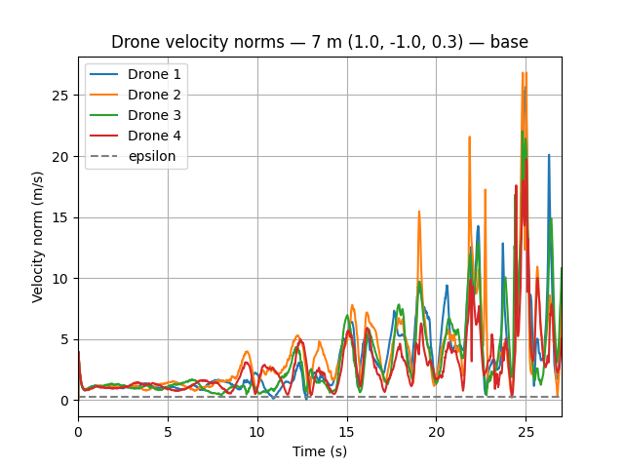

Slide 19
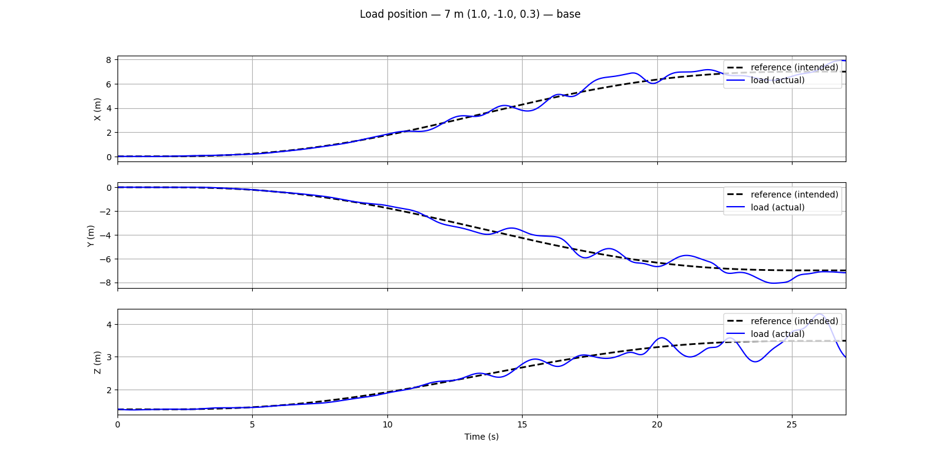

Slide 20
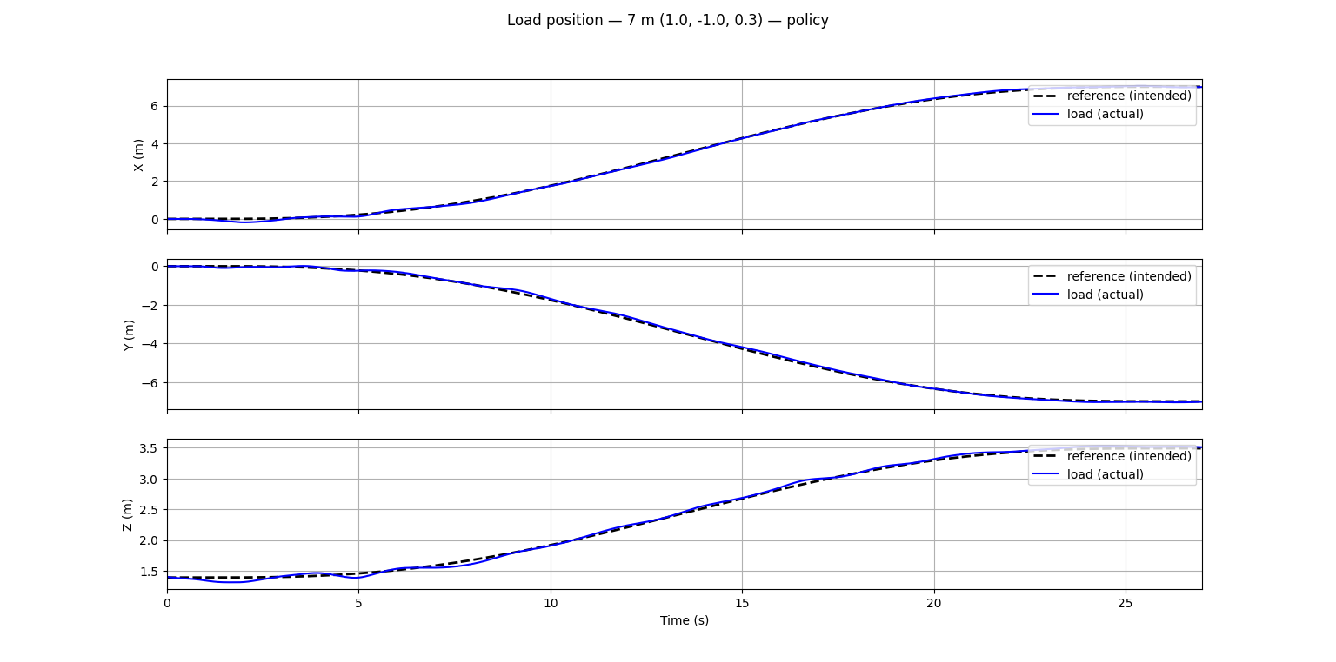

Slide 21
Load and Expert* Tracking Performance: Trajectory 2
Metric | Policy | Base (No residual)
Expert loop MSE (m²) | ~0.1740 | ~3.0715
Load Track MSE (m²) | ~0.0083 | ~0.3058
*Expert tracking is not supposed to reach an MSE of zero, but it is just used as qualitative proxy for smooth orbiting behavior

Slide 22
Residual MARL: Status and Challenges remaining
The policy is showing acceptable generalization results across:
Different episode lengths
Different movement magnitudes
Generally better than the base controller alone
The policy is struggling to generalize well across various movement directions
Some directions exhibit significantly worse performance than others, even though they are all represented roughly equally in the training data.

Slide 23
Residual MARL: Status and Challenges remaining
Training the policy specifically on these directions yields improvements, but at the cost of the other directions.
Training on a wide combination of trajectories makes the reward extremely high variance making learning practically impossible.
I was able to distill a combination of two policies using Behavioral Cloning in one net of the same size. Therefore, the issue is likely that MAPPO is not able to find a good generalizing strategy, but it does exist (at least something better that what it finds currently exists).

Slide 24
Residual MARL: Code
Github
MAPPO
MARL Environment
Trajectory test

