Slide 1
EDA Report: Super Store Sales Analysis
Exploratory Data Analysis Presentation

Slide 2
Executive Summary
Analyzed sales trends, product performance, and profitability across multiple dimensions.
Identified seasonal patterns, regional performance, and discount impact on profits.
Provided actionable insights for improving sales and profitability.

Slide 3
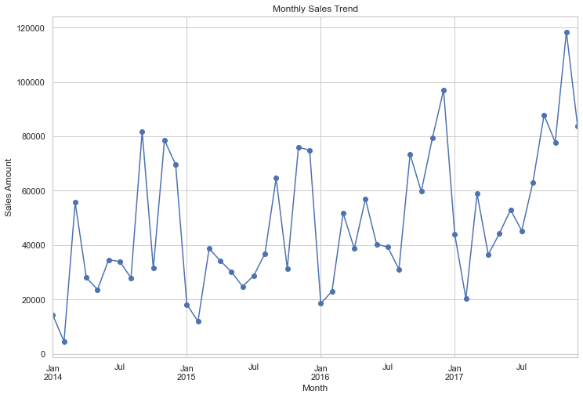
Seasonal Sales Trends
Monthly and quarterly sales trends reveal seasonal peaks during Q4 and dips in Q1.

Slide 4
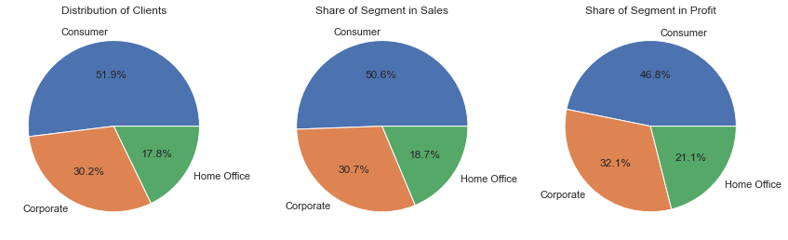
Customer segmentation
The Consumer segment forms the largest customer base but generates a lower profit margin compared to Corporate and Home Office segments.

Slide 5
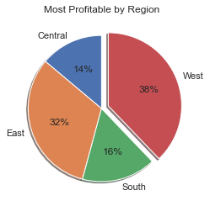
Regional Performance
West and East regions contribute the most to profitability.

Slide 6
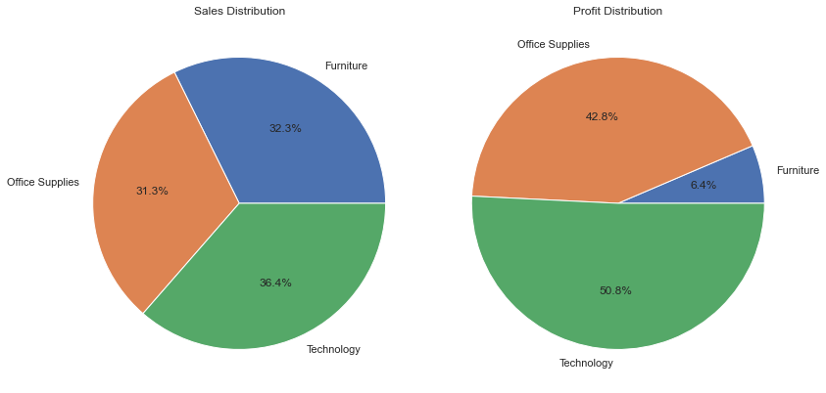
Category Performance
Technology is the most profitable category; Furniture struggles with low margins.

Slide 7
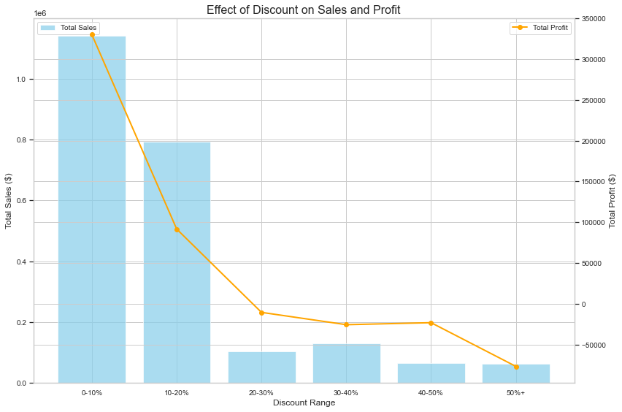
Impact of Discounts on Profitability
Discounts have a direct negative impact on profit margins. High discount rates (beyond 20%) erode profitability significantly.

Slide 8
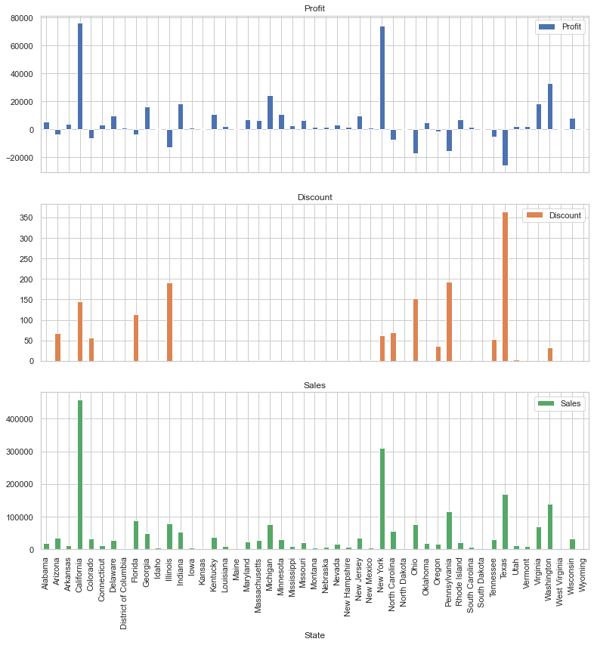
Impact of Discounts on Profitability
States like Texas and Pennsylvania face losses due to excessive discounts.

Slide 9
Recommendations
Focus on promoting high-margin products like Technology.
Reduce discounts in loss-making regions.
Leverage seasonal peaks with targeted marketing campaigns.
Address Furniture category profitability through strategic pricing or sourcing.

Slide 10
Next Steps
Conduct deeper analysis into customer demographics.
Optimize inventory management based on sales patterns.
Develop tailored marketing campaigns for high-value customer segments.

