Slide 1
Vertical Cross Sections for the Weather Briefing
Phenomena, scales, parameters and examples
Meeting on 28 May 2020

Slide 2
Phenomena to be seen in such cross sections
Frontal structure and large scale PV anomalies
dynamical tropopause, potential temperature, equivalent pot. temp., wind (how?), vorticity, relative humidity, suspended & precipitating, (freezing level) -> needs >= 2 figures
Cloud structure (stratiform or convective; “cold” or “warm”; hydrometeors)
suspended & precipitating
all 4 categories, not all in one plot (precipitating shaded (transparent?))
theta-e
Stratification and instability (potential, conditional, absolute)
theta-e (contours), region of conditional instability (theta_es <0; line or shaded), (N_m)^2 < 0 (Kirshbaum 2004 eq (6) but with all hydrometeors)
total cloud water (suspended & precipitating)
wind vector (u/w) in cross section plane, possibly color-coded with diverging color scale for perpendicular component, possibly with outline (e.g. white) to distinguish it from shaded background

Slide 3
(ctd processes/phenomena)
Orographic lifting and precipitation
theta-e, wind vectors (see instabilities), hydrometeors (precipitating, suspended)
Gravity waves (hydrostatic and non-hydrostatic)
theta (in second plot), theta-e, vertical velocity (shaded, diverging), hydrometeors (total, transparent grey shading or contour lines)
Downslope windstorms, gap flows
as gravity waves plus wind speed (total)
Mesoscale PV anomalies
new horizontal plots? (@700 hPa, 850 hPa)
try vertical ones
Boundary-layer and deep convection
deep convection: CAPE from each level
convergence (new horizontal plot?)
(reminder: for horizontal charts: add deformation to theta(-e))

Slide 4
Scales to be captured by such cross sections
Synoptic scale: Lx ~ 1000 - 5000 km, Lz ~ 15 km → ECMWF
Alpine scale: Lx ~ 500 km, Lz ~ 10 km → ECMWF & COSMO
Valley scale: Lx ~ 50 - 100 km, Lz ~ 5 km → COSMO

Slide 5
Parameters to be shown in such cross sections
Wind field parallel and perpendicular to cross section
Vertical velocity
Potential, equivalent potential and saturation equivalent potential temperature
Temperature (e.g. freezing level)
Moisture (rel. hum., vapor mixing ratio)
Hydrometeor mixing ratio (e.g., solid/liquid, suspended/precipitating)
Cloud fraction (?)
moist/dry buoyancy frequency
Potential vorticity, relative/absolute vorticity
CIN and CAPE
Horizontal convergence

Slide 6
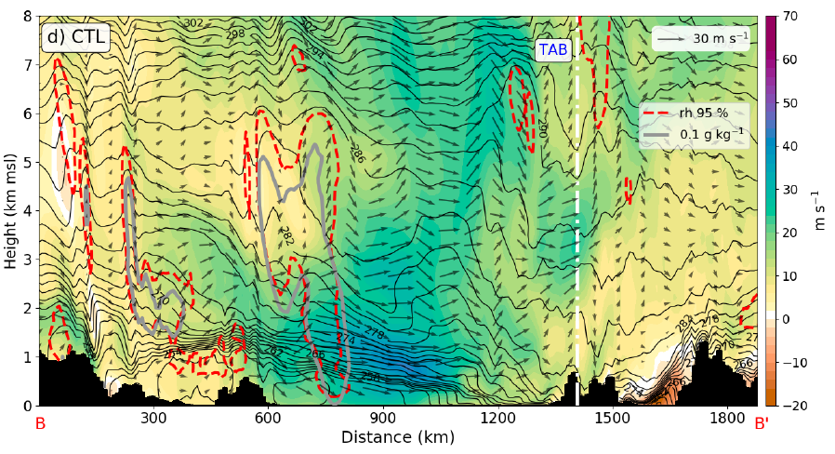
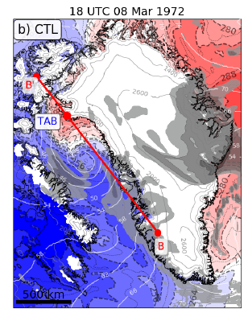
Cold front structure
Tollinger (2018): transect-parallel wind speed and wind vectors, equivalent potential temperature (contour lines with 2-K increments), total hydrometeor mixing ratio (grey contour lines for 0.1, 0.2 and 0.5 g kg^-1) and relative humidity

Slide 7
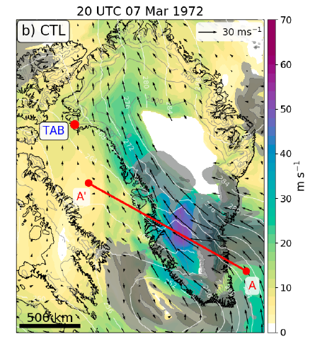
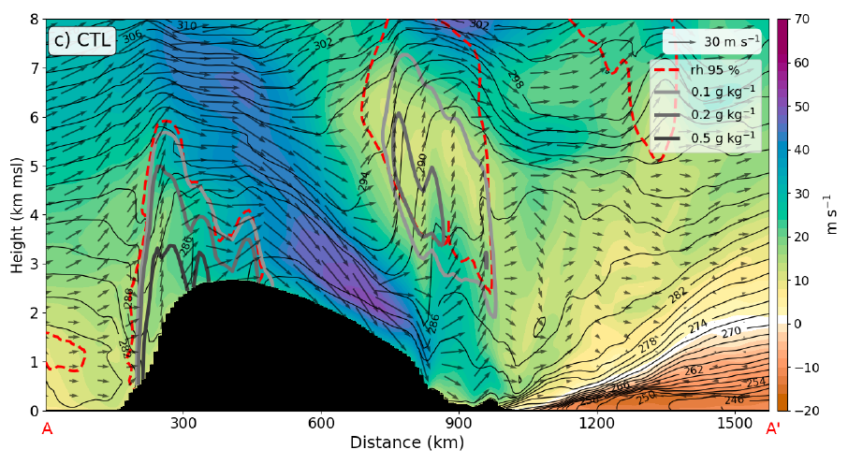
Gravity waves, orographic precipitation and downslope windstorm
Tollinger (2018): transect-parallel wind speed and wind vectors, equivalent potential temperature (contour lines with 2-K increments), total hydrometeor mixing ratio (grey contour lines for 0.1, 0.2 and 0.5 g kg^-1) and relative humidity

Slide 8
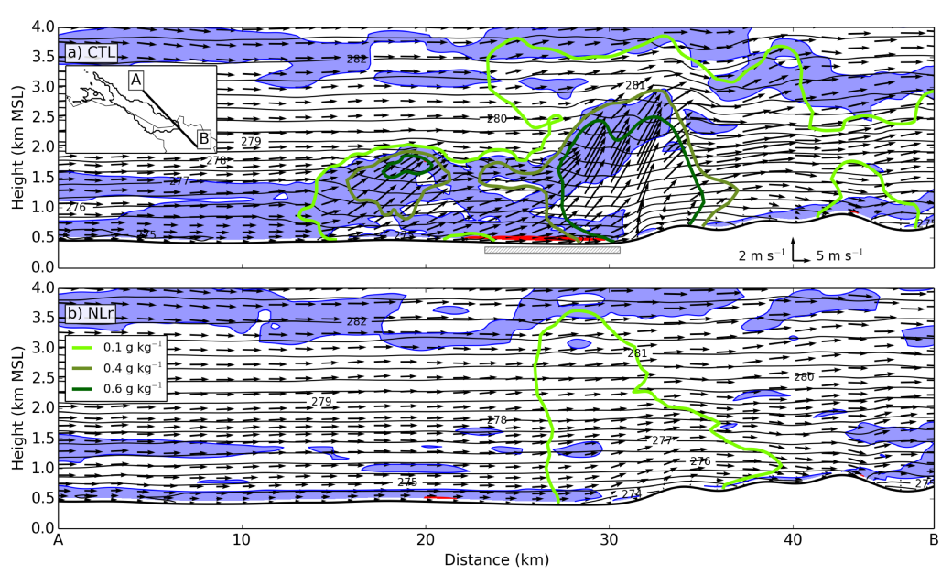
Convection triggered by orographic and lake effects
Umek (2019): Conditional instability (∂θ_es /∂z < 0) as blue shading, absolute instability (∂θ/∂z < 0) as red shading, potential temperature θ as thin black contour lines with 0.5 K increments, total hydrometeor mixing ratio as thick green contour lines for 0.1, 0.4 and 0.6 g kg −1 and wind vectors for the wind component parallel to the transect

Slide 9
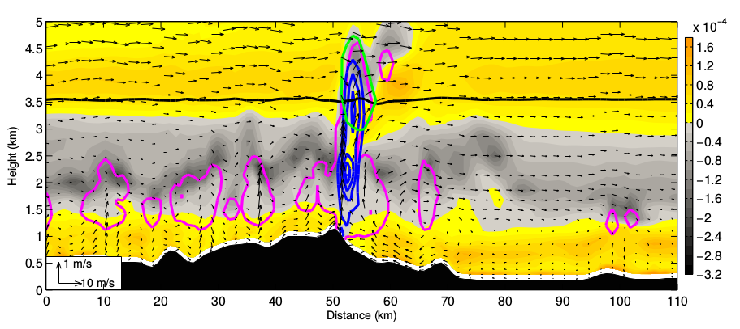
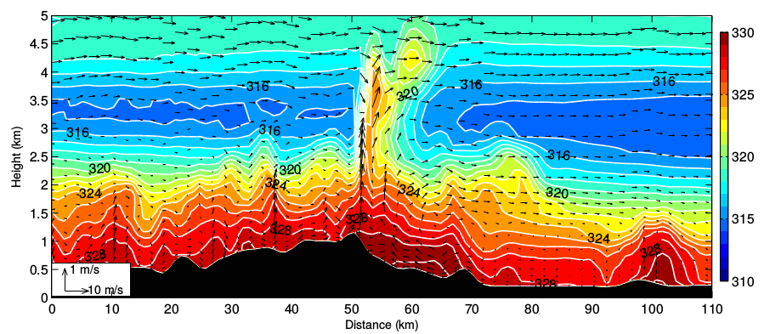
Convection triggered by orographic lifting
Schreiner (2011): (a) Squared moist Brunt-Vaisala frequency, contours of mixing ratio of rain every 0.5 g kg^−1 (blue lines), contours of cloud water (magenta lines), ice (yellow lines), snow (red lines), graupel (green lines) with interval every 0.25 g kg^−1 , zero degree level (black line) and wind vectors along cross section. (b) Equivalent potential temperature (shaded and white contours, interval 1 K) and wind vectors along cross section.
Potentially unstable stratification: dtheta_e/dz <0

Slide 10
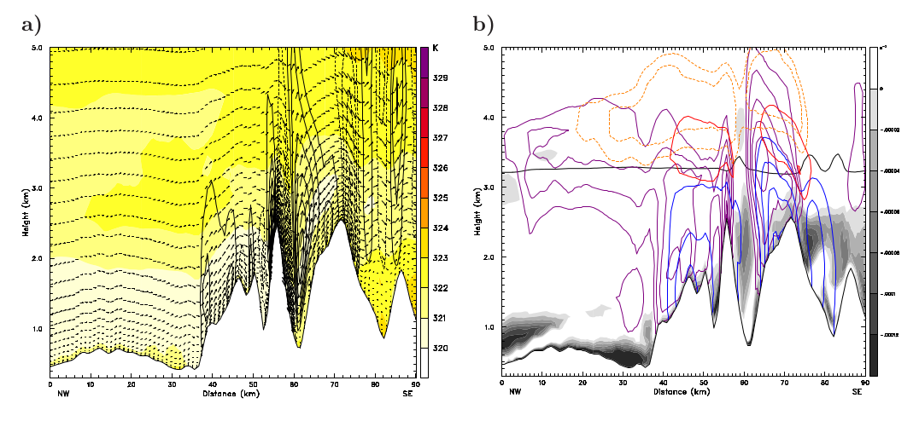
Orographic clouds and precipitation
Langhans (2008): (a) Wind vectors showing the components along the cross-section, equivalent potential temperature (shading increment 1 K, see color key), and vertical wind speed (contour interval 0.75 m s^−1 , negative values dashed, no zero line). (b) Squared moist Brunt-Vaisala frequency (see gray scale key), mixing ratios of rain (solid blue lines), cloud water (solid violet lines), ice (dashed orange lines, contour interval), snow (solid red lines), graupel (dashed green lines), and zero degree level (bold black line).

Slide 11
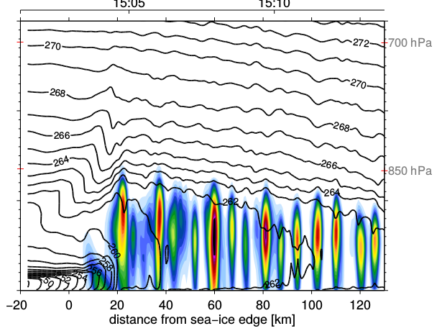
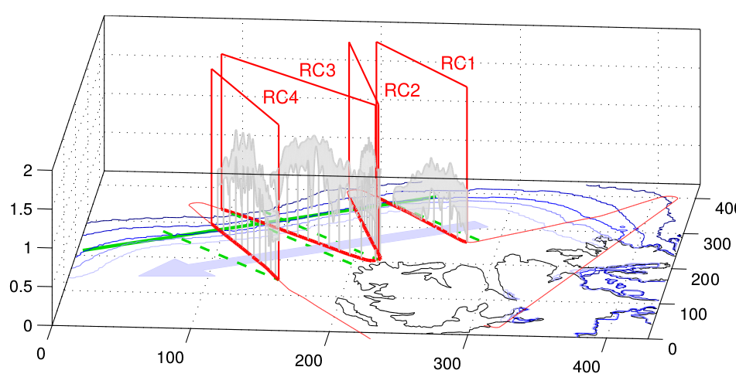
Cumulus convection in the boundary layer
Stuetz (2010): total hydrometeor mixing ratio (g kg^−1 ) in colour contours.
Potential temperature (K) as solid contour lines (1 K increment).

Slide 12
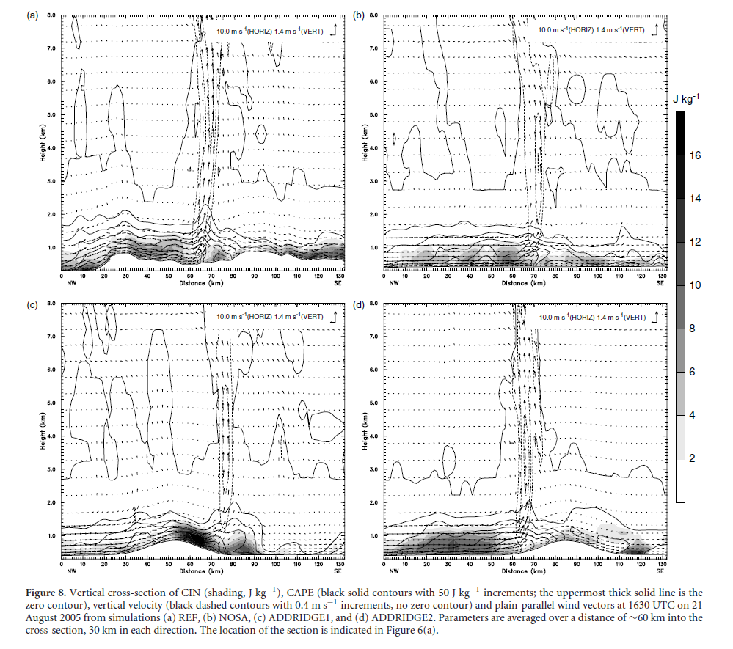
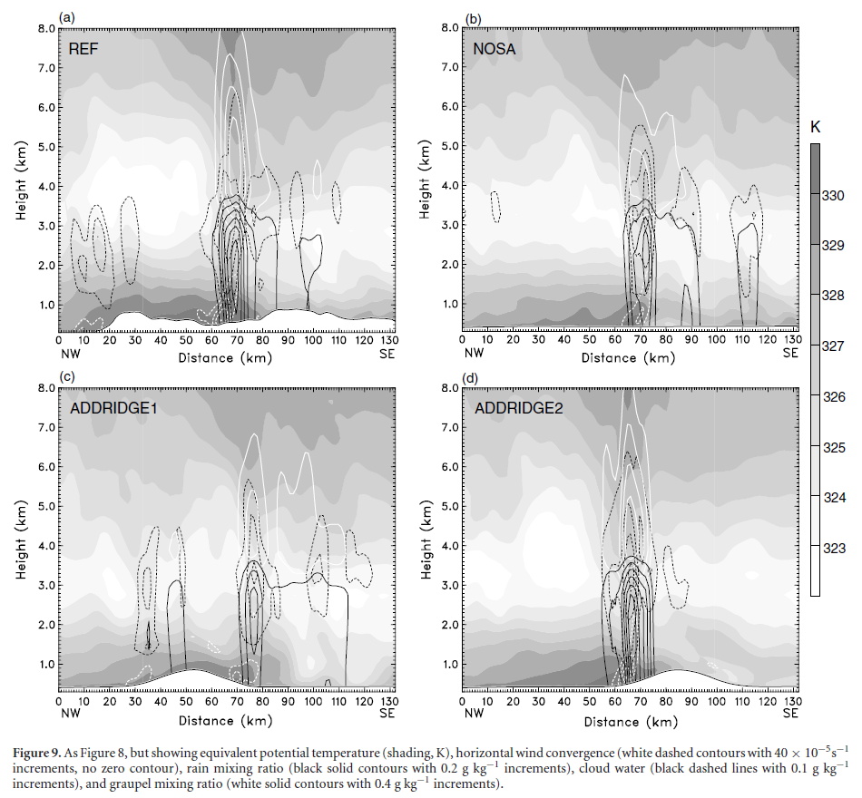
Triggering of convection by low-level convergence
Langhans (2011): Left: CIN, CAPE and vertical velocity. Right: thetae, horizontal convergence, hydrometeors

