Slide 1
Keycloak in SpringBoot
Ameena K A
245255

Slide 2
What is KeyCloak?
Keycloak is an open-source Identity and Access Management (IAM Tool) solution administered by RedHat and developed in Java by JBoss.
The purpose of an IAM tool is to ensure that the right people in a company have appropriate access to resources.
Keycloak supports mainly three types of protocols, which include OpenID Connect, OAuth 2.0(Open Authorization), and SAML 2.0(Security Assertion Markup Language).

Slide 3
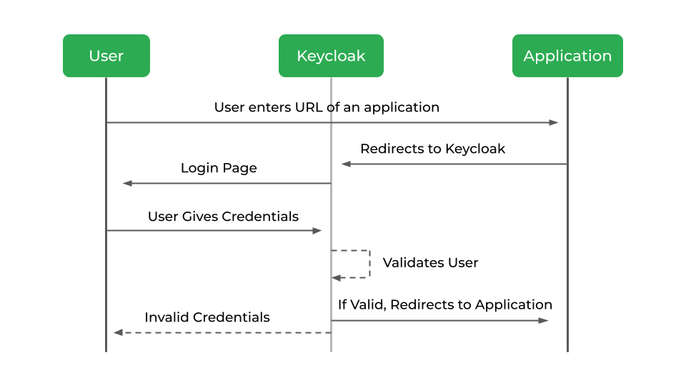
Browser applications redirect a user's browser from the application to the Keycloak authentication server where they enter their credentials.
Keycloak provides a secure way of authenticating users and allows them to access various resources and services with a single set of credentials.
It supports Role-based authorization.
Keycloak comes with its own embedded Java-based relational database called H2

Slide 4
Other Authorization Servers available in the market
AWS Cognito
Microsoft Azure AD
Google Identity Platform
OKTA
Spring Authorization server

Slide 5
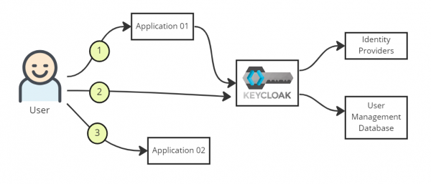
FEATURES OF KEYCLOAK
Single-Sign On
Single sign-on works as follows:
The user visits Application 01's URL and presses the login button.
The Keycloak login page pops up, prompting the user to log in.
The user is redirected to Application 01's landing page when successfully logged in.
Users who visit Application 02's URL within a reasonable amount of time don't have to log in again.

Slide 6
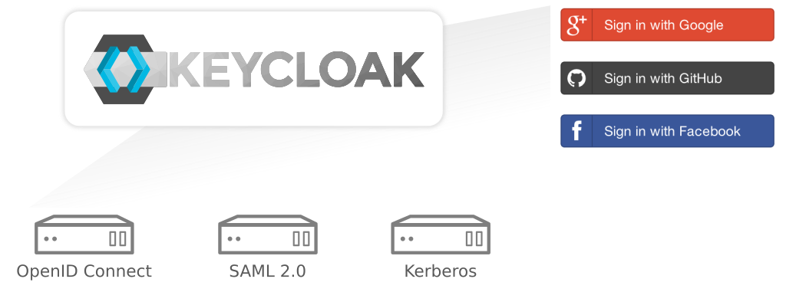
FEATURES OF KEYCLOAK
Identity Brokering and Social Login :
Identity Provider: An application or
system that manages identity
information. Allow you to create &
manage it.
Identity Broker: an intermediatory service that lets you connect with the Identity Providers.
Enabling login with social networks is easy to add through the admin console.
It's just a matter of selecting the
social network you want to add.
No code or changes to your
application is required.

Slide 7

FEATURES OF KEYCLOAK
Standard Protocols :
Keycloak is based on standard protocols and provides support for OpenID Connect, OAuth 2.0, and SAML.

Slide 8
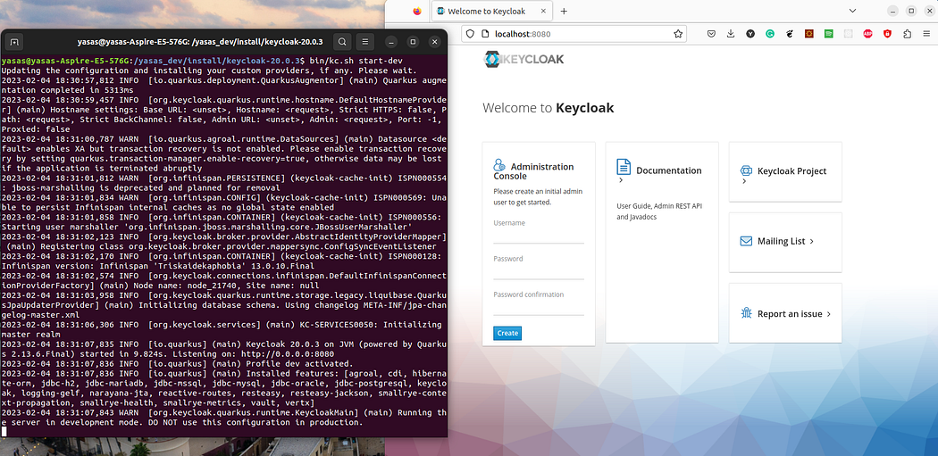
KEYCLOAK CONFIGURATION

Slide 9
Download Keycloak from https://www.keycloak.org/
Run bin/kc.bat start-dev to start the server.
navigate to http://localhost:8080 using the browser
Creating a Realm - It is a management entity that controls a set of users, their credentials, roles, and groups. A user belongs to and logs into a realm.
Creating a client - Clients are applications and services that can request Keycloak to authenticate a user.
Creating Roles
Creating Users
Role Mapping

Slide 10
ADVANTAGES OF KEYCLOAK
It’s an open source solution
It adds authentication to applications and secure services with minimum fuss. No need to deal with storing users or authenticating users.
Easy customisation
JSON web token
OpenID and SAML support
Supports multiple identity provider

Slide 11
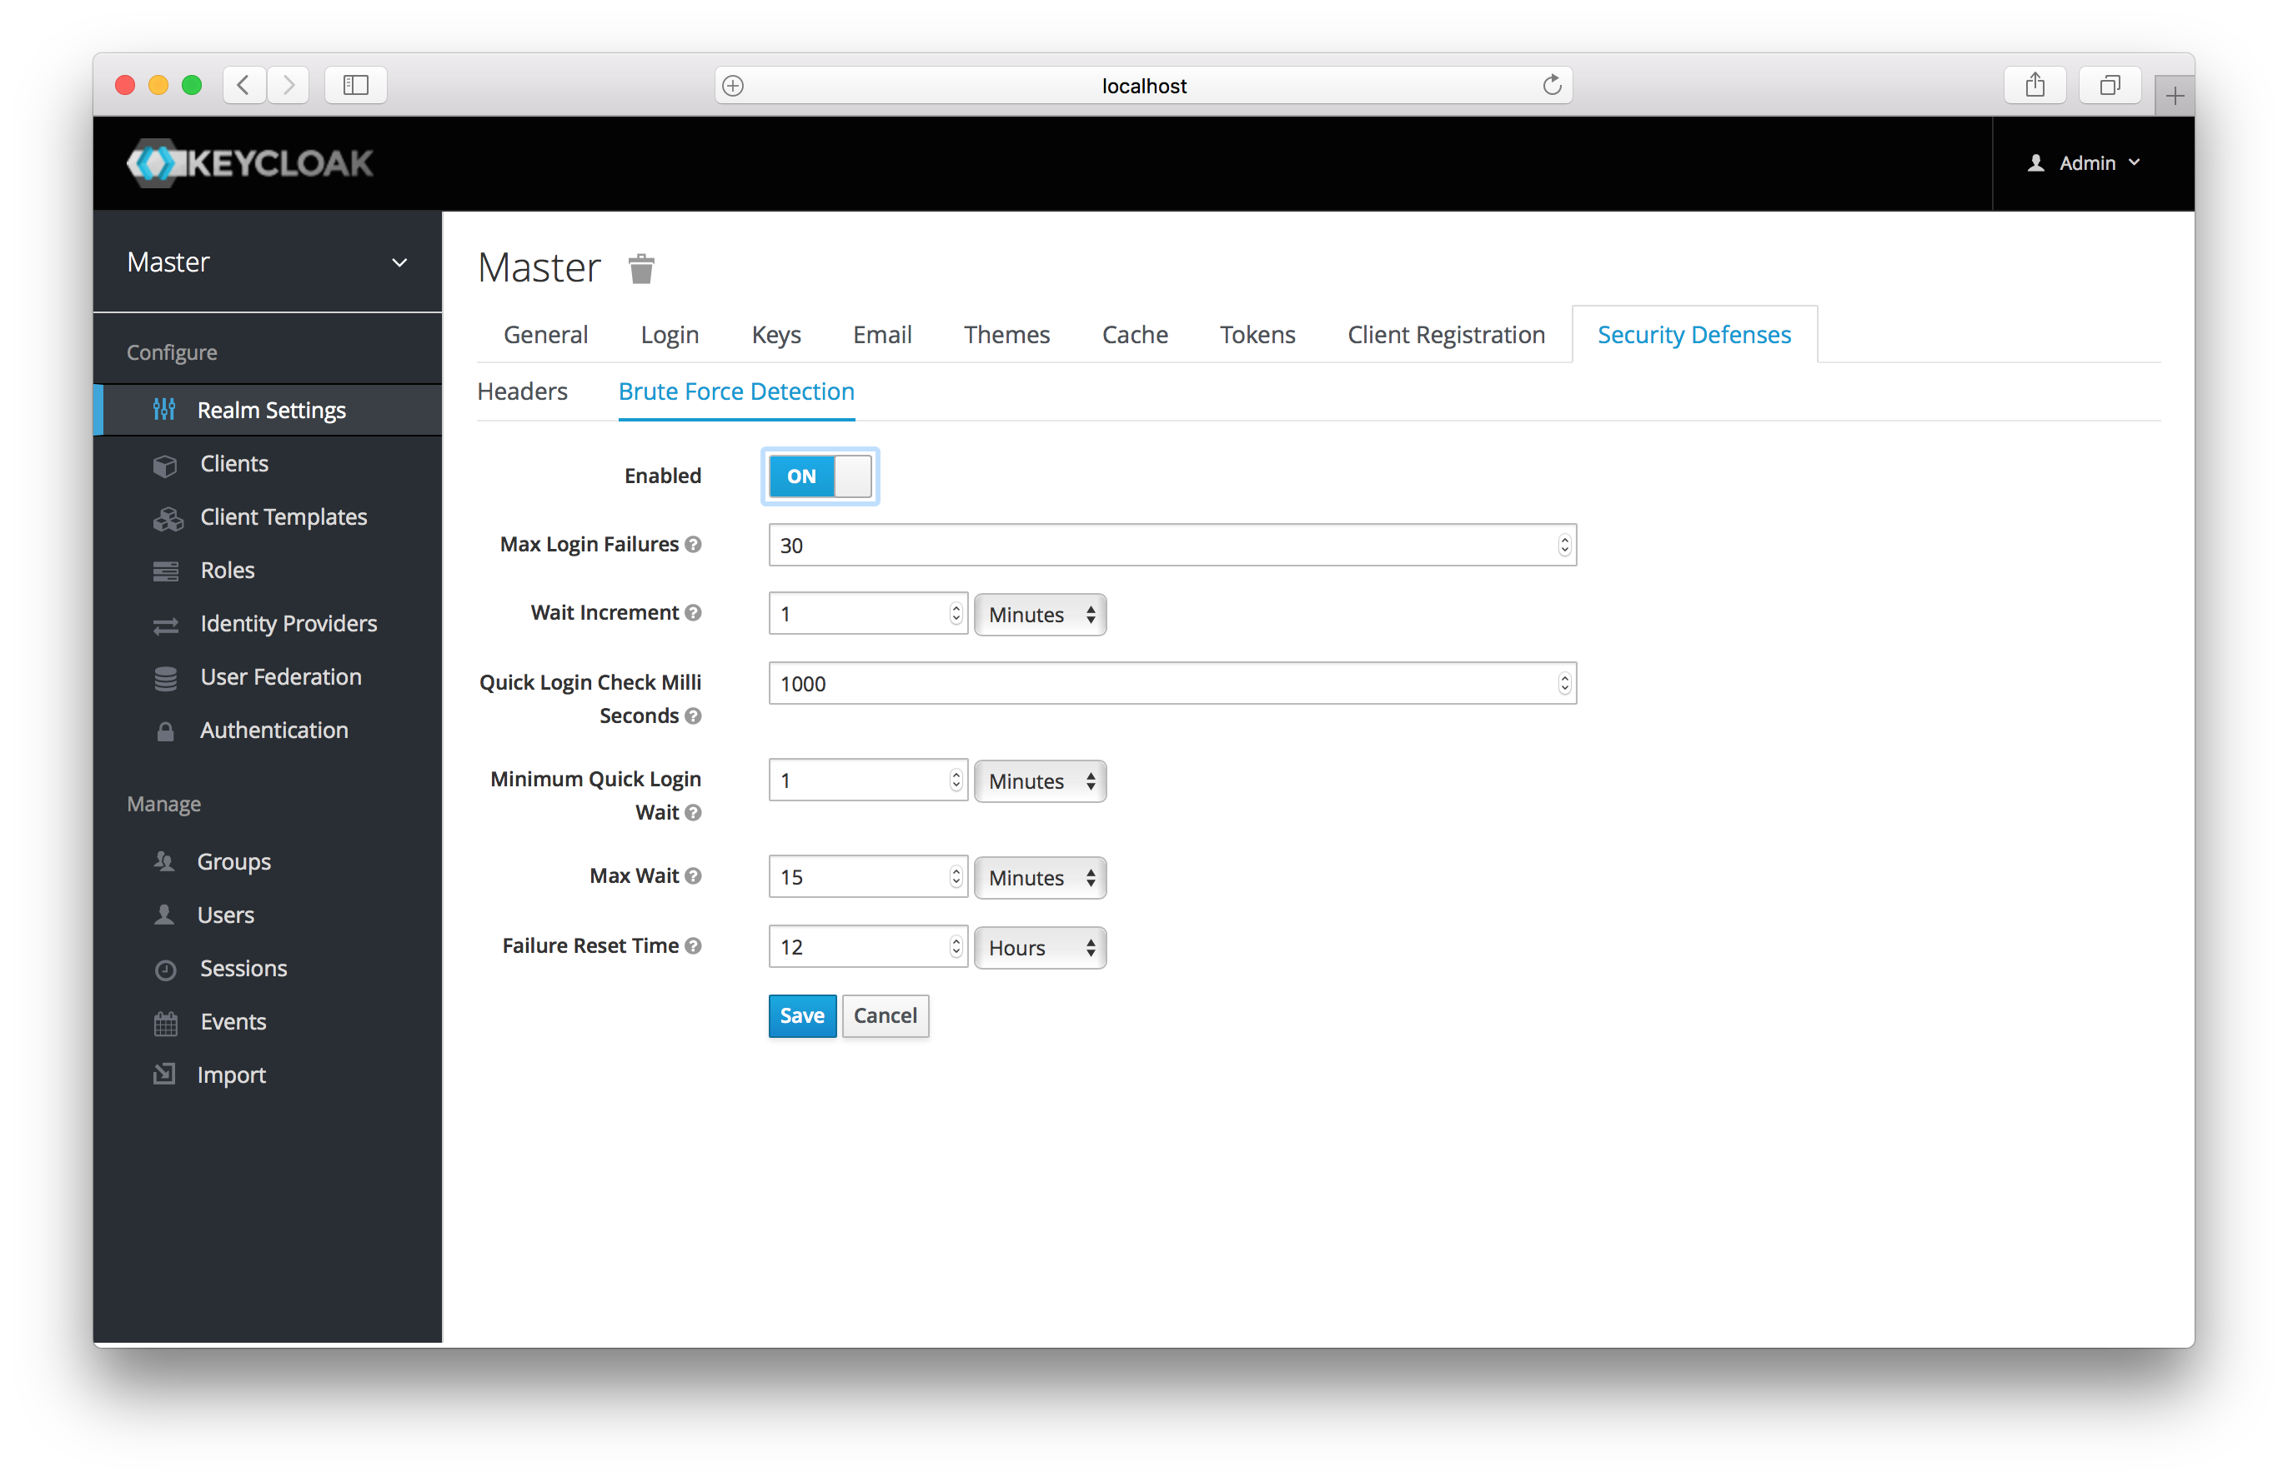
DISADVANTAGES OF KEYCLOAK
A brute force attack happens when an attacker is trying to guess a user's password. Keycloak has some limited brute force detection capabilities. If turned on, a user account will be temporarily disabled if a threshold of login failures is reached.

Slide 12
REFERENCE
Documentation
https://medium.com/geekculture/using-keycloak-with-spring-boot-3-0-376fa9f60e0b
https://www.baeldung.com/spring-boot-keycloak
Source Code
https://github.com/ameena08/spring-boot-keycloak
Video
https://youtu.be/La082JsJoH4

