Slide 1

Capstone Project
Cardiovascular Risk Prediction

Slide 2

Team Consists of: 1. ameen attar 2. Hrithik Chourasia 3. Pradip Solanki 4. Vridhi Parmar

Slide 3
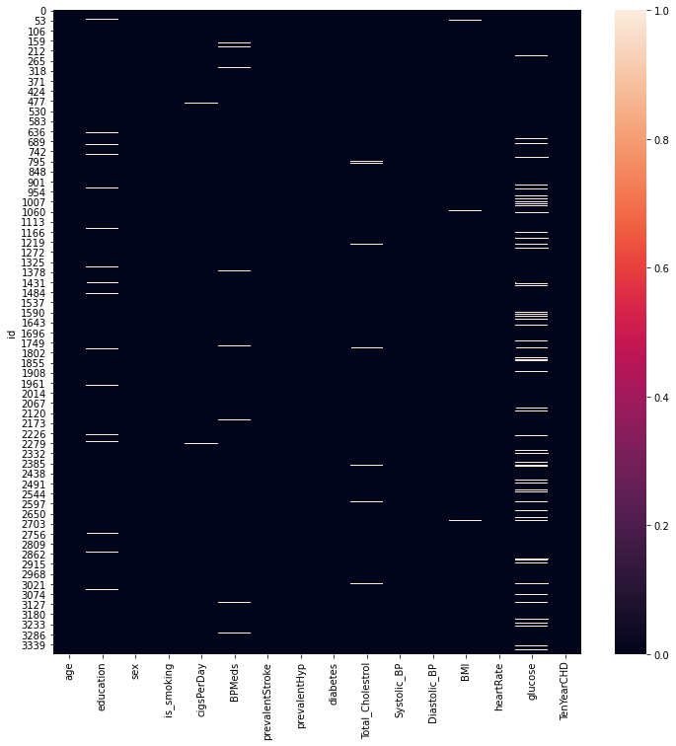
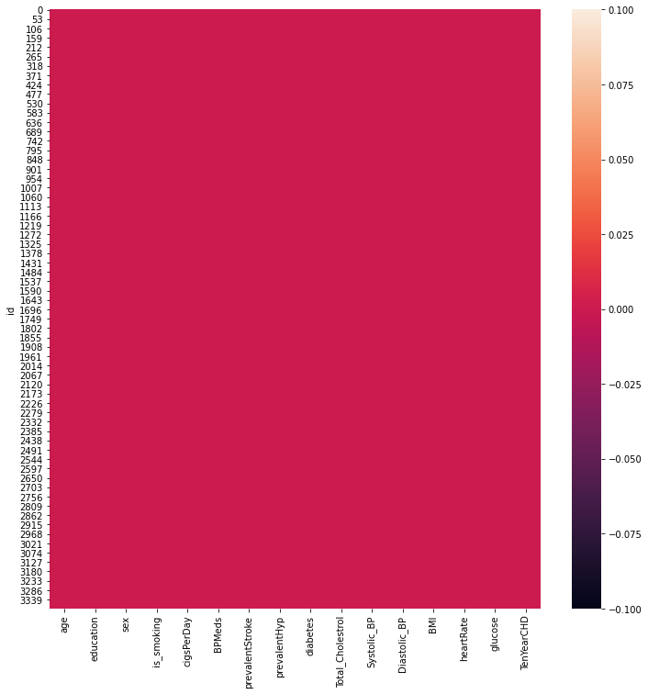
Missing Values & After filling NaN Values

Slide 4
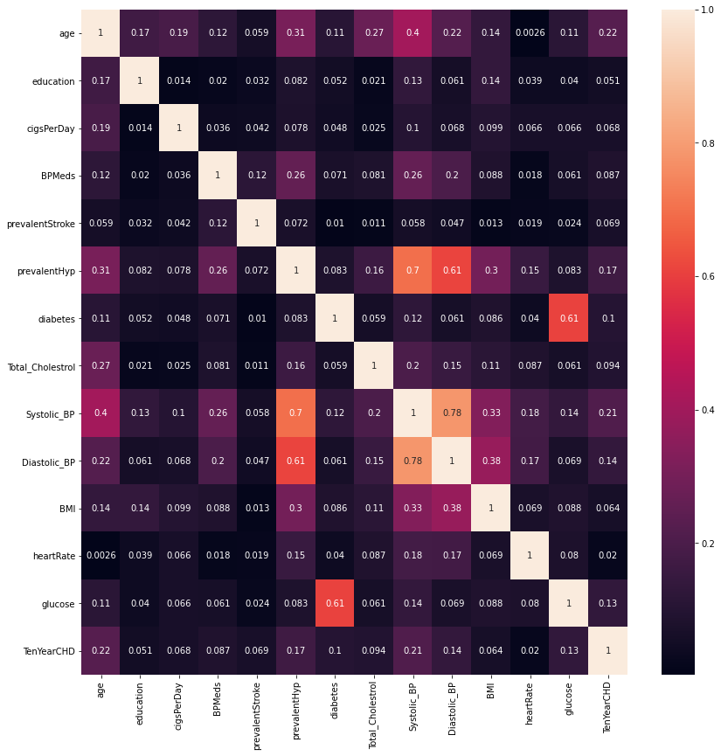
Correlation between each features

Slide 5
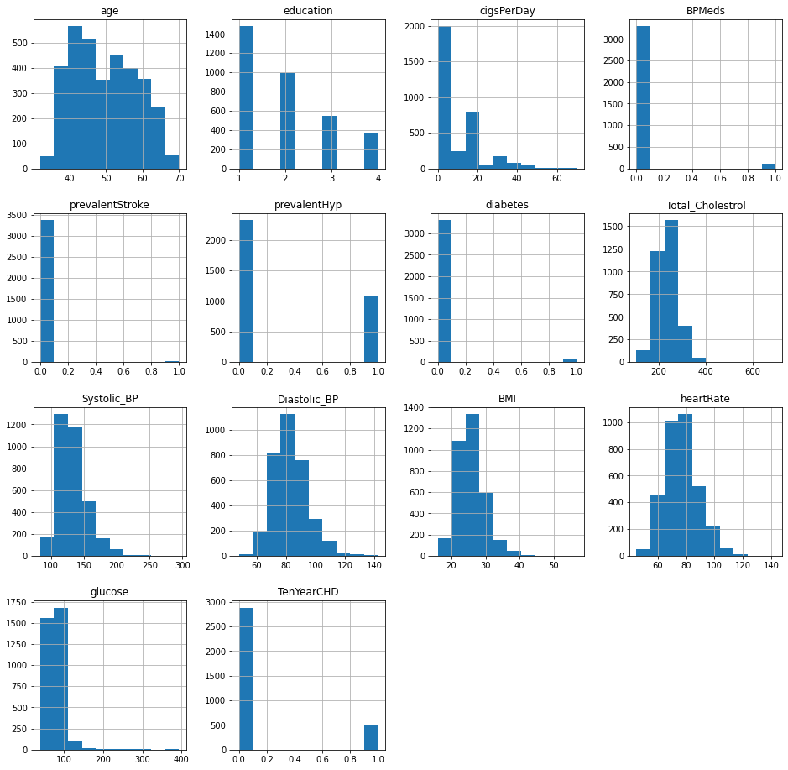
Plot of all the features:

Slide 6
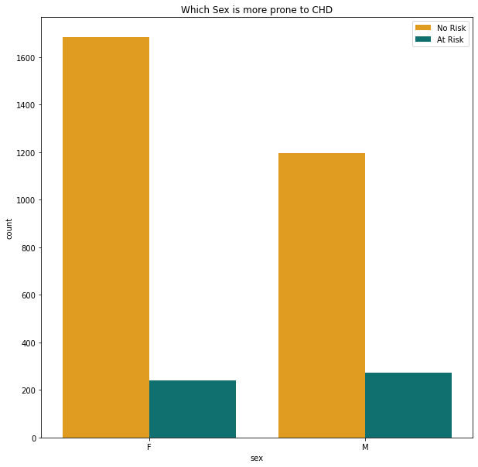
Which Sex is more prone to CHD ?

Slide 7
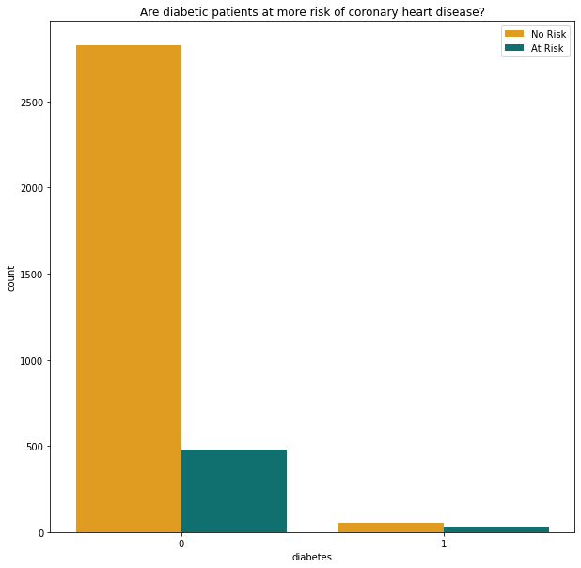
Are diabetic patients at more risk of chd ?

Slide 8
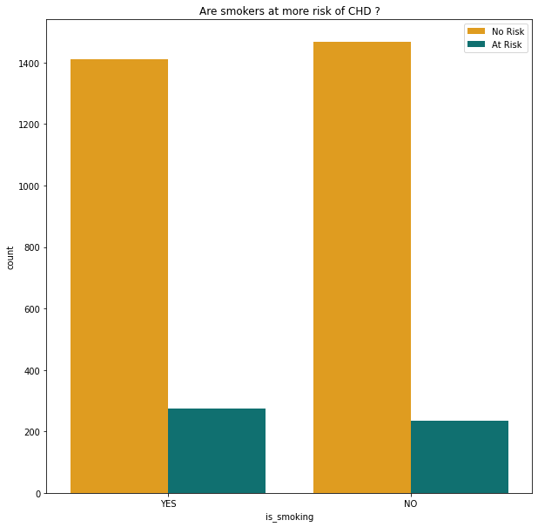
Are smokers at more risk of chd ?

Slide 9
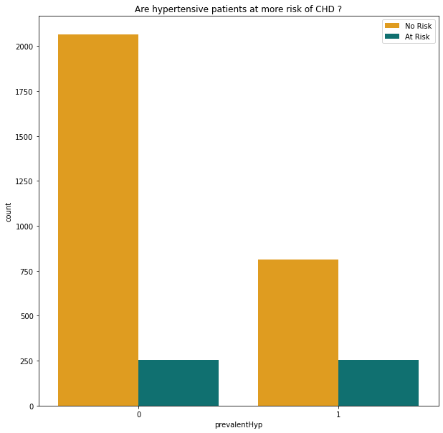
Are hypertensive patients at more risk of chd ?

Slide 10
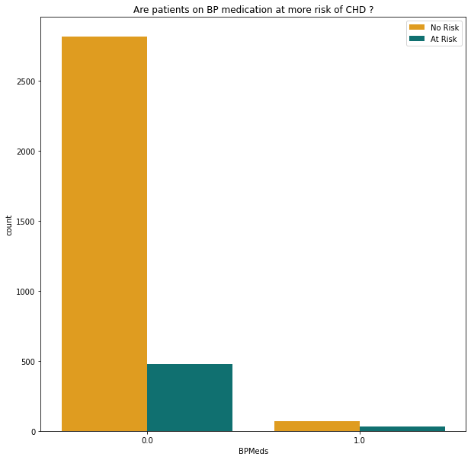
Are patients on bp medication at more risk of chd ?

Slide 11
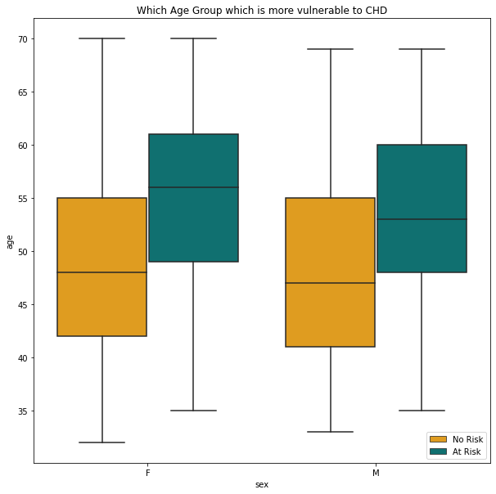
Which age group is more vulnerable to chd ?

Slide 12
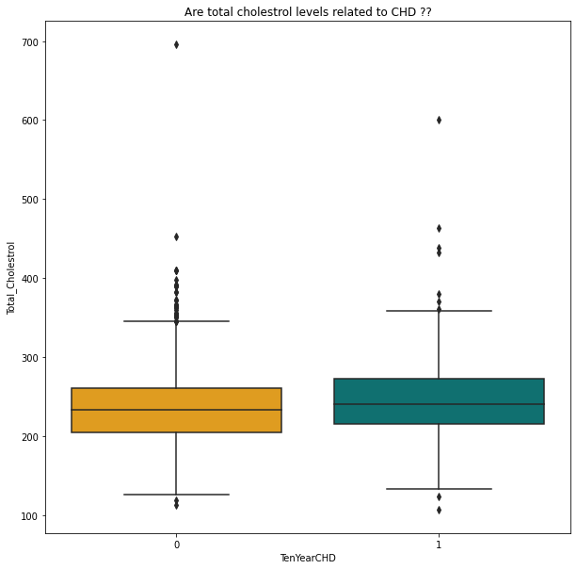
Are total cholesterol levels related to chd ?

Slide 13
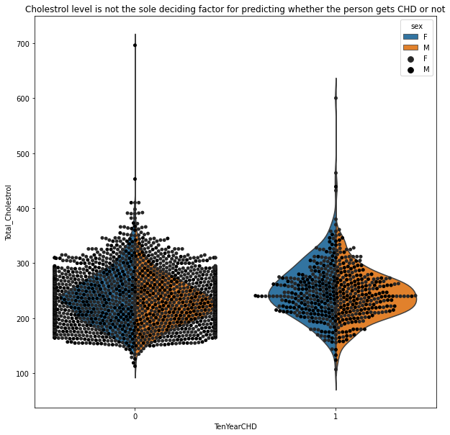
Cholestrol level is not the sole deciding factor for chd

Slide 14
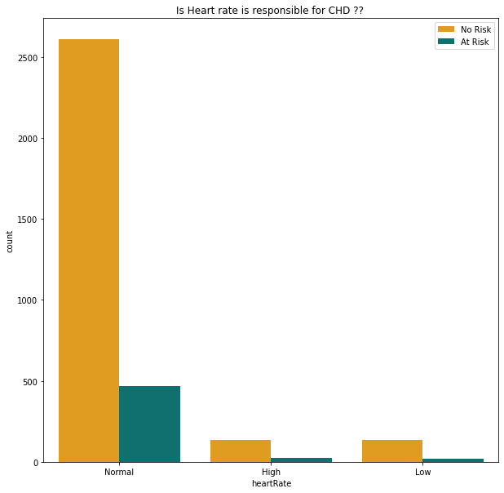
Is heart rate is responsible for chd ?

Slide 15
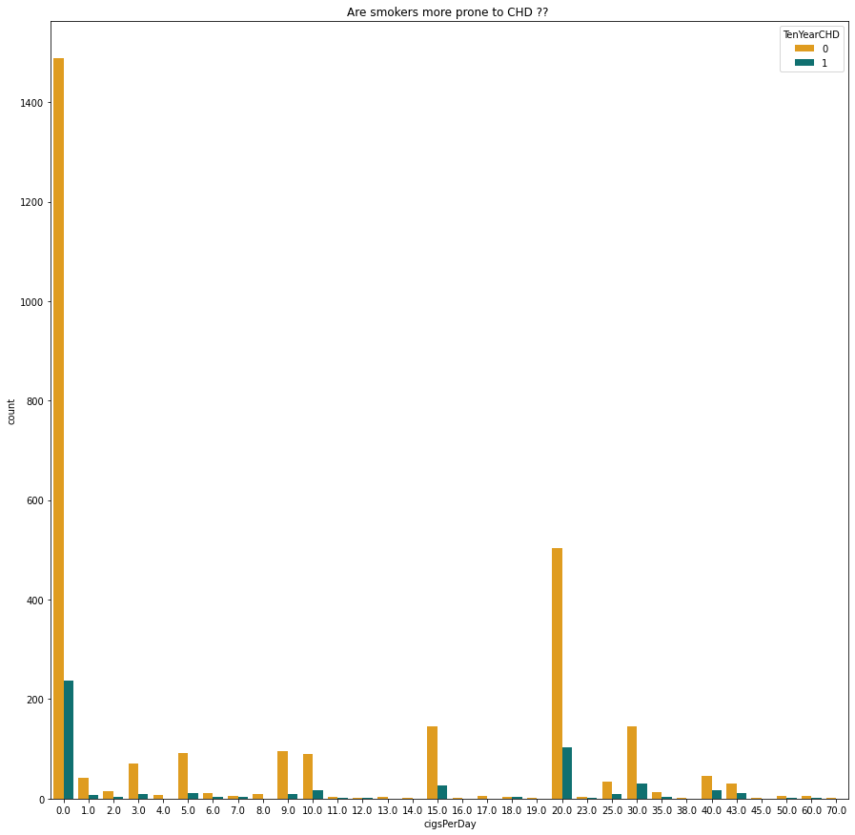

Slide 16
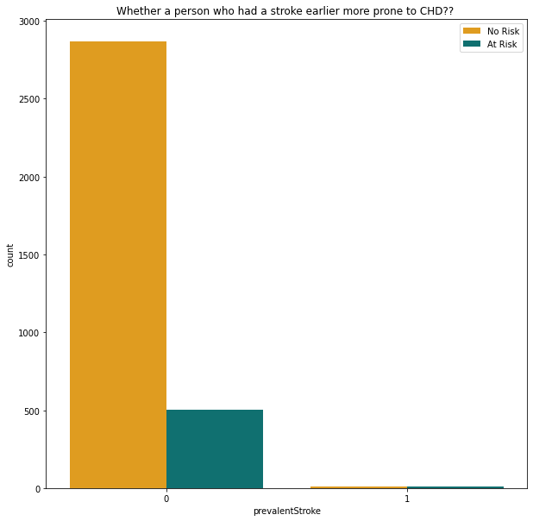
Who had a stroke earlier more prone to chd ?

Slide 17
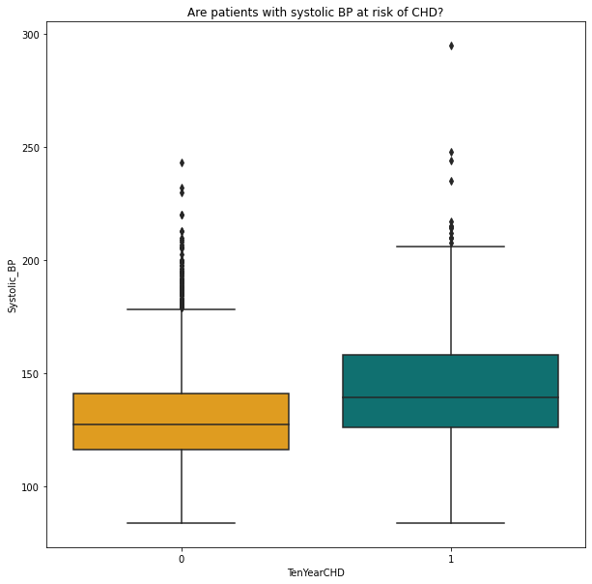
Are patients with systolic bp at risk of chd ?

Slide 18
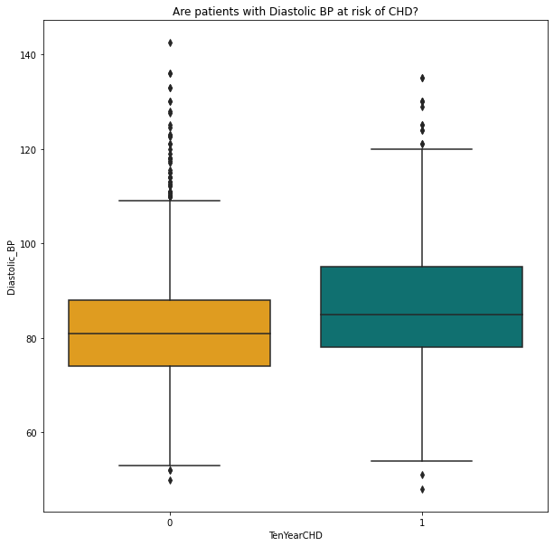
Are patients with diastolic bp at risk of chd ?

Slide 19
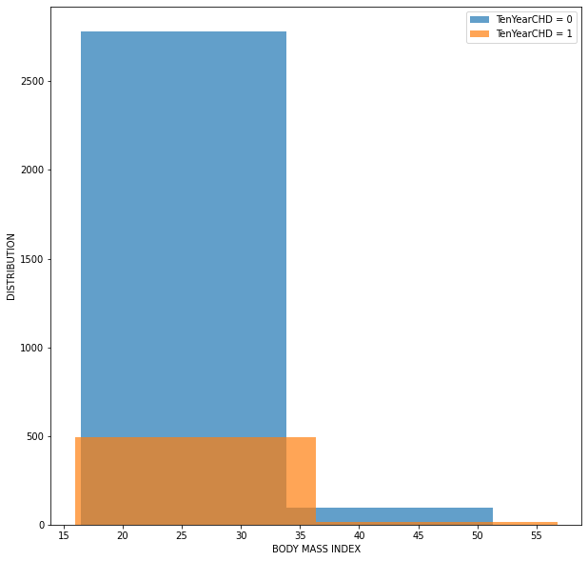
patients bmi is important to show the risk of chd ?

Slide 20
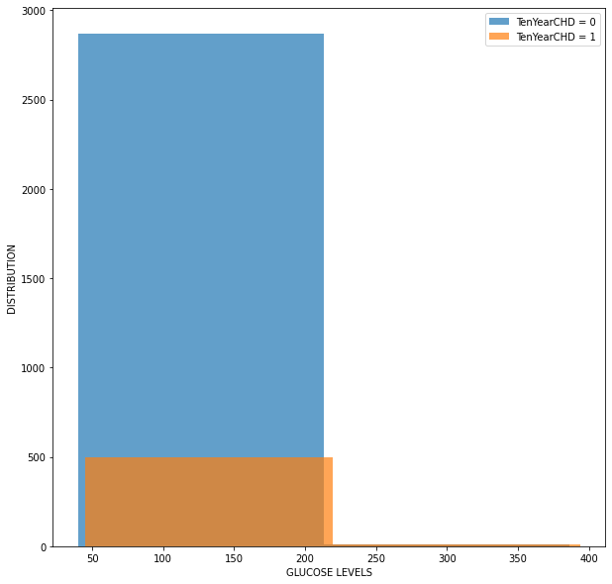
Can patients glucose levels show the risk of chd ?

