Slide 1
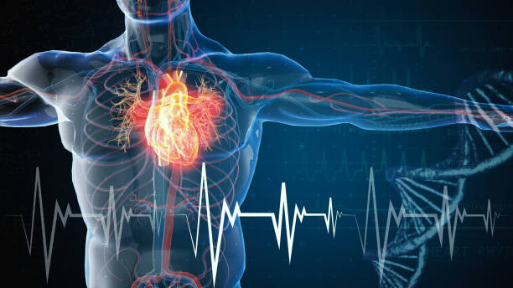
Capstone Project
Cardiovascular Risk Prediction

