Slide 1
Supply Chain & Inventory Management
Analysis
Done by Ameer Batcha

Slide 2
CONTENTS
Status Of Orders
Status Of Delivery
Total Inventory Stock
Total Value Of Inventory
Total Stock
Seasonal Trend Analysis (w.r.t ORDER QUANTITY)
Shipping Mode (Most Efficient Shipping Mode in Terms of Not Delaying)
Profitable Categories (Top 5)
Geospatial Analysis
Countries with the Highest Total Profit (Top 10)

Slide 3
HIGH LEVEL METRICS | TOTAL VALUE
Total Sale Value | 36784735.01337984
Total Sale Units | 384079
Inventory Value | 2536160997.4468727
Inventory Quantity | 30378127
Profit Value | 3966902.9740503575
Number of Distinct Products | 118
Number of Distinct Categories | 51
Number of Distinct Customers | 20652

Slide 4

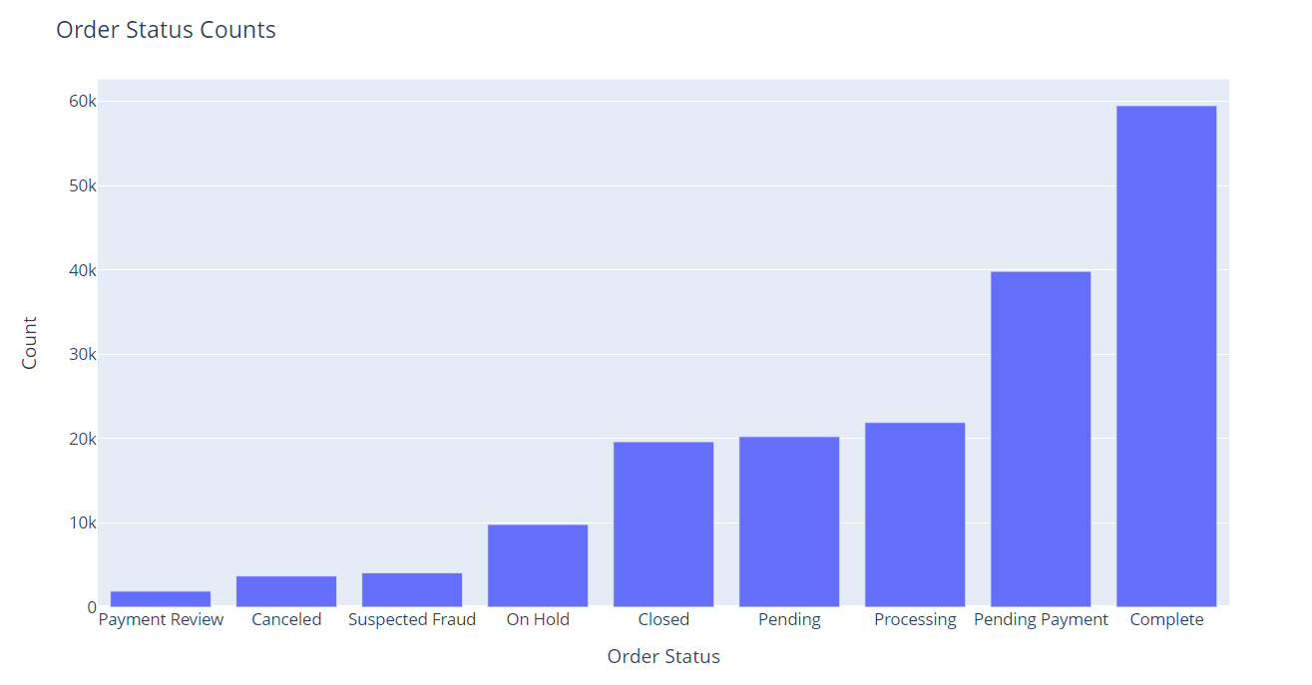
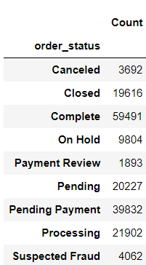

Status of Orders

Slide 5

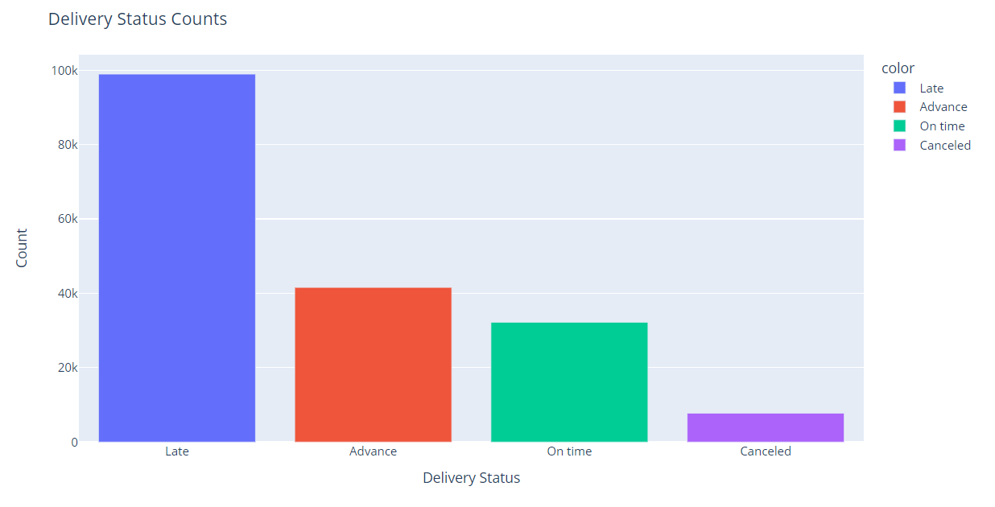
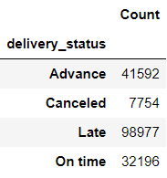
Status of Delivery

Slide 6

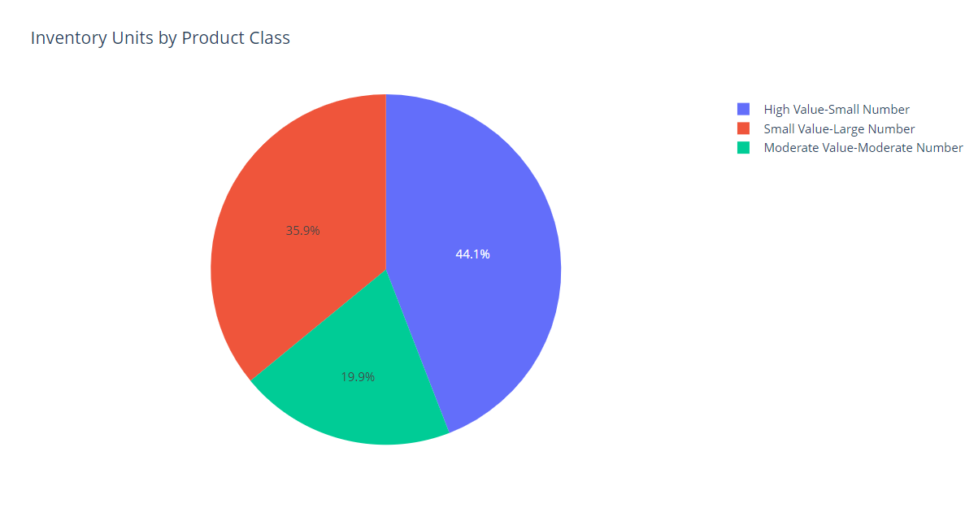
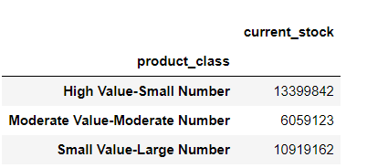
Total Inventory Stock

Slide 7

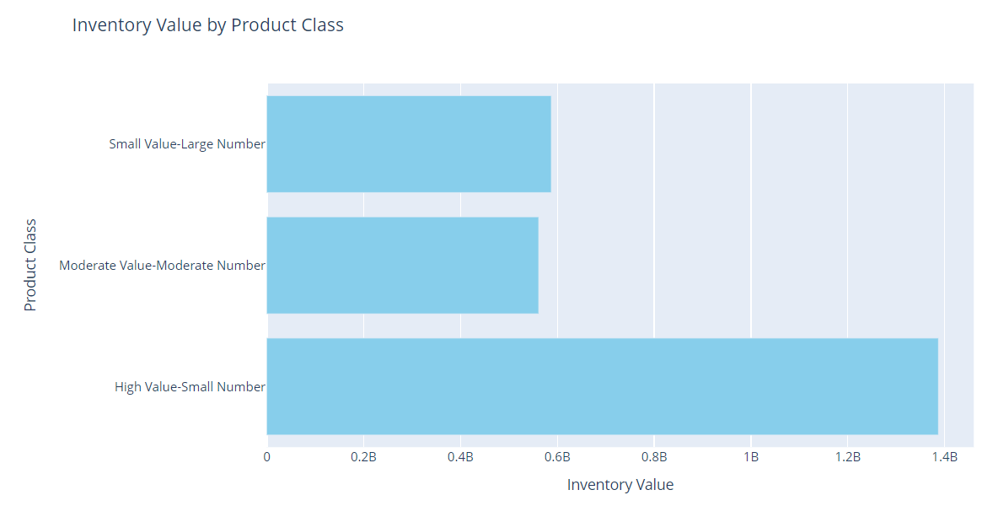
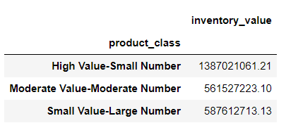
Total Value OF Inventory

Slide 8
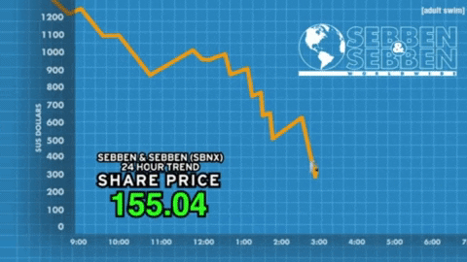
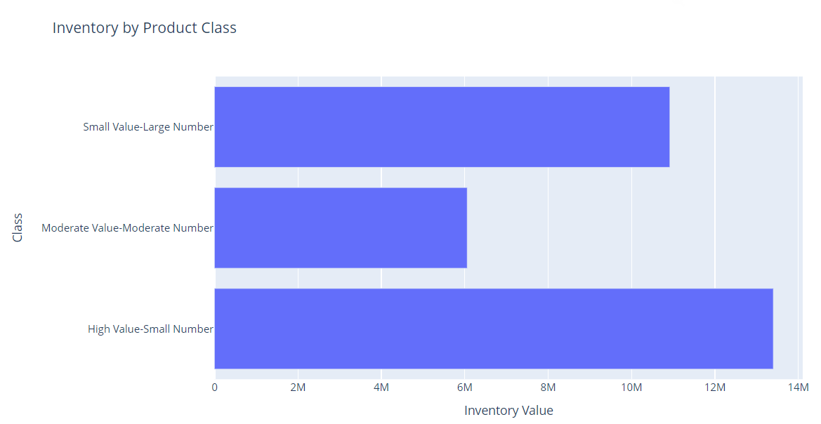
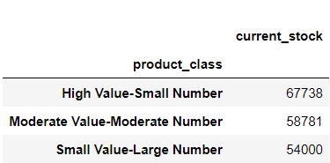
Total Stock

Slide 9

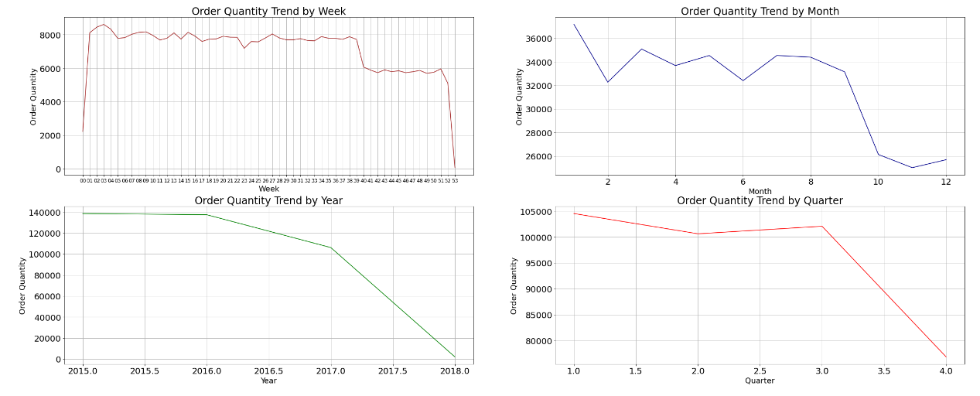
Seasonal Trend Analysis
(w.r.t ORDER QUANTITY)

Slide 10

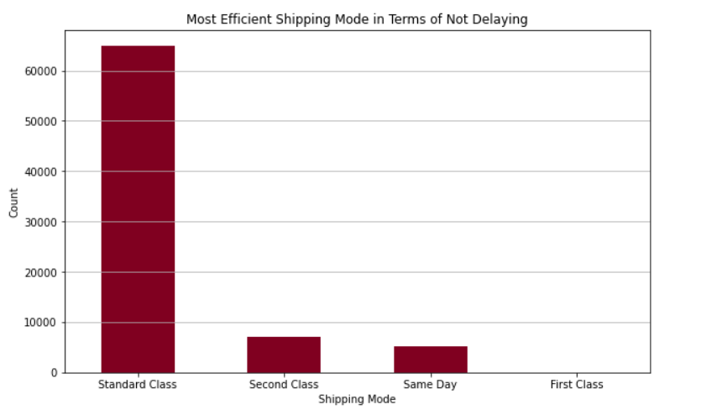
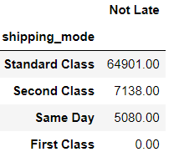
Shipping Mode
(Most Efficient Shipping Mode in Terms of Not Delaying)

Slide 11

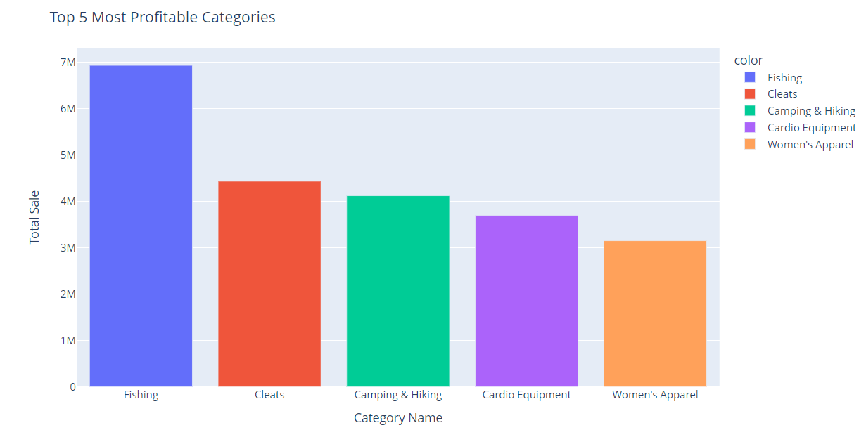
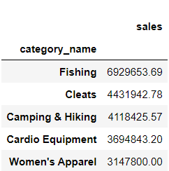
Profitable Categories
(Top 5)

Slide 12

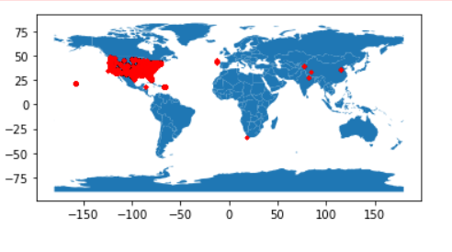
Geospatial Analysis

Slide 13

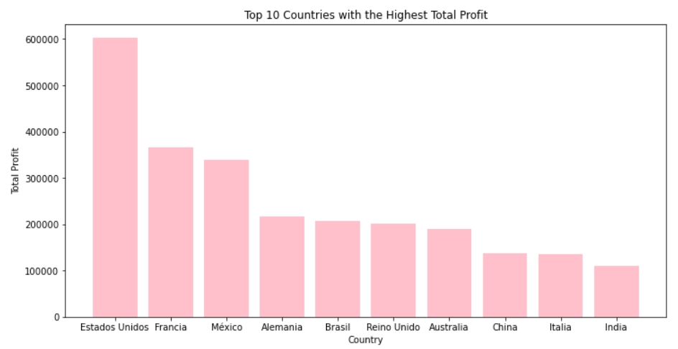
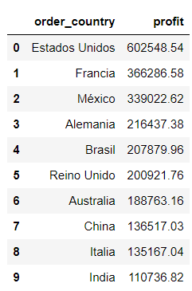
Countries with the Highest Total Profit
(Top 10)

Slide 14
THANK YOU

