Slide 1
Digital Portfolio
STUDENT NAME: AMMER.J
REGISTER NO AND NMID: 2422k0777 and asbruaf2422k0777
DEPARTMENT: II Bsc.computer science
COLLEGE: pollachi college of arts and science / Bharathiar University

Slide 2
RESUME CREATION

Slide 3


AGENDA
Problem Statement
Project Overview
End Users
Tools and Technologies
Portfolio design and Layout
Features and Functionality
Results and Screenshots
Conclusion
Github Link
3/21/2024 Annual Review

Slide 4

PROBLEM STATEMENT
In today’s digital era , traditional resumes alone are not enough to showcase
Skills and projects effectively. Many students and professionals lack a
Structured online presence to highlight their work. A digital portfolio provides
An interactive and accessible platform to present achievements, skills , and
experiences

Slide 5

PROJECT OVERVIEW
What it is: A personal website built using HTML, CSS, and JavaScript.
Purpose: To showcase personal profile, skills, education & certification in a clean, organized, and visually appealing way. Acts as an online presence to share with potential employers.
Key features: Responsive layout, navigation that allows easy access to resume content, certificate, projects and contact details.
Technologies used: HTML, CSS, JavaScript.

Slide 6

WHO ARE THE END USERS?
Portfolio Website:
What it is: A personal website built using HTML, CSS, and JavaScript.
Purpose: To showcase personal profile, skills, education & certification in a clean, organized, and visually appealing way. Acts as an online presence to share with potential employers.
Key features: Responsive layout, navigation that allows easy access to resume content, certificate, projects and contact details.
Technologies used: HTML, CSS, JavaScript.

Slide 7

TOOLS AND TECHNIQUES
•HTML→Structure(pages,sections).
•CSS→Styling(colors,layouts,responsiveness).
•JAVAScript→Interactivity(navigation menu,animatioms,from validation).
•code editor(VS Code) and hosting platfrom(GitHub Pages).

Slide 8
POTFOLIO DESIGN AND LAYOUT
•Single-Page Layout (Scroll-based Navigation)
•Section-Based Layout
•Smooth scrolling(likely using JavaScript)
•Skills
•Contact
•Responsive Design (mobile+desktop view).
8

Slide 9
FEATURES AND FUNCTIONALITY
•Resume Display.
•Certificate Showcase.
•Navigation Bar.
•Clean UI/UX
•Contact Information.
• Lightweight Performance

Slide 10
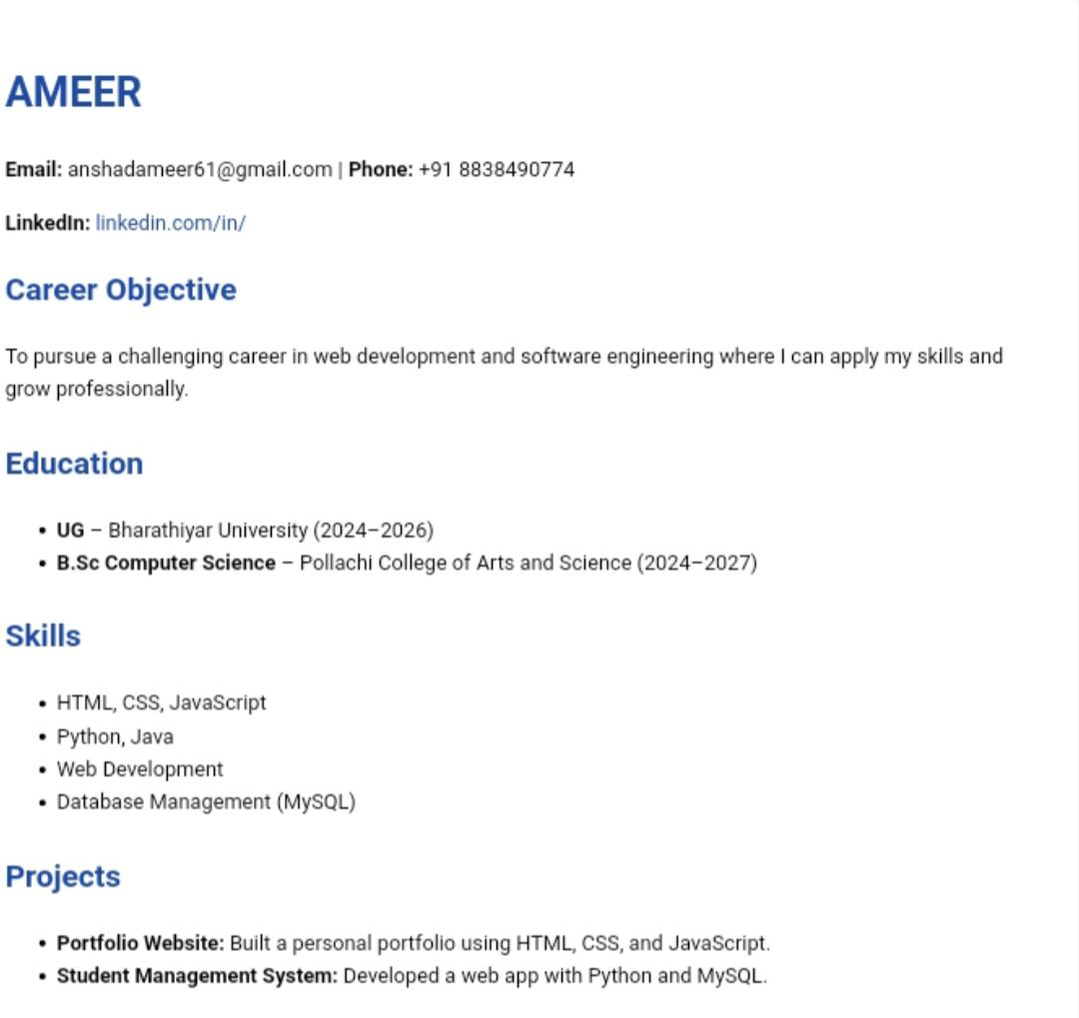
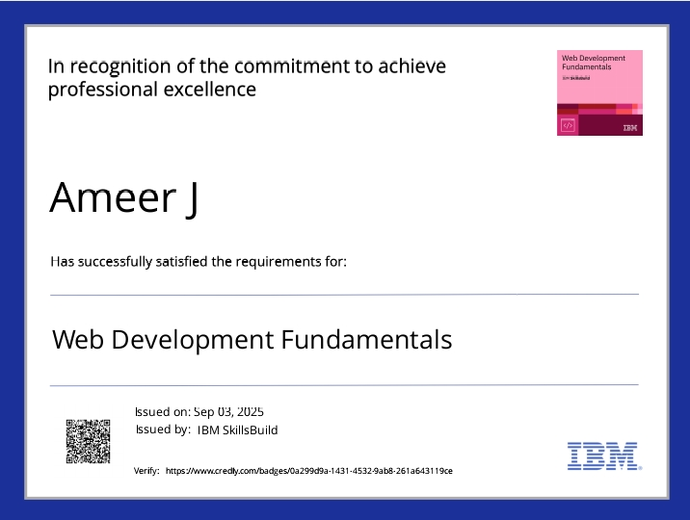

RESULTS AND SCREENSHOTS
3/21/2024 Annual Review
10

Slide 11
CONCLUSION
Highlights of the project :
1. Professional Resume Presentation
Clearly structured display of academic qualifications, skills, and experience.
Acts as a digital resume accessible anytime, anywhere.
2. Certification Showcase
Organized section to display technical certifications.
Adds credibility by showing verified learning and skill development.
3. Responsive and Mobile-Friendly Design
Built with responsive layout techniques to work seamlessly on desktops, tablets, and smartphones.
4. Clean and Minimalist UI
Simple, clutter-free design focused on readability and professionalism.
Effective use of colors, fonts, and layout for a modern look.
5. Smooth Navigation
Anchor-based navigation bar for easy access to different sections of the page.
Enhances user experience with smooth scrolling behavior.
11

Slide 12
Final summary :
This project is a personal portfolio website designed to showcase my academic background, technical skills, certifications, and projects in a structured and visually appealing format. Developed using HTML, CSS, and JavaScript, the site follows a clean, responsive layout that ensures accessibility across all devices. Key features include a dedicated resume section, a certificate gallery, smooth in-page navigation, and live deployment for public access.
Benefits to the society :
• Promotes Digital Literacy and Professionalism
• Inspires Others to Build Personal Branding
• Improves Accessibility of Personal Credentials
• Encourages Use of Open-Source Tools
GITHUB LINK :
https://github.com/ameer858/resume.git

