Slide 1






Pico W
Sensor Kit
Component Guide
KV Bootcamp 2026 | 9–12 Jun 2026 | Hotel Granada, Johor Bahru
Raspberry Pi Pico W
DHT22 Temp+Humidity
MCP9700 Analog Temp
LDR Light Sensor

Slide 2
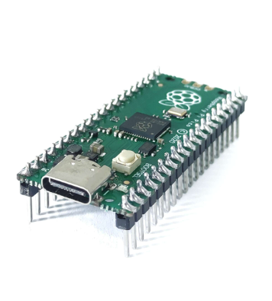
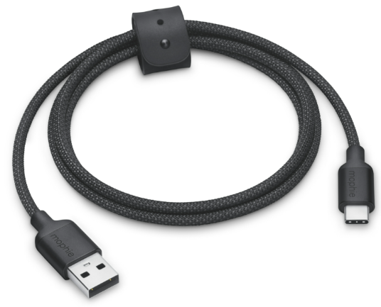
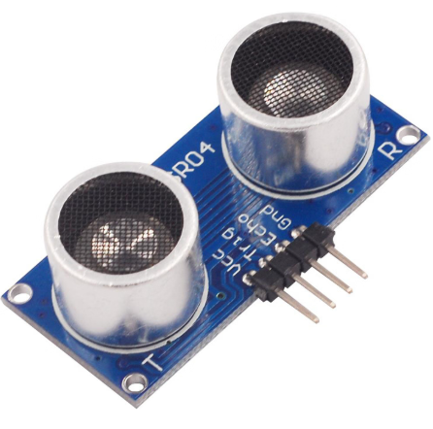
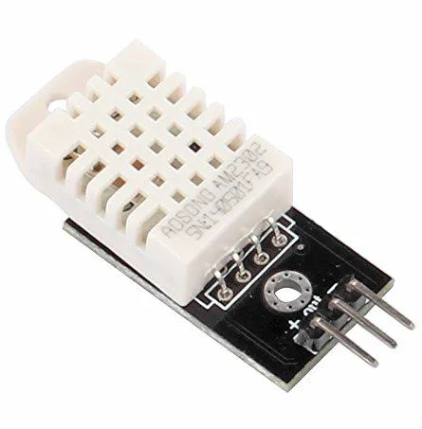
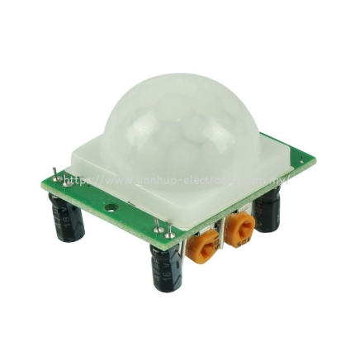
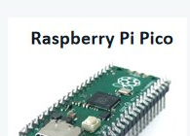
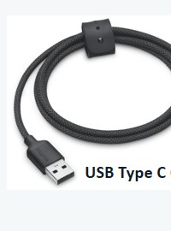
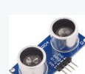
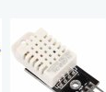
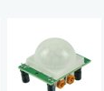
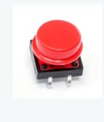
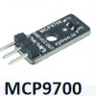
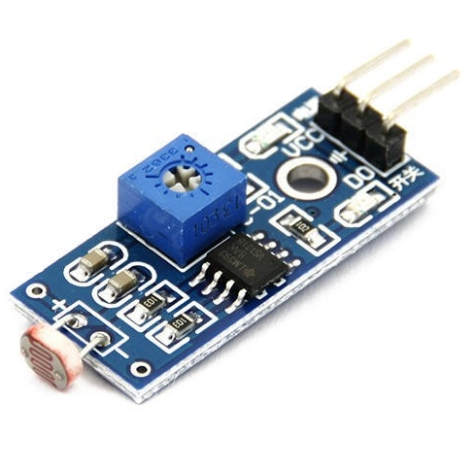
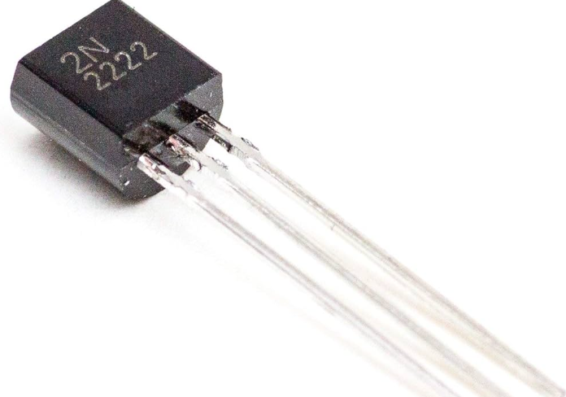

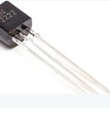
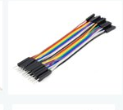
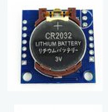
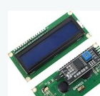
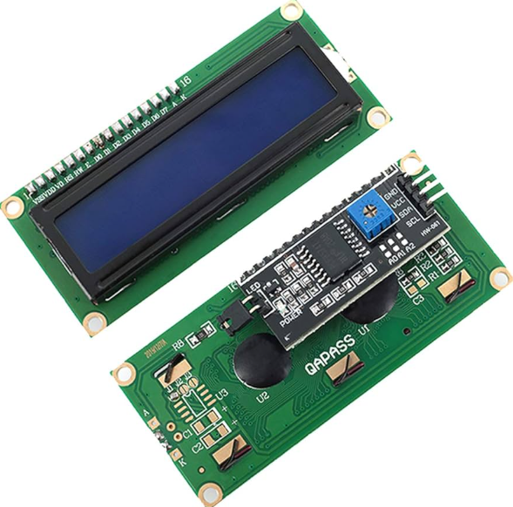
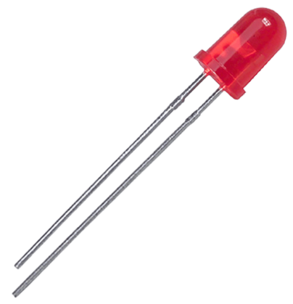
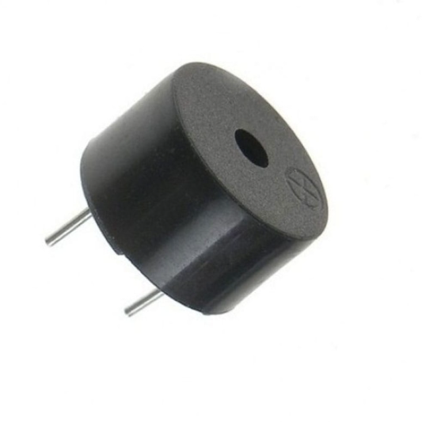
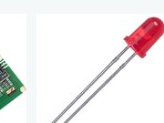
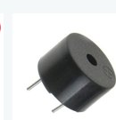
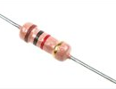
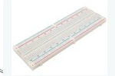
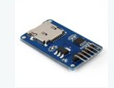
What Each Component Does
Raspberry Pi Pico
USB Type-C Cable
HC-SR04 Ultrasonic
DHT22 Sensor
PIR Motion Sensor
Push Button
Temperature Sensor
LDR Sensor
Transistor (NPN)
Jumper Wires
DS1307 RTC I2C Module
LCD Display
LED
Buzzer
Resistor
Breadboard
SD Card Module

Slide 3

What Each Component Does
Every kit streams one CSV row per second — feeding your pandas and ML exercises
Component
Measures
Pico W Pin
CSV Column
Raspberry Pi Pico W
Microcontroller + WiFi + on-board temp
—
onboard_temp_c
OVERVIEW
MCP9700 (Analog)
Ambient temperature (analog voltage)
A0 (GP26)
mcp_temp_c
LDR + 10kΩ Divider
Light level (raw ADC value 0–65535)
A1 (GP27)
ldr_raw
DHT22
Temperature + Relative Humidity (%)
GP15
dht_temp_c
dht_humidity_pct
All sensors powered from Pico W 3V3 OUT (pin 36). One CSV row per second over USB Serial and MQTT to broker seaicthree.local:1883

Slide 4
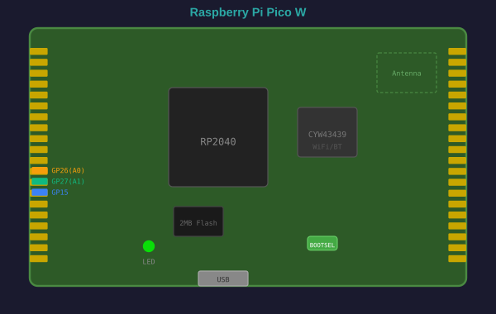
Raspberry Pi Pico W
The brain of the kit — RP2040 microcontroller with built-in WiFi
Processor
RP2040 dual-core ARM Cortex-M0+ 133 MHz
Memory
264 kB SRAM | 2 MB Flash
PICO W
WiFi
CYW43439 — 2.4 GHz 802.11n
ADC
3× 12-bit ADC (GP26/27/28)
GPIO
26 multi-function GPIO pins
Power
3V3 OUT (pin 36) → sensors
Key Pins Used in This Kit
GP26 (A0)
GP27 (A1)
GP15
3V3 OUT
MCP9700 analog output
LDR voltage divider midpoint
DHT22 digital data
Power for all sensors (pin 36)

Slide 5
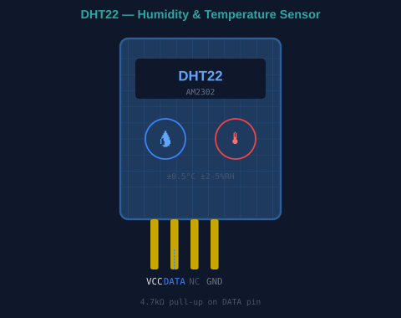
DHT22 — Temperature & Humidity Sensor
Digital sensor outputting calibrated temperature + relative humidity in one data packet
How It Works
Uses a capacitive humidity sensing element that changes electrical resistance with moisture.
Internal NTC thermistor measures temperature simultaneously.
DHT22
Onboard ADC converts both readings to digital, sends via single-wire protocol.
Python reads with adafruit_dht library — one call returns both values.
Specifications
Temp Range
-40°C to +80°C
Accuracy
±0.5°C
Connection
Humidity
0–100% RH
Accuracy
±2–5% RH
VCC → 3V3 | GND → GND | DATA → GP15 | 4.7kΩ pull-up on DATA
Voltage
3.3V – 5V
Sample Rate
0.5 Hz (2s min)
Data Pin
GP15
Pull-up
4.7kΩ to 3V3 required

Slide 6
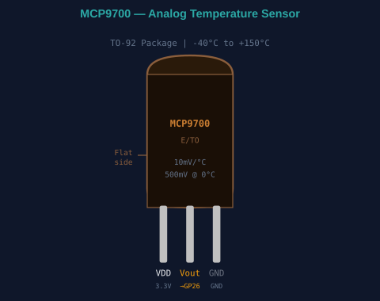
MCP9700 — Analog Temperature Sensor
Linear active thermistor — outputs a voltage proportional to temperature. Simple and reliable.
The Formula:
Vout = 500mV + (Temp × 10mV/°C)
At 0°C → 0.500V At 25°C → 0.750V At 50°C → 1.000V
MCP9700
Reading in CircuitPython:
import analogio, board
adc = analogio.AnalogIn(board.A0)
voltage = adc.value * 3.3 / 65535
temp_c = (voltage - 0.5) / 0.01
Specifications
Range
-40°C to +150°C
Sensitivity
10 mV/°C
Connection
Package
TO-92 (3 pins)
Supply
2.3V – 5.5V
VDD → 3V3 | GND → GND | Vout → GP26 (A0) | No resistor needed
Pico Pin
A0 (GP26)
Output
Analog voltage

Slide 7
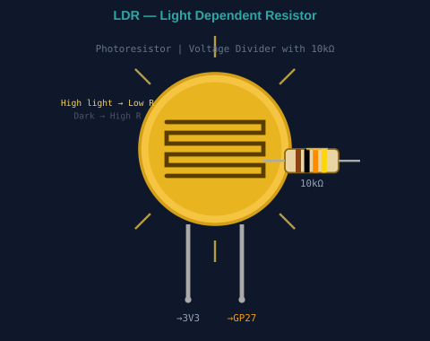
LDR — Light Dependent Resistor
Photoresistor that changes resistance based on light intensity — used with voltage divider circuit
Voltage Divider Circuit:
3V3 ── LDR ──┬── 10kΩ ── GND
└── GP27 (A1)
ADC reads voltage at midpoint → converts to 0–65535 (12-bit ADC)
LDR
How Light Affects the Reading
Condition
LDR Resistance
Vout
ldr_raw value
Bright light
Low (~1kΩ)
High (~3V)
~60000+
Dim light
Medium (~10kΩ)
~1.65V
~32000
Dark / covered
High (~1MΩ)
Low (~0V)
~0–500
Connection
One LDR leg → 3V3 | Other LDR leg → midpoint → GP27 | 10kΩ from midpoint → GND

Slide 8
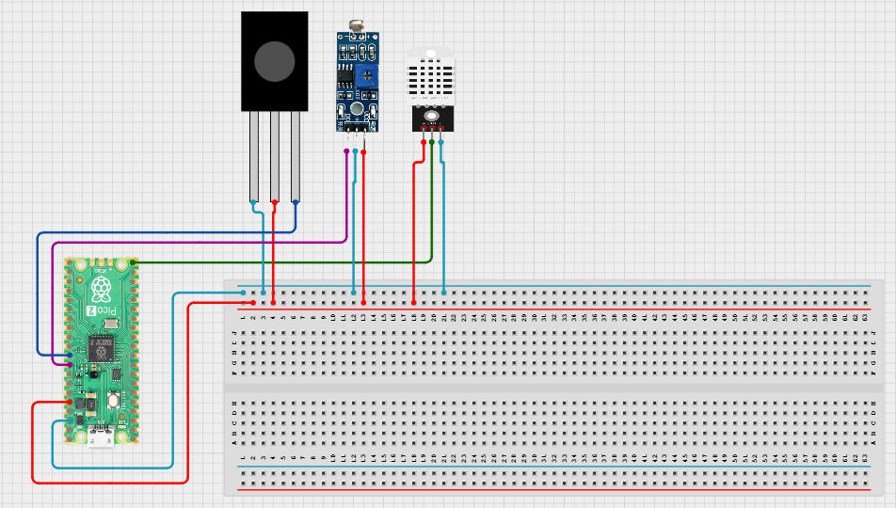
Complete Wiring Diagram
Power everything from 3V3 OUT (pin 36). Double-check polarity before plugging in USB.
WIRING

Slide 9
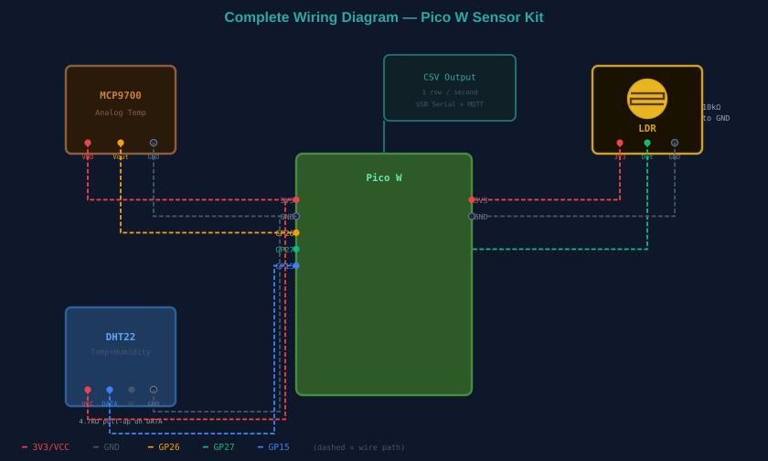
Complete Wiring Diagram
Power everything from 3V3 OUT (pin 36). Double-check polarity before plugging in USB.
WIRING

Slide 10

Quick Pinout Reference
Component
Component Pin
Pico W Pin
Notes
MCP9700
VCC
3V3 OUT (pin 36)
3.3V supply
MCP9700
OUT
GP26 / A0 (pin 31)
10 mV/°C, 500 mV @ 0°C
MCP9700
GND
GND (any)
Common ground
PINOUT
LDR
VCC
3V3 OUT (pin 36)
Pull-up end
LDR
A0
GP27 / A1 (pin 32)
Voltage divider output
LDR
GND
GND (any)
Common ground
DHT22
+
3V3 OUT (pin 36)
3.3V supply
DHT22
OUT
GP15 (pin 20)
4.7kΩ pull-up to 3V3
DHT22
-
GND (any)
Common ground
All VCC/3V3 connections share pin 36. All GND connections can use any GND pin (3, 8, 13, 18, 23, 38).

Slide 11
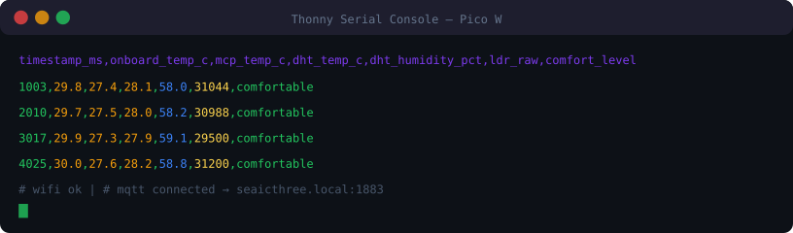
CSV Output → pandas DataFrame
The device streams one CSV row per second
OUTPUT
timestamp_ms
Pico W — Milliseconds since boot
dht_humidity_pct
DHT22 — Relative humidity % (GP15)
onboard_temp_c
RP2040 — Chip internal temperature
ldr_raw
LDR — Light ADC value 0–65535 (GP27)
mcp_temp_c
MCP9700 — Ambient temperature (GP26)
comfort_level
Derived — Computed: comfortable / warm / hot
dht_temp_c
DHT22 — Air temperature (GP15)
Load into pandas: df = pd.read_csv('sample_pico_readings.csv')

Slide 12

From Sensor to AI
The full data journey — from physical world to machine learning prediction
1
2
3
4
5
FLOW
Physical World
Pico W Kit
USB / MQTT
pandas (Day 2)
ML Model (Day 3)
Temperature, humidity, light — real environment in the room
MCP9700, DHT22, LDR read values → one CSV row per second
Data streams to laptop (USB Serial) and room broker (MQTT)
df = pd.read_csv(...) → clean, filter, groupby, visualize
scikit-learn → train classifier → predict comfort_level
Make sure each kit streams a steady CSV

Slide 13

Troubleshooting Guide
Check these first before spending time debugging code
No CIRCUITPY drive
Re-flash. Confirm a data USB cable — not a charge-only cable.
dht_temp_c blank every row
DHT22 wiring or missing 4.7kΩ pull-up. Re-seat data wire on GP15. Occasional blank row is normal.
TROUBLE
mcp_temp_c wildly wrong
Check MCP9700 orientation. Confirm Vout is on GP26, not a power pin. Flat side faces you when reading label.
ldr_raw stuck at 0 or 65535
Voltage divider not wired correctly. Check 10kΩ pulldown to GND and the A1 (GP27) connection.
ImportError: adafruit_dht
Library missing from CIRCUITPY/lib/. Redo Step 2 — copy adafruit_dht.mpy to lib/.
No '# wifi ok' line
Wrong SSID/password in secrets.py, or you flashed the plain Pico build instead of Pico W build.
No '# mqtt connected' but WiFi ok
Broker unreachable. Device still streams over USB — acceptable for the lab exercises.

