Slide 1
Patient Info Manager – Requirement Specification.

Slide 2
Application Overview
This is a dialog based application which display information about Patients registered in a hospital and the end users can perform some operations on registered information.

Slide 3
Major Functionalities
Patient Registration.
Scan.
Keeping history of registered information.
Transfer information to other clients.

Slide 4
Data structure details.
Patient Information – Basic Patient information.
  Patient ID – A unique number to identify patient details.
  Patient name – Name of patient
  Gender– Gender of patient.
  Registration date – Registration date of patient.
  Age – Age of patient.
Study Information – This represents Study details of a Physician/doctor about the patient.
  Height – Height of patient.
  Weight – Weight of patient.
  Study comment – any other information from physician.
Series Information– This represents Scan details of the patient.
  Body part – Which body part need to be scanned.
  Number of images – Total number of images after scan.( This is a simulation application without any hardware. So this information should be filled along with patient information during registration.)
  Operator name– Name of the scanning device operator.

Slide 5
User interface
#Topic: Dialog and Controls
Main Dialog
Patient Registration dialog
Scan Status dialog
About dialog.

Slide 6
Patient Registration dialog
#Topic: Dialog and Controls
Create a dialog named Patient Registration with following controls:
  Patient information list control – List control, Report view , not allow multiple selection & Full row select
  Patient ID edit control – Edit control, always disabled.
  Patient name edit control – Edit control
  Gender Radio buttons – Radio buttons
  Registration date – Date/Time picker control.
  Age edit control – Edit control, Accept numbers only.
  Age combo box – Combo box
  Height edit control – Edit control, Accept numbers only.
  Weight edit control – Edit control, Accept numbers only.
  Study Comments edit control – Edit control, Multi line support required.
  Body Part combo box – Combo box.
  Number of Images edit control – Edit control, Accept numbers only.
  Operators name edit control – Edit control.
  3 Group boxes to separate above specified information to Patient, Study & Series
  Static controls for all Edit, Combo and Radio controls.
  4 Buttons named, Clear, Emergency ID, Register & Scan.

Slide 7
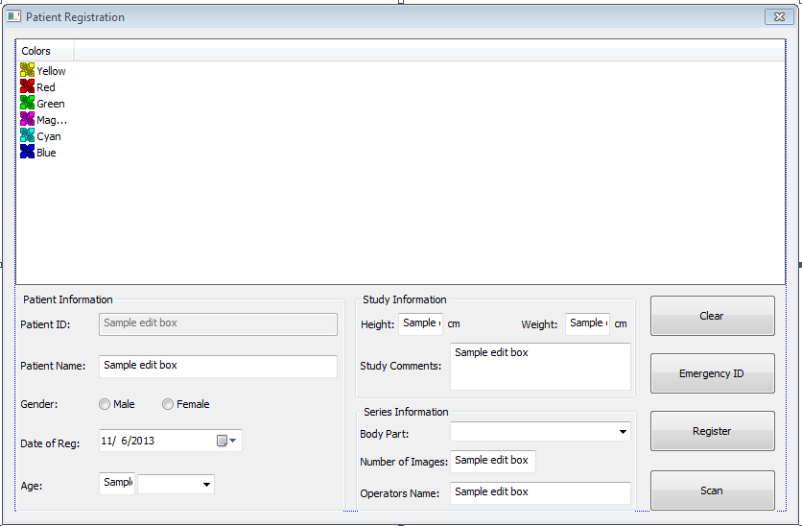
Patient Registration dialog – Expected UI
#Topic: Dialog and Controls

Slide 8
Patient Browser dialog
#Topic: Dialog and Controls
Create a dialog named Patient Browser with following controls:
  Patient information Tree control – Tree control
  Patient detailed information – List control, Report View , Grid support & Full row select.
  Image list control – List control, Icon view
  3 Buttons named Save Data, Retrieve Data & Exit

Slide 9
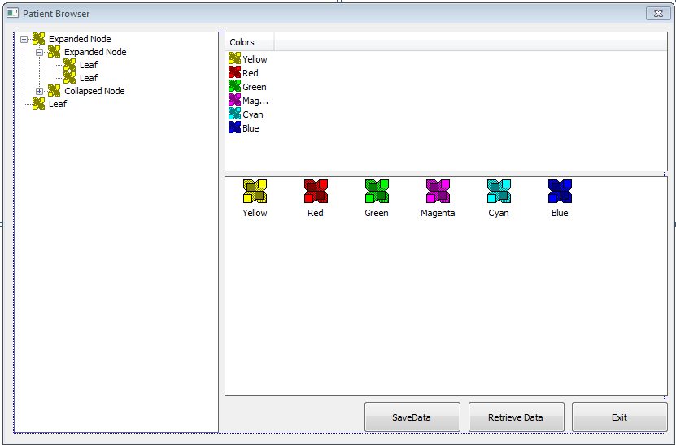
Patient Browser dialog – Expected UI
#Topic: Dialog and Controls

Slide 10
Main dialog – Functionalities.
#Topic: Dialog and Controls – Property Pages & Sheets
Main dialog should display Patient Registration dialog and Patient browser dialog in a tabbed view on application start-up.

Slide 11
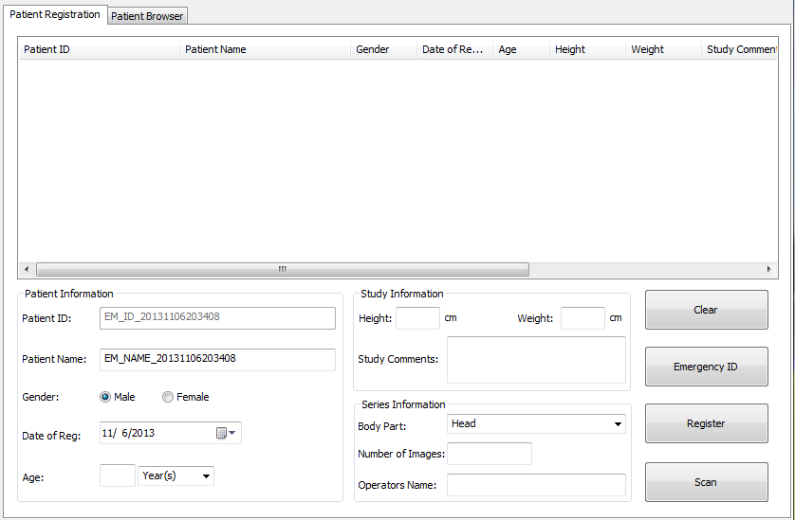
Main dialog – Expected UI.
#Topic: Dialog and Controls – Property Pages & Sheets

Slide 12
Patient registration - Functionalities
#Topic: Dialog and Controls
First display:
  No items in list control.
  All Controls except Patient ID, Gender, Date of registration, Age unit combo box and Body Part should be cleared.
  Patient ID edit control should be filled with current date, time and a constant as prefix e.g. PAT_ID_20131106192220
  Male radio button should be selected.
  Current date should be filled in Date of registration control.
  Age unit combo box should be filled with Year(s), Month(s) & Day(s) strings.
  “Year(s)” should be displayed in Age unit combo box.
  Body part combo should be filled with “Abdomen”, “Head”, “Chest”, “Hand” & “Heart” values.
  “Head” Should be displayed in Body part combo box.
Clear Button:
  All Controls except Patient ID, Gender, Date of registration, Age unit combo box and Body Part should be cleared.
  Patient ID edit control should be filled with current date, time and a constant as prefix e.g. PAT_ID_20131106192220
  Male radio button should be selected.
  Current date should be filled in Date of registration control.
  “Year(s)” should be displayed in Age unit combo box.
  “Head” Should be displayed in Body part combo box.
  List control selection should be cleared.

Slide 13
Patient registration – Functionalities(Cont..)
#Topic: Dialog and Controls
Emergency ID Button:
  All Controls except Patient ID, Gender, Date of registration, Age unit combo box and Body Part should be cleared.
  List control selection should be cleared.
  Patient ID edit control should be filled with current date, time and a constant as prefix e.g. EM_ID_20131106192220
  Patient Name edit control should be filled with current date, time and a constant as prefix e.g. EM_NAME_20131106192220
  Male radio button should be selected.
  Current date should be filled in Date of registration control.
  “Year(s)” should be displayed in Age unit combo box.
  “Head” Should be displayed in Body part combo box.
List control selection – One item
  Details of selected item should be displayed in corresponding controls.
List control selection – No item
  Operations same as “Clear” button operation.
Register operation
  Restrict registration if Patient Name or Patient ID edit control is empty.
  Get all inputted vales from all controls and display into list control.
  For Gender, “Male” is displayed in “Gender” column if “Male” radio button is selected. Otherwise display “Female”
  Age should be displayed as Age + SIGLE SPACE + Age unit. E.g. 21 Year(s)
  If an item already selected in list control, modify details of that item in list control on registration.
  If no item selected, Add this to new item and select the item.
  Notify Patient browser about new item addition.

Slide 14
Data structure creation.
#Topic: MFC Collection Class
Create a structure named “SERIES_INFO_t” with Series attributes.
Create a structure named “STUDY_INFO_t” with Study attributes and object of “SERIES_INFO_t” as member.
Create a structure named “PATIENT_INFO_t” Patient attributes and object of “STUDY_INFO_t” as member.

Slide 15
Patient Browser – Functionalities
#Topic: MFC Collection Class
On getting new item addition notification from Patient Registration dialog.
  Add item details to tree control in Patient->Study->Series structure. Patient: Patient Name should be displayed as parent node e.g. “Patient: EM_NAME_20131106192220”
  Keep registered information in a data structure( use CMap of PATIENT_INFO_t with Patient ID as key)
Tree control operations:
  When select a node in tree control, display detailed information of selected node in “Patient detailed information” list control by searching information from data structure.
  On double click any node, node should be expanded if it is in collapsed state. Collapse node if double click on expanded node.

Slide 16
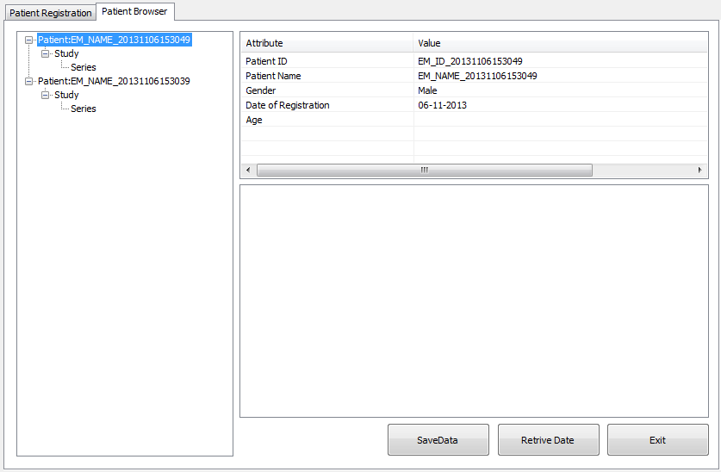
Expected UI.
#Topic: MFC Collection Class

