Slide 1
Smart Contract
Second Price Sealed-Bid Auction
048888
Ameer Saleh
Jiaqi Chen

Slide 2
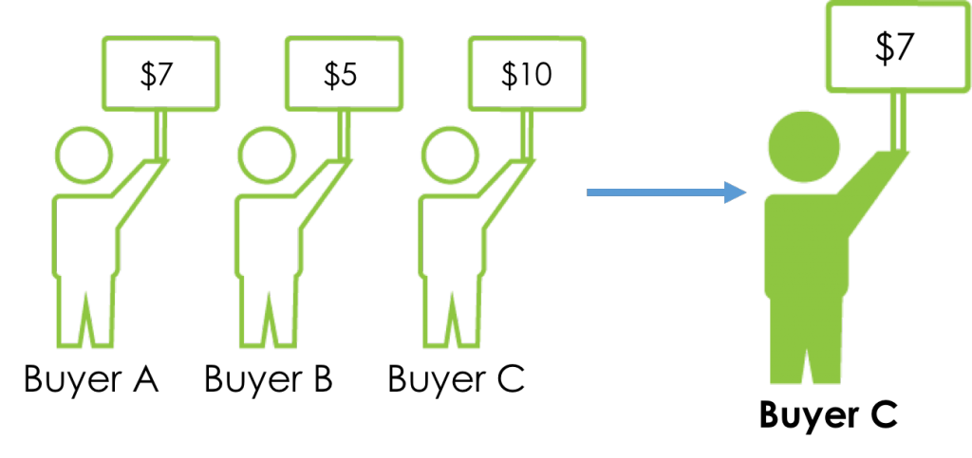
Second Price Sealed-Bid Auction
Basic Format
Participants submit sealed-bid to auction
Highest bidder wins and pays the second highest bid.
More details in the following slides…

Slide 3
Second Price Sealed-Bid Auction
Advantages
“Bidding truthfully” is dominant strategy for second price auction.
Sealed-bid eliminates the risk of inserting fake bids to raise the payment of the winner.

Slide 4
Our Smart Contract Design Considerations
Sealed-bids
Hash(Hash(bid) || Hash(salt))
Spoof Proof
Escrowed fund
Timeline
Timestamps are not reliable.
Block numbers are deterministic
Use block numbers to approximate time (≈15 sec/block)

Slide 5
Our Smart Contract Design Considerations
Minimizing storage
IPFS file for auction details
Reserved Price
Auction Stages
Bidding period
Revealing period
Claiming period

Slide 6
Example run
Auction Deployment
B bids
C bids
Auction Starts
A bids
D bids
Escrow fund = 3 reserved price = 4
B reveals 5
A reveals 10
C reveals 9
Owner withdraws balance
C refunded 3
A pays 6
B refunded 3
Bidding Period
Claiming Period
Revealing Period

Slide 7
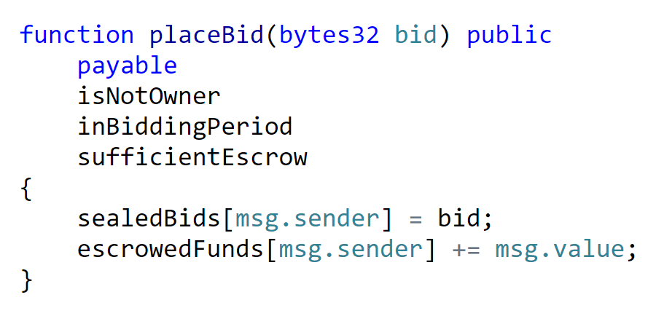
Some Code

Slide 8
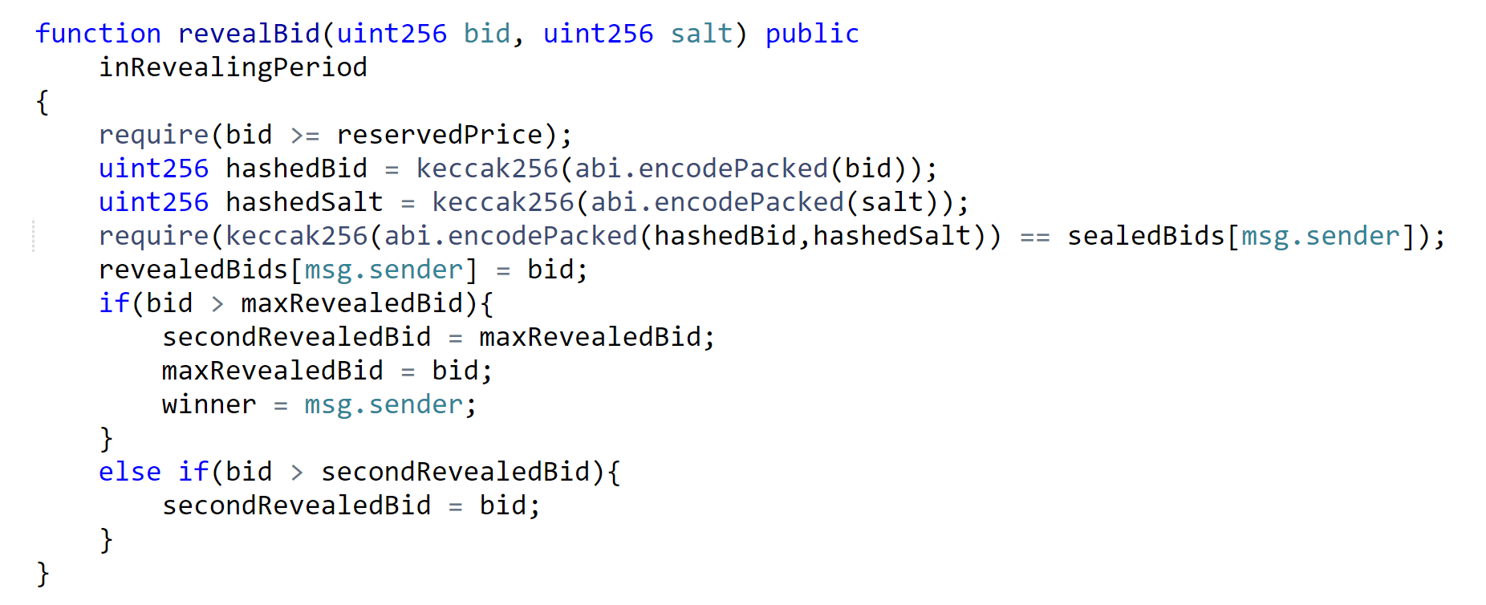
Some Code

Slide 9
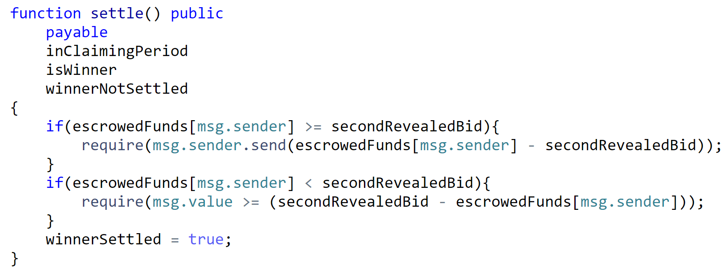
Some code

Slide 10
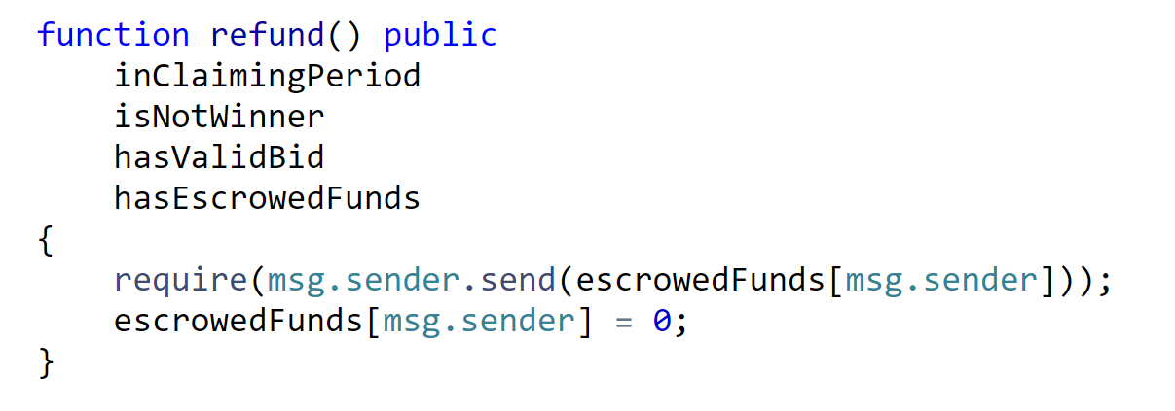
Some code

Slide 11
Potential Improvements
Add buyer protection
Seller delivers to get deposit refund.
Buyer confirms receipt to get escrow refund.
Use third party courier.
Implement ERC20 Auction Token.

Slide 12
Questions?

