Slide 1



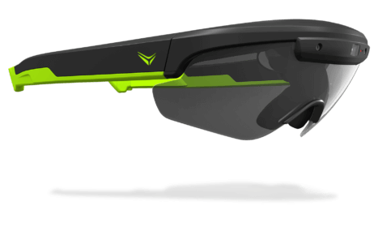
Geolocation Based Augmented Reality
Using everysight Raptor glasses with head’s up display

Slide 2
Directed by: Dr. Hector Rotshtein
Students: Ameer Saleh
Qasem Sayah

Slide 3
Agenda
Overview
Work flow
logic
Summary

Slide 4
Overview
Main goal is to build the main logic for developing geolocation based augmented reality apps to run on everysight’s glasses.
Provide a user friendly library to augment objects on the HUD depending on assigned location and given drawable object.
Using only sensors and GPS receiver available on the glasses and android phones.

Slide 5
Workflow
Getting familiar with android development and the glasses features.
Understanding given example apps.
Reviewing and studying:
android sensors.
positioning and GPS.
Basic computer graphics (rotation matrices, projection).
Articles about augmented reality.
We found very few developments of geolocation based AR.
Wikitude.
Development of Geolocation based AR from scratch.

Slide 6

Wikitude – unsuccessful try
Wikitude is a SDK that provides API for geolocation based augmented reality
We built a simple android app that displays a 3D object at a given location using their SDK.
Worked on our phone, was pretty good.
Problem is: the geolocation API is in java script and doesn’t run on the glasses
There goes two months.

Slide 7
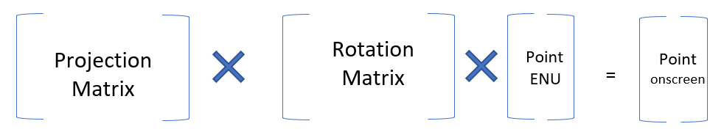
Breaking down the math
Objective: given the current location, orientation and target location, calculate the target’s position on the screen

Slide 8


Rotation
Rotation is calculated by sensor fusion of the Accelerometer, Gyro and magnetometer on board the glasses
TYPE_ROTATION_VECTOR in the sensor manager.
The rotation is relative to the ENU coordinates system.
We can calculate the target point’s position in ENU.
Yaw around the UP axis
Pitch around the EAST axis

Slide 9
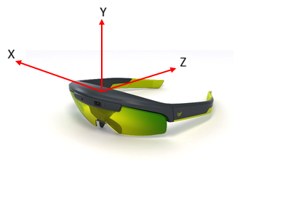
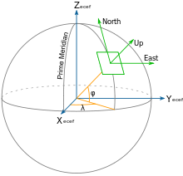
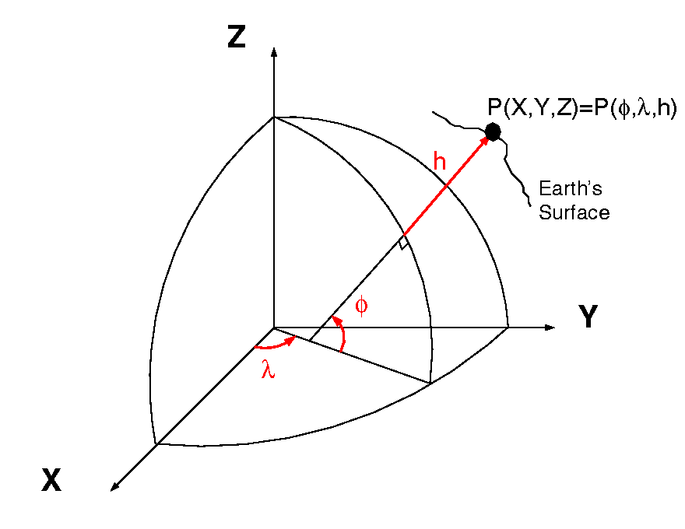
Position
We calculate each target point relative to our current location in EastNorthUp coordinates system.
First we calculate each point in EarthCenteredEarthFixed coordinates system
Then we calculate the vector from the point to our HUD in ENU.
ECEF
ENU

Slide 10
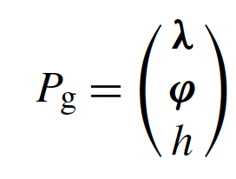
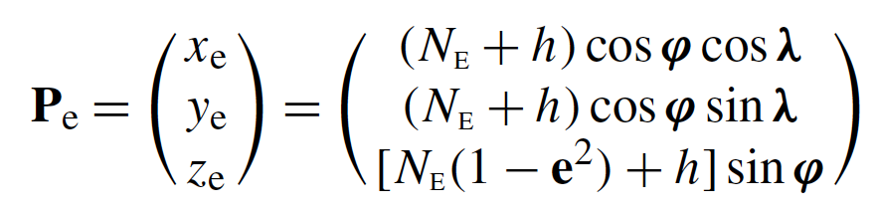
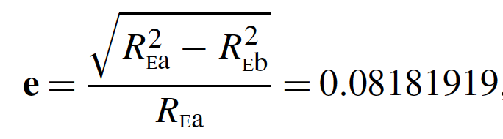
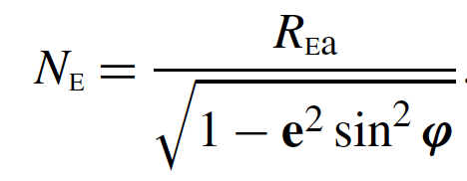

LLA coordinate to ECEF
Latitude
Longitude
altitude
Delta ECEF to ENU

Slide 11
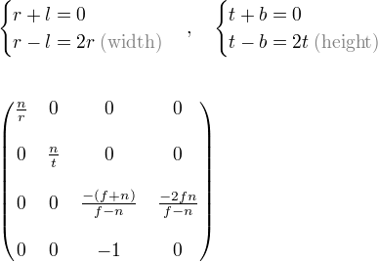
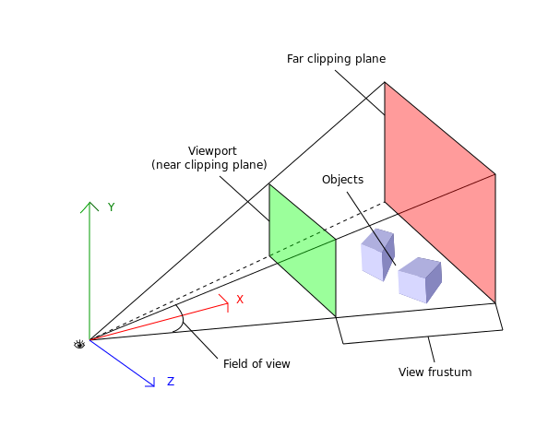
Projection:
We want to translate points from ENU to our 2D HUD.
We want to project only points that fall within our line of sight.
➔ We use a projection frustum to filter these points.

Slide 12
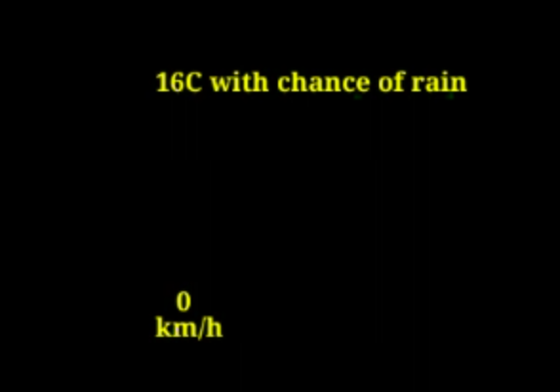
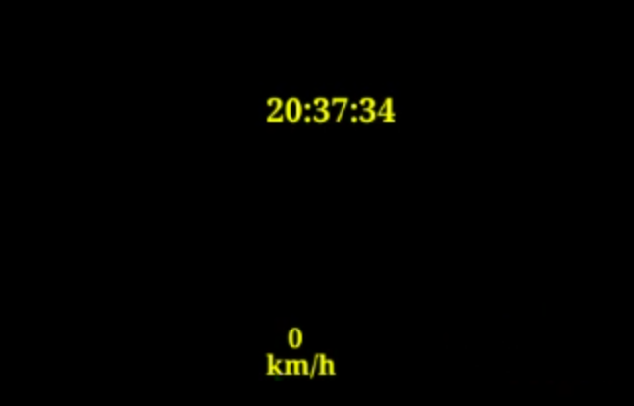
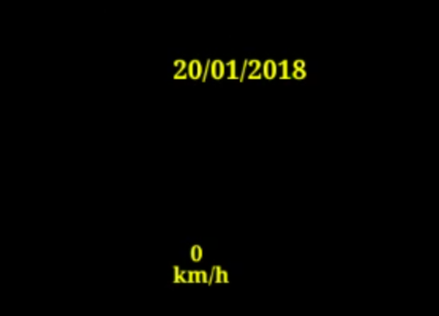
Widgets
Widgets are still objects that are displayed after head movement in a specific direction.
API user can specify movement at which the widget is displayed.
Can override the draw function.
Going back to previous head orientation hides the widget.

Slide 13
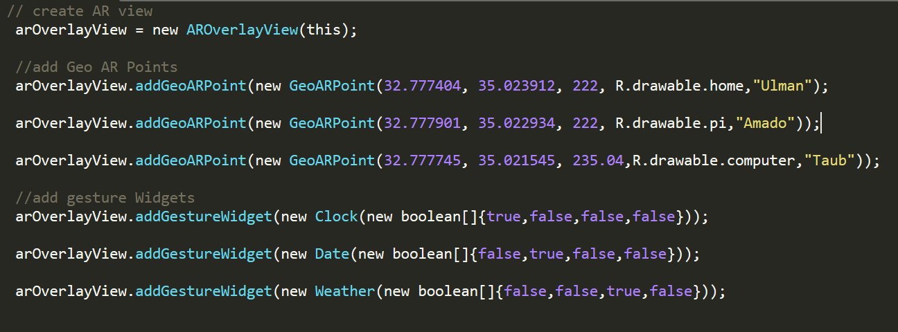
API

Slide 14
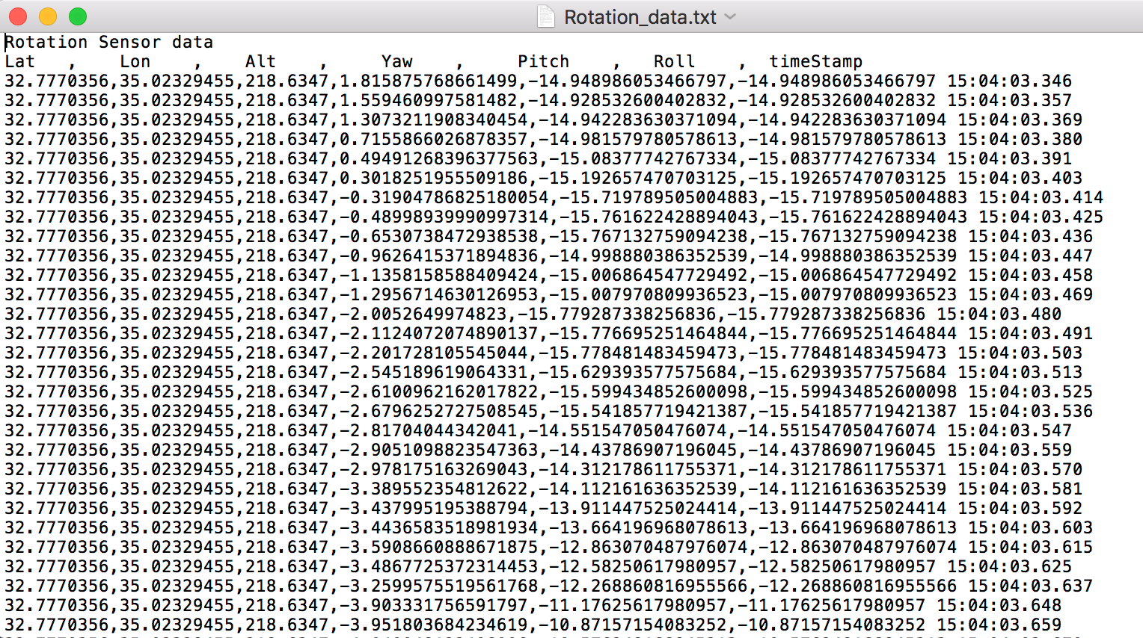
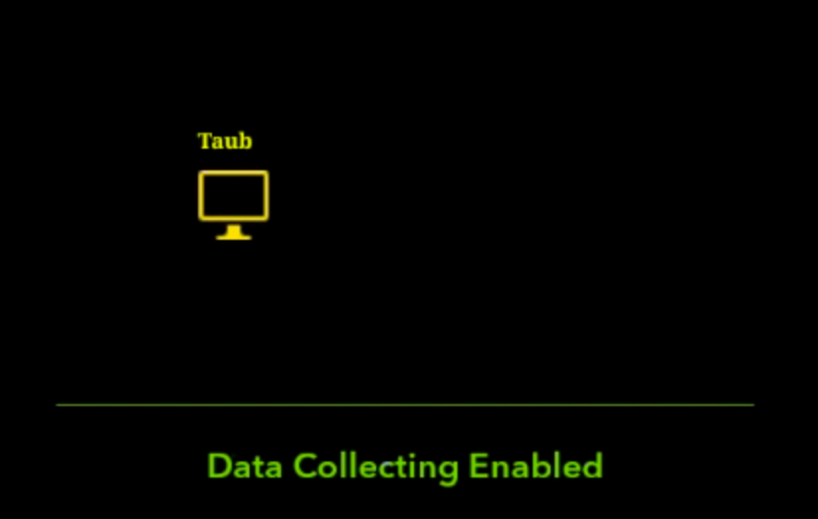
Data collection
We log sensor and location events (currently by user’s activation)
Aim is to collect data for analysis, future uses (like building trails)
Used it to analyze drift in rotation and location bias.

Slide 15
Experiment
We observed inaccuracy in point projections even if the location and orientation are still.
We recorded pitch, yaw angles and GPS coordinates from a still position outside for about 30 minutes.
We saw that the yaw and pitch angles were precise and accurate (~1.5 degrees between max and min).
We observed inaccuracy of GPS readings, up to 61 meters between furthest points.

Slide 16
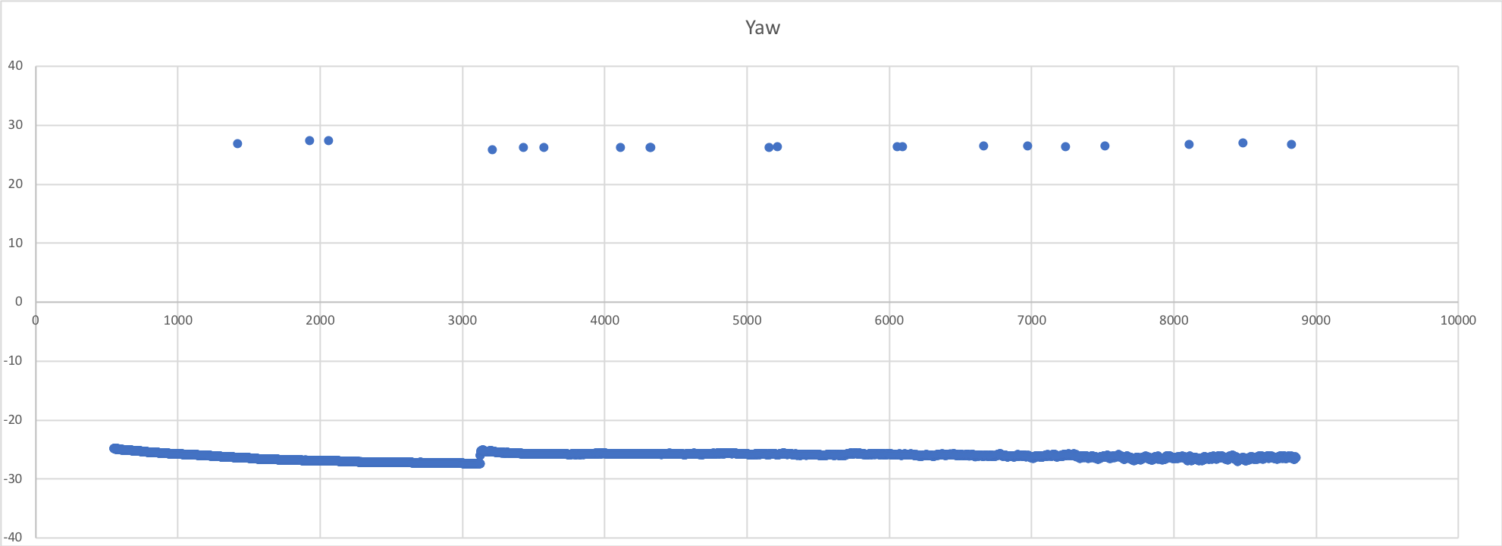
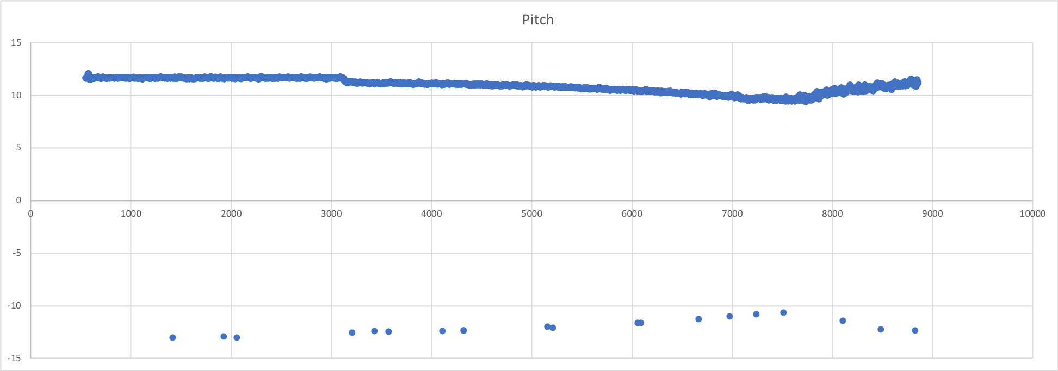

Slide 17
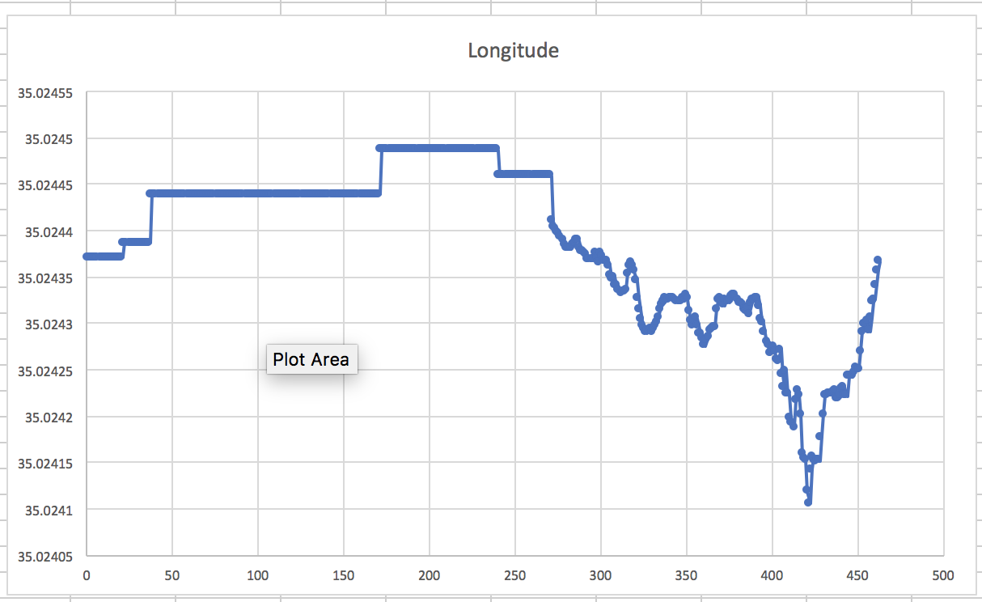
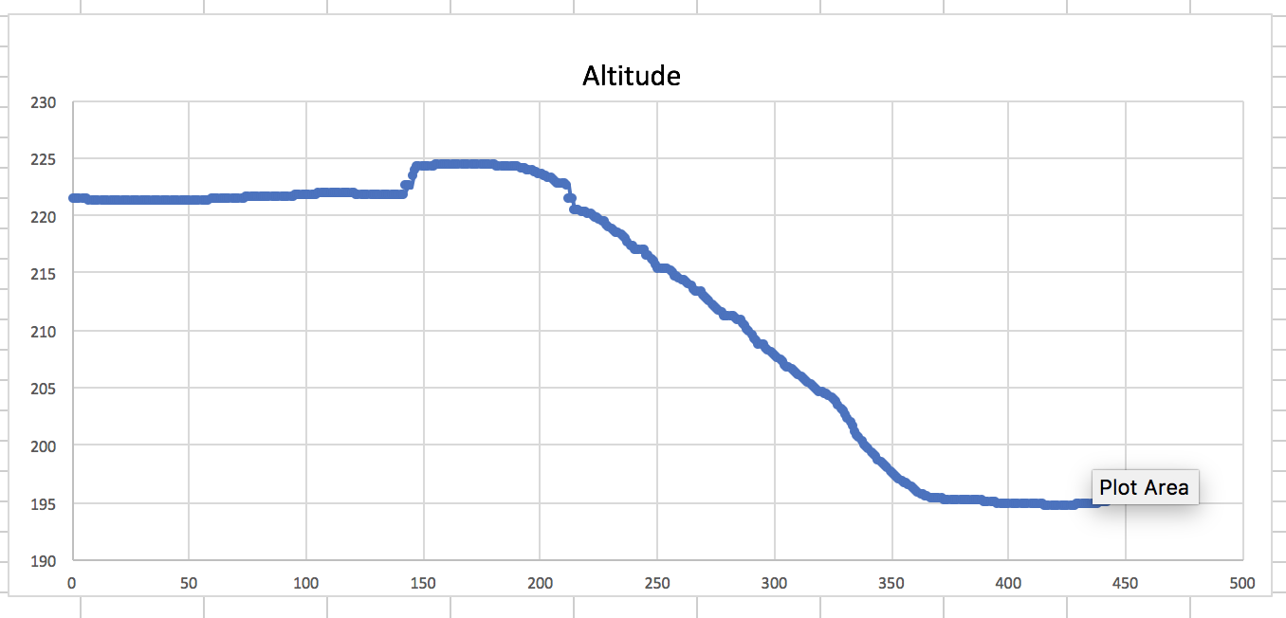
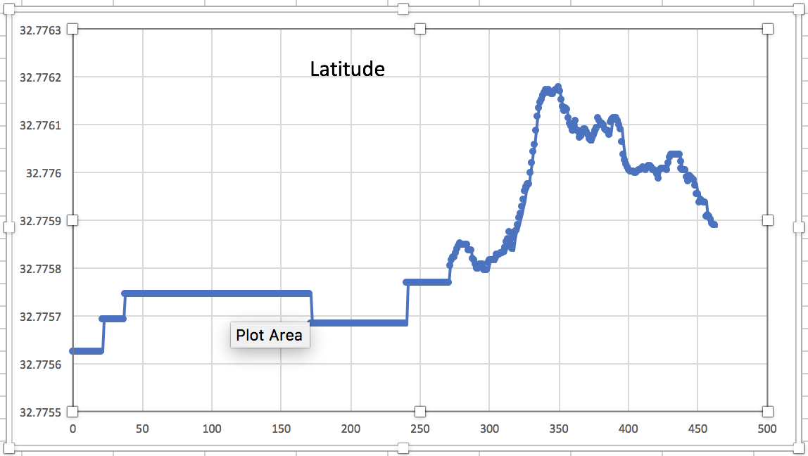

Slide 18
Future development
Improving the readings of the sensors and GPS.
Using filters (Kalman)
Using complex algorithms
Improving the performance of the API
improve power utilization by efficient sensors and GPS management
Adding more feature for the library.
Build trail of points
Scaling of objects
Flexible projection distance range for each point
Make widgets relative AR objects

Slide 19
Thanks!! ☺

