Slide 1
COA/CA Project Methodology
Processor Analysis using the SimpleScalar Simulator
Benchmarks Utilized: go.ss, gcc95.ss, and ijpeg.ss
Simulation Tool: sim-outorder executed on Ubuntu via Oracle VM
Roll no: BSEE23038
Roll no: BSEE23016

Slide 2
Project Workflow
Modified processor, cache, and branch predictor parameters
Executed simulations using sim-outorder
Redirected simulation outputs to .txt files
Extracted required statistics using grep commands
Prepared tables, graphs, and comparative analyses

Slide 3
Part I Methodology
Benchmarks Selected: go.ss and gcc95.ss
Evaluated Small, Medium, Large, and Excessive cache configurations
Configured cache parameters using -cache:il1, -cache:dl1, -cache:dl2, and -cache:il2 options
Recorded sim_cycle and sim_CPI performance metrics

Slide 4
Part I Output Analysis
Extracted sim_cycle values using grep sim_cycle
Extracted sim_CPI values using grep sim_CPI
Compared execution cycles and CPI across multiple configurations
Generated graphs with memory model size represented on the X-axis

Slide 5
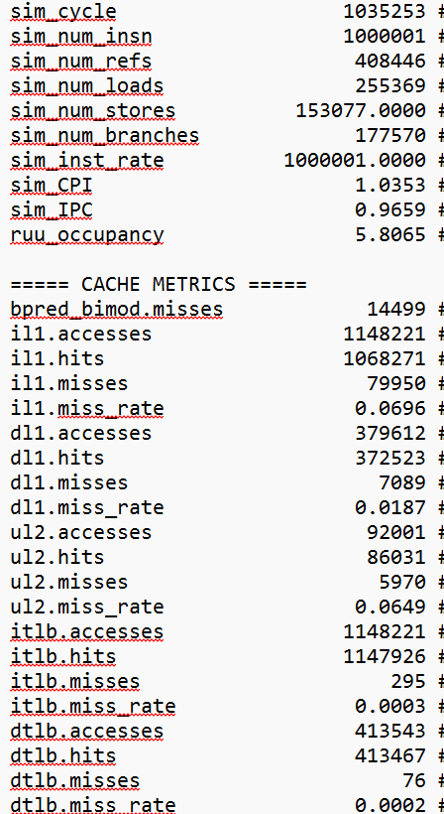
Results
For gcc95.ss
Small Processor:

Slide 6
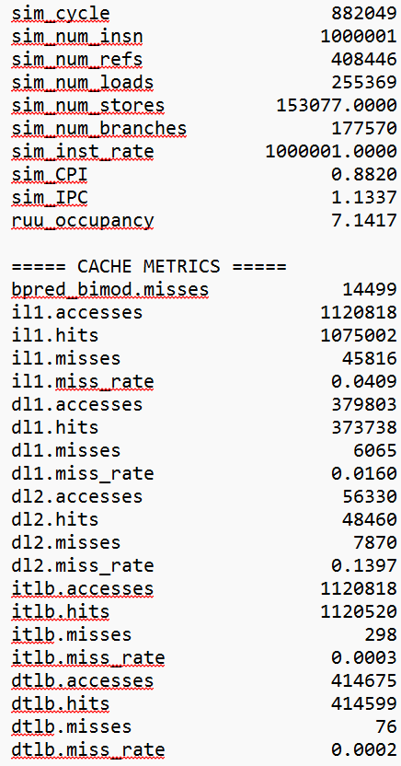
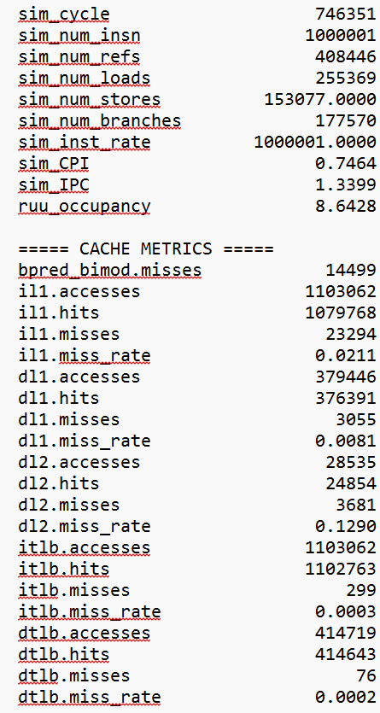
For gcc95.ss
Medium Processor:
Large Processor

Slide 7
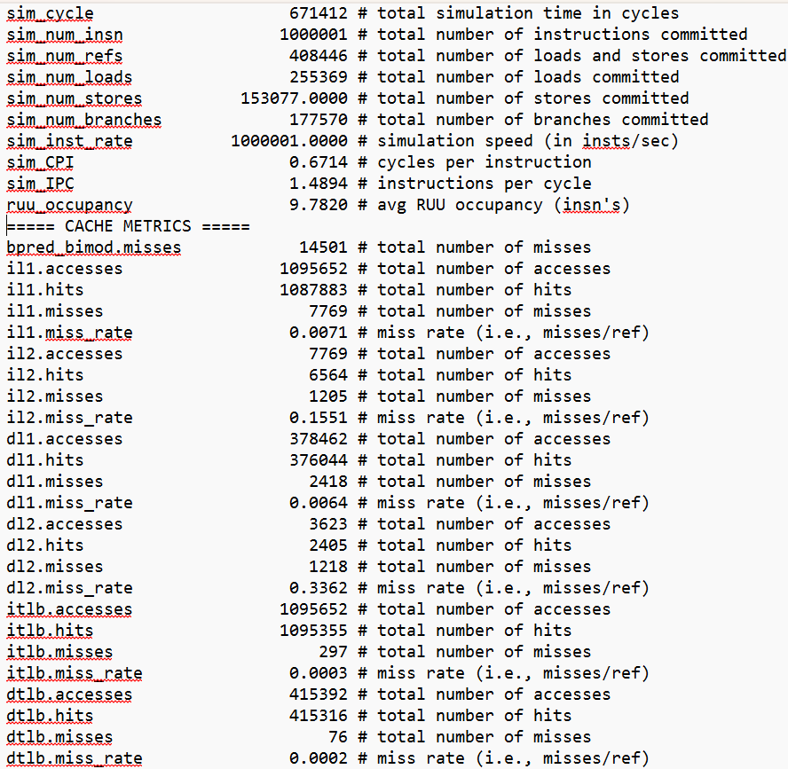
For gcc95.ss
Excessive Processor:

Slide 8
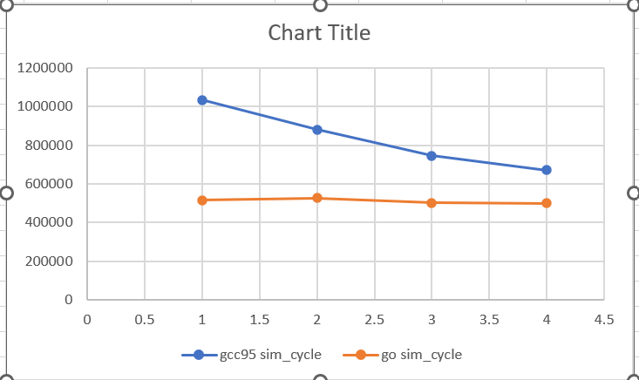
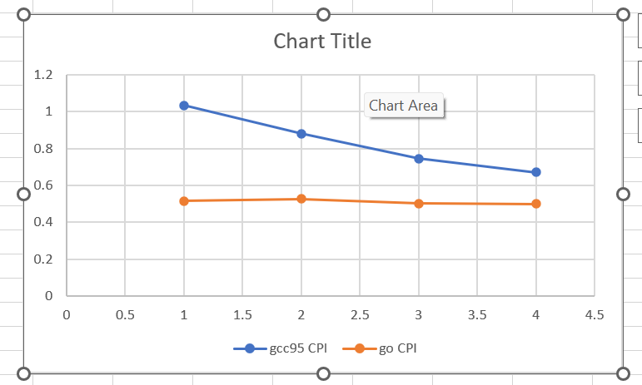
For gcc95.ss
Execution Time
CPI
Rest of the Screenshots and Values are shown in Appendix

Slide 9
Part II(a) Methodology
Compared branch predictors using ijpeg.ss with large.ppm input
Evaluated Bimodal predictor configurations: 512, 1024, and 2048
Evaluated 2-Level predictors with varying history widths and table entries
Implemented Combination predictors integrating Bimodal and 2-Level schemes

Slide 10
Part II(a) Analysis
Extracted directional hits and miss statistics
Utilized grep commands for bpred_bimod, bpred_2lev, and bpred_comb
Prepared comparative performance tables
Generated branch predictor performance graphs

Slide 11
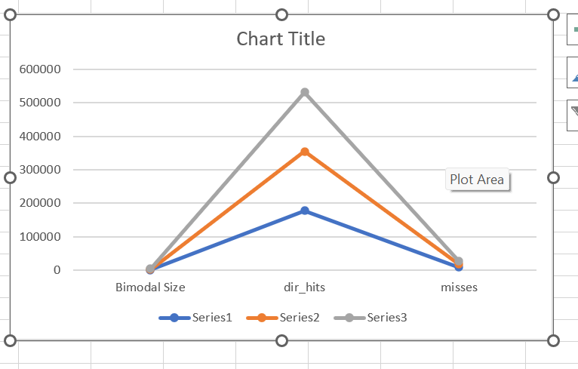
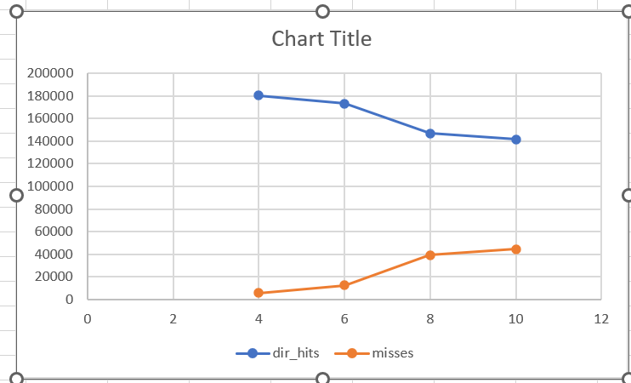
Results
Bimodal Size
2-Level Width Comparison

Slide 12
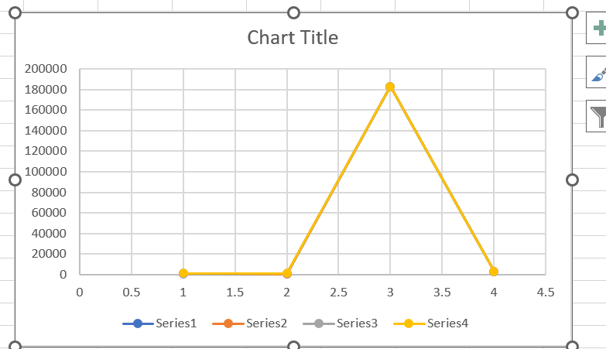
Results
Combination Predictor

Slide 13
Part II(b) BTB Methodology
Compared BTB performance using addr_hits statistics
Varied the number of BTB sets
Analyzed different associativity configurations
Compared configurations with a fixed total BTB size

Slide 14
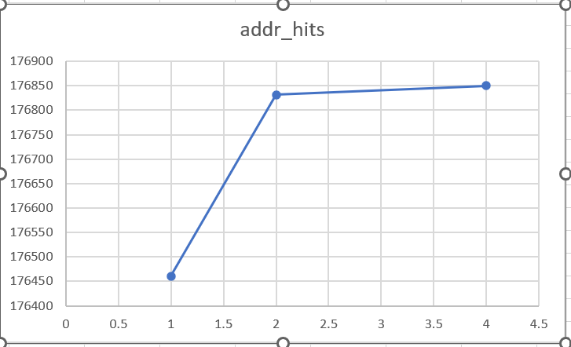
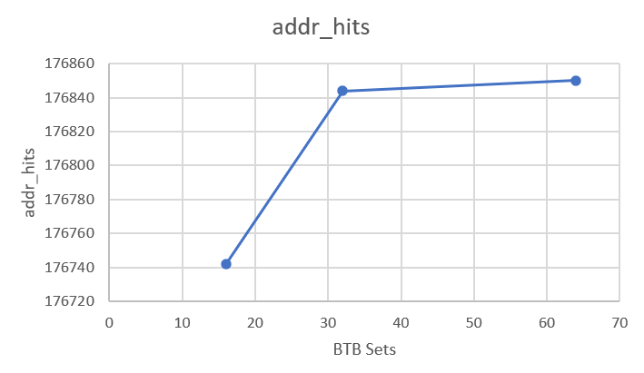
Results
BTB Associativity
BTB Sets

Slide 15
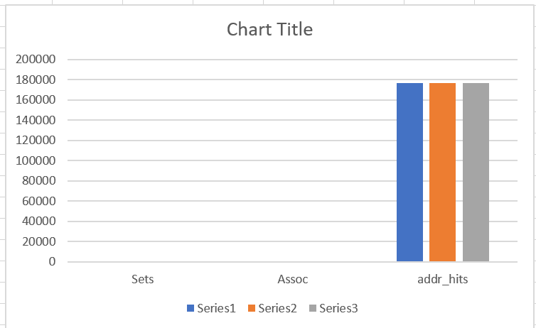
Results
Fixed BTB Size
Exact values, given both in excel and appendix

Slide 16
Part III Methodology
Selected Benchmark: ijpeg.ss
Compared bimod, taken, nottaken, and 2-level branch predictors
Analyzed IFQ size, decode width, and issue width
Compared in-order and out-of-order execution models

Slide 17
Part III Cache Analysis
Varied Data Cache L1 parameters: nsets, block size, and associativity
Varied Instruction Cache L1 parameters: nsets, block size, and associativity
Extracted cache hit-rate and miss-rate statistics
Plotted cache performance evaluation graphs

Slide 18
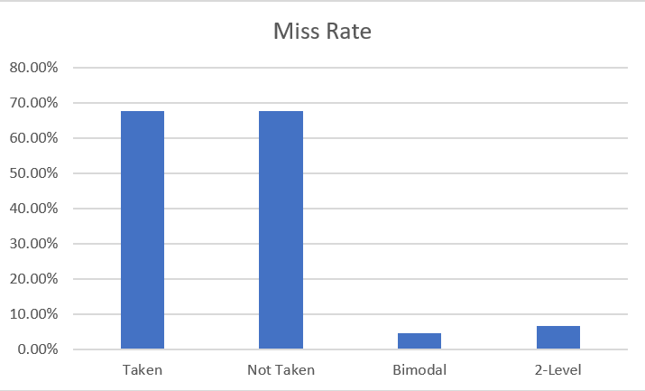
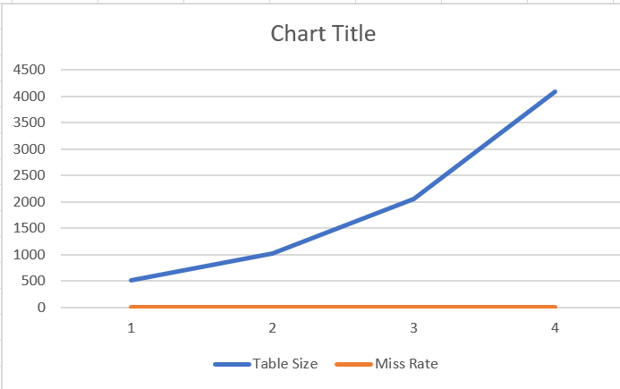
Results
Branch Predictor Comparison
Bimodal Size vs Miss Rate

Slide 19
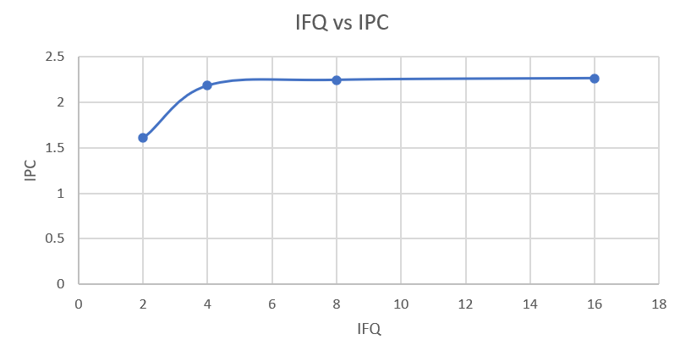
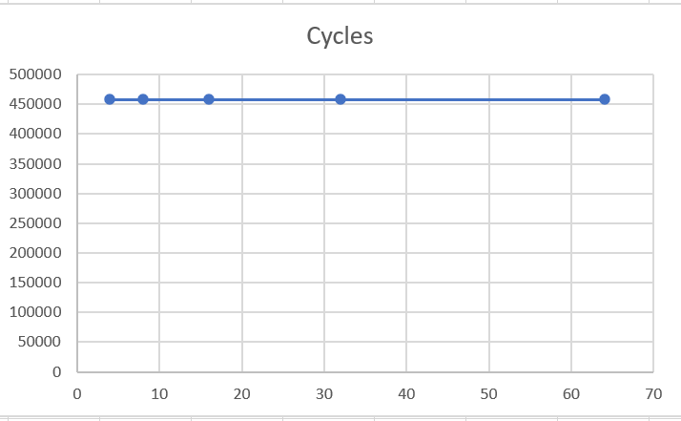
Results
IFQ Size vs IPC
Decode Width vs Cycles

Slide 20
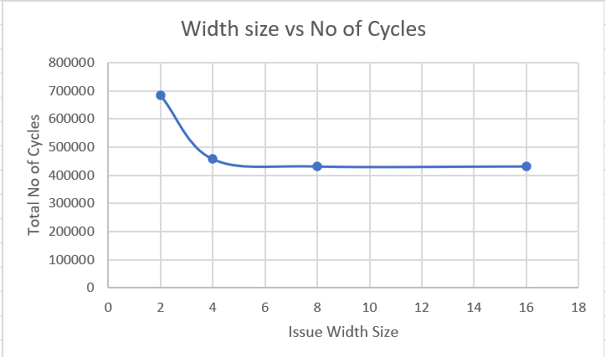
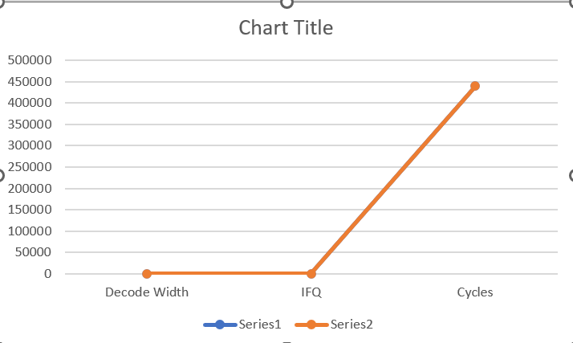
Results
Issue Width vs Cycles
When both IFQ and decode width are changed

Slide 21
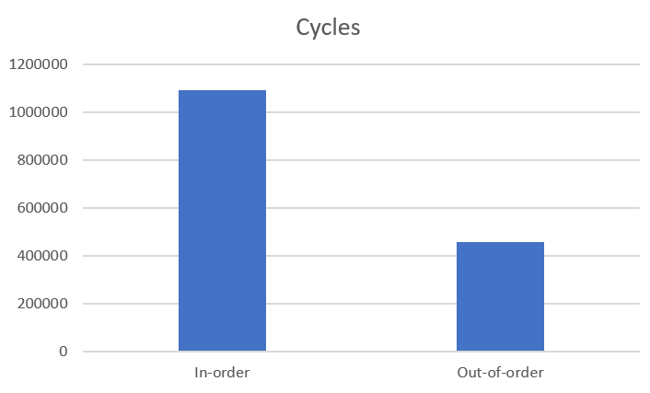
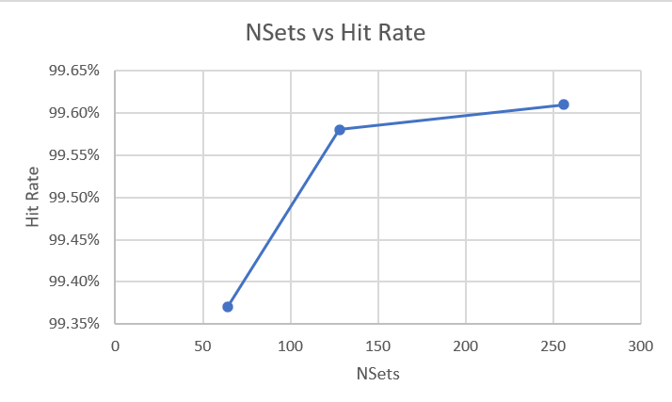
Results
In-order vs Out-of-order
DCache Hit Rate vs nsets

Slide 22
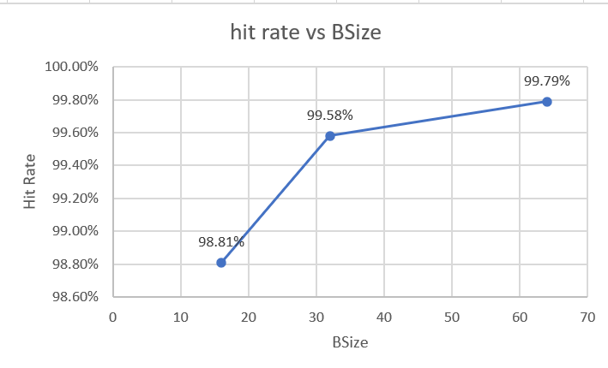
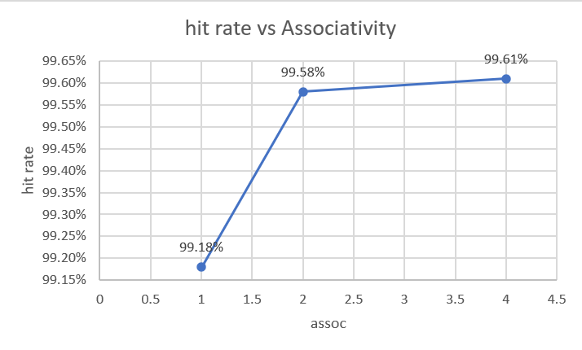
Results
DCache Hit Rate vs bsize
DCache Hit Rate vs Associativity

Slide 23
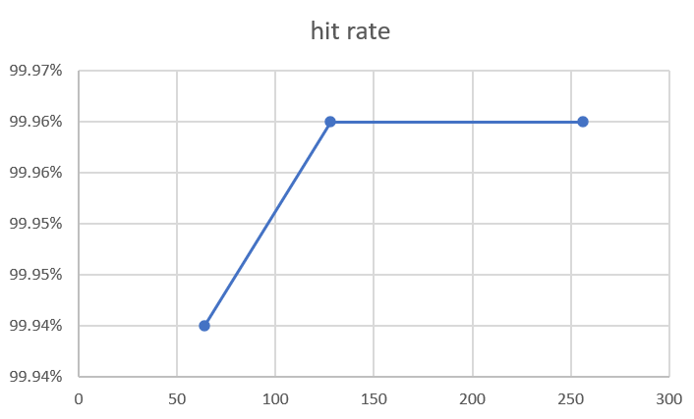
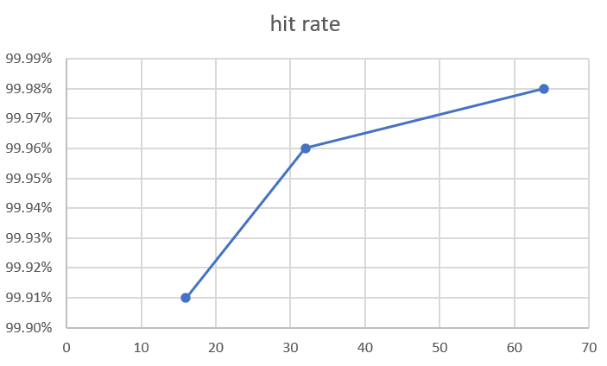
Results
ICache Hit Rate vs nsets
ICache Hit Rate vs bsize

Slide 24
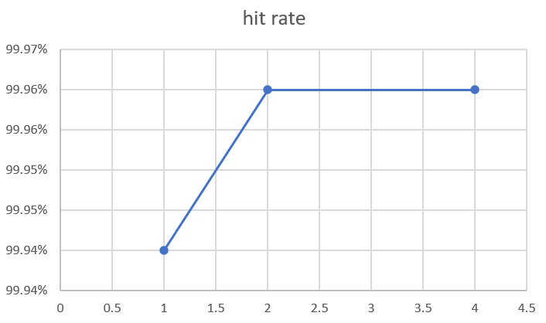
Results
ICache Hit Rate vs Associativity

Slide 25
Part IV Methodology
Designed an optimized processor configuration for ijpeg.ss
Constraints Applied: bimod predictor only, in-order issue, and 512B total memory
Allocated 7 shared units among IFQ, decode width, and issue width
Evaluated multiple valid processor configurations

Slide 26
Part IV Final Selection
Compared sim_cycle values across all evaluated configurations
Selected the processor configuration with minimum execution cycles
Balanced predictor, cache, and pipeline width parameters
Provided detailed justification for the final optimized design

Slide 27
Results
Comparison of Different Configurations

Slide 28
Results
Comparison of Different Configurations
After comparing the simulation cycles of all tried configurations, we found that Configuration C gave the minimum cycles. Although, the difference was not too significant, C turns out to be the optimum Processor.
Details are as following:
IFQ: 4 Decode Width: 2 Issue Width:1
Sim Cycles: 1316840
All configurations were tried keeping the given constraints in view.

Slide 29
Conclusion
The project was successfully completed through simulation-based evaluation
Results were validated using tables, graphs, and comparative analyses
The optimal processor configuration was selected based on minimum sim_cycle
SimpleScalar provided comprehensive architectural performance insights

Slide 30
Key Achievements
• Successfully analyzed processor performance using SimpleScalar
• Evaluated cache and branch predictor configurations systematically
• Compared architectural trade-offs using CPI and execution cycles
• Identified an optimized processor design under given constraints

