Slide 1
DEPARTMENT OF AGRICULTURE · SEASON 2026
Agricultural Input Subsidy
Distribution Register
A working register that checks entitlement at the point of issue —
so duplicate collection and missed entitlements stop happening quietly.
PRACTICAL ASSESSMENT — SIH 2026
Live demo: agriculture-subsity-distribution-re.vercel.app
PDKVCET CSE, PDKV

Slide 2
THE PROBLEM
A paper register that no one has time to search
Farmers
Some collect their seed or fertiliser twice; others are turned away for an entitlement they never actually received — because no one could check in time.
Distribution officers
At peak season, searching pages by hand is too slow to do for every farmer in the queue, so the check is skipped.
The department
Once the season ends, there is no way to reconstruct who actually collected what — the record and the loss both disappear together.
2 / 8

Slide 3
OUR SOLUTION, IN ONE SENTENCE
A register that checks a farmer's entitlement the moment it is issued —
so nothing can be handed out twice, and nothing goes missing unrecorded.
No technical words. That's the whole idea — the computer does the checking
that a busy counter never has time to do by hand.
3 / 8

Slide 4
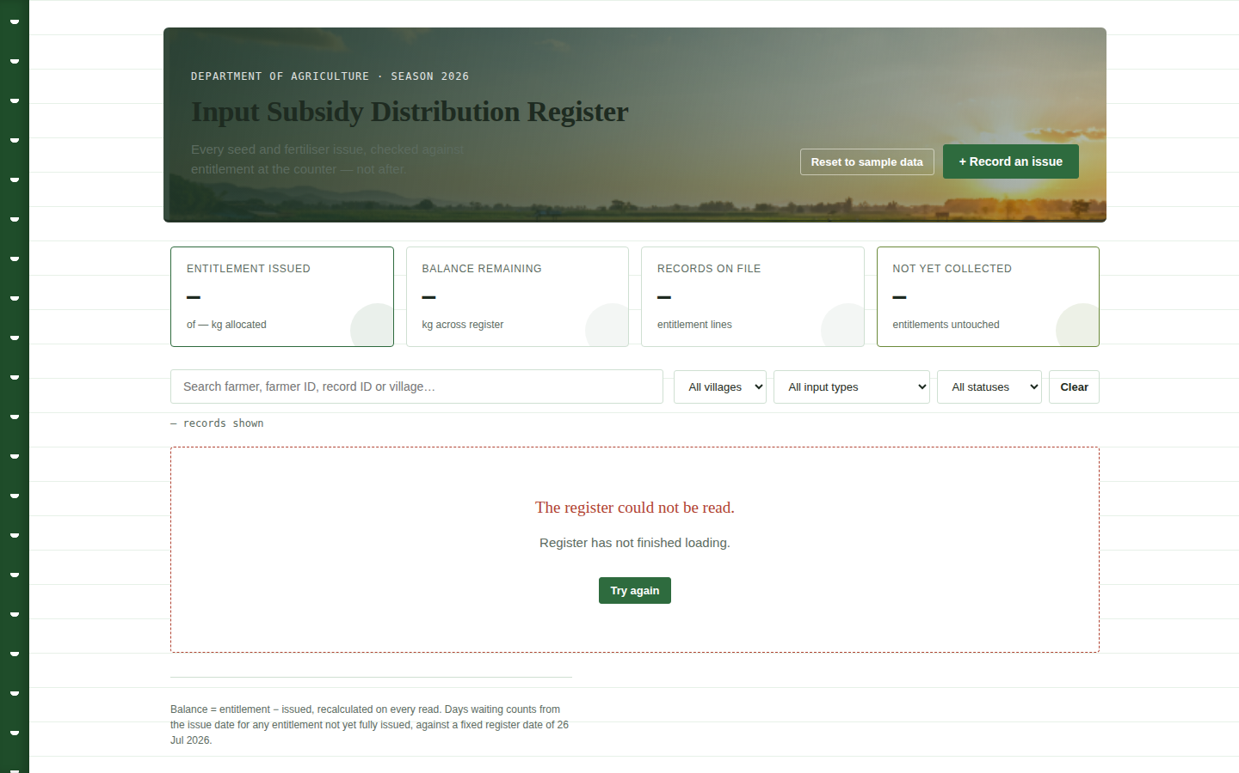
THE MAIN SCREEN
Every entitlement, one register, nothing hidden
4 / 8

Slide 5
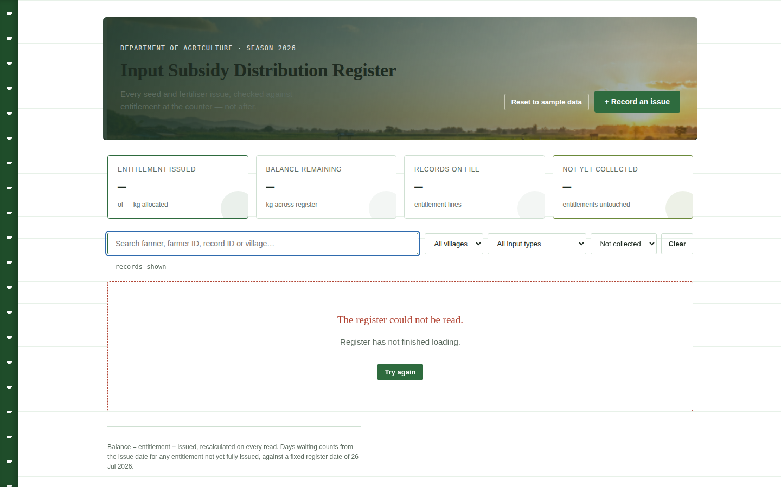
FINDING A RECORD INSTANTLY
Search and filters update the list as you type
Filtered to "Not collected" — the count updates live so the operator always
knows whether a filter is hiding rows, not the data.
5 / 8

Slide 6
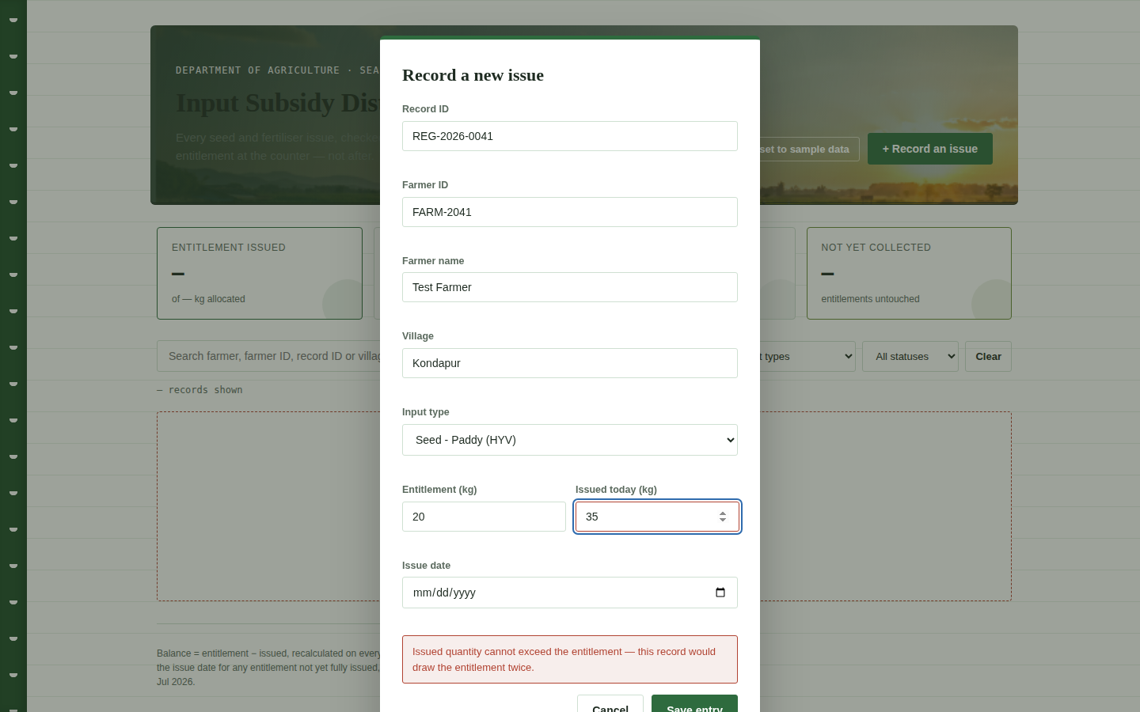
PREVENTING A DUPLICATE DRAW
The register refuses to issue more than the entitlement
This check happens the moment an entry is saved — not afterwards.
Try to issue more than a farmer is entitled to, and the form is rejected with a plain-language reason before it ever reaches the register.
The same rule stops two different entries from sharing one record ID — which is what makes a duplicate collection impossible to save by accident.
6 / 8

Slide 7
HOW THE NUMBERS ARE CALCULATED
Every figure comes from one formula, computed once
Entitlement
−
Issued
=
Balance
Status
Fully issued / Partial / Not collected / Unrecorded — set from the balance and whether an issue was ever logged.
Days waiting
Days since the issue date, shown only while an entitlement is not yet fully issued.
Register totals
Sums and status counts recalculated across every record on each read — not just the ones on screen.
7 / 8

Slide 8
WHERE IT STANDS
What works, what's unfinished, what's next
Working now
Unfinished
Next improvement
Live search across name, farmer ID, record ID, village
Filter by village, input type and status together
Balance, status and days-waiting computed centrally
Server-style validation rejects over-issue and duplicate record IDs
Loading, empty and error states all handled
No delete/void of a record, only create and edit
Duplicate-issue check works on record ID, not yet on farmer + input type across a season
Data lives in the browser (localStorage), not shared across devices
Add a real shared database so every distribution counter sees the same register live, closing the one gap a browser-only build can't.
8 / 8

