Slide 1

Design and Analysis of Algorithms
Dinesh Singh
Department of Computer Science & Engineering

Slide 2
DESIGN AND ANALYSIS OF ALGORITHMS
Transform and Conquer
Dinesh Singh
Department of Computer Science & Engineering

Slide 3
Design and Analysis of Algorithms
Transform and Conquer
Transform and Conquer Technique
Design strategy based on transforming a problem into a form that is easier to solve.
Works in two stages:
1. Transformation stage
2. Conquering (solving) stage

Slide 4
Design and Analysis of Algorithms
Transform and Conquer
Stage 1: Transformation
The original problem instance is modified to make it easier to solve.
Transformation may simplify the problem or change its representation.
Stage 2: Conquering
After transformation, the modified problem is solved using an appropriate algorithm

Slide 5
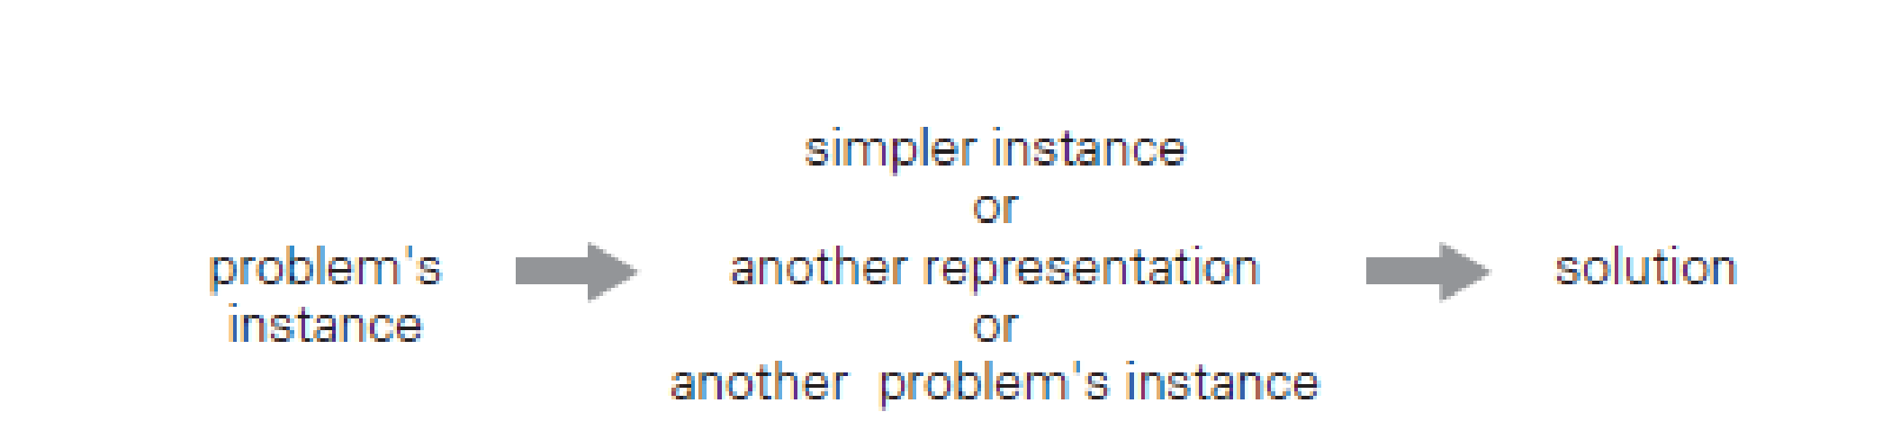
Design and Analysis of Algorithms
Transform and Conquer
Major Variations of Transform and Conquer
1. Instance Simplification
2. Representation Change
3. Problem Reduction

Slide 6
Design and Analysis of Algorithms
Transform and Conquer
Instance Simplification
Transforms the problem into a simpler or more convenient instance of the same problem.
Example: Presorting data before applying another algorithm
Representation Change
Transforms the problem into a different representation of the same instance.
The new representation makes the problem easier to solve.
Representation change : Heaps, Heap Sort, Red Black Trees, 2-3 Trees

Slide 7
Design and Analysis of Algorithms
Transform and Conquer
Problem Reduction
Transforms the problem into another problem for which a known algorithm already exists. The solution to the new problem helps solve the original problem.

Slide 8
Design and Analysis of Algorithms
Transform and Conquer
Presorting
Presorting is a technique where the input data is sorted first to make solving the problem easier.
Many algorithmic questions become simpler when the list is sorted.
The overall efficiency depends on the efficiency of the sorting algorithm used.

Slide 9
Design and Analysis of Algorithms
Transform and Conquer
Example: Element Uniqueness Problem
Problem: Check whether all elements in an array are unique.
Brute-force approach compares all pairs of elements.
Worst-case complexity: Θ(n²).
Presorting Idea
Instead of comparing all pairs:
1. Sort the array.
2. Compare only consecutive elements.
If duplicates exist, they must appear next to each other

Slide 10
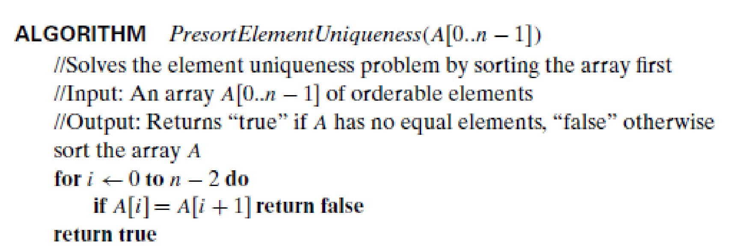
Design and Analysis of Algorithms
Transform and Conquer

Slide 11
Design and Analysis of Algorithms
Transform and Conquer
Running Time Analysis
T(n) = T-sort(n) + T-scan(n)
Sorting requires Θ(n log n).
Scanning requires Θ(n).
Overall complexity: Θ(n log n).
Using a good sorting algorithm (e.g., Merge Sort), the presorting approach solves the element uniqueness problem in Θ(n log n) time

Slide 12
Design and Analysis of Algorithms
Transform and Conquer
Computing a Mode
A mode is the value that occurs most frequently in a list of numbers.
Example: For the list {5,1,5,7,6,5,7}, the mode is 5.
If several values have the same highest frequency, any of them can be considered a mode.

Slide 13
Design and Analysis of Algorithms
Transform and Conquer
Brute Force Approach
Scan the list and compute the frequency of every distinct value.
Maintain a separate list storing:
• Distinct elements encountered
• Their frequencies.
For each element in the original list:
Compare it with elements in the auxiliary list.
If a match is found, increase its frequency.
Otherwise, add it as a new distinct value with frequency = 1.

Slide 14
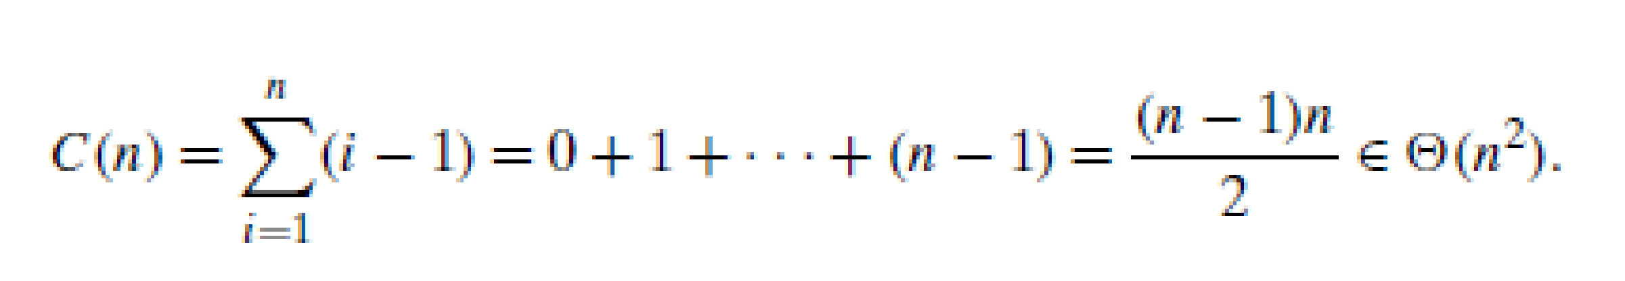
Design and Analysis of Algorithms
Transform and Conquer
Worst Case Scenario
The worst case occurs when the list has no equal elements.
Each element must be compared with all previously seen elements.
Number of Comparisons

Slide 15
Design and Analysis of Algorithms
Transform and Conquer
Finding the Mode
After building the frequency list,
scan the auxiliary list to find the value with the largest frequency.
This requires at most (n − 1) additional comparisons
The additional comparisons do not change the overall complexity.
Therefore, the brute-force algorithm has worst-case time complexity Θ(n²).

Slide 16
Design and Analysis of Algorithms
Transform and Conquer
Presorting Approach
1. First sort the input list.
2. Equal values will become adjacent.
3. The mode is the value that forms the longest run of consecutive equal elements
Advantage of Presorting
After sorting, we only need to scan the array once to find the longest sequence of identical adjacent elements.

Slide 17
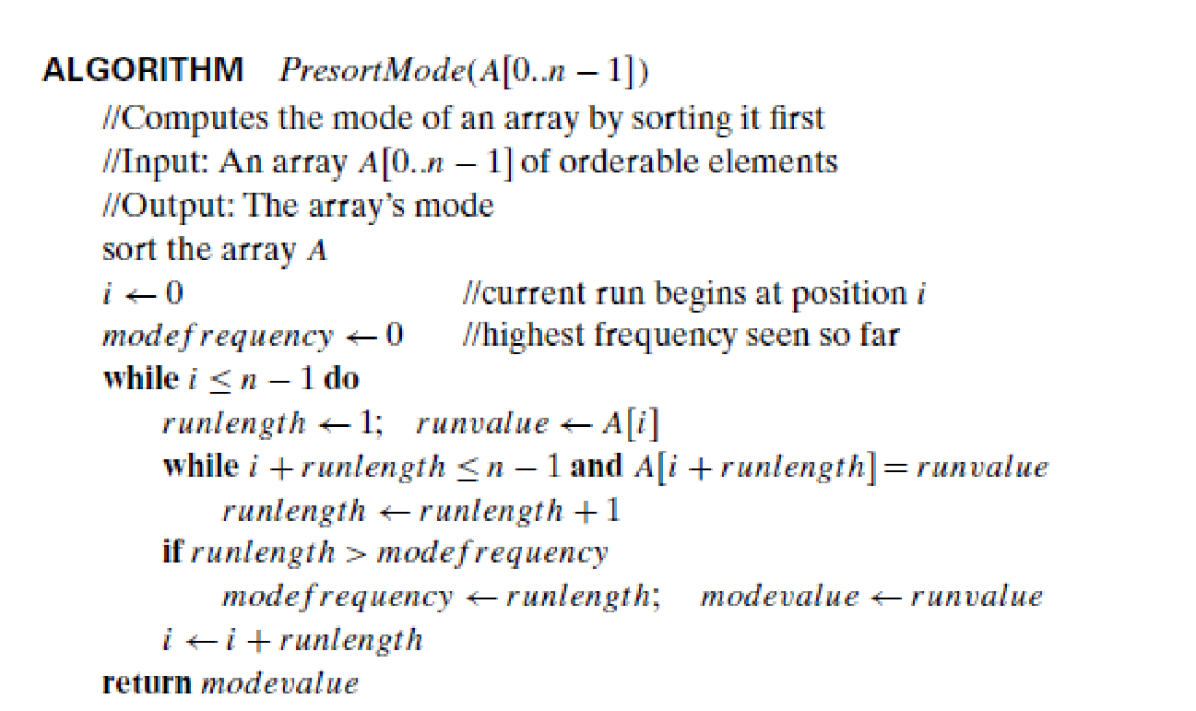
Design and Analysis of Algorithms
Transform and Conquer

Slide 18
Design and Analysis of Algorithms
Transform and Conquer
Time Complexity with Presorting
T(n) = T_sort(n) + T_scan(n)
If sorting uses an efficient algorithm (e.g., Merge Sort):
T(n) = Θ(n log n) + Θ(n) = Θ(n log n).

Slide 19
Design and Analysis of Algorithms
Transform and Conquer
Searching problem
Consider the problem of searching for a given value v in a given array of n sortable items.
The brute-force solution here is sequential search which needs n comparisons in the worst case
If the array is sorted first, we can then apply binary search, which requires only
log₂ n + 1 comparisons in the worst case.
Assuming the most efficient n log n sort, the total running time of such a searching algorithm in the worst case will be

Slide 20
Design and Analysis of Algorithms
Transform and Conquer
Searching problem
This is inferior to sequential search.
But if we are to search in the same list more than once, the time spent on sorting might well be justified

Slide 21
Design and Analysis of Algorithms
Transform and Conquer
Consider the problem of finding the distance between the two closest numbers in an array of n numbers. (The distance between two numbers x and y is computed as |x − y|.)
a. Design a presorting-based algorithm for solving this problem and determine
its efficiency class.
b. Compare the efficiency of this algorithm with that of the brute-force algorithm

Slide 22
Design and Analysis of Algorithms
Transform and Conquer
Sort the array first and then scan it to find the smallest difference between two successive elements A[i] and A[i + 1] (0 ≤ i ≤ n − 2).
If the presorting is done with a ϴ(n log n) algorithm, the running time of
the entire algorithm will be in
ϴ(n log n) + ϴ(n) = ϴ(n log n)
The time efficiency of the brute-force algorithm is in Ɵ(n²) because the algorithm considers n(n − 1)/2 pairs of the array’s elements.

Slide 23
Design and Analysis of Algorithms
Multiple choice Questions
An algorithm checks whether all elements in an array of size n are unique using the presorting technique. The array is first sorted using Merge Sort, and then adjacent elements are compared.
What is the overall worst-case time complexity of the algorithm?
A. Θ(n) B. Θ(nlog⁡n) C. Θ(n²) D. Θ(log⁡n)
Answer B. Θ(nlog⁡n)

Slide 24
Design and Analysis of Algorithms
Multiple choice Questions
Consider the brute-force algorithm for computing the mode of an array by building a frequency list of distinct elements.
If the input contains all distinct elements, how many comparisons are made in the worst case while constructing the frequency list?
A. n B. n(n−1) C. n(n−1)/2​ D. n log⁡n
Answer c. n(n−1)/2​

Slide 25
Design and Analysis of Algorithms
Multiple choice Questions
Suppose an array of n elements is sorted first and then scanned to compute the mode by finding the longest run of identical adjacent elements.
Which of the following statements is TRUE?
A. The scanning step dominates the running time B. The sorting step dominates the running time C. Both steps contribute equally D. The algorithm runs in Θ(n²)
Answer B. The sorting step dominates the running time

Slide 26
Design and Analysis of Algorithms
Multiple choice Questions
Which of the following statements correctly explains why presorting helps solve many algorithmic problems efficiently?
A. Sorting reduces the input size B. Sorting eliminates duplicate elements automatically C. Sorting places related elements together, simplifying later processing D. Sorting reduces the number of comparisons to constant time
Answer C. Sorting places related elements together, simplifying later processing

Slide 27
THANK YOU
Dinesh Singh
Department of Computer Science & Engineering

