Slide 1
Predict Click through rate
Data science workshop – intensive
Ameesh Baxi - ameeshbaxi@gmail.com
30th January 2017

Slide 2
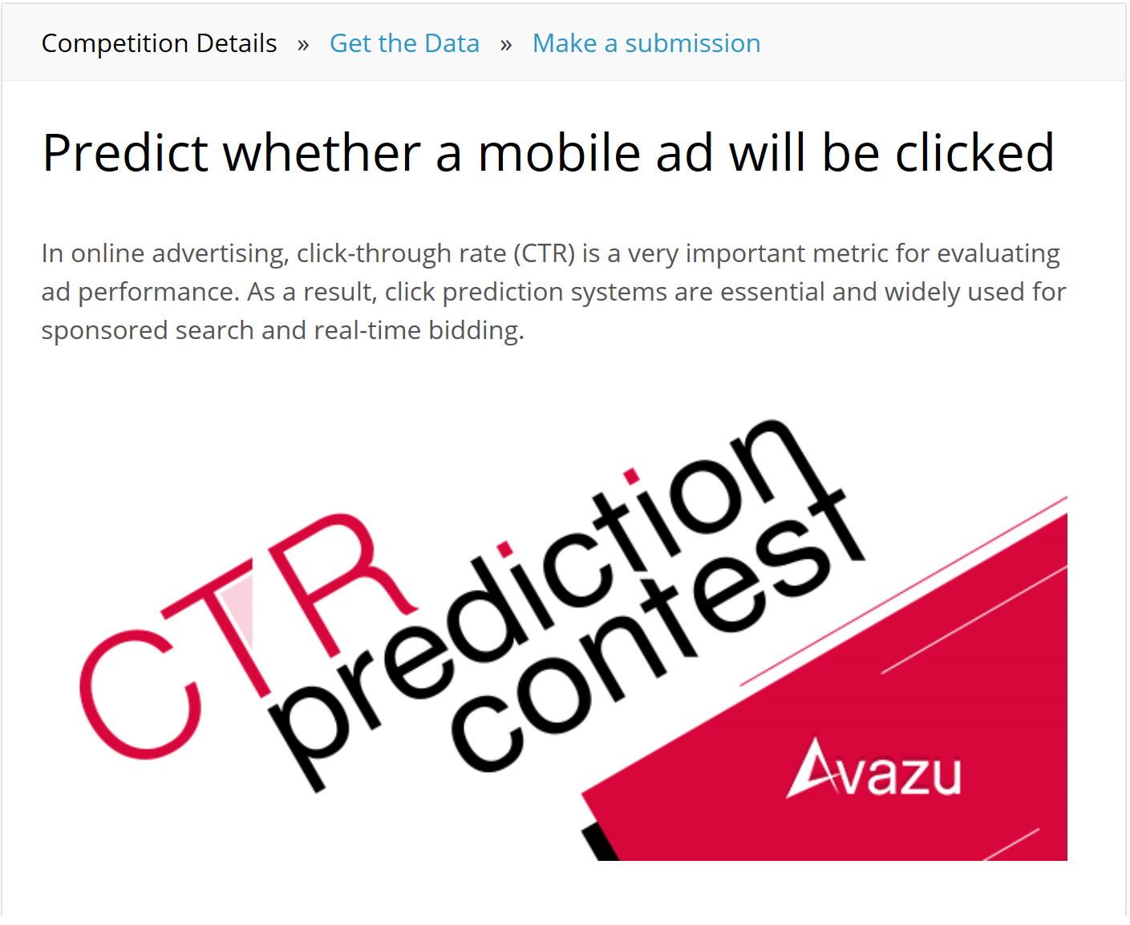
Problem to be solved
The project is to predict whether a mobile ad will be clicked or not.
The project is a completed Kaggle Competition.

Slide 3
Why This Problem?
Click-Through-Rate is a key matric for evaluating ad performance in internet economy.
This problem is still relevant.
Real life problem.
Provides opportunity to apply the course learning.
The project is for my learning!

Slide 4
Data-SET
DATA FIELDS
id: ad identifier
click: 0/1 for non-click/click
hour: format is YYMMDDHH, so 14091123 means 23:00 on Sept. 11, 2014 UTC.
C1 -- anonymized categorical variable
banner_pos
site_id
site_domain
site_category
app_id
app_domain
app_category
device_id
device_ip
device_model
device_type
device_conn_type
C14-C21 -- anonymized categorical variables
Training and Test data-set is available on Kaggle website.
The training data set has 40+ million entries.
Training data-set is 6 Gb in size.
Test data-set is @700 Mb.
Click-Through-Rate of training data-set is about 17%.
Click column provides classification.
Id field will not be used for modeling.

Slide 5
Anonymized Categorical Variables
☹
Most of the fields are self-explanatory around mobile ad being clicked or not.
However, there are anonymized categorical variables.
It would have been good to get an idea about these variables.
Not knowing the name or significance of these fields, any data engineering could not be applied to these fields and they have to be taken as they are given.

Slide 6
Data Cleaning and Sampling
Data Cleaning:
Ensure that hour field is of datetype.
Convert all hex value in string format to integer.
Sampling:
Develop a smaller sample that can be used on local computer.
Data has imbalance classes with 17% positives and 83% negatives.
Ensure that sample could be generated with different positive-negative ratio.

Slide 7
According to theory…
There are about 22 features in play.
There are about 40+ Mil data entries.
For high number of feature set and high volume of data, Random Forest classifier works the best.
For class-imbalance problem, the sample should be balanced.
Random Forest Classifier trained with 50-50 (pos-neg proportion) balanced sample should perform the best.

Slide 8
Data Modeling Approach
With smaller sample on local computer:
Train the following classifier with 50-50, 33-67, 20-80 (pos-neg proportion) samples.
Logistic Regression
SVM / SGD Classifier
Based on the results from above classifiers, use the right sample for Random Classifier.
Ensure that Random Classifier is tuned correctly.
Use GridSearchCV to try different parameters for different classifiers.
On server in cloud compute:
Perform the same steps as local machine with larger data-set on a machine with bigger RAM to train Random Forest Classifier.
The results on server should co-relate with the results on local computer.

Slide 9
glossary
LR: Logistic Regression.
SGDC: SGD Classifier.
RFC: Random Forest Classifier.
LR50: Logistic Regression trained with data-set containing balanced 50-50 positive-negative classes.
LR33: Logistic Regression trained with data-set containing 33% positive class entries.
LR20: Logistic Regression trained with data-set containing 20% positive class entries.
SGDC50: SGD Classifier trained with data-set containing balanced 50-50 positive-negative classes.
SGDC33: SGD Classifier trained with data-set containing 33% positive class entries.
SGDC20: SGD Classifier trained with data-set containing 20% positive class entries.
RFC50: Random Forest Classifier trained with data-set containing balanced 50-50 positive-negative classes.

Slide 10
Logistic Regression
 | BEST PARAMS | Training Accuracy | Test Accuracy
LR50 | {'C': 0.1} | 0.55 | 0.56
LR33 | {'C': 0.01} | 0.67 | 0.67
LR20 | {'C': 0.01} | 0.80 | 0.80
C values: [0.001, 0.1, 1, 10, 100]
 | LR50 + Xtest_lr_50 | LR33 + Xtest_lr_33 | LR20 + Xtest_lr_20
Confusion Matrix | [[3238 4851] [2345 5738]] | [[10859 39] [ 5257 17]] | [[12923 0] [ 3249 0]]
LR classifier with imbalanced set suffer from False Positive issue.

Slide 11
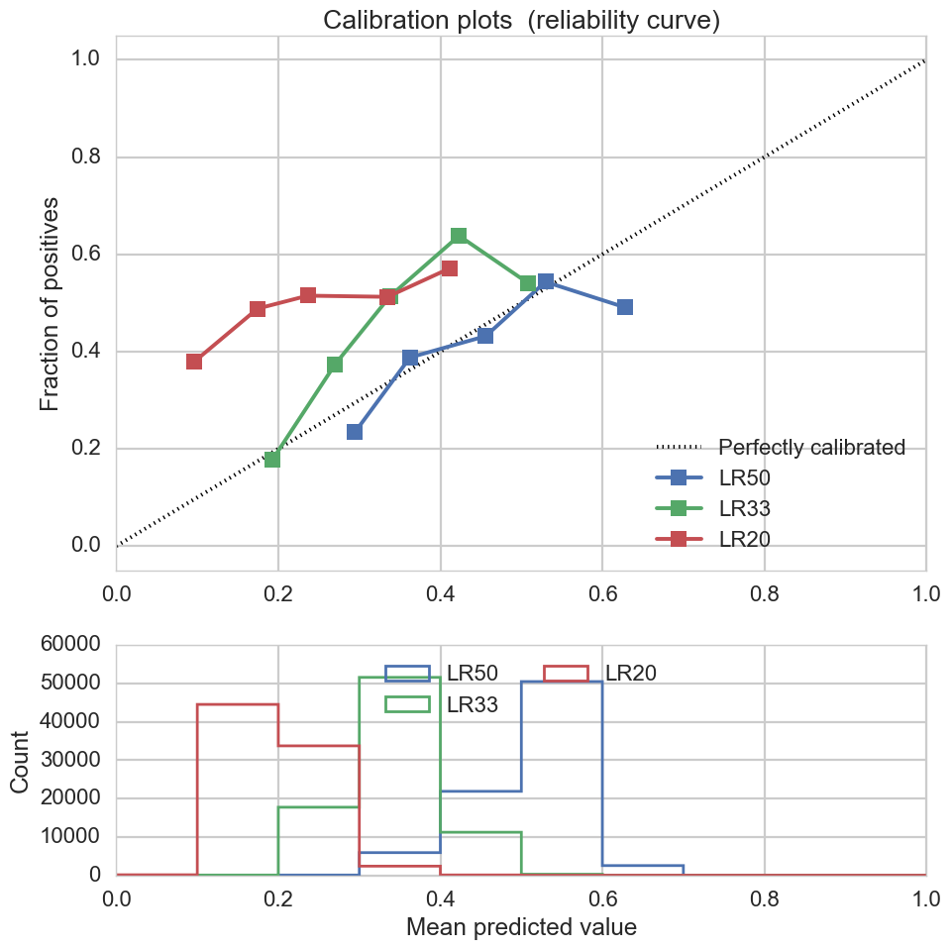
Logistic Regression Calibration CURVE

Slide 12
SGD Classifier
 | BEST PARAMS | Training Accuracy | Test Accuracy
SGDC50 | {'alpha': 1, 'n_iter': 120} | 0.50 | 0.50
SGDC33 | {'alpha': 1, 'n_iter': 120} | 0.46 | 0.45
SGDC20 | {'alpha': 10, 'n_iter': 200} | 0.80 | 0.80
alpha: [0.01, 0.1, 1, 10, 100]
n_iter: [50, 80, 100, 120, 150]
 | SGDC50 + Xtest_sdg_50 | SGDC33 + Xtest_sgd_33 | SGDC20 + Xtest_sgd_20
Confusion Matrix | [[7193 969] [7075 935]] | [[4235 6572] [2132 3233]] | [[12952 0] [ 3220 0]]
SGD Classifier suffer from False Positive issue.

Slide 13
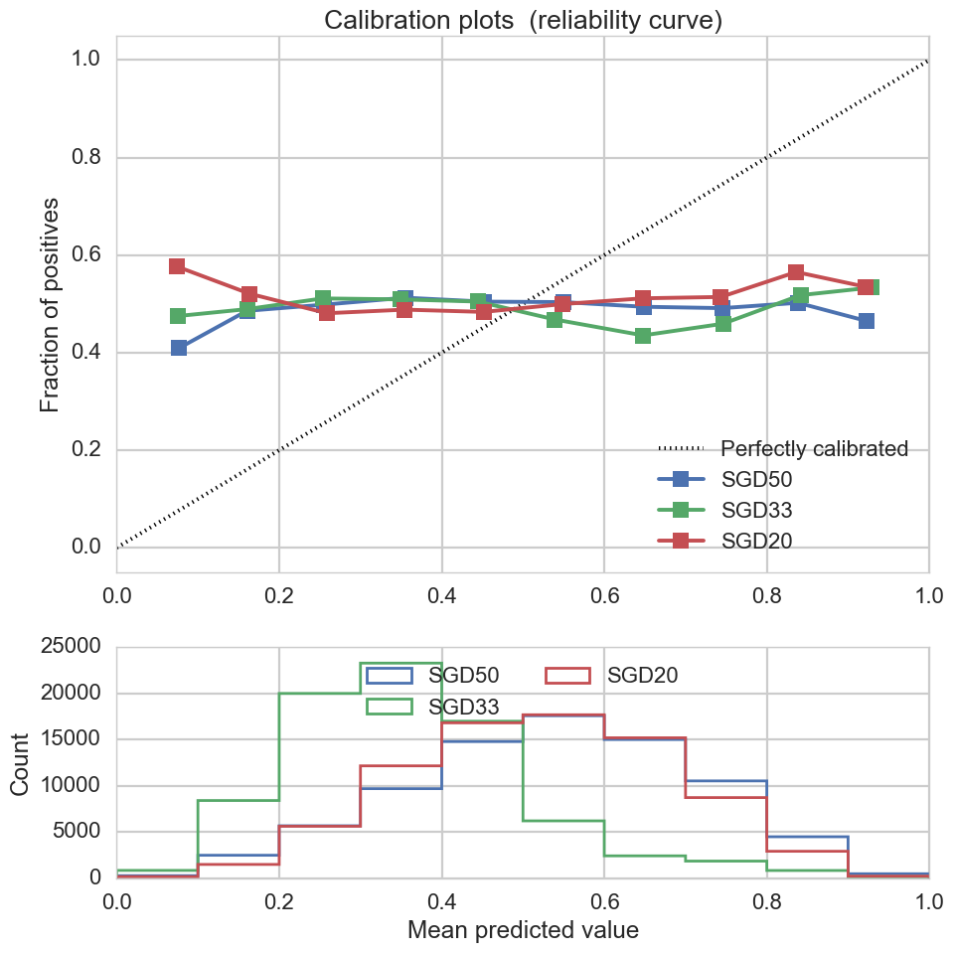
SGD Classifier Calibration CURVE

Slide 14
Random Forest Classifier – small Sample
 | BEST PARAMS | Training Accuracy | Test Accuracy
RFC50 | {'min_samples_leaf': 20, 'n_estimators': 100} | 0.70 | 0.66
OOB: True
n_estimators: [80, 100, 120, 150]
min_samples_leaf: [20, 50, 80]
RFC50 | Xtest_rfc_50 | X33 | X20
Confusion Matrix | [[4972 3051] [2387 5762]] | [[33613 20562] [ 7903 18781]] | [[39955 24732] [ 4710 11462]]
Accuracy | 0.696859 | 0.647967 | 0.635885
TEST DATA
PREDICTED CTR: 35.11%

Slide 15
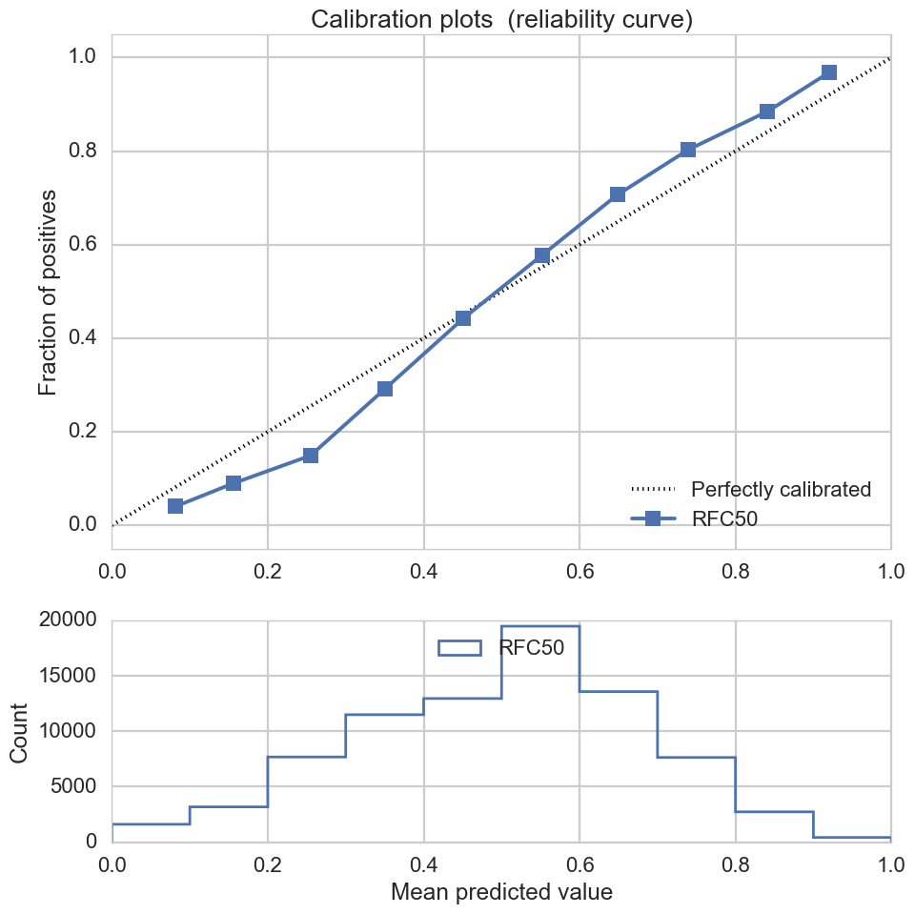
Random Forest Classifier SMALL Sample Calibration CURVE

Slide 16
Random Forest Classifier – LARGE Sample
OOB: True
n_jobs: 8
n_estimators: [120, 150, 180, 200]
min_samples_leaf: [20, 50, 80]
 | BEST PARAMS | Training Accuracy | Test Accuracy
RFC50 | {'min_samples_leaf': 20, 'n_estimators': 150} | 0.70 | 0.68
RFC50 | Xtest_rfc_50 | X50
Confusion Matrix | [[ 83630 53030] [ 33829 104114]] | [[427149 259041] [159917 526906]]
Accuracy | 0.683692 | 0.694862
TEST DATA
PREDICTED CTR: 35.01%

Slide 17
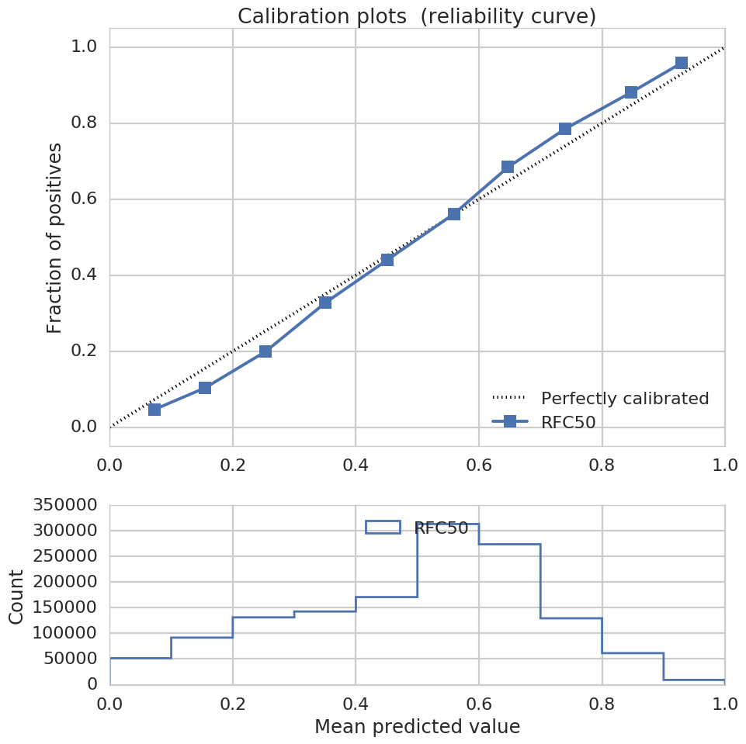
Random Forest Classifier LARGE Sample Calibration CURVE

Slide 18
Comparing RESULTS
Sample Type | Sample Size | Training Accuracy | Test Accuracy | Predicted CTR
Small Sample | 0.2% of training data | 70% | 66% | 35.11%
Large Sample | 3.4% of training data | 70% | 67% | 35.01%
Large Sample is @17 time larger than the sample used for local computer.
Local computer had 8 GB RAM and 2 Cores (4 logical processors).
Server had 64 GB RAM and 16 CPU.

Slide 19
Conclusion
Random Forest Classifier trained with with 50-50 balanced sample performed the best among Logistic Regresson, SGD Classifier and Random Forest Classifier.
Predicted CTR of the TEST DATA is 35%.
The results from small samples are comparable with large sample.

Slide 20
Key LEARNING
Work with complex data-set.
Use different classifiers from sklearn module / library.
Find an appropriate classifier for problem on hand.
Tune the model so that training accuracy and cross validation accuracy match.
Find an acceptable solution that can be used on limited resources.
Use servers in cloud compute solutions like Amazon AWS for modelling with large data-set.

Slide 21
FUTURE WORK
The accuracy of the Random Forest Classifier could be improved.
Reduce number of features for prediction.
Increase weights of certain features.
Use different ensemble classifier.

Slide 22
Project jupyter notebook
Located here!

Slide 23
THANK YOU!

