Slide 1
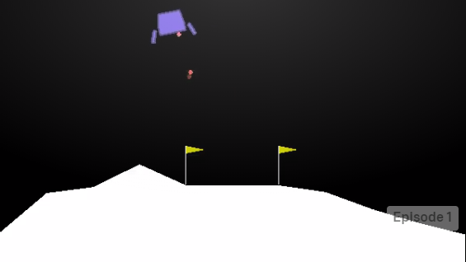
Land a Lunar Rover
Reinforcement learning with Deep Q-learning

Slide 2
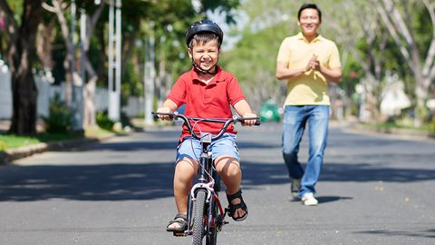
What is Reinforcement Learning
Learning by an agent
Learning from experience
Learning in an Environment
Learning from a feedback
Learn what to do in uncharted territory
Learn a sequential steps of actions, a plan
Image source: shuttercock, Source: https://www.bicycling.com/skills-tips/a20032688/never-make-these-7-mistakes-when-teaching-someone-to-ride/

Slide 3


Slide 4
Examples
AlphaGo Zero – watching 24-hours and self-play superhuman levels in Go and Chess. https://arxiv.org/pdf/1712.01815.pdf
Watson Daily-Double wagering strategy
Backgammon player – Tesauro ’92
Personalized web services – maximize total clicks over repeated visits to a website. Formulated as an RL problem of guiding user down a ‘sales funnel’. Theocharous et al. 2015 at Adobe.
Learn by watching videos - https://www.youtube.com/watch?v=V1eYniJ0Rnk&feature=youtu.be
Adjusting refinery’s operations in real-time. Controller optimizes yield/cost/quality trade-off without sticking strictly to the parameters set by engineers – Sutton book.

Slide 5
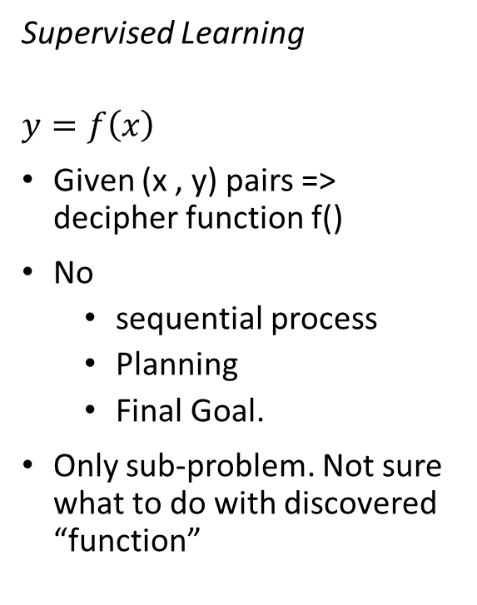
Comparison w/ other learnings
Supervised Learning
$$y=f\left(x\right)$$
Given (x , y) pairs => decipher function f()
No
sequential process
Planning
Final Goal.
Only sub-problem. Not sure what to do with discovered “function”
Reinforcement Learning
Learning from interaction/experience
Achieve a final goal.
Agent learning from environment
Whole problem, since leads you to a “goal”.
Incremental learning

Slide 6
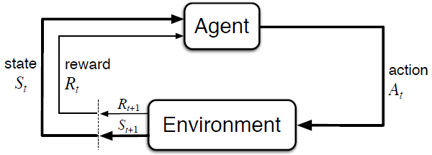
Markov Decision Process (MDP)
A formalism to describe problem
Past does not matter… sort of
Current state is the key
Sense => Act => Goal
Deterministic or Stochastic
Components
States: S
Reward: scalar, R
Action: A
Model: Pr (s’ | s, a)

Slide 7
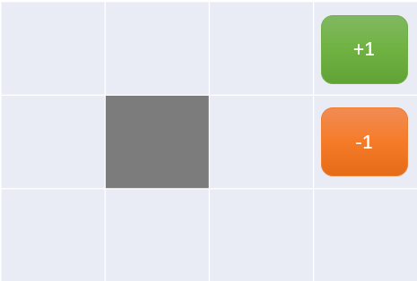
MDP: Grid World
12 states
4 actions: L, U, R, D
Wall at r2, c2
Reward at each state: -0.04
Probability of action perpendicular to desired direction: 0.1 L, 0.1 R
Objective ->
optimal action at each state.

Slide 8


Value of MDP state
Value function – what’s best in the long run.
Reward: immediate. Rt
Long term reward:
State-value function:
Expected sum of all rewards from here on, following “optimal policy”
Total reward received acting “optimally” from now, starting from given state s.

Slide 9
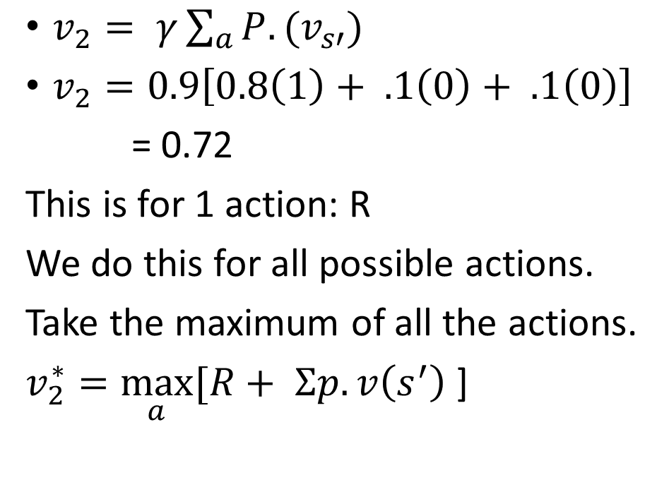
Calculation of Value function
 |  | s = 2, .72
$v_{2}= γ\sum_{a}{P.(v_{s′})}$
$v_{2}=0.9\left[0.8\left(1\right)+ .1\left(0\right)+ .1\left(0\right)\right]$
= 0.72
This is for 1 action: R
We do this for all possible actions.
Take the maximum of all the actions.
$v_{2}^{∗}=\max_{a}{[R+ Σp.v\left(s^{′}\right)}$ ]
+1
-1

Slide 10
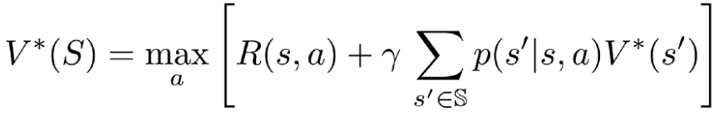
Value Iteration: Quiz
Max Value function over 3 actions: L, R, U
V[10] = max
{
0.8 x .6 + 0.1 x 0.3 + 0.1 x 0.55,
0.8 x .6 + 0.1 x 0.3 + 0.1 x 0.55,
0.8 x .6 + 0.1 x 0.3 + 0.1 x 0.55
} = max { 0.565, 0.55, 0.35 }
Best Action => UP
 |  | .81
 |  | .6
 | .55 | .5 | .3
+1
-1
10

Slide 11
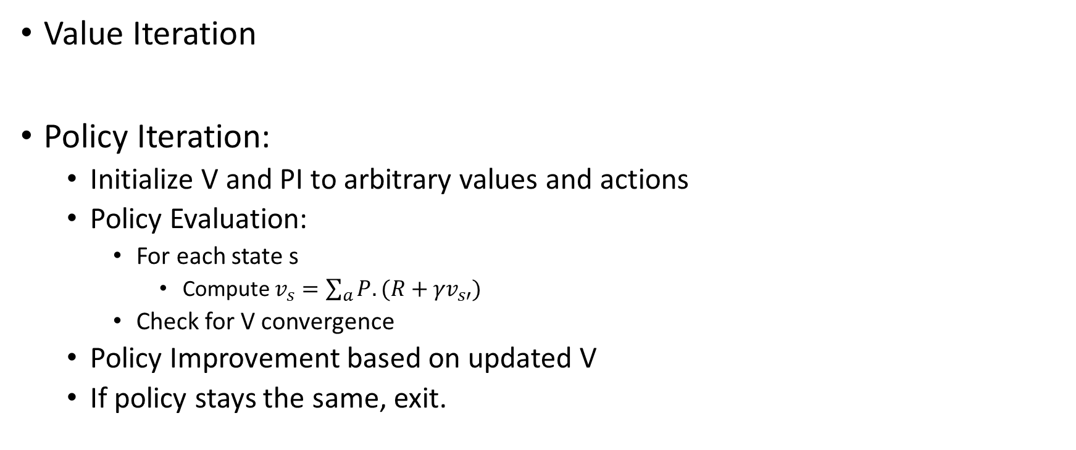
Model-based Learning
Value Iteration
Policy Iteration:
Initialize V and PI to arbitrary values and actions
Policy Evaluation:
For each state s
Compute $v_{s}=\sum_{a}{P.({R+γv}_{s′})}$
Check for V convergence
Policy Improvement based on updated V
If policy stays the same, exit.

Slide 12
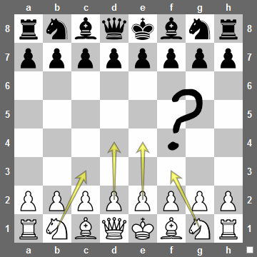
Model-free Learning
Q-Learning
Transition probabilities unknown
Reward function unknown
Exploration
Learn new states
randomized
Exploitation
Utilize the knowledge gained to achieve the goal.
Balance.

