Slide 1
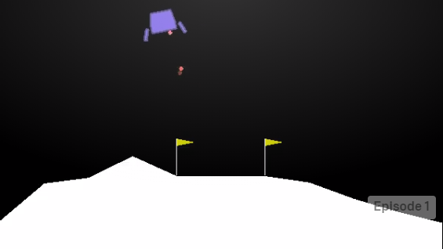
Land a Lunar Rover
Reinforcement learning with Deep Q-learning

Slide 2
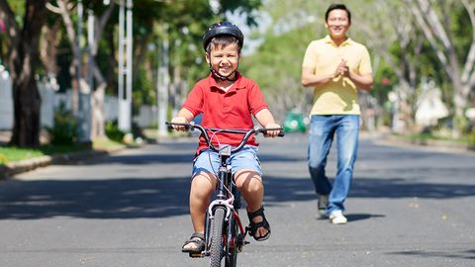
What is Reinforcement Learning
Learning by an agent
Learning from experience
Learning in an Environment
Learning from a feedback
Learn what to do in uncharted territory
Learn a sequential steps of actions, a plan
Image source: shuttercock, Source: https://www.bicycling.com/skills-tips/a20032688/never-make-these-7-mistakes-when-teaching-someone-to-ride/

Slide 3


Slide 4

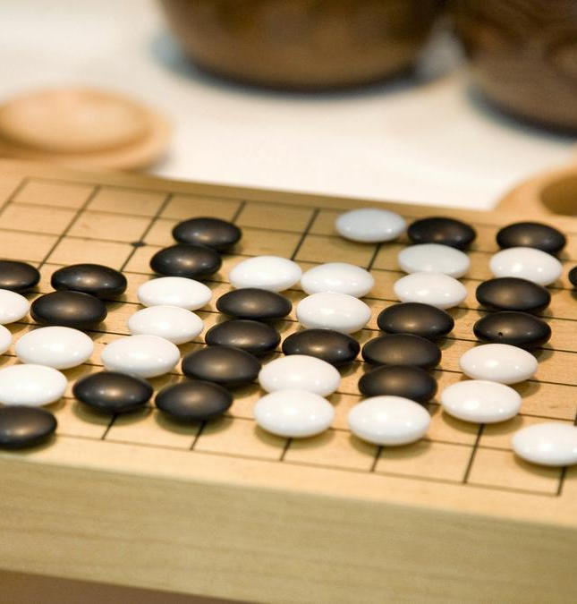
Applications
AlphaGo Zero – watching 24-hours and self-play superhuman levels in Go and Chess.
https://arxiv.org/pdf/1712.01815.pdf
Image Source: Fishman / ullstein bild via Getty

Slide 5

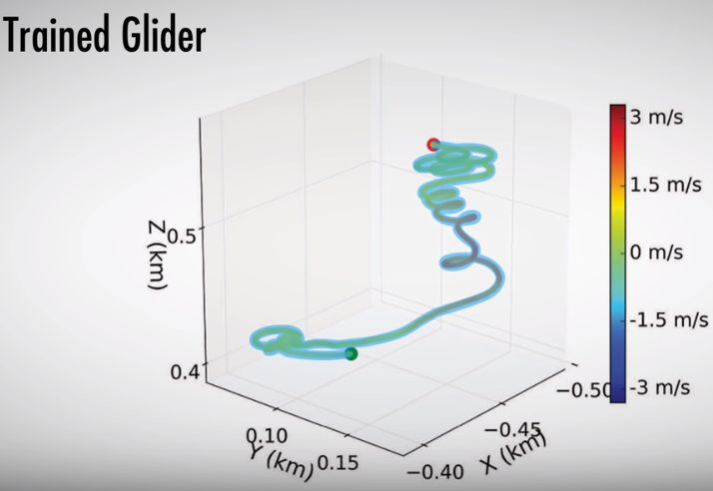
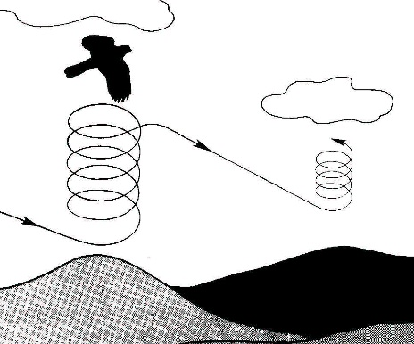
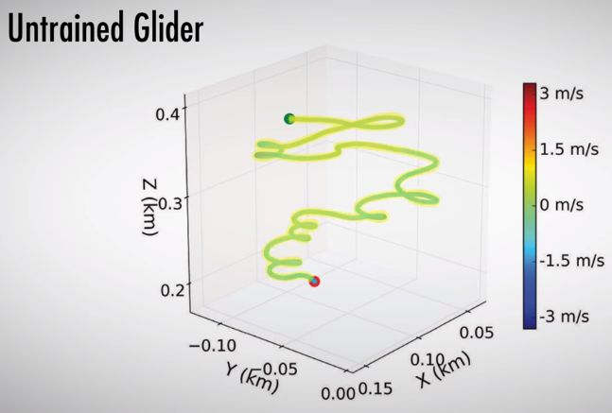
Applications
Thermal Soaring by Birds:
Using rising hot air currents to gain altitude
Fly without energy
Reinforcement Learning
Navigate thermal updraft
Handle turbulence
Source:
Reddy, Celani, Sejnowski, and Vergassola, Learning to Soar in Turbulent Environments.
https://www.youtube.com/watch?v=V6tu7dL_MZE
http://raptorcorridor.org/node/75.html

Slide 6

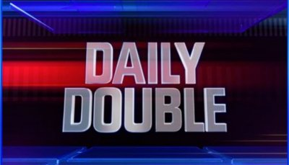

Applications
Watson daily double wagering strategy
Function approximation with Q-learning
Source:
Tesauro, Gondek, Lechner, Fan, and Prager (2012, 2013)

Slide 7

Applications
Personalized web services
maximize total clicks over repeated visits to a website.
Formulated as an RL problem of guiding user down a ‘sales funnel’.
Improve offers on successive visits to encourage a click.
Banking data for offers.
Sequence of offers following a policy.
Source:
Theocharous et al. 2015 at Adobe.
Reinforcement Learning, An Introduction – Barto, Sutton
Image: https://www.nosto.com/blog/personalizing-the-customer-service-experience/

Slide 8

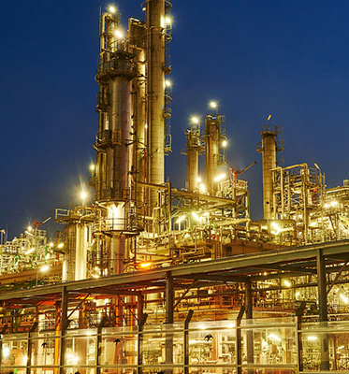
Applications
Adjusting refinery’s operations in real-time.
Controller optimizes yield/cost/quality trade-off without sticking strictly to the parameters set by engineers – Sutton book.
Image source: Bigstockphoto

Slide 9
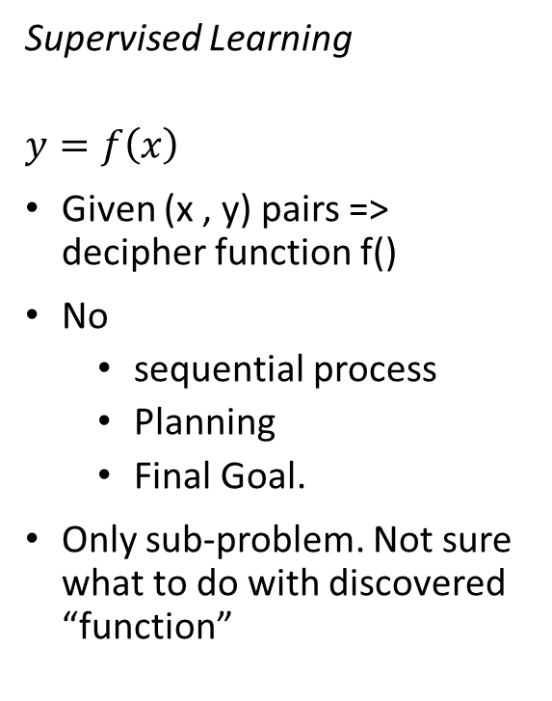
Comparison w/ other learnings
Supervised Learning
$$y=f\left(x\right)$$
Given (x , y) pairs => decipher function f()
No
sequential process
Planning
Final Goal.
Only sub-problem. Not sure what to do with discovered “function”
Reinforcement Learning
Learning from interaction/experience
Achieve a final goal.
Agent learning from environment
Whole problem, since leads you to a “goal”.
Incremental learning

Slide 10
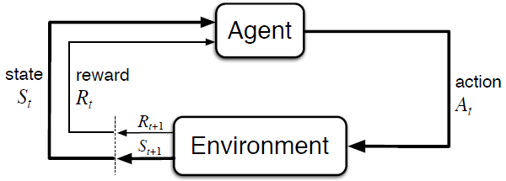
Markov Decision Process (MDP)
A formalism to describe problem
Past does not matter… sort of
Current state is the key
Sense => Act => Goal
Deterministic or Stochastic
Components
States: S
Reward: scalar, R
Action: A
Model: Pr (s’ | s, a)

Slide 11
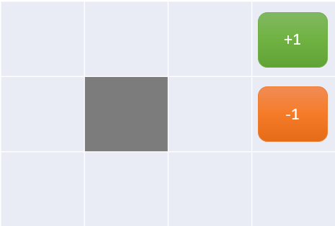
MDP: Grid World
12 states
4 actions: L, U, R, D
Wall at r2, c2
Reward at each state: -0.04
Probability of action perpendicular to desired direction: 0.1 L, 0.1 R
Objective ->
optimal action at each state.

Slide 12


Value of MDP state
Γ Discount Factor:
High -> we value future rewards more
We wish to get to the final state desperately.
Value function – what’s best in the long run.
Reward: immediate. Rt
Long term reward:
State-value function:
Expected sum of all rewards from here on, following “optimal policy”
Total reward received acting “optimally” from now, starting from given state s.

Slide 13
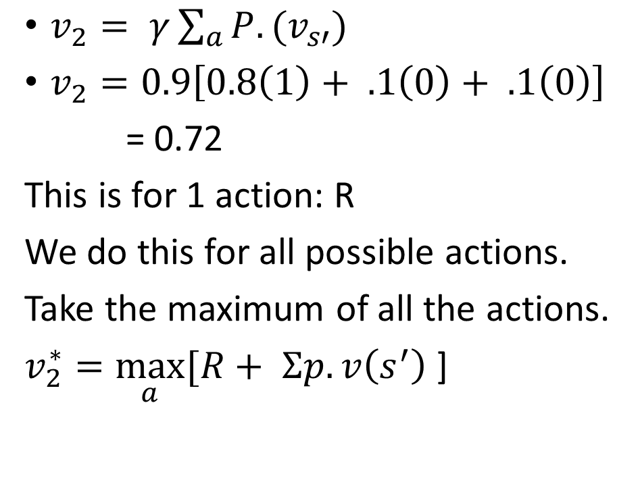
Calculation of Value function
 |  | s = 2, .72
$v_{2}= γ\sum_{a}{P.(v_{s′})}$
$v_{2}=0.9\left[0.8\left(1\right)+ .1\left(0\right)+ .1\left(0\right)\right]$
= 0.72
This is for 1 action: R
We do this for all possible actions.
Take the maximum of all the actions.
$v_{2}^{∗}=\max_{a}{[R+ Σp.v\left(s^{′}\right)}$ ]
+1
-1

Slide 14
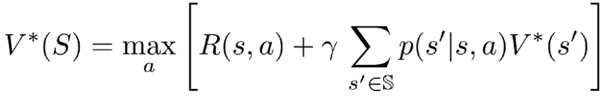
Value Iteration: Quiz
Max Value function over 3 actions: L, R, U
V[10] = max
{
0.8 x .6 + 0.1 x 0.3 + 0.1 x 0.55,
0.8 x .6 + 0.1 x 0.3 + 0.1 x 0.55,
0.8 x .6 + 0.1 x 0.3 + 0.1 x 0.55
} = max { 0.565, 0.55, 0.35 }
Best Action => UP
 |  | .81
 |  | .6
 | .55 | .5 | .3
+1
-1
10

Slide 15
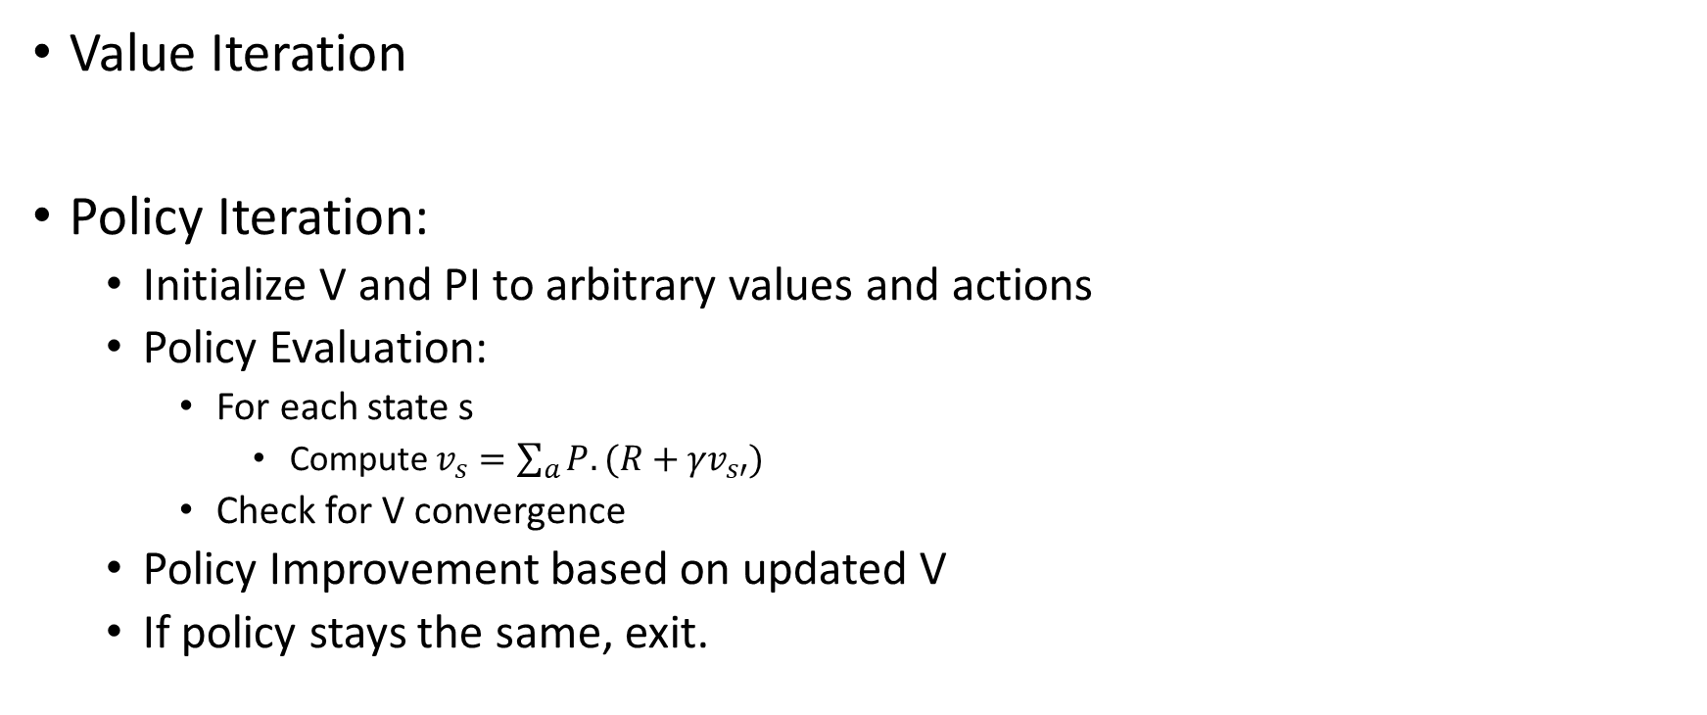
Model-based Learning
Value Iteration
Policy Iteration:
Initialize V and PI to arbitrary values and actions
Policy Evaluation:
For each state s
Compute $v_{s}=\sum_{a}{P.({R+γv}_{s′})}$
Check for V convergence
Policy Improvement based on updated V
If policy stays the same, exit.

Slide 16

Model-free Learning
Q-Learning
Transition probabilities unknown
Reward function unknown
α – Learning rate
Intuition:
Update each state
Reward for reaching new state
Long term utility of being in new state
$Q_{s}\overset{←}{α}Q_{s}+ α\left(Q_{s^{′}}−Q_{s}\right)$
$Q_{s}\overset{←}{α}Q_{s}+ α$(error)

Slide 17

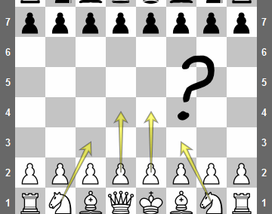
Exploration vs. Exploitation
Exploration
Learn new states
randomized
Exploitation
Utilize the knowledge gained to achieve the goal.
Balance.

