Slide 1

Player Performance
Cricket Analytics in Power BI
AMEGH ANIL
B.TECH AI & DATA SCIENCE

Slide 2

Project Overview
Player Performance Dashboard turns cricket stats into an interactive Power BI report for player comparison, batting/bowling analysis, and yearly trend tracking.
Analyze
Compare
Identify
Cricket stats
Batting vs bowling
Top players
Visualize
Yearly trends

Slide 3
Dataset Overview
Format: CSV
Records: 1,096
Columns: 25
Key fields: player name, year, runs, wickets, batting average, strike rate, bowling average, economy, highest score, 100s, 50s, not outs
Prepared in: Power Query

Slide 4
Tools & Technologies
Four tools powered the project’s data pipeline.
Power BI
Power Query
Dashboards and reporting
Cleaning and transformation
DAX
CSV / Excel
Custom cricket metrics
Source data across seasons

Slide 5
Dashboard Architecture
Components
KPI Cards
Top Performers
Trends
Key totals
Runs and wickets
Yearly runs
Slicers
Year and player filters

Slide 6
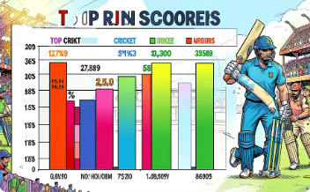
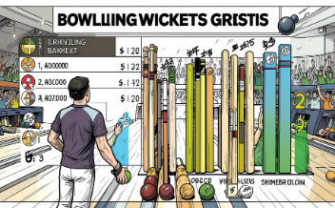
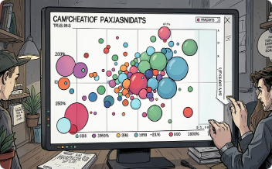
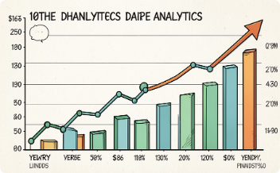
Key Visualizations
Top Run Scorers
Top Wicket Takers
Average vs. Strike Rate
Runs by Year
Horizontal bar chart ranking players by total runs.
Bar chart comparing bowlers by wickets taken.
Line chart tracking season-by-season total runs.
Scatter plot with bubble size = total runs.

Slide 7
DAX Measures
DAX powers dashboard KPIs with reusable, filter-aware calculations.
Measures
Why It Matters
Reusable
Dynamic
Faster
Context-aware
Total Runs
Total Wickets
SUM(cricket_data_2026[Runs_Scored])
SUM(cricket_data_2026[Wickets_Taken])
Avg. Batting
Avg. Strike Rate
AVERAGE(cricket_data_2026[Batting_Average])
AVERAGE(cricket_data_2026[Batting_Strike_Rate])

Slide 8

Key Insights
Virat Kohli
Yuzvendra Chahal
Yearly Trends
Top run scorer in the dataset.
Leading wicket taker.
Runs vary by season, with clear peaks.
Interactive Filters
Quick player and year comparisons.

Slide 9
Challenges & Solutions
Key Challenges
Key Solutions
Inconsistent data
Missing values
Text-to-number conversion
Power Query cleaning
DAX measures
Responsive visual design

Slide 10

Conclusion
The Player Performance Dashboard turns cricket stats into an interactive report that demonstrates strong data engineering and BI skills.
Cleaning
DAX
Viz
Power BI turns cricket analytics into actionable insights.

