Slide 1
Project Update 1
Ryan Babcock, Stacy Carlson, and Laura Humphreys

Slide 2
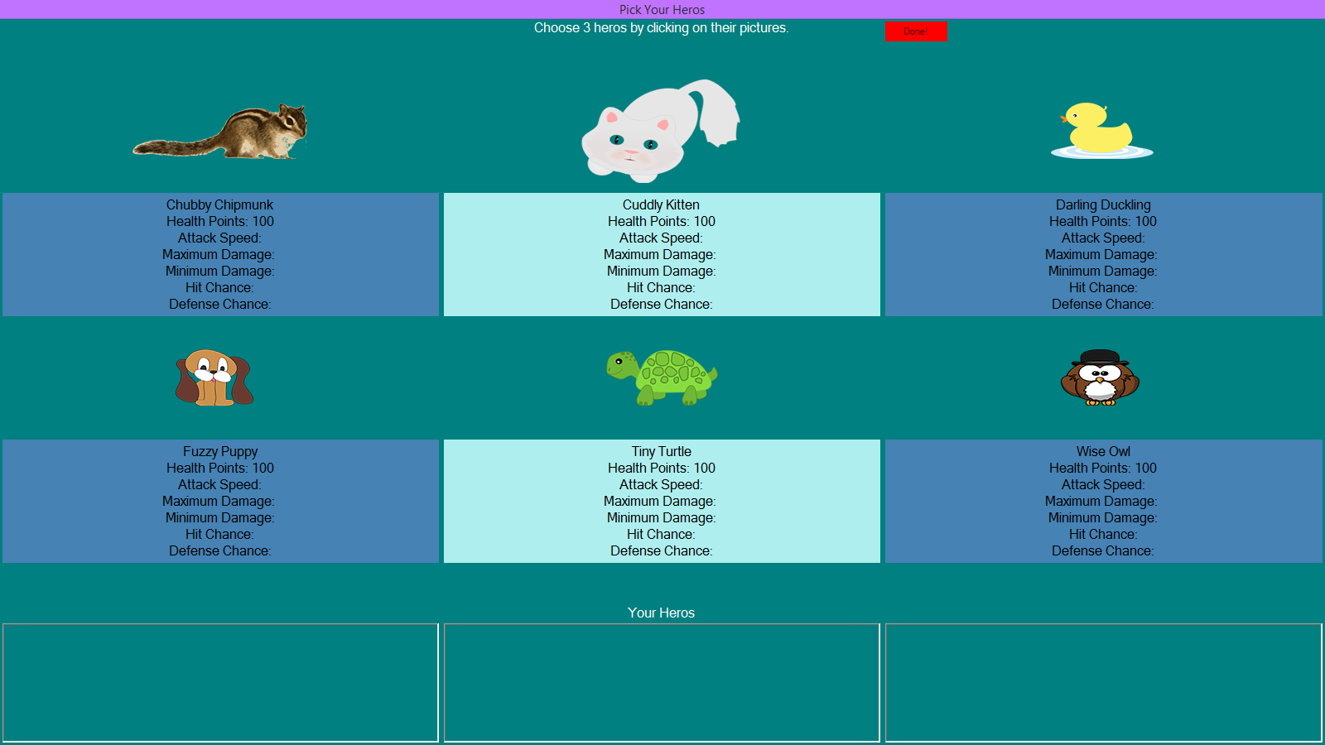
Game Idea
Cute fuzzy animals face off against scary animals using robots.

Slide 3

Design Patterns We’re Using
Factory
Heroes and Monsters
Decorator
Robots
Strategy
Special Actions
Mediator
Battle

Slide 4

Design Patterns We’re Thinking About
State
Status effects
Decorator
Leveling up

Slide 5
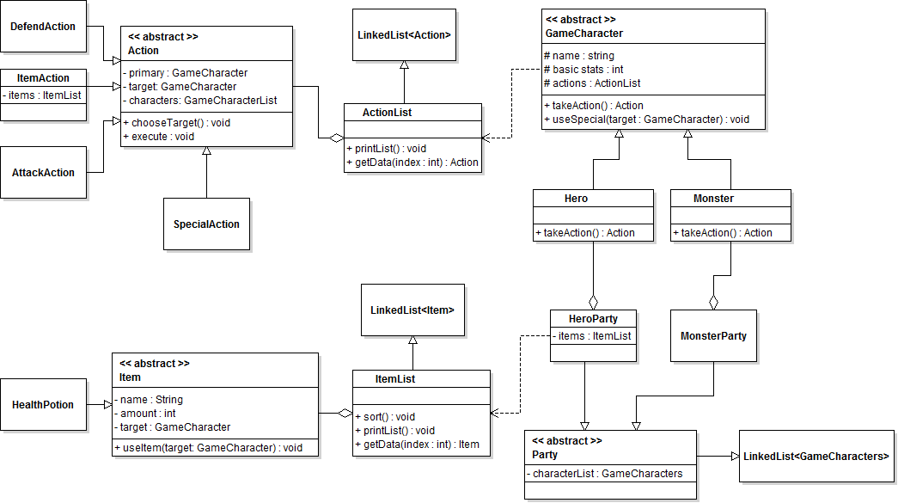
Overall UML

Slide 6
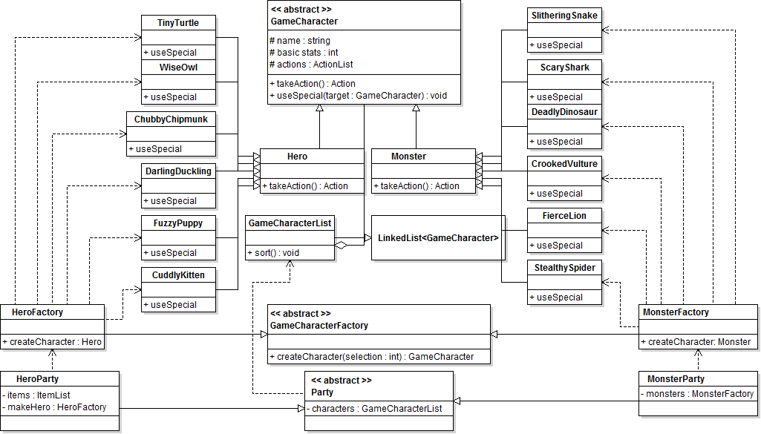
Character UML

Slide 7
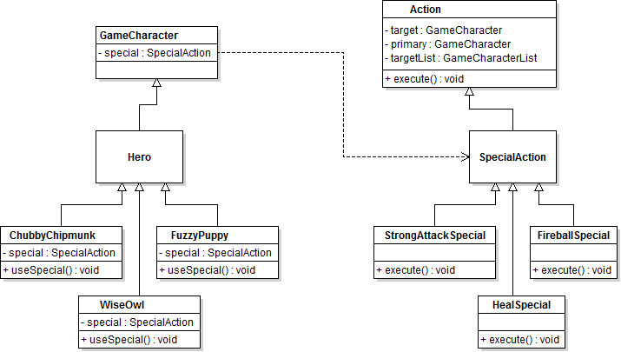
Special Attack UML

Slide 8
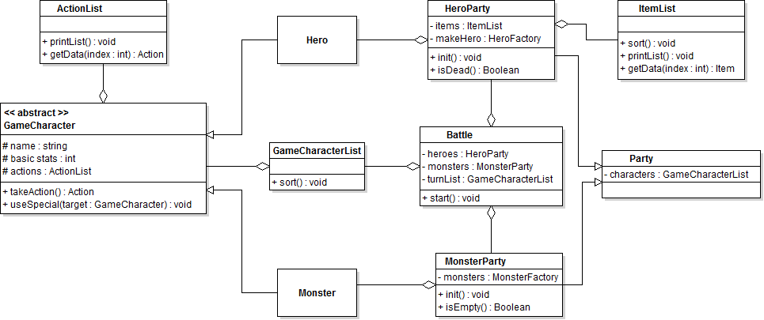
Battle UML

