Slide 1

Electronic Field Input System
Team 5
Stacy Carlson, Thomas Flores, and Ralph Parkison

Slide 2
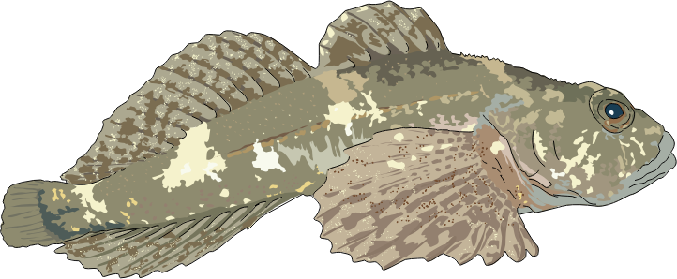
User Interface

Slide 3
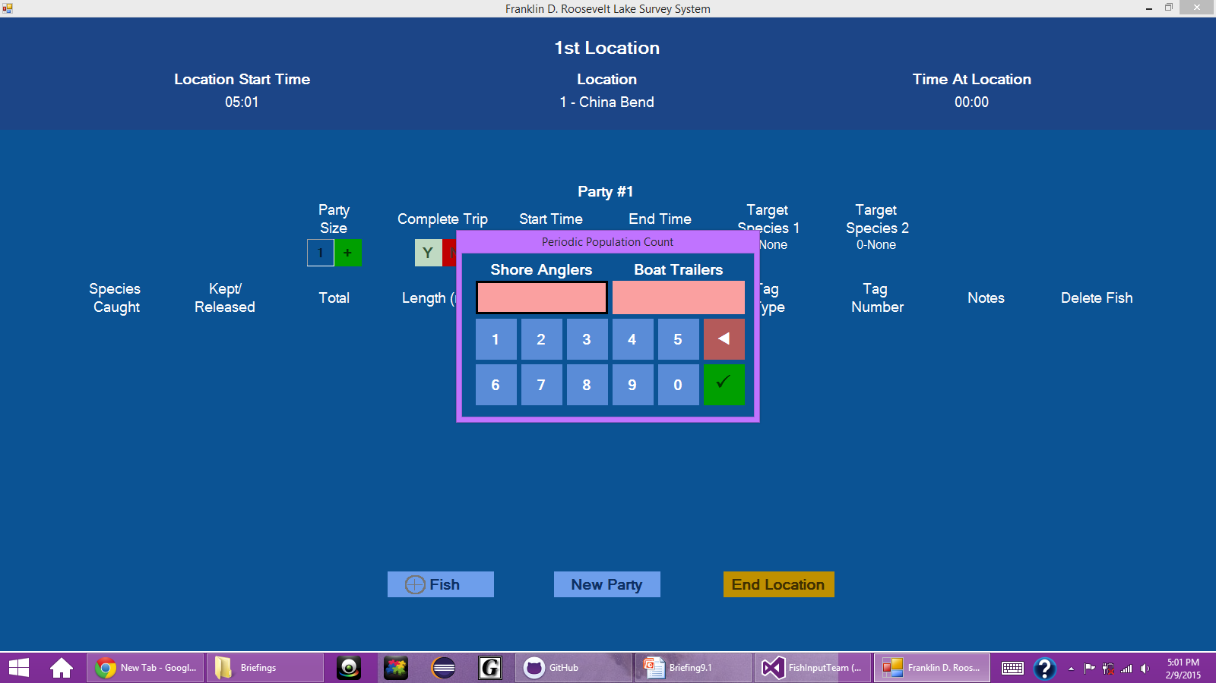
Shore Angler and Boat Trailer Counts

Slide 4
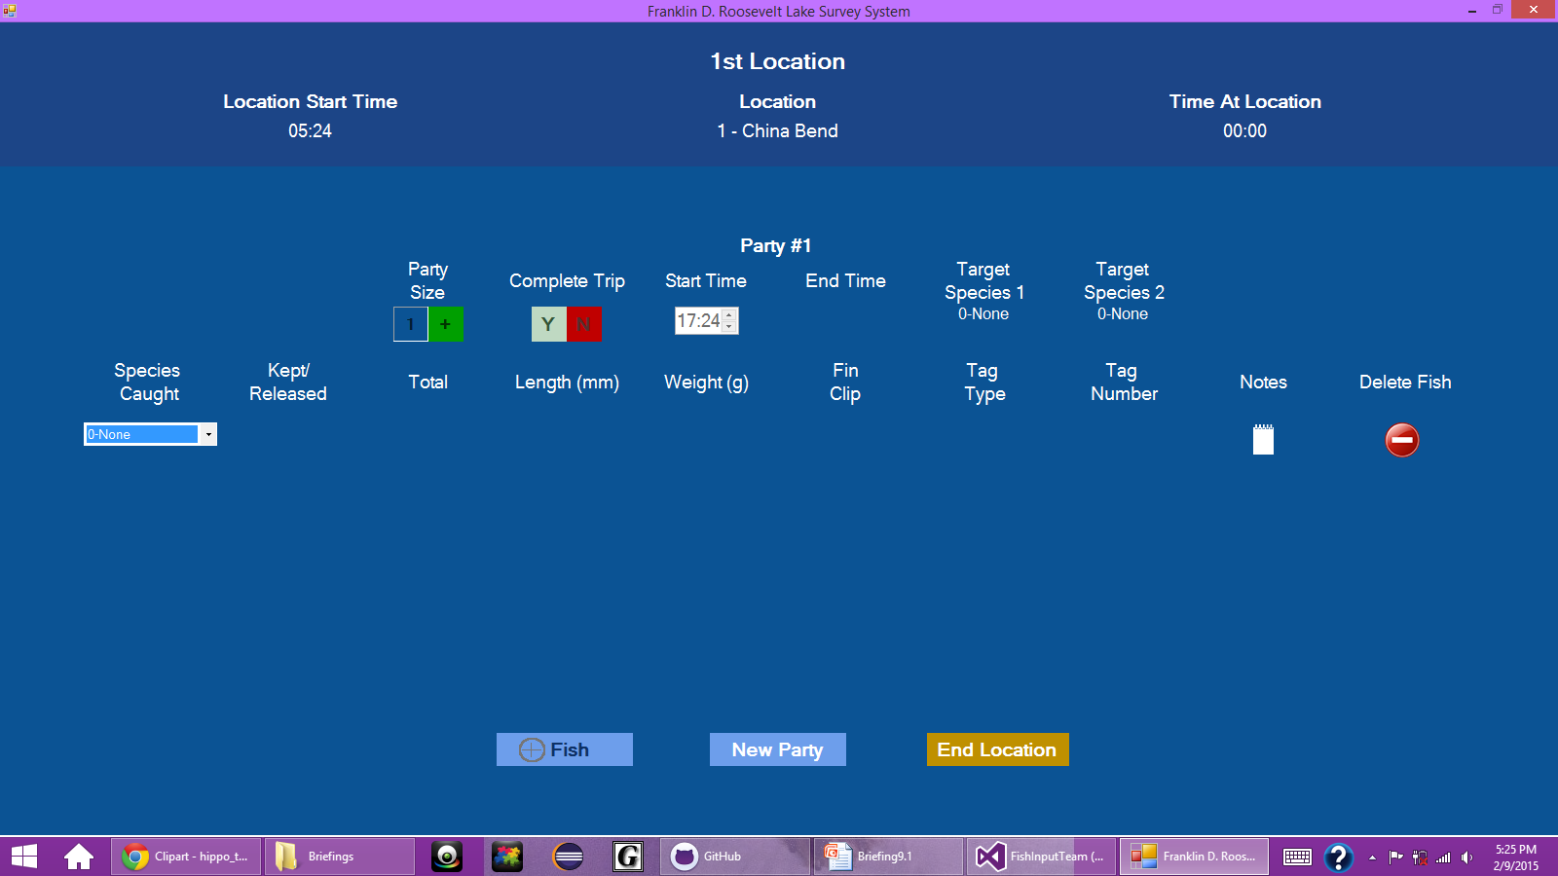
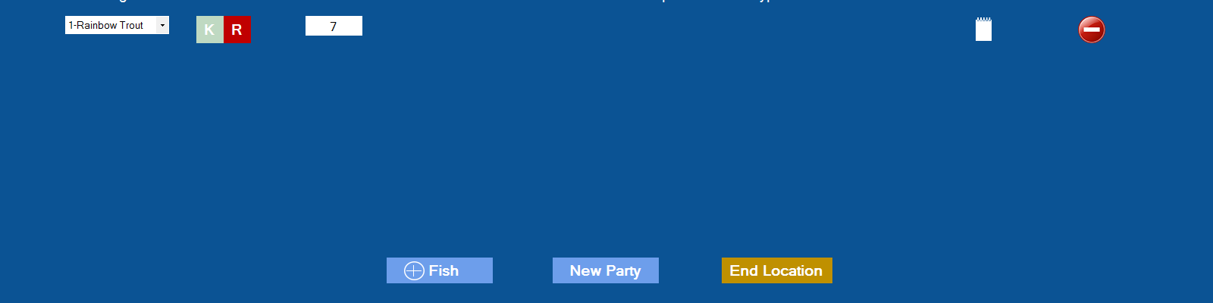
Enable/Disable Buttons for Completed Fish

Slide 5
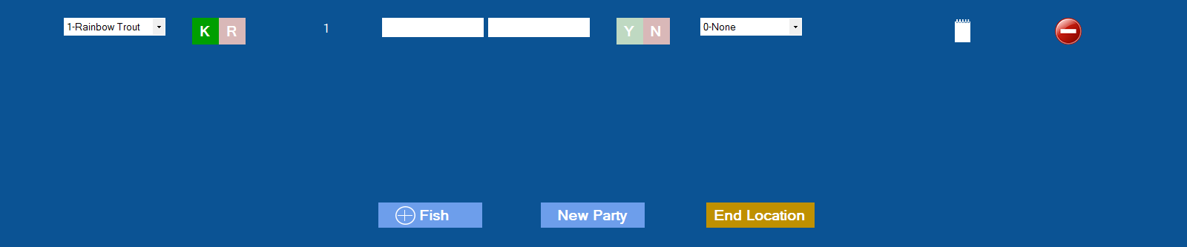
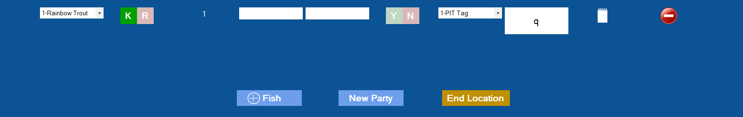
Enable/Disable Buttons for Completed Fish (Continued)

Slide 6
Delete Button Work
Delete works for first and last row
Delete doesn’t work for middle rows
Different attempts
panel.Controls.RemoveAt(rowCount);
panel.RowStyles.RemoveAt(rowCount);
panel.Invalidate() and panel.Refresh()
Loop with panel.RowStyles[i] = panel.RowStyles[i+1]

Slide 7
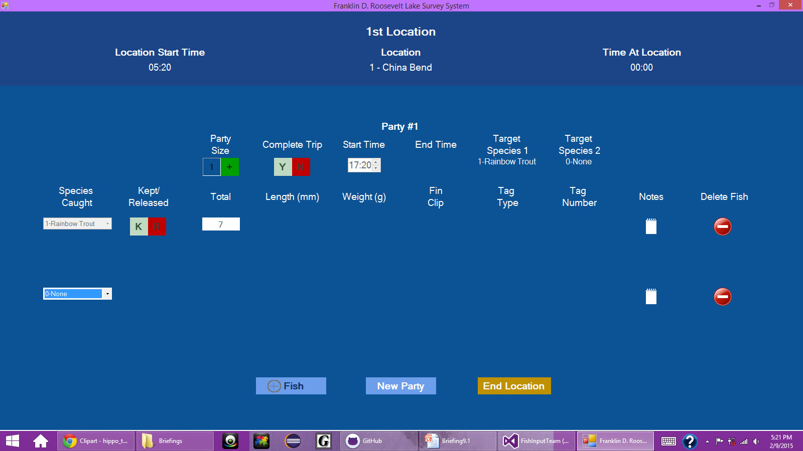
Delete Button Issues

Slide 8
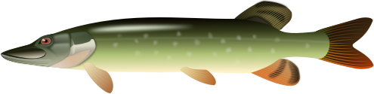
JSON

Slide 9
Lookup Tables Implemented
Several problems occurred acquiring DB team JSON
JSON sent from our side with username and password required a variable name attached to it
JSON received from DB team had various escape characters littered in the JSON

Slide 10
Working Solution for Escape Characters
Problem: Escape characters sent from DB team
Solution: Remove characters with string replace function
Hack Fix
json = json.Replace("\"[", "[");
json = json.Replace("]\"", "]");
json = json.Replace(@"\r", "");
json = json.Replace(@"\n", "");
json = json.Replace(@"\", "");
DB team will need to resolve this issue on their side

Slide 11
Design of Lookup Tables Object
Look up tables are accessed through a root class.
class LookupTables
{
public List <CreelSurveyLookup> CRSrvyMthLUT { get; set; }
public List<RawFishSpeciesLookup> SppLUT { get; set; }
public List<CreelSpeciesLookup> CRSppLUT { get; set; }
public List<CreelAnglerTypeLookup> AngTypeLUT { get; set; }
public List<CreelLocationLookup> BoatLaunchLUT { get; set; }
public List<CreelReachLookup> CRReachLUT { get; set; }
public List<CreelOrgLookup> OrgAffilLUT { get; set; }
public List<CreelTagColorLookup> TagColorLUT { get; set; }
public List<CreelTagLookup> TagLUT { get; set; }
}

Slide 12
Where We’re Going
Continue work on the UI
Finish up client requested changes
Increase size on the buttons for ease of use
Begin transitioning from static to dynamic data in controls
Continue work on the JSON and CSV
Communicate with DB team about issues

