Slide 1
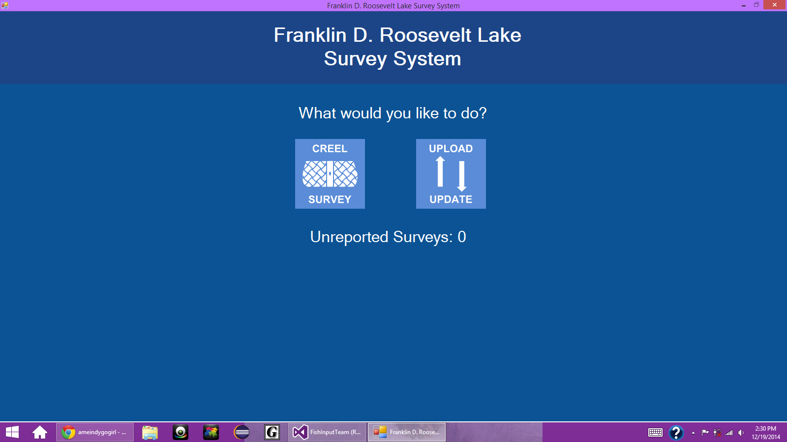
Start Screen

Slide 2
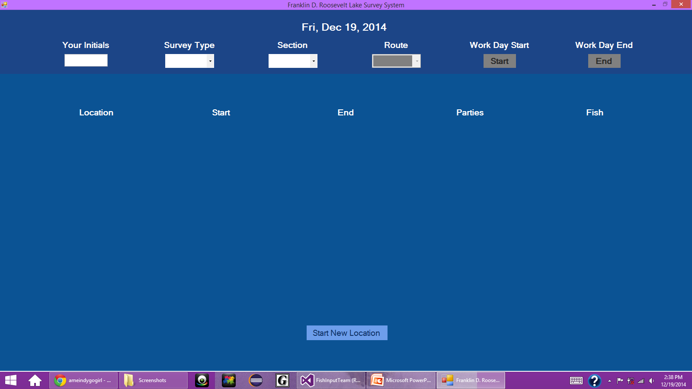
Waiting for Information

Slide 3
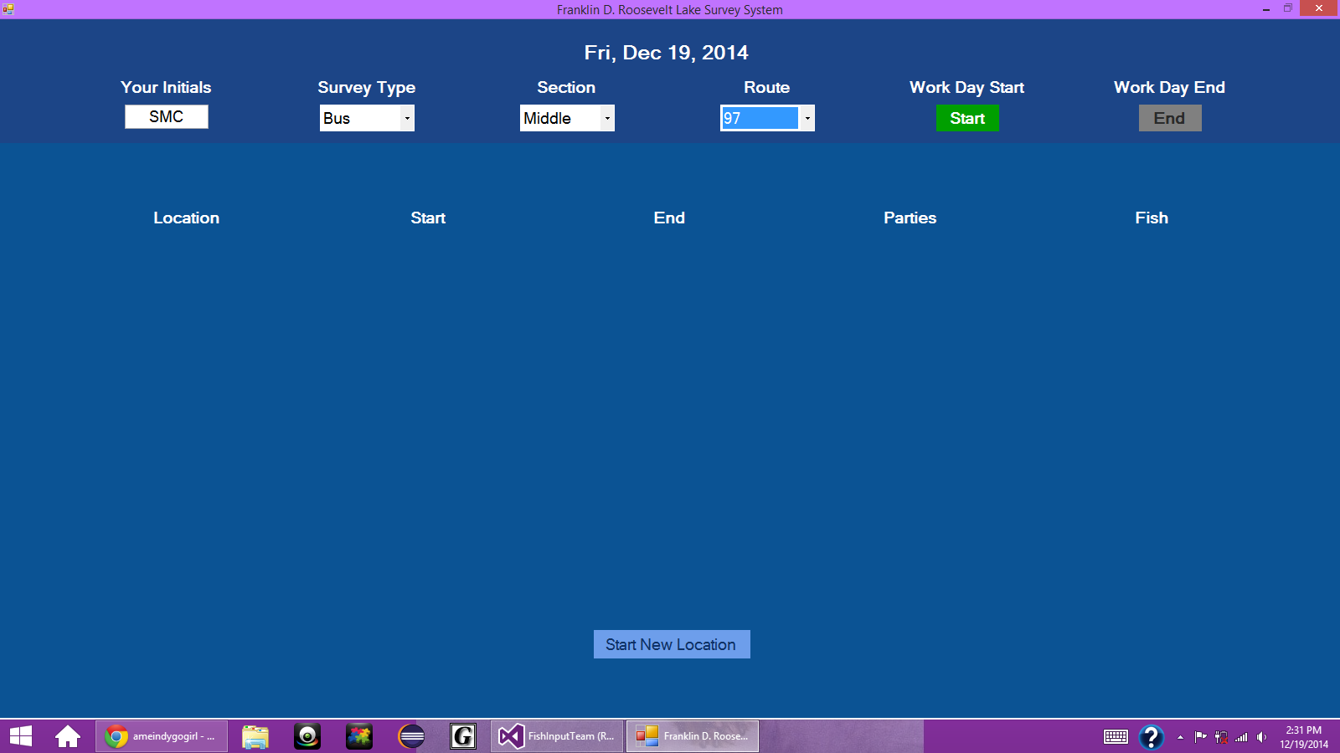
Information Entered: Bus Route Example

Slide 4
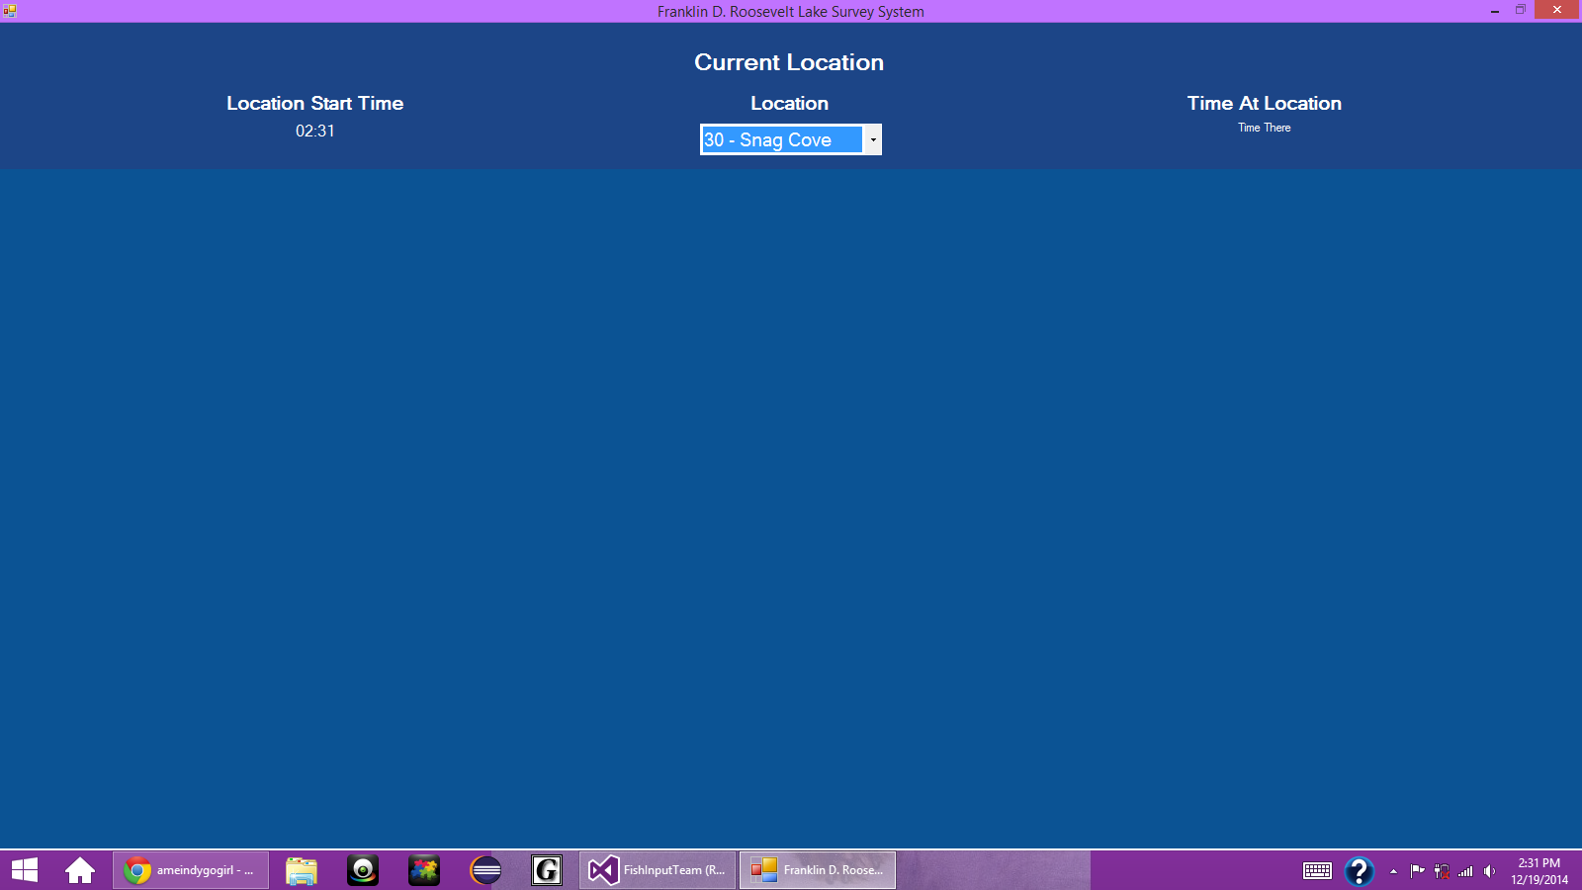
Creel Survey (Work In Progress)

Slide 5
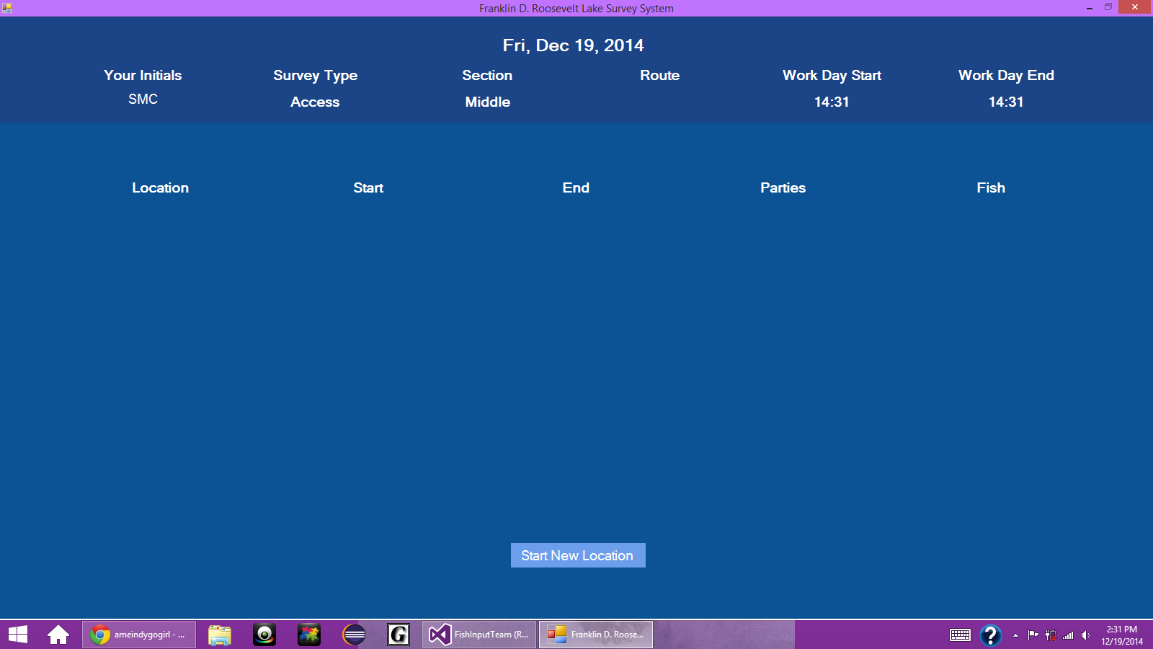
Information Submitted: Access Example

