Slide 1
Electronic Field Input System
Team 5
Stacy Carlson, Thomas Flores, and Ralph Parkison

Slide 2
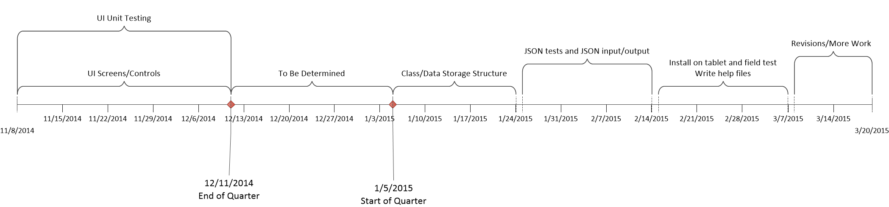
Timeline

Slide 3

Distribution of Work

Slide 4
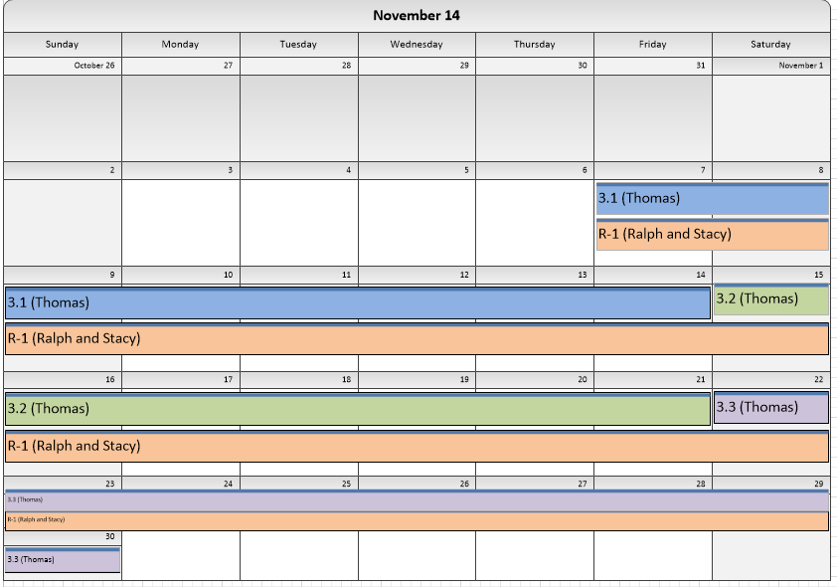

Slide 5
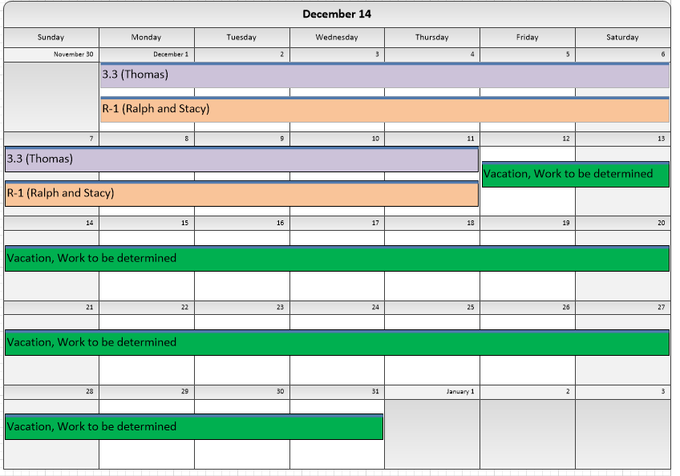

Slide 6
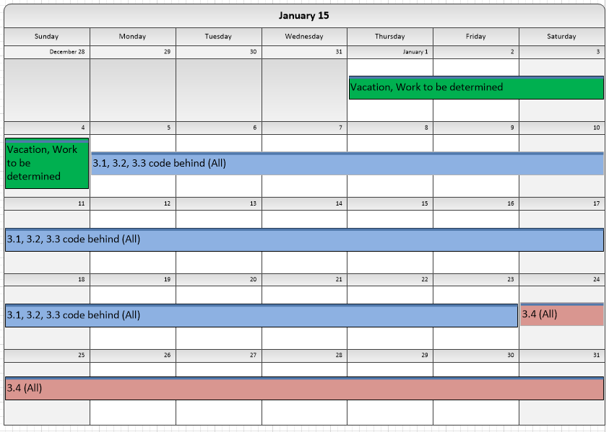

Slide 7
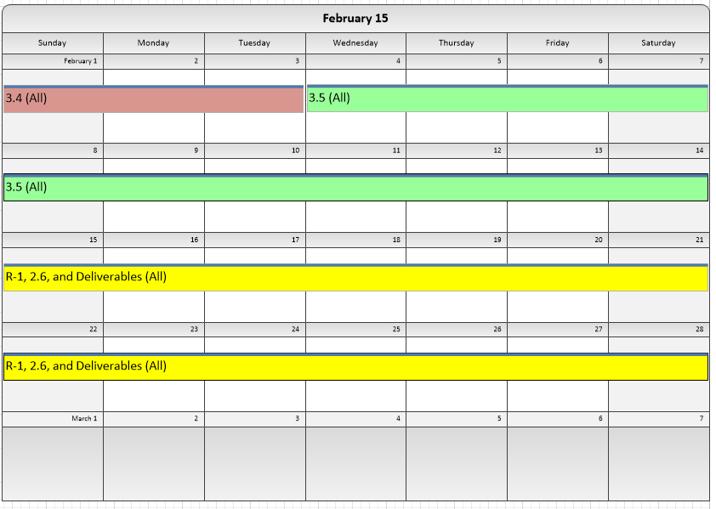

Slide 8
