Slide 1

Electronic Field Input System
Team 5
Stacy Carlson, Thomas Flores, and Ralph Parkison

Slide 2

Client Feedback

Slide 3
Meeting Summary
Client answered our “small” detail questions
Client agreed to edit/delete capabilities for fish on current party
Overall approval of our work
Gave us a tablet for testing

Slide 4
Angler Type Changes
Remove “No Angler/None” Type
Not important to research
Separate Count Types
Not associated with talking to people
New form/control (TBD)
Shore Angler Count
Boat Trailer Count
Done when clerk arrives and leaves (minimum)

Slide 5
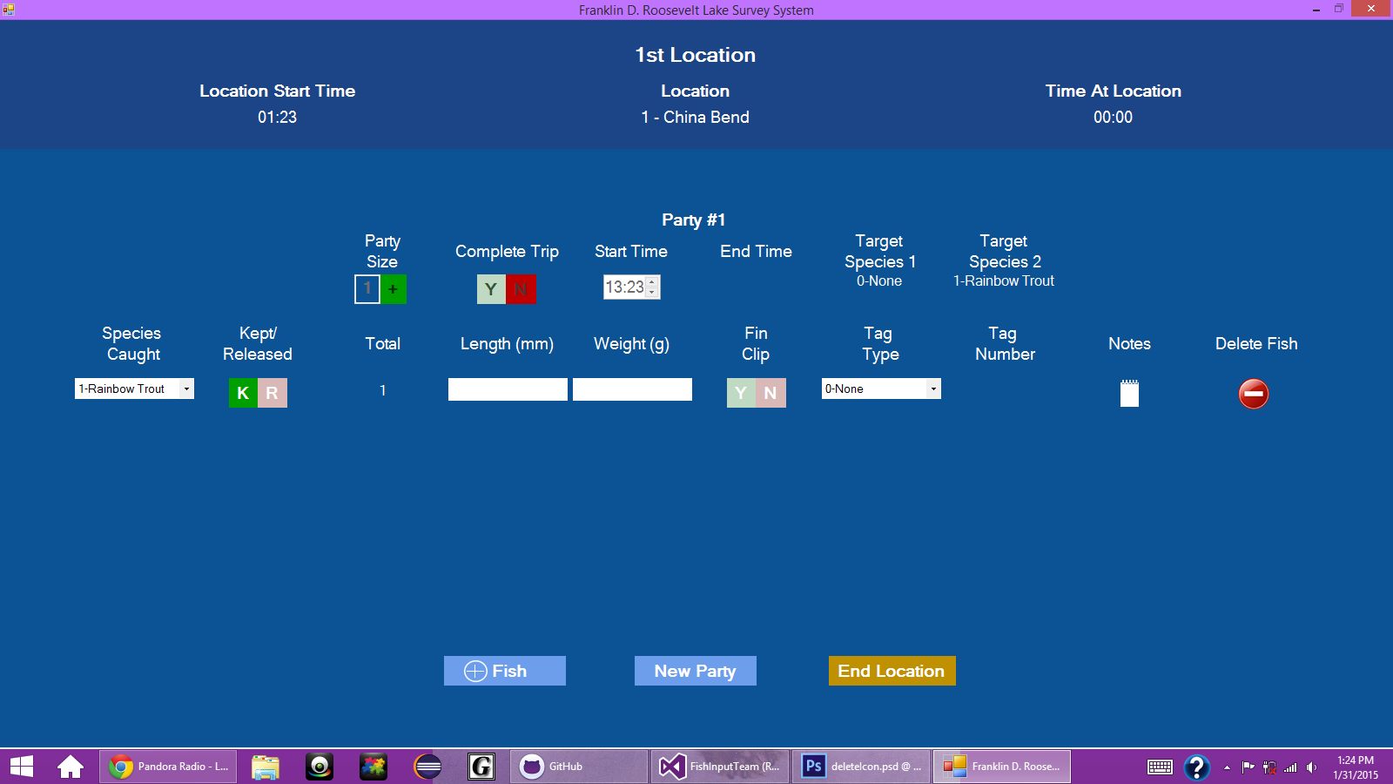
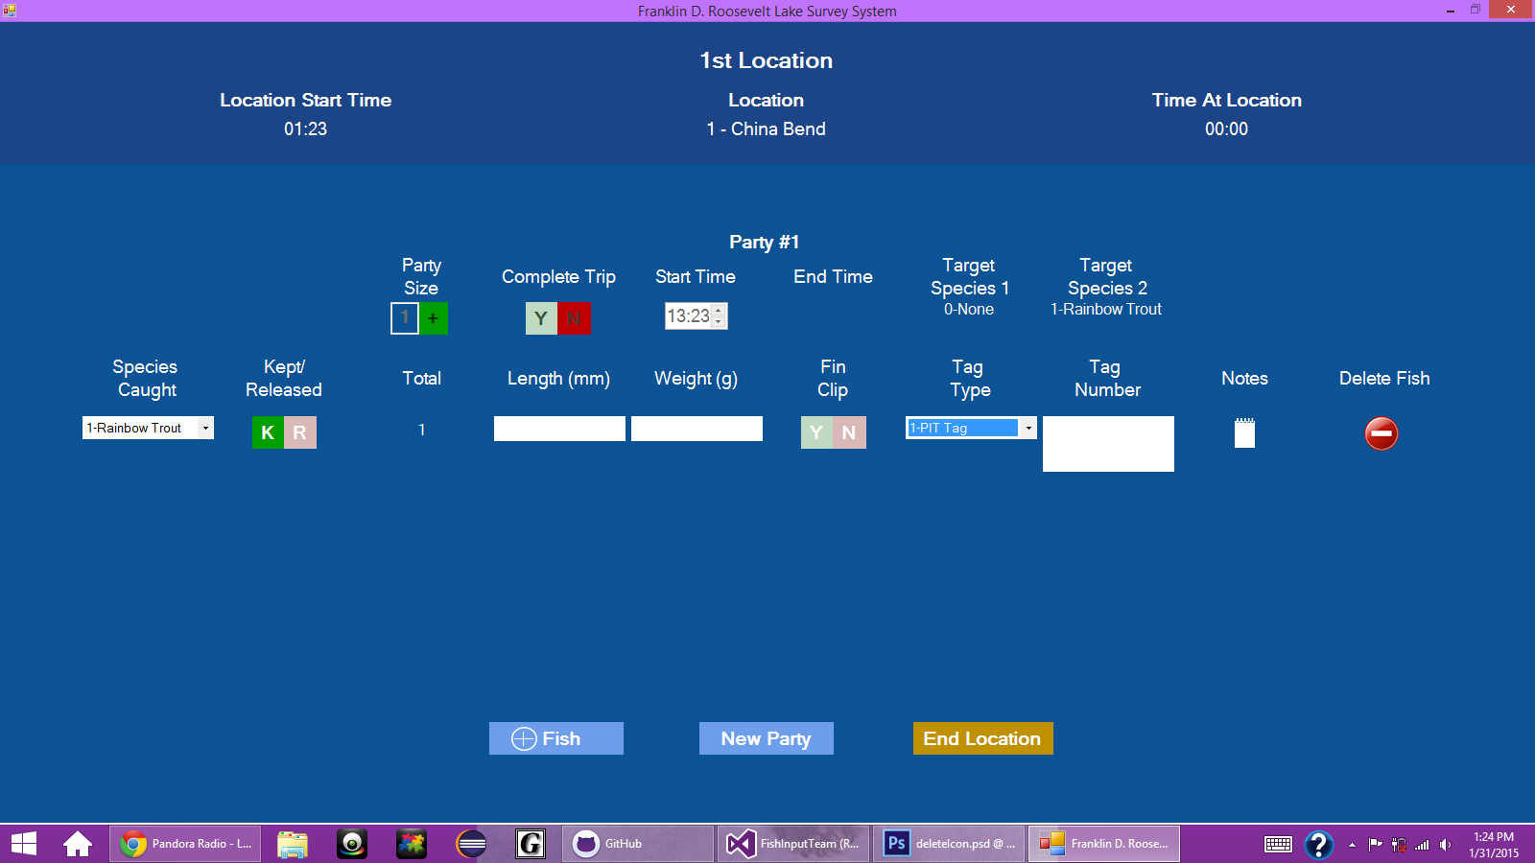
Fish Line Changes
Remove “Mark/Tag” Control
Fish can have both

Slide 6

Completed Fish Changes
Current design is too rigid
Can’t guarantee input for fields
Length
Weight
Fin clip

Slide 7
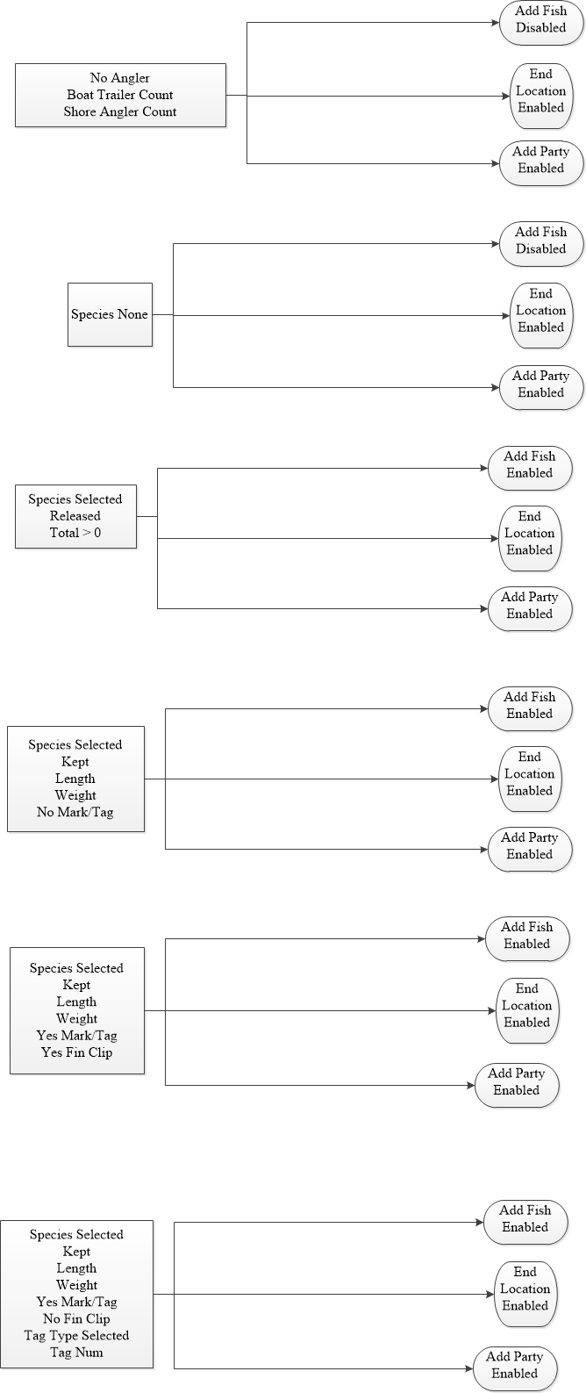
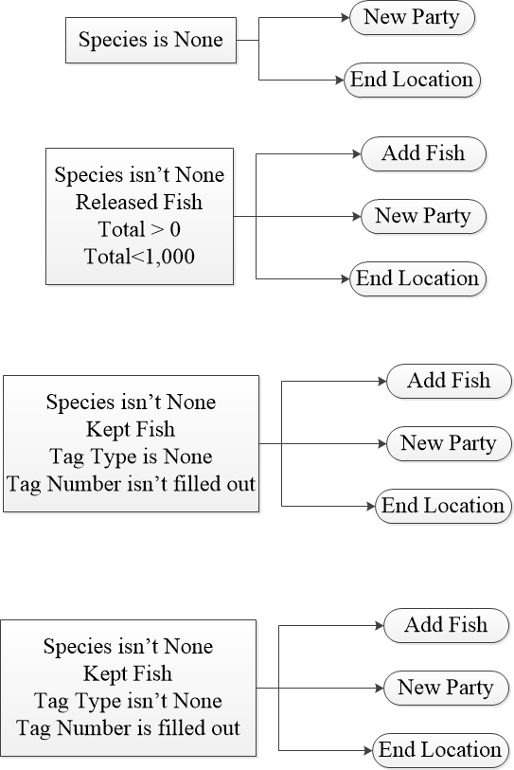
Completed Fish Diagrams
Old Diagram
New Diagram

Slide 8

CSV Output
Must match current format for use in another program
Lower priority than the JSON output

Slide 9
Where We’re Going (Short Term)
Test the UI
Functionality
Layout
Finish up the UI
Client changes
Work flow
Underlying objects
Continue work on JSON/CSV

Slide 10
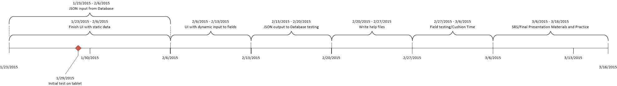
Where We’re Going (Long Term)

