Slide 1

Electronic Field Input System
Team 5
Stacy Carlson, Thomas Flores, and Ralph Parkison

Slide 2

User Interface Changes
Found and implemented a click tester
Restructured the fish row
Tested and rewrote methods

Slide 3
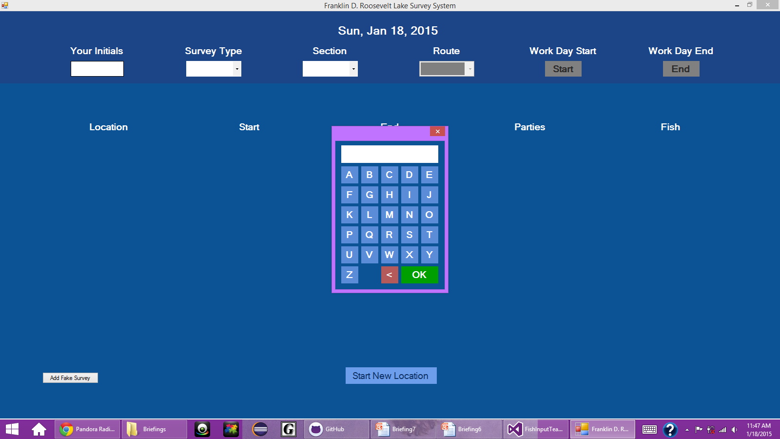
Restrict Keyboard to Alphabet

Slide 4
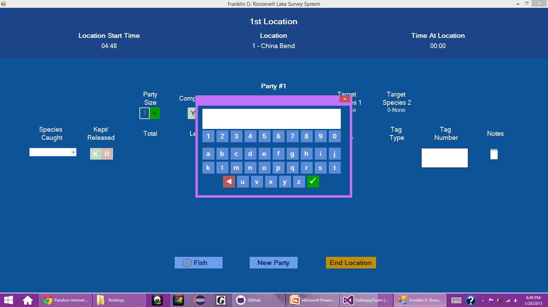
Restrict Keyboard to Alpha-Numerical

Slide 5
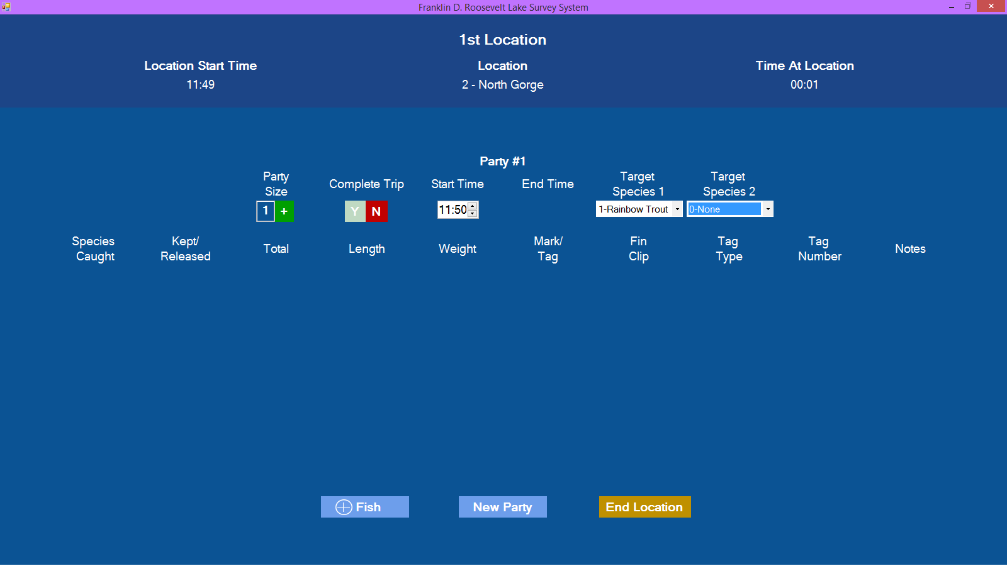
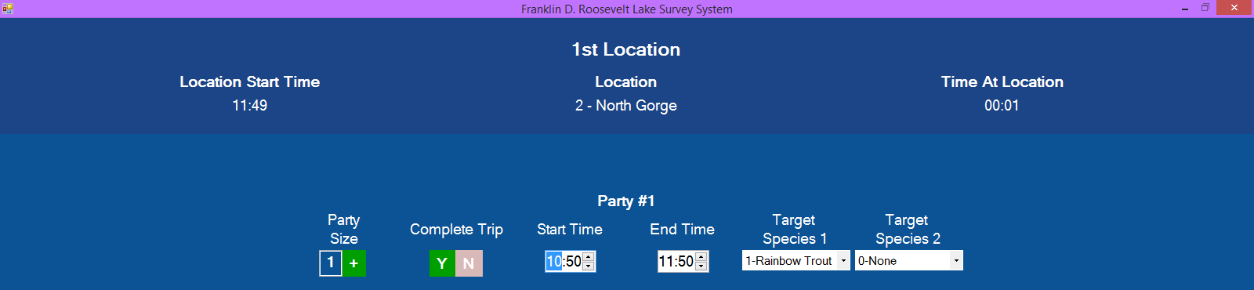
Change Complete Trip Flow

Slide 6
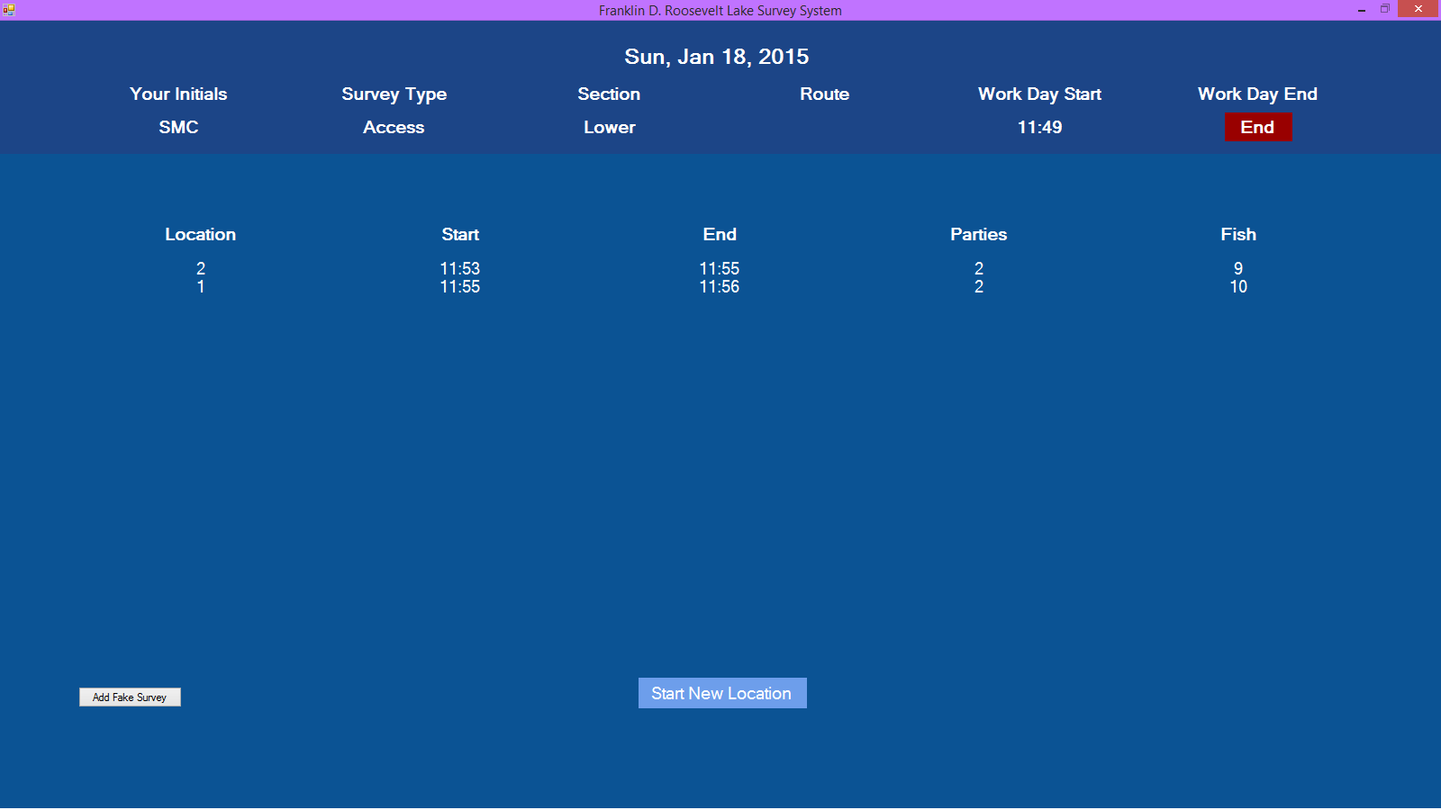
Day Summary Added at Runtime

Slide 7
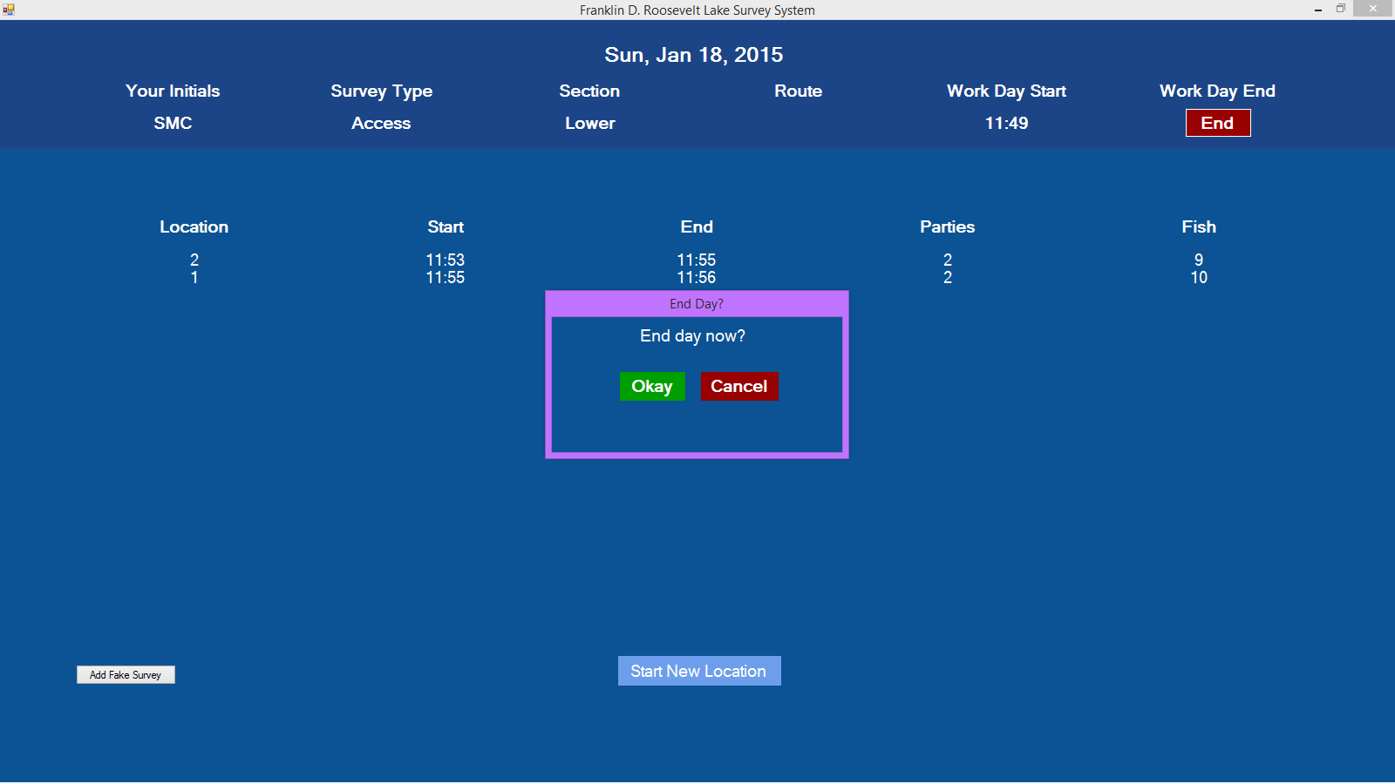
End Day Control

Slide 8
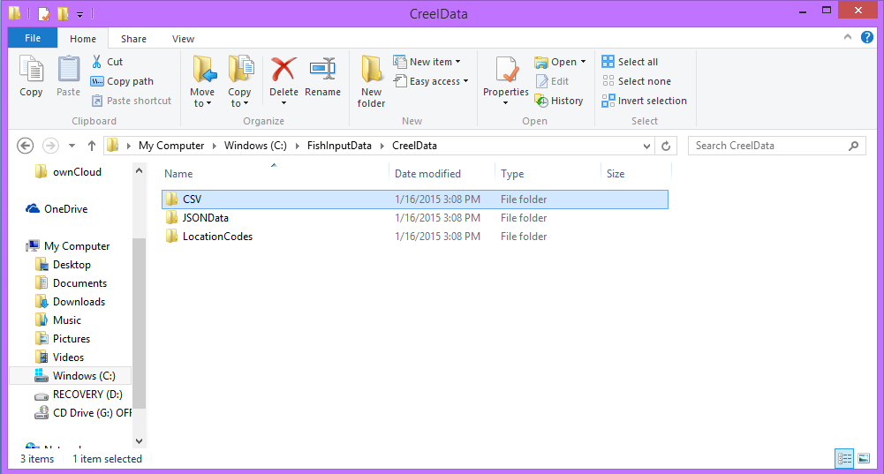
File Structure

Slide 9
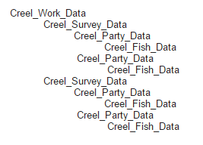
CSV Format Draft

Slide 10
Where We’re Going
Meet with the client and Team 4 (January 28th)
Demo and feedback
Get a tablet for testing
Complete the UI flow
Figure out a way to test the JSON

