Slide 1

Electronic Field Input System
Team 5
Stacy Carlson, Thomas Flores, and Ralph Parkison

Slide 2
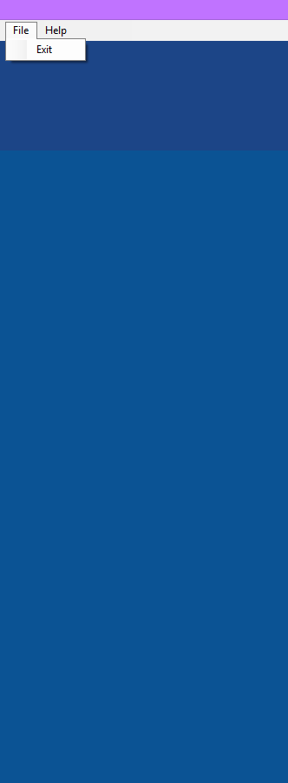
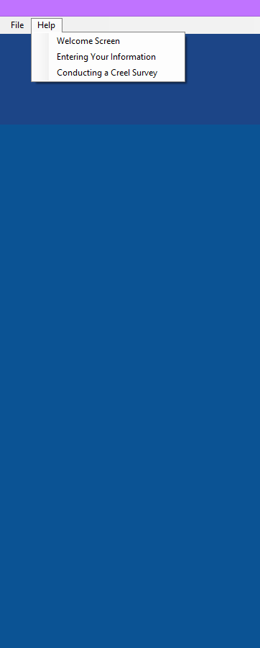

User Interface

Slide 3

Dynamic Data
Accessed via Managed Object

Slide 4
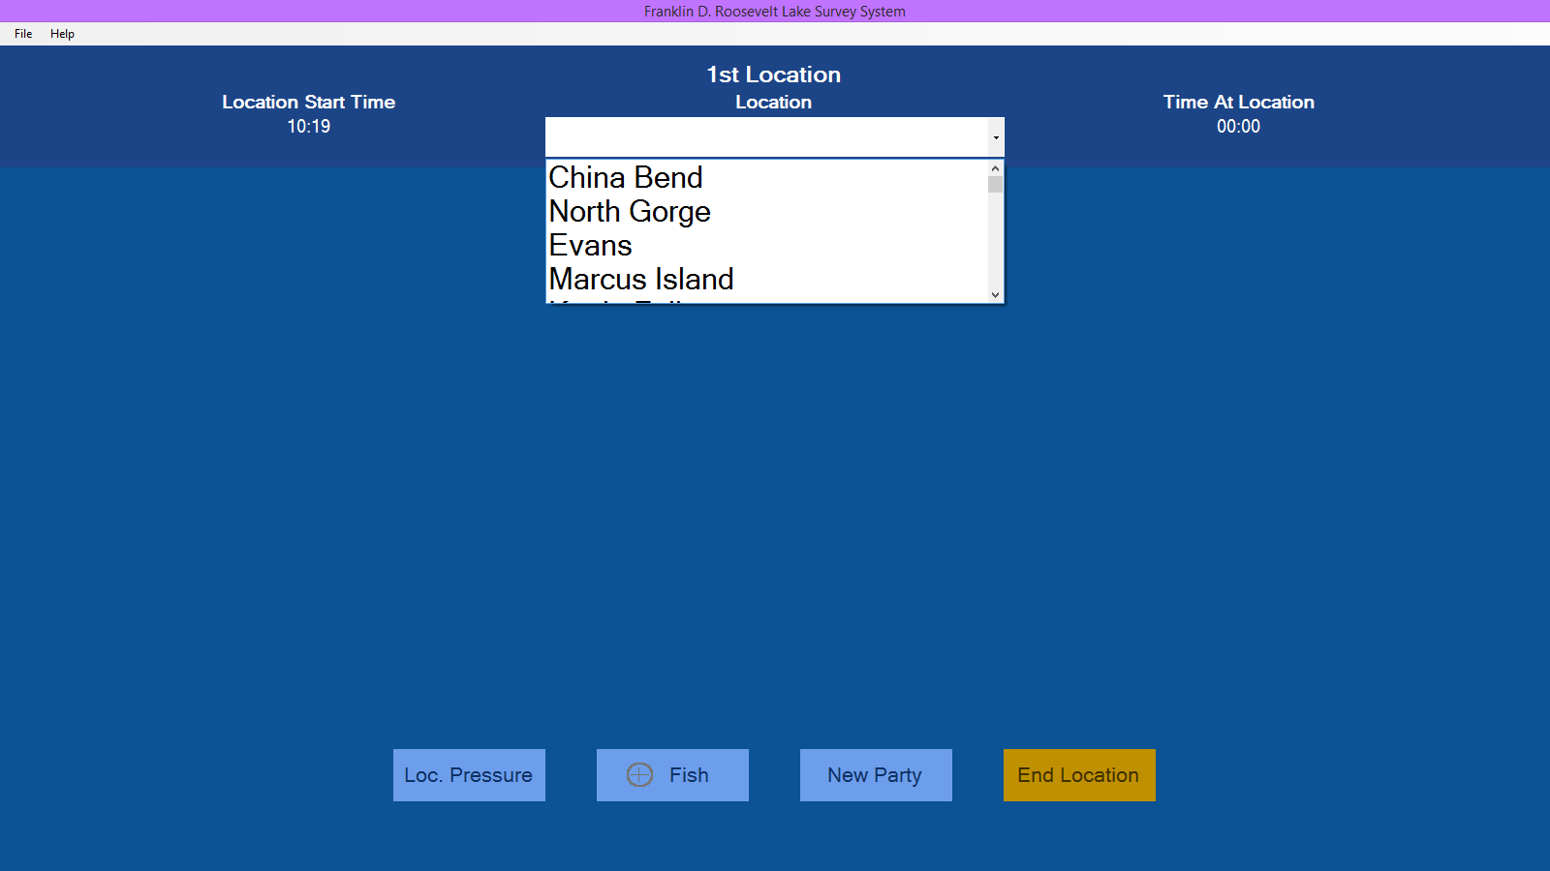
Dynamic Locations

Slide 5
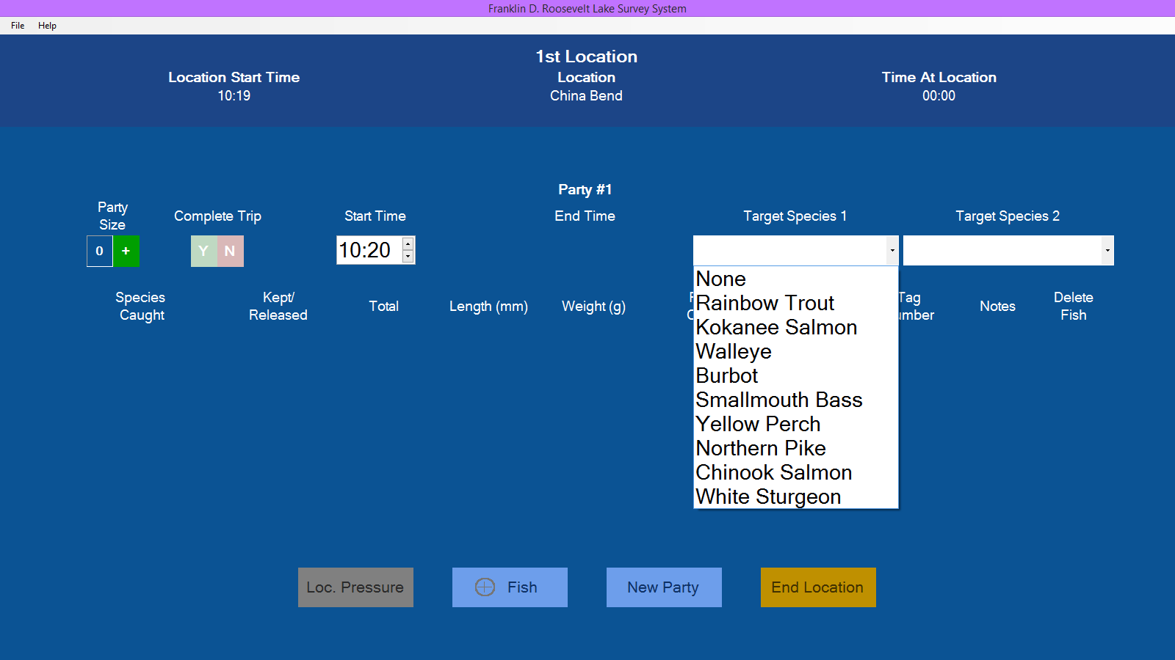
Dynamic Target Species

Slide 6
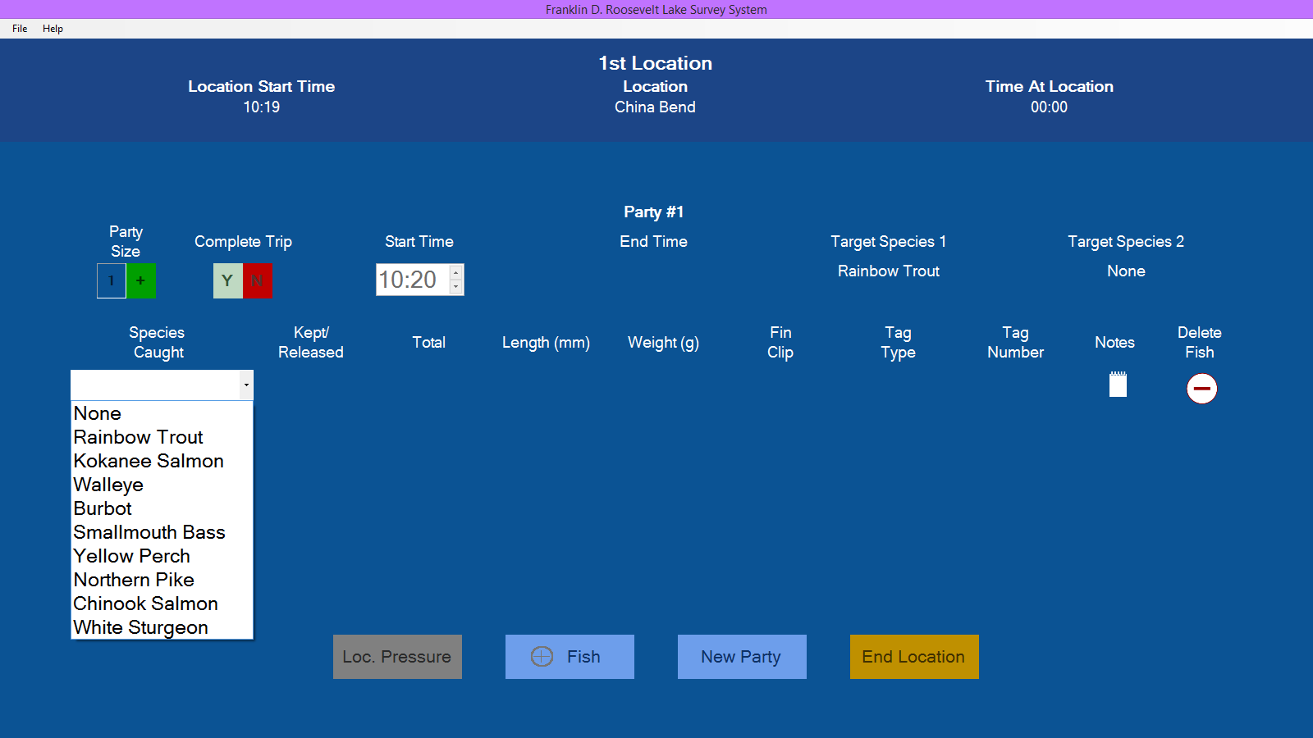
Dynamic Species Caught

Slide 7
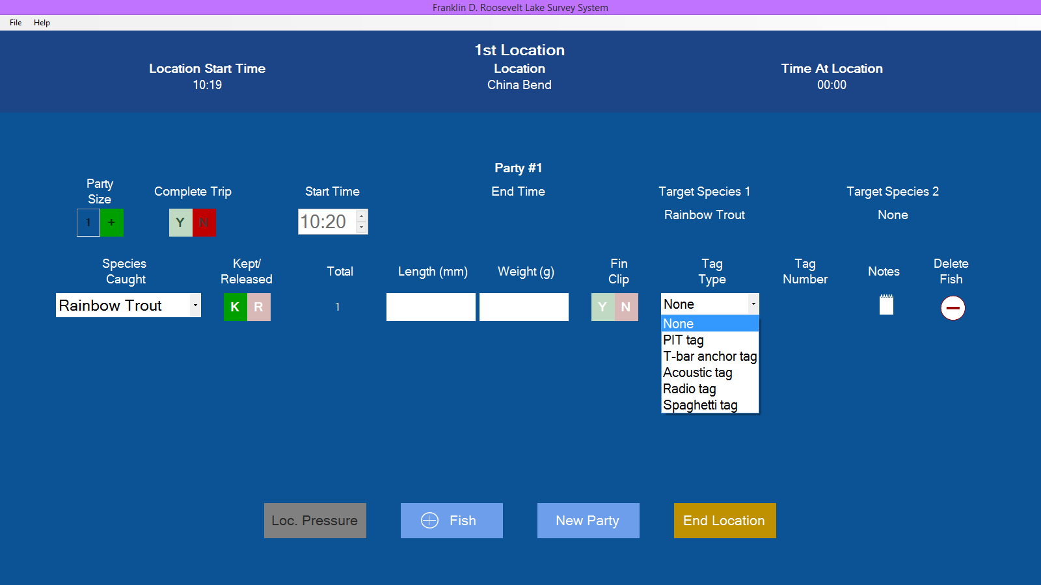
Dynamic Tag Types

Slide 8

Help Files

Slide 9
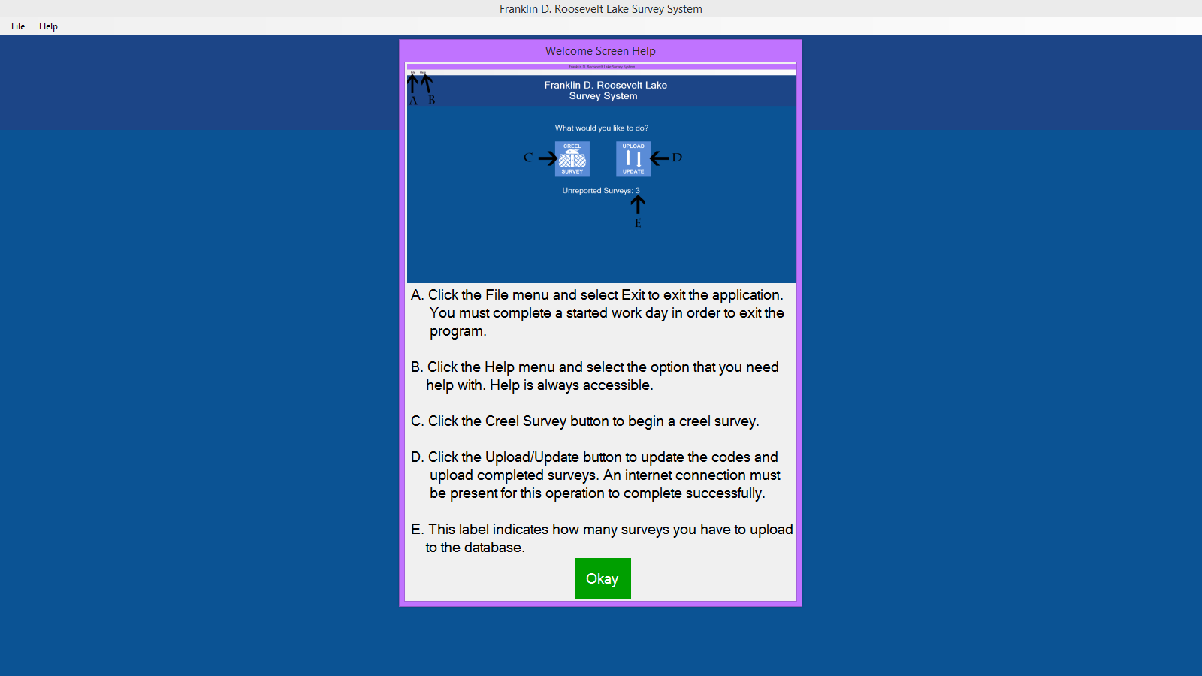
Welcome Screen Help

Slide 10
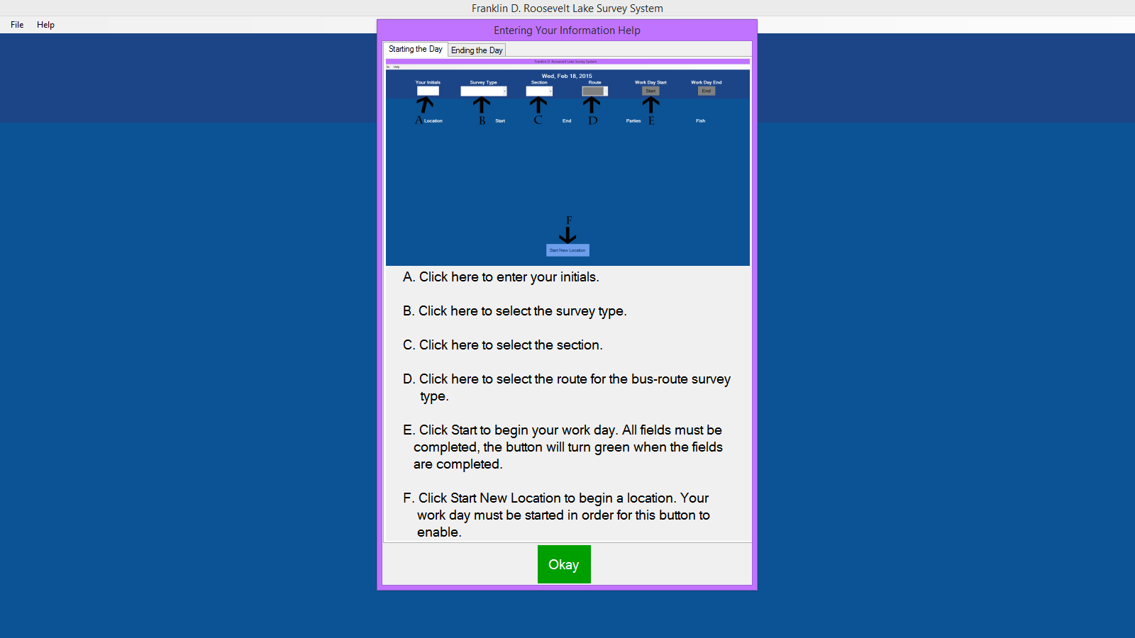
Help Starting the Day

Slide 11
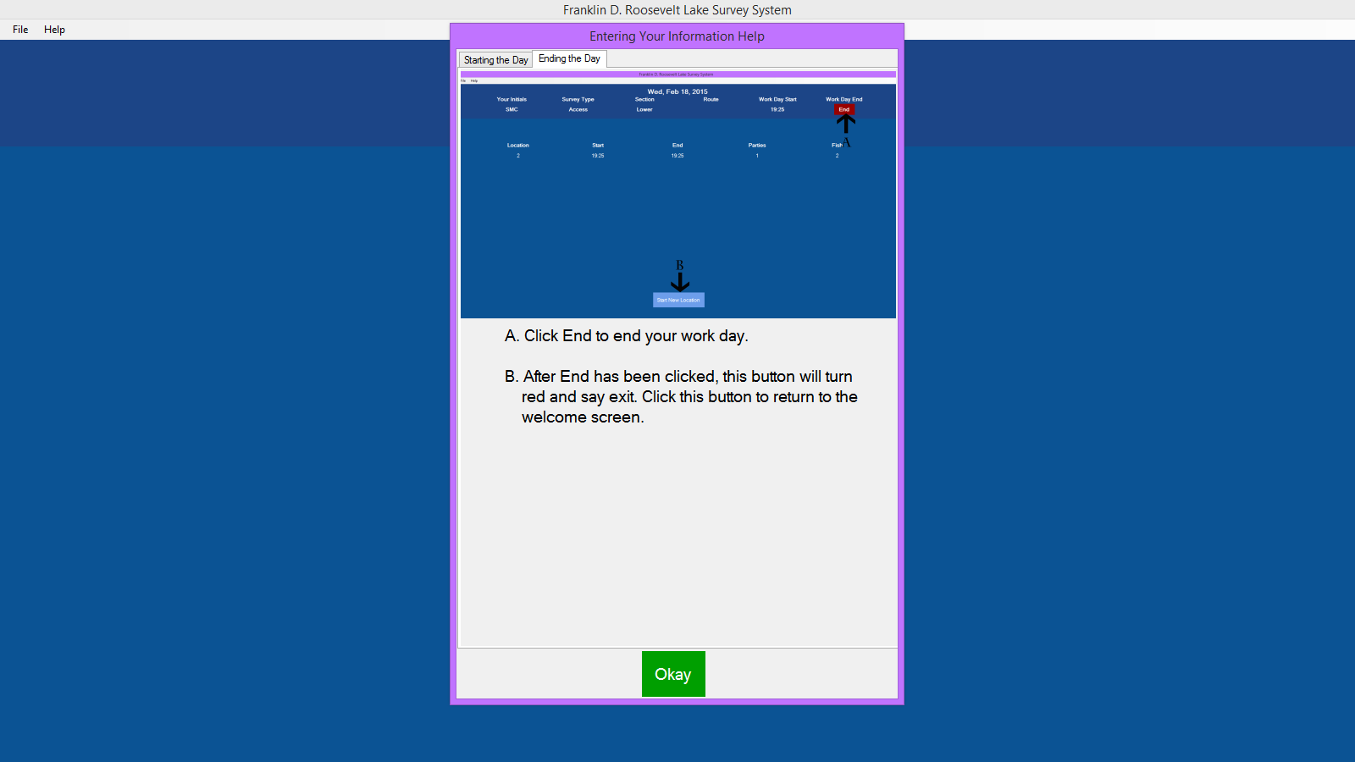
Help Ending the Day

Slide 12
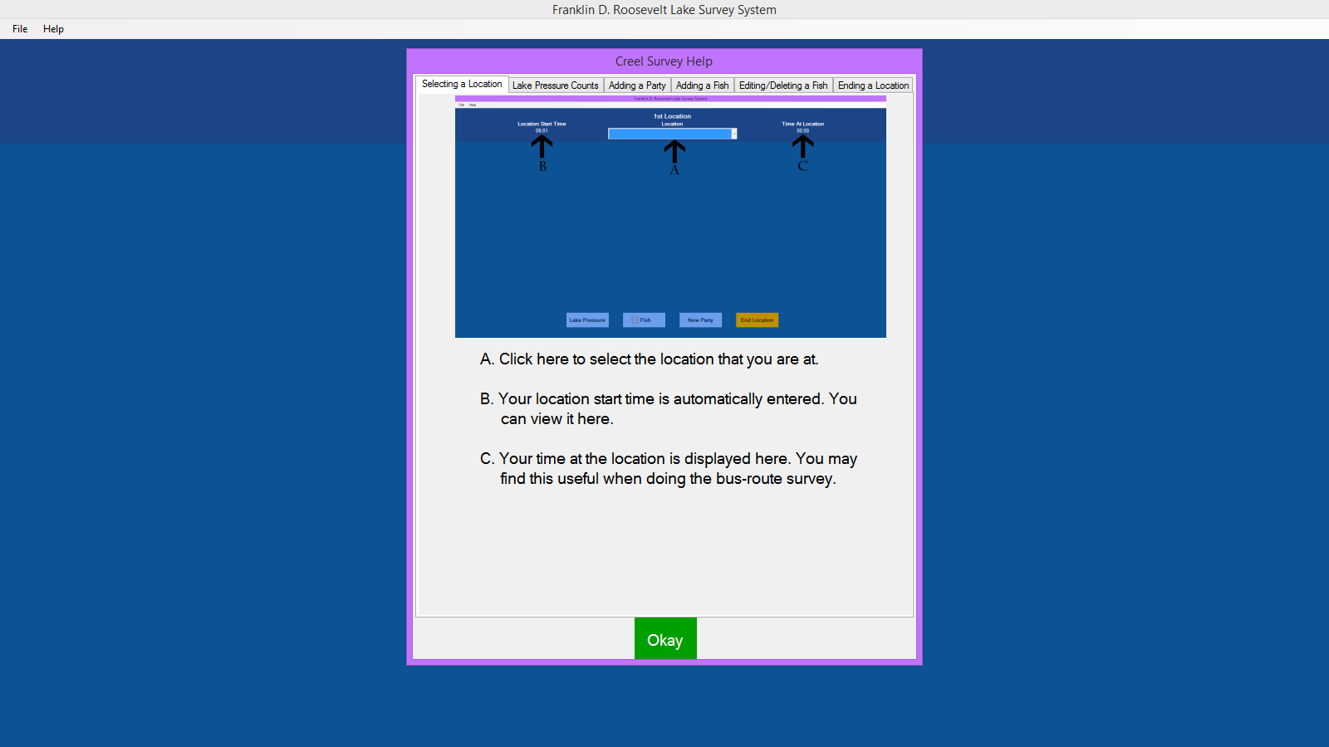
Help Selecting a Location

Slide 13
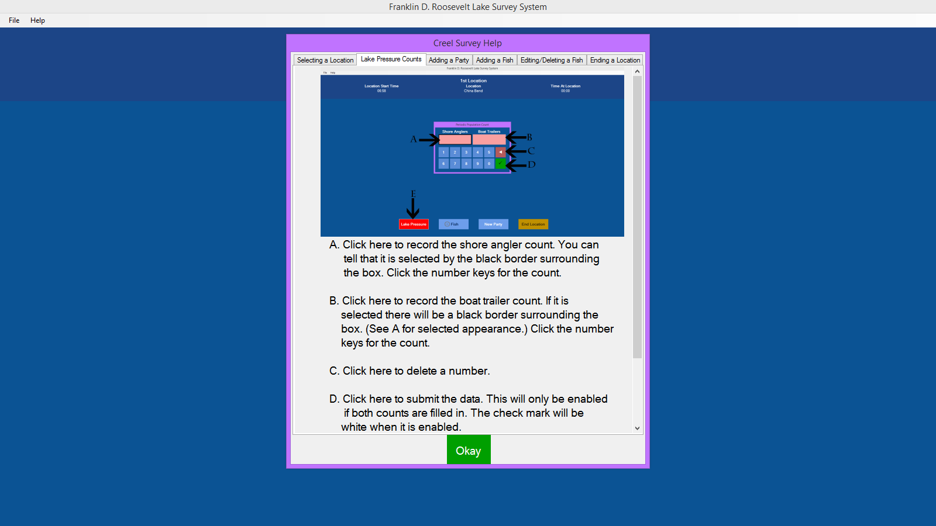
Help Doing Counts

Slide 14
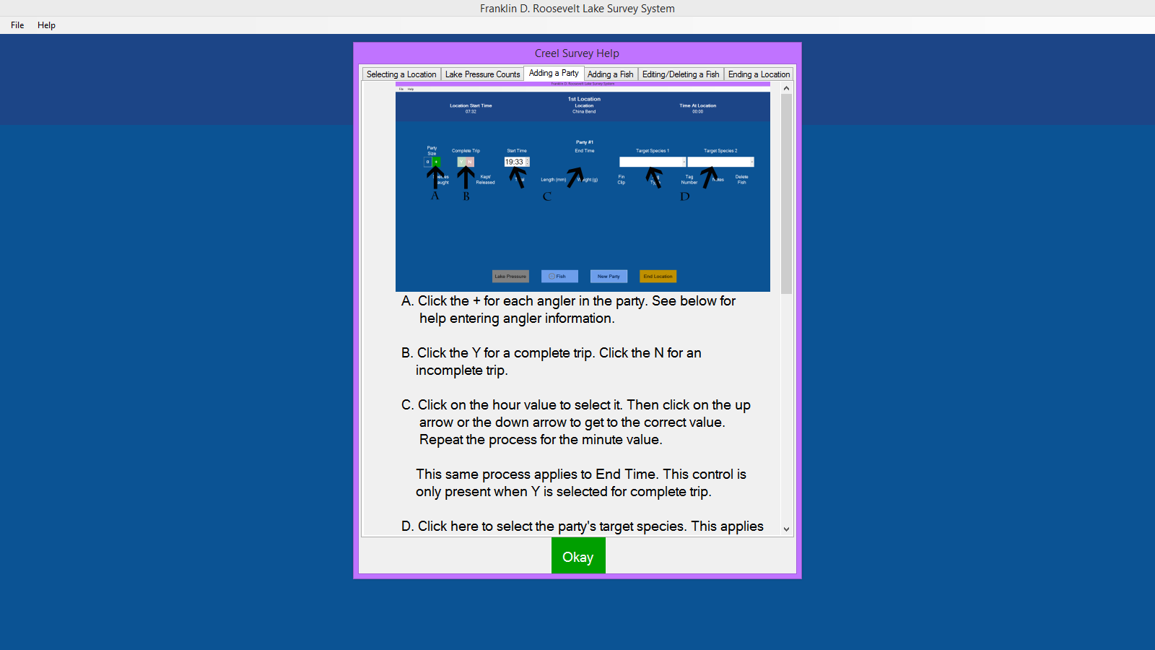
Help Adding a Party

Slide 15
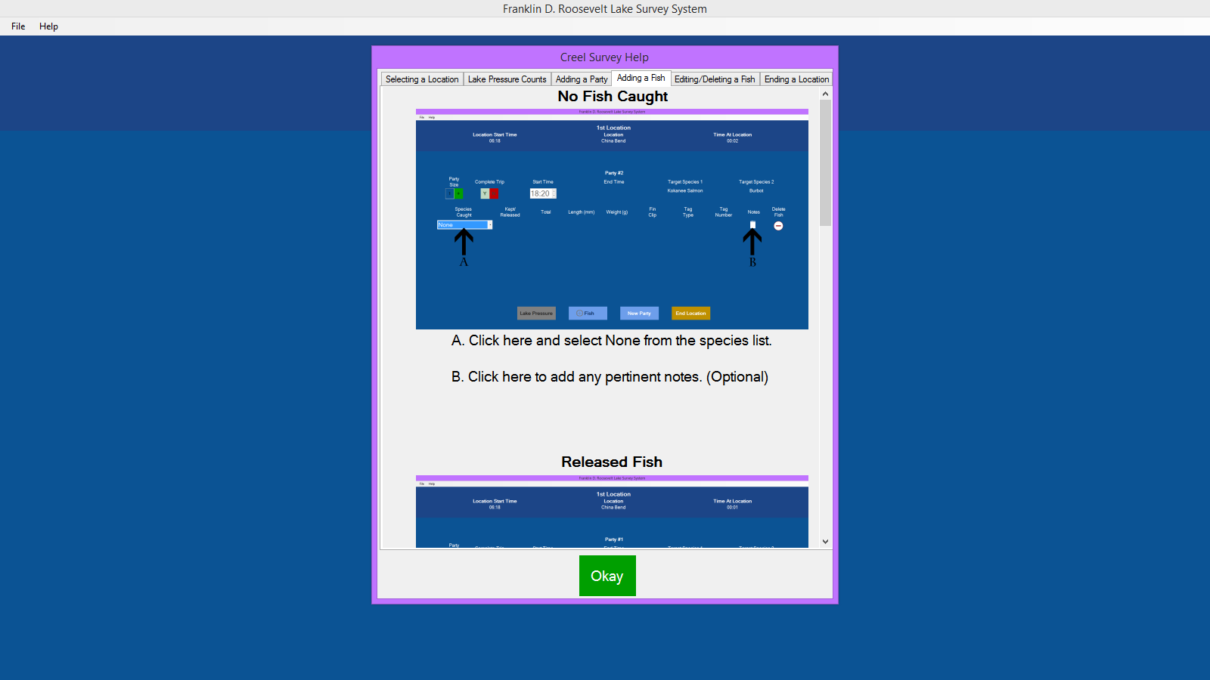
Help Adding a Fish

Slide 16
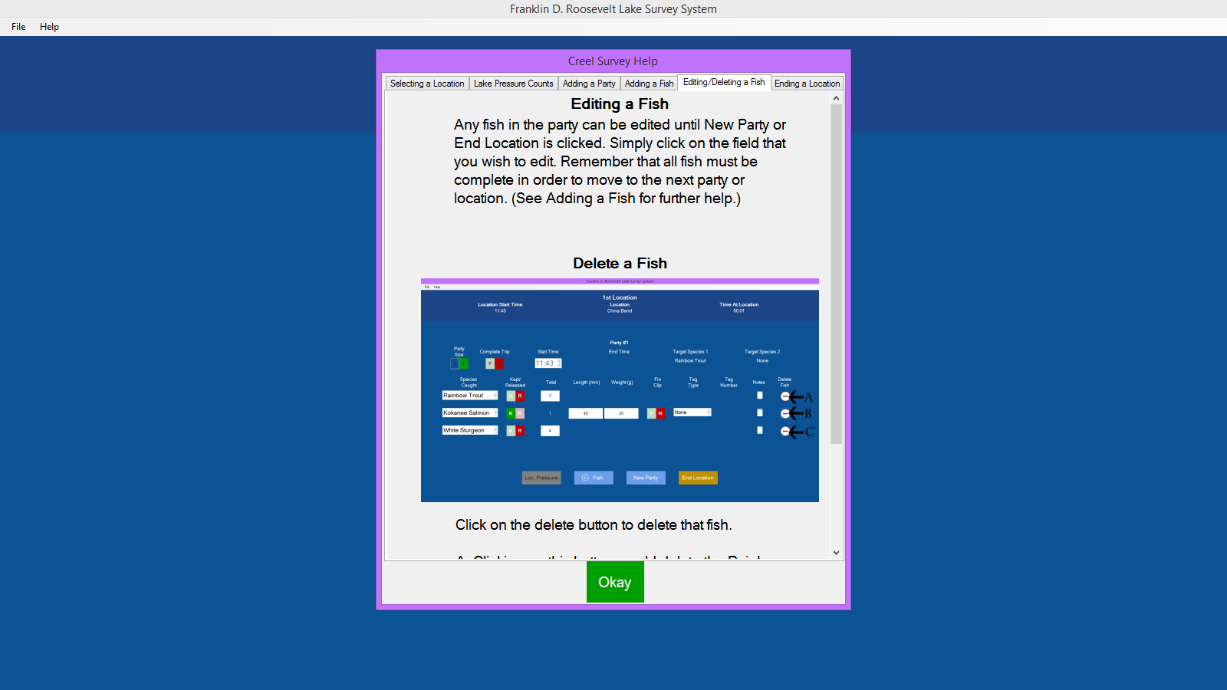
Help Editing/Deleting a Fish

Slide 17
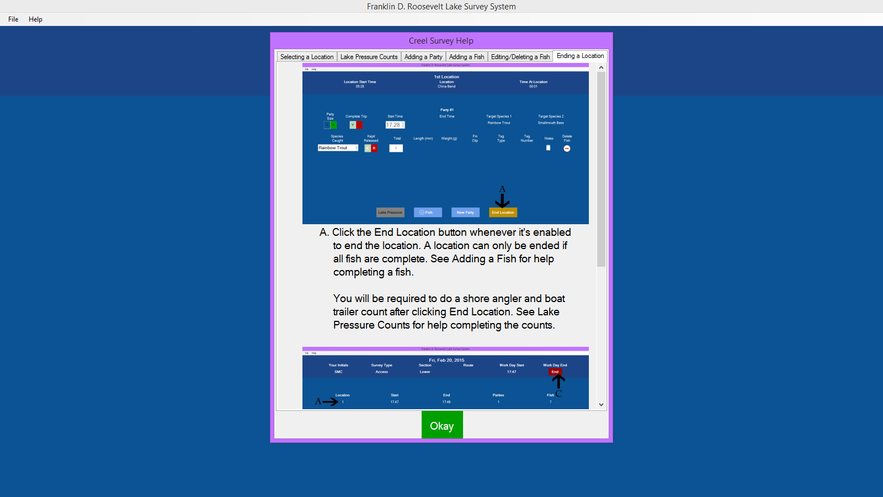
Help Ending a Location

Slide 18
Where We’re Going
Meet with the client on Wednesday
Finish any last minute details on the UI
Continue work on the output JSON/CSV

