Slide 1
Electronic Field Input System
Team 5
Stacy Carlson, Thomas Flores, and Ralph Parkison

Slide 2
The Problem
Surveys done by hand, mailed, and entered into Excel
Potential for loss
Inaccuracies in transcription
Long time to access the data

Slide 3
Client Requirements
Electronic Input System
Creel (Top priority)
Raw Fish
FWIN
Easily updatable and maintainable
Fully functional with the database
Run on Getac Tablet
Solution can’t depend on an Internet connection

Slide 4
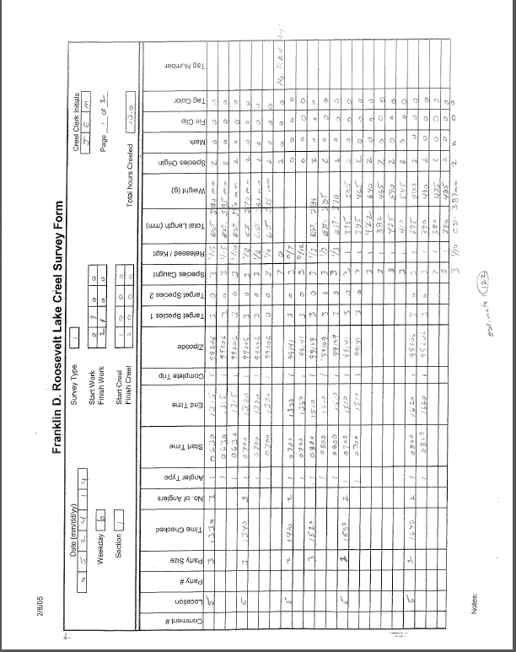

Slide 5

End User
Creel Clerk
Two types
Stationary
Bus Route
Trained how to do Creel survey
Varying computer skills

Slide 6

Highlights of Our Journey

Slide 7
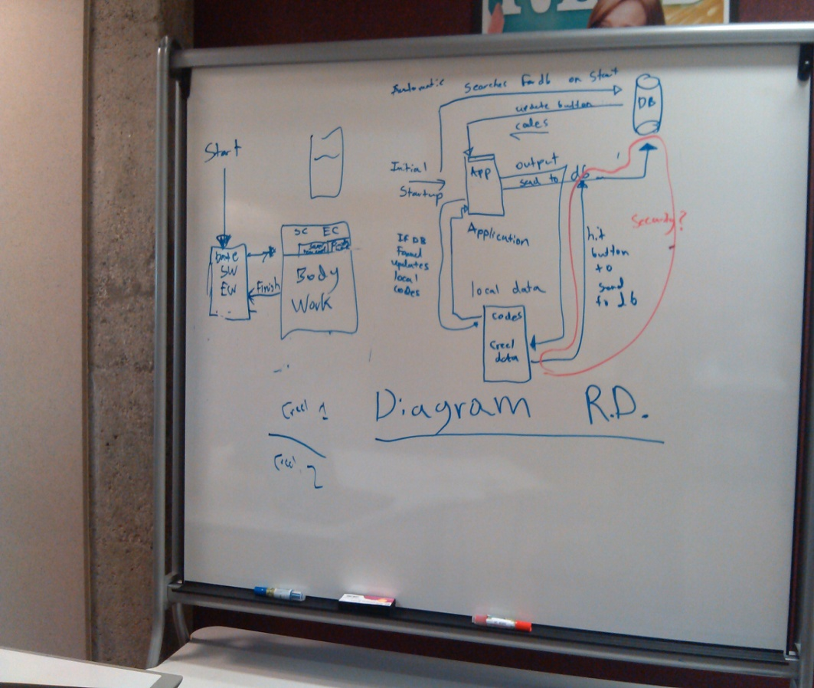
Initial Ideas
Automatically try to download updates
Complete survey
Loading screen
General work info
Data entry
Store survey data in internal database

Slide 8



Slide 9


Slide 10


Slide 11
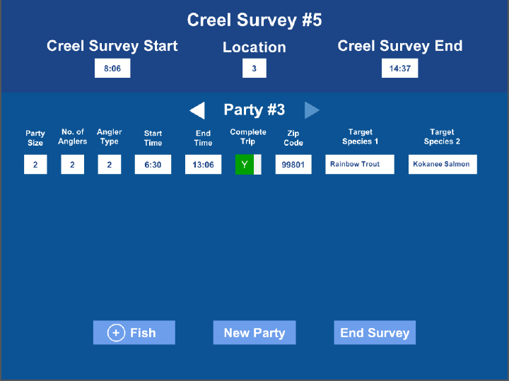

Slide 12
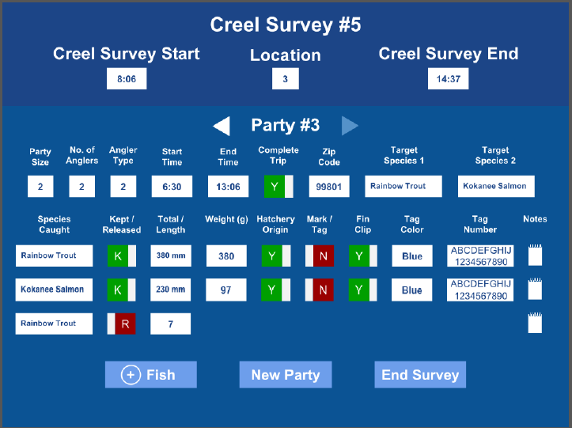

Slide 13
After Further Thought…
Eliminate the loading screen
Two use cases
At wifi hotspot to update/upload
At lake to do surveys
Store data in log files
Uploaded data will be sent through QA
Display text to eliminate user error
Send codes to database

Slide 14
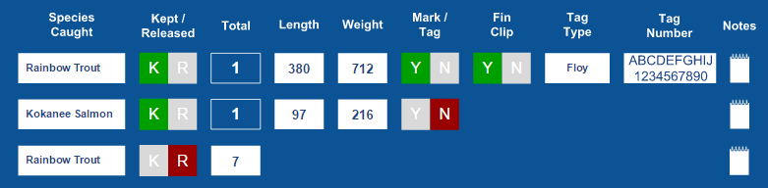
Client Suggested Revisions
Data has relationships
Fish kept with tag info
Fish kept without tag
Fish released

Slide 15




Client Suggested Revisions
No preselected defaults for toggle switches
Remove edit/view functionality for previously entered data

Slide 16
“Final” Technology Choices
C# Winforms
Mix of built in and custom controls
Utilize Windows on screen keyboard
JSON to communicate with database
Store survey data as log files

Slide 17
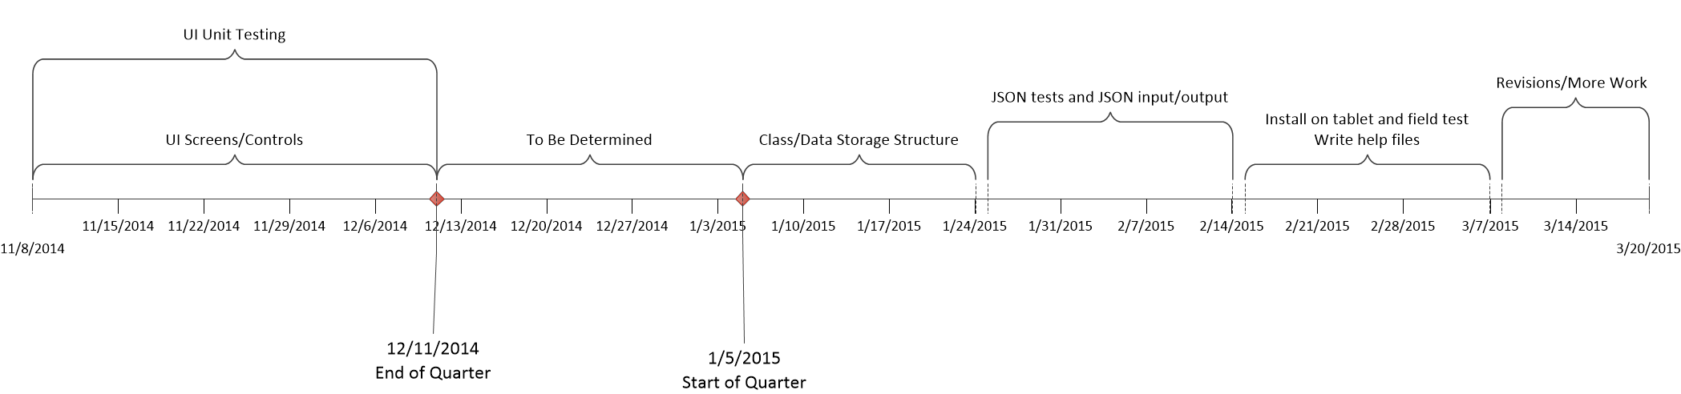
Timeline

Slide 18

Current Diagrams

Slide 19
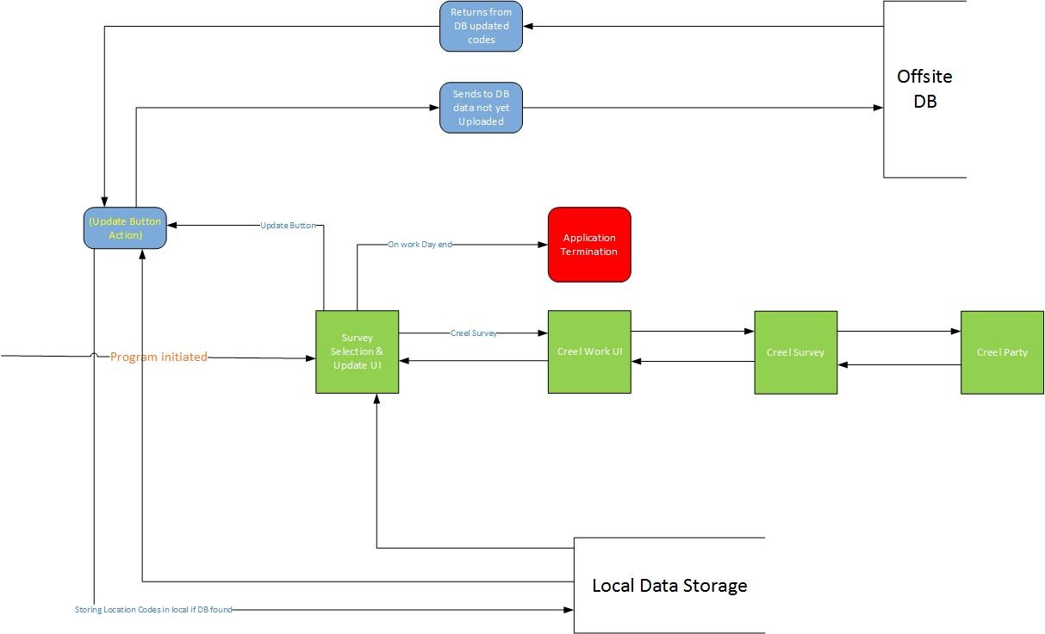
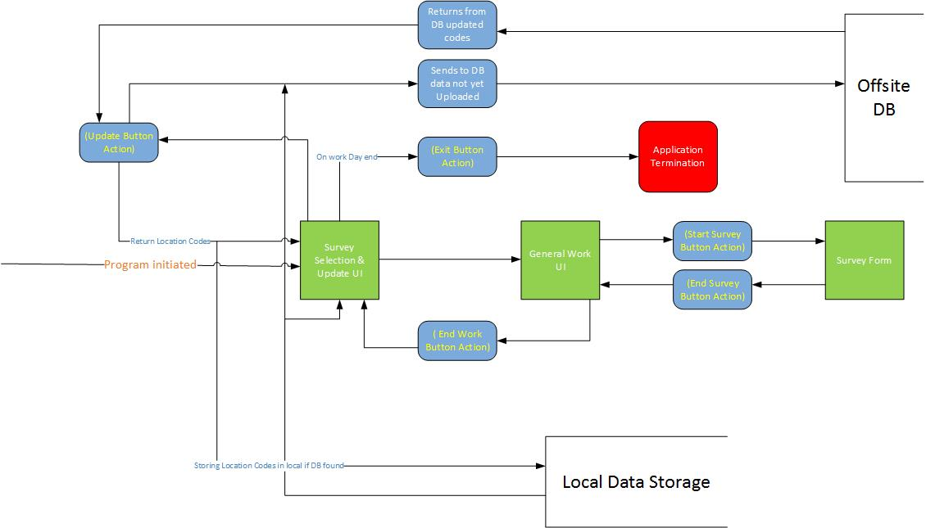

Slide 20
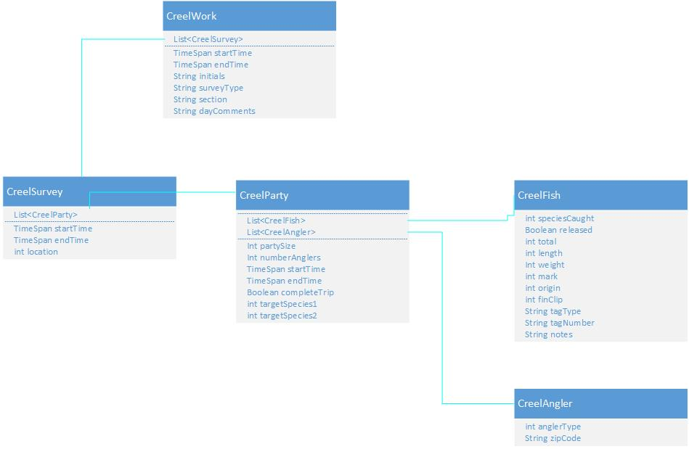

Slide 21

Unit Tests

Slide 22
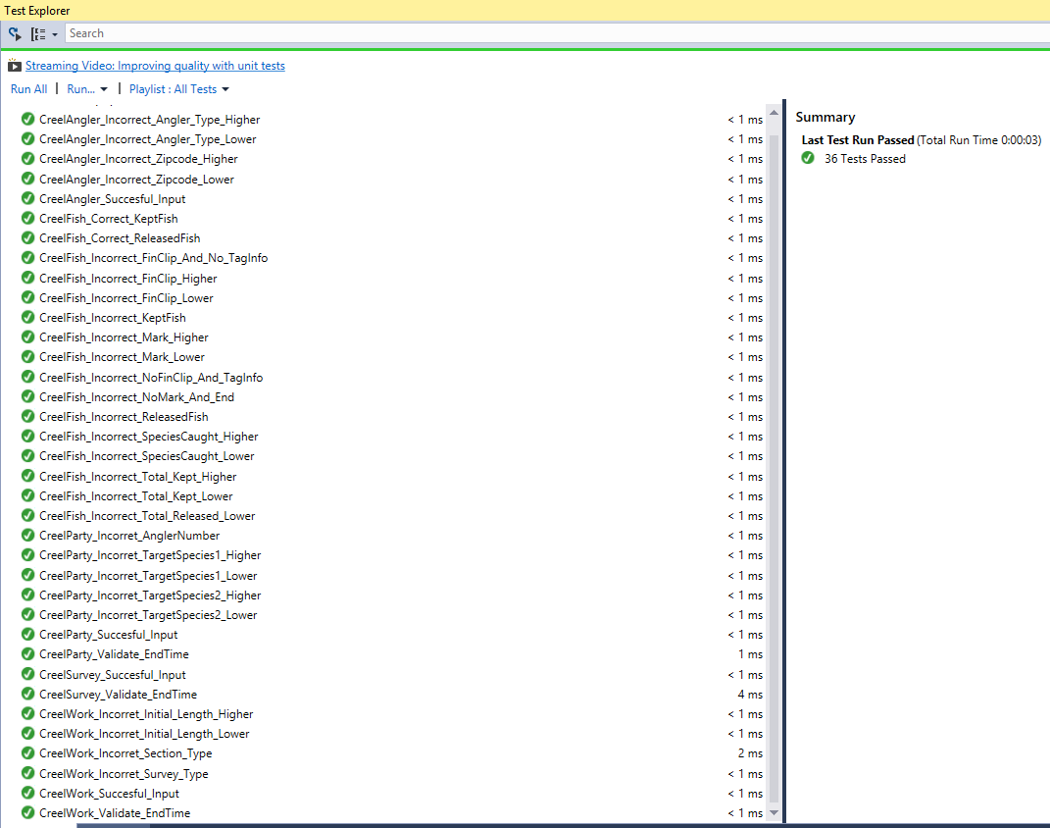

Slide 23

User Interface

Slide 24
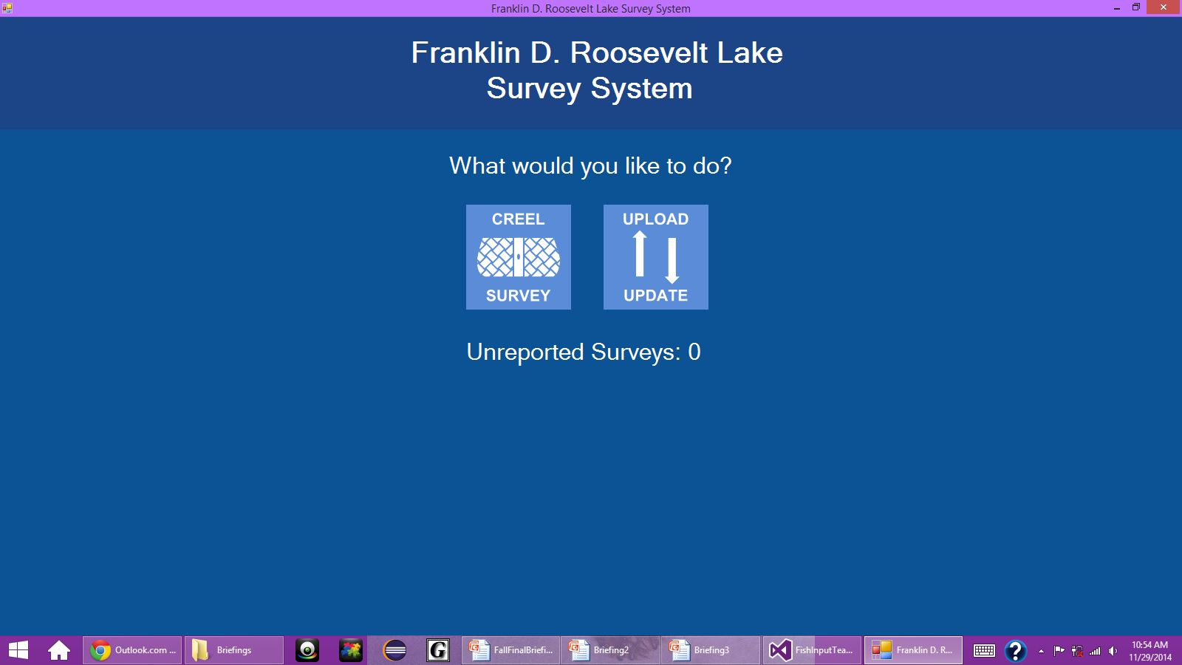


Slide 25


Slide 26
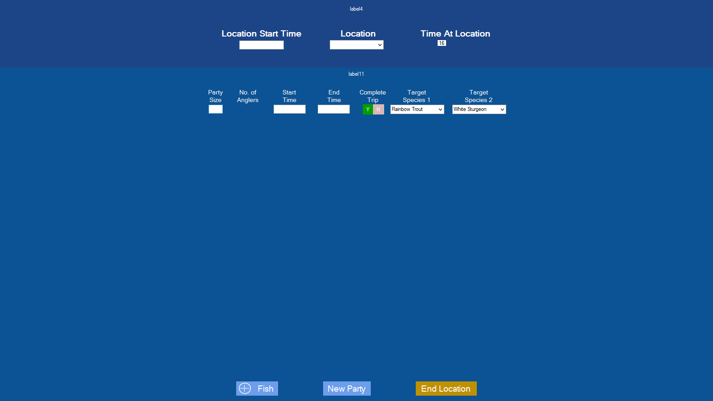

Slide 27
Where We Are Going
Finish UI
Code behind for UI
JSON communication

