Slide 1
Electronic Field Input System
Team 5
Stacy Carlson, Thomas Flores, and Ralph Parkison

Slide 2
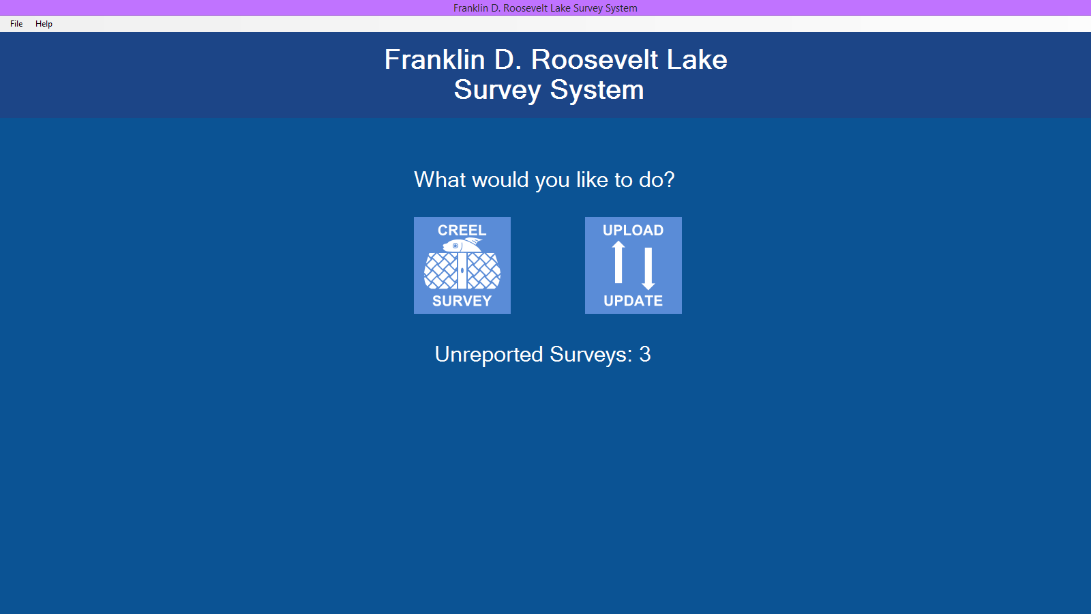
Welcome Screen

Slide 3
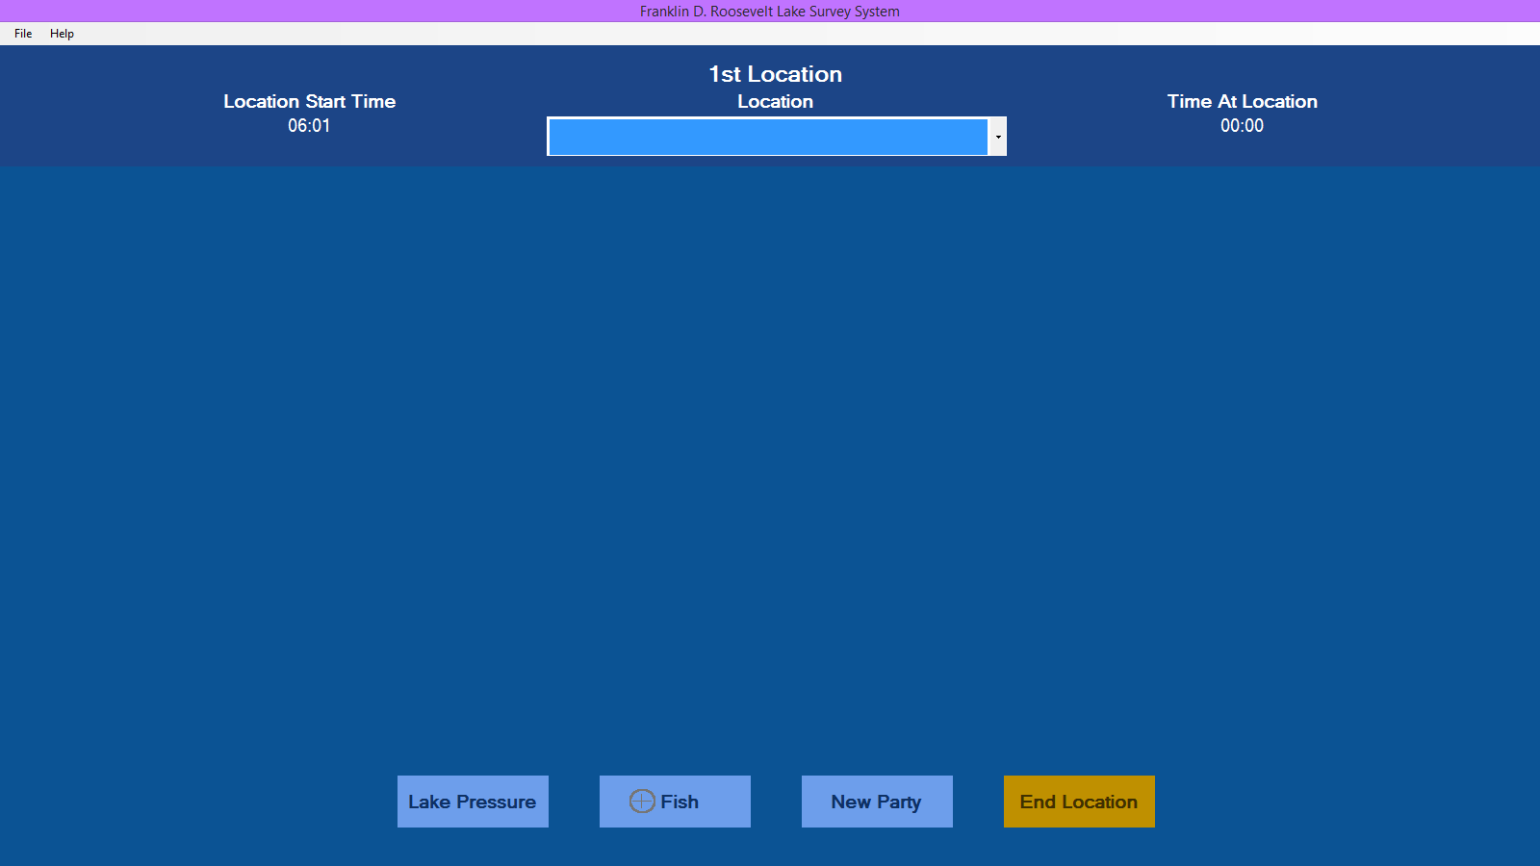
Adding a Location

Slide 4
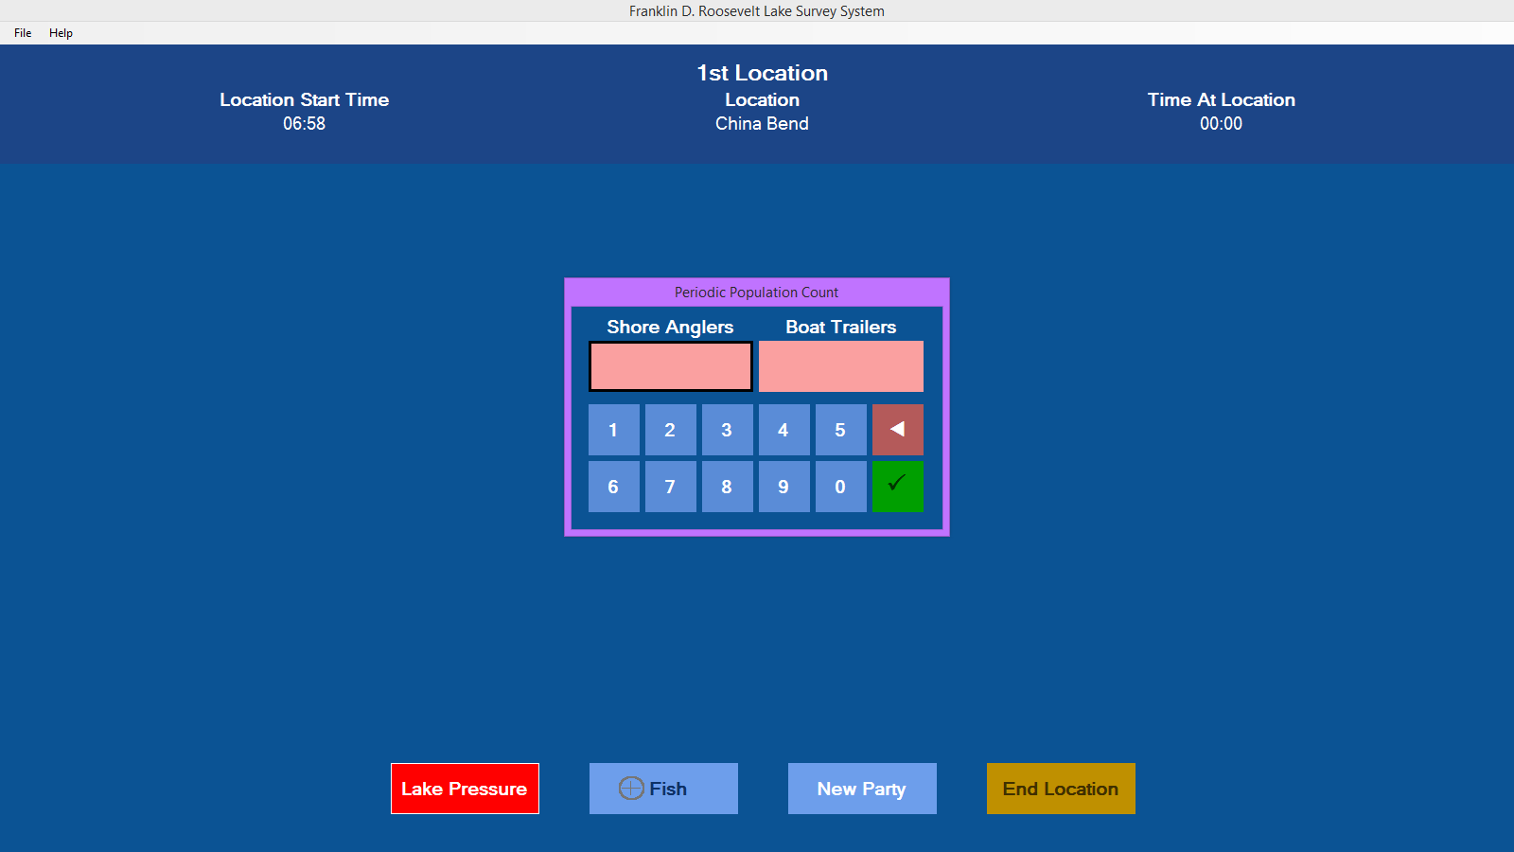
Pressure Counts

Slide 5
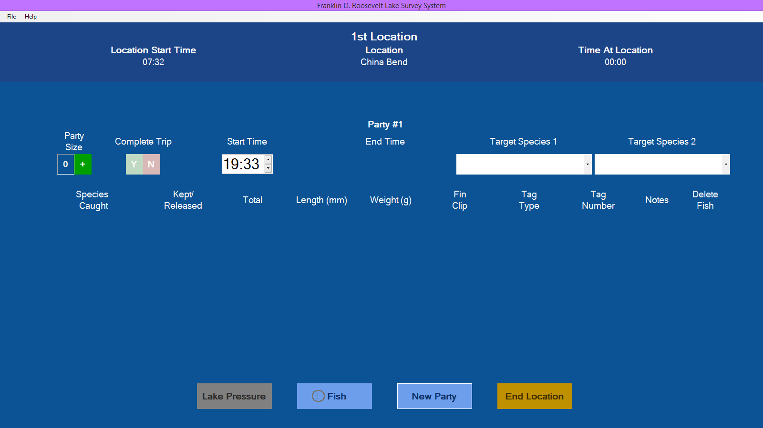
Adding a Party

Slide 6
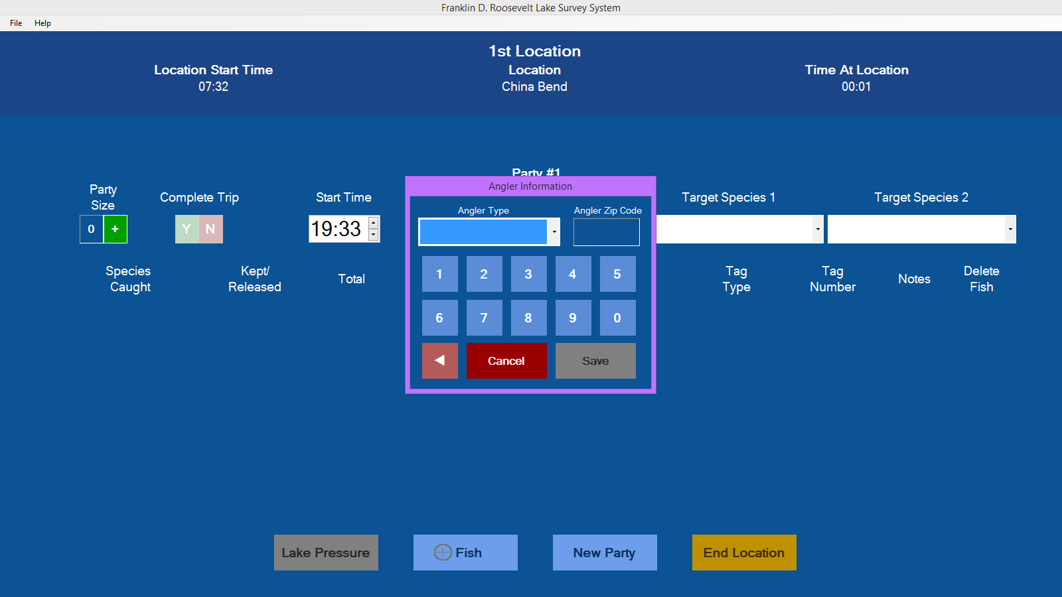
Angler Information

Slide 7
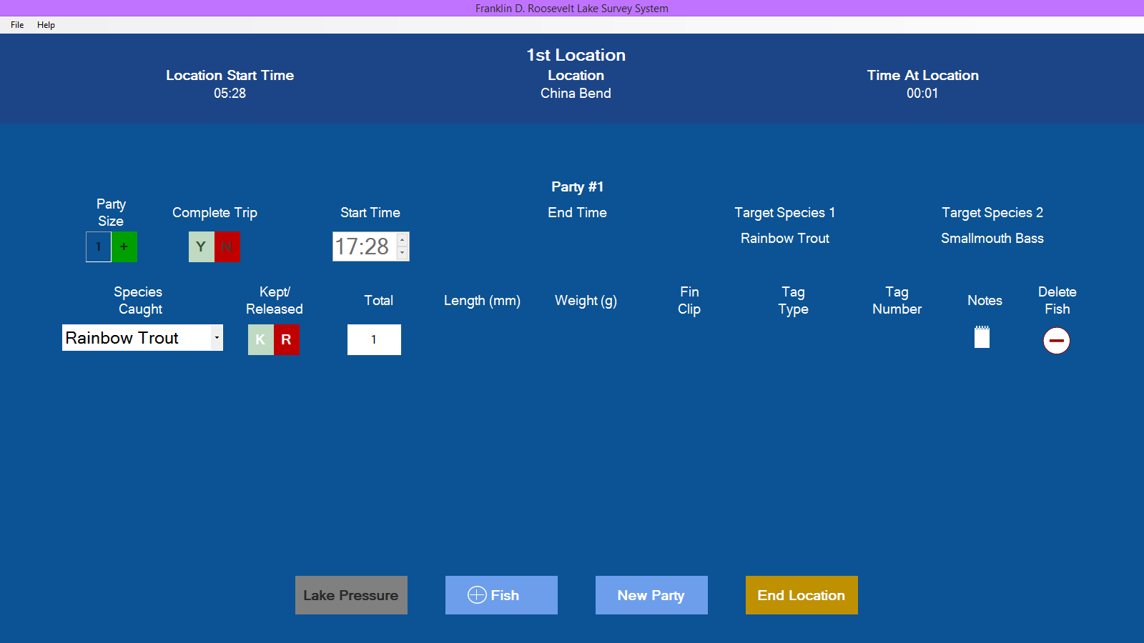
Adding a Released Fish

Slide 8
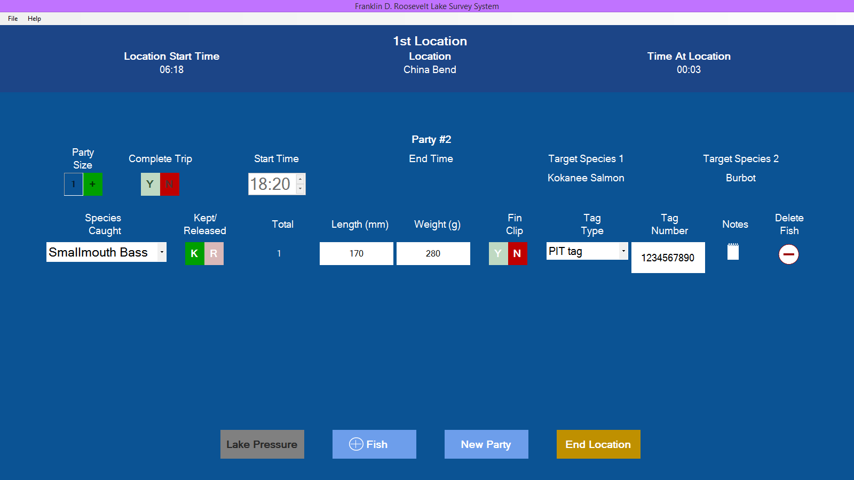
Adding a Kept Fish

Slide 9
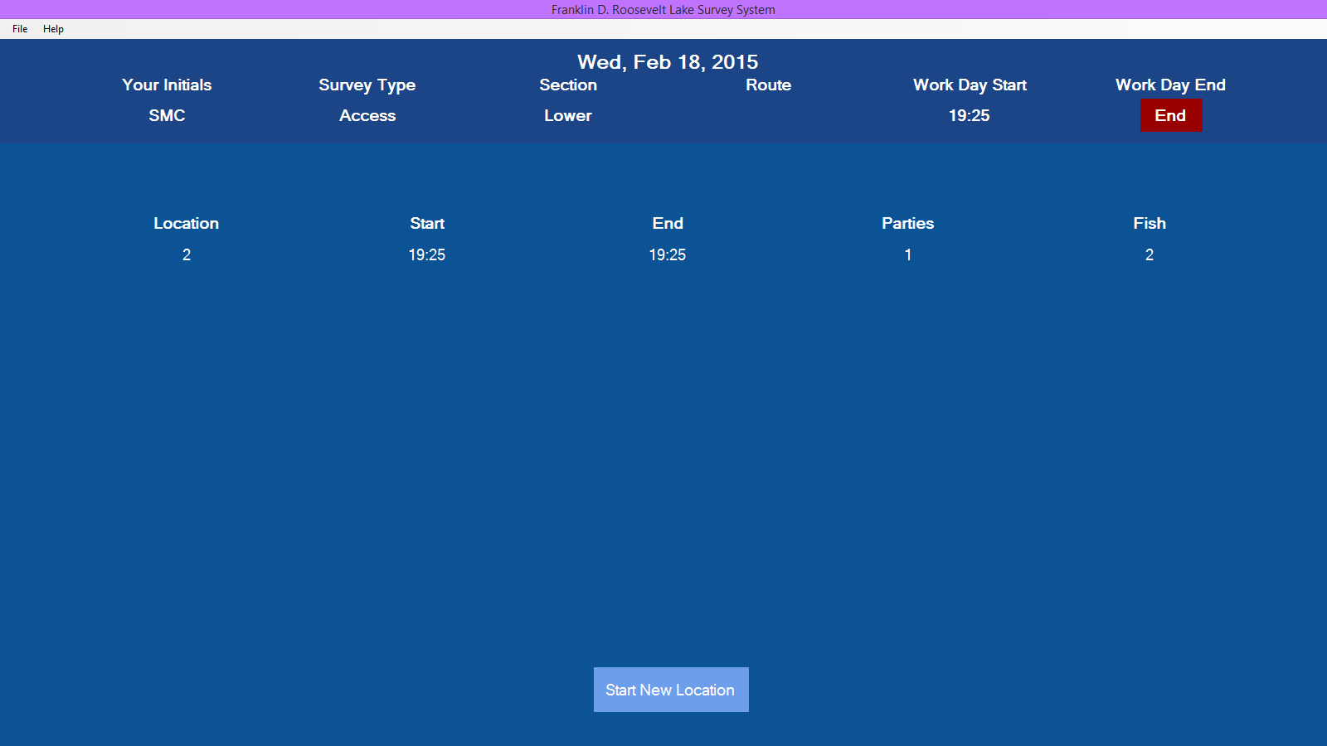
Summary of a Location

Slide 10
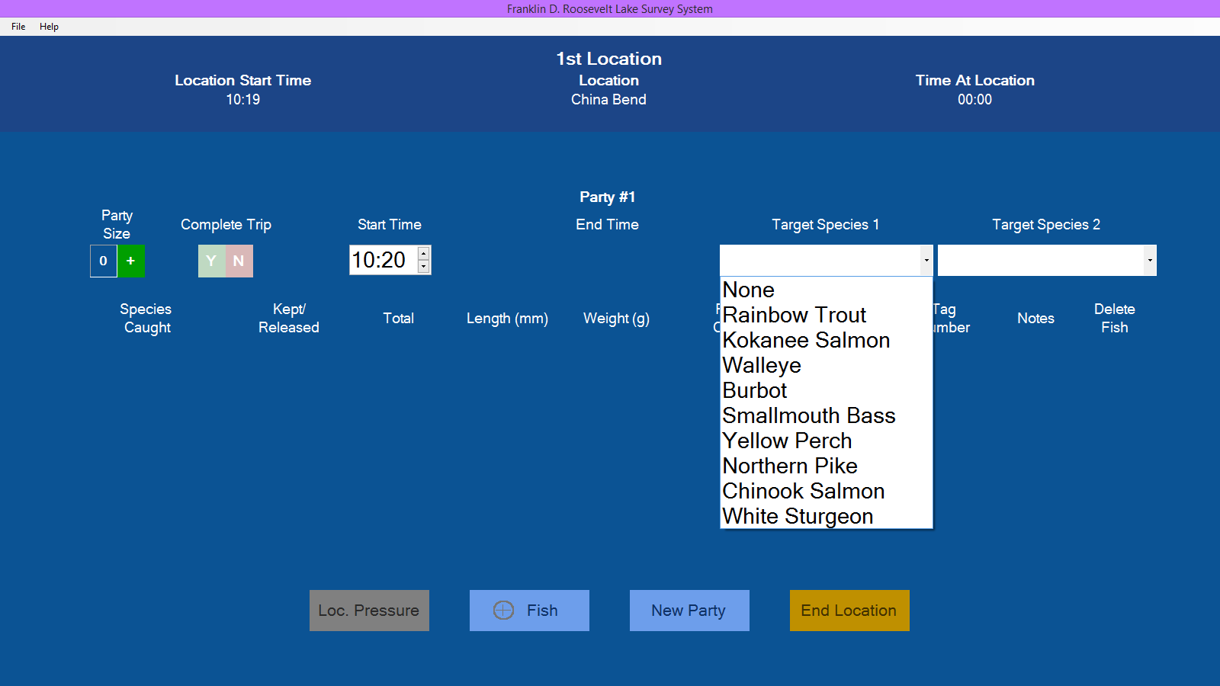
Data Pulled from Database

Slide 11
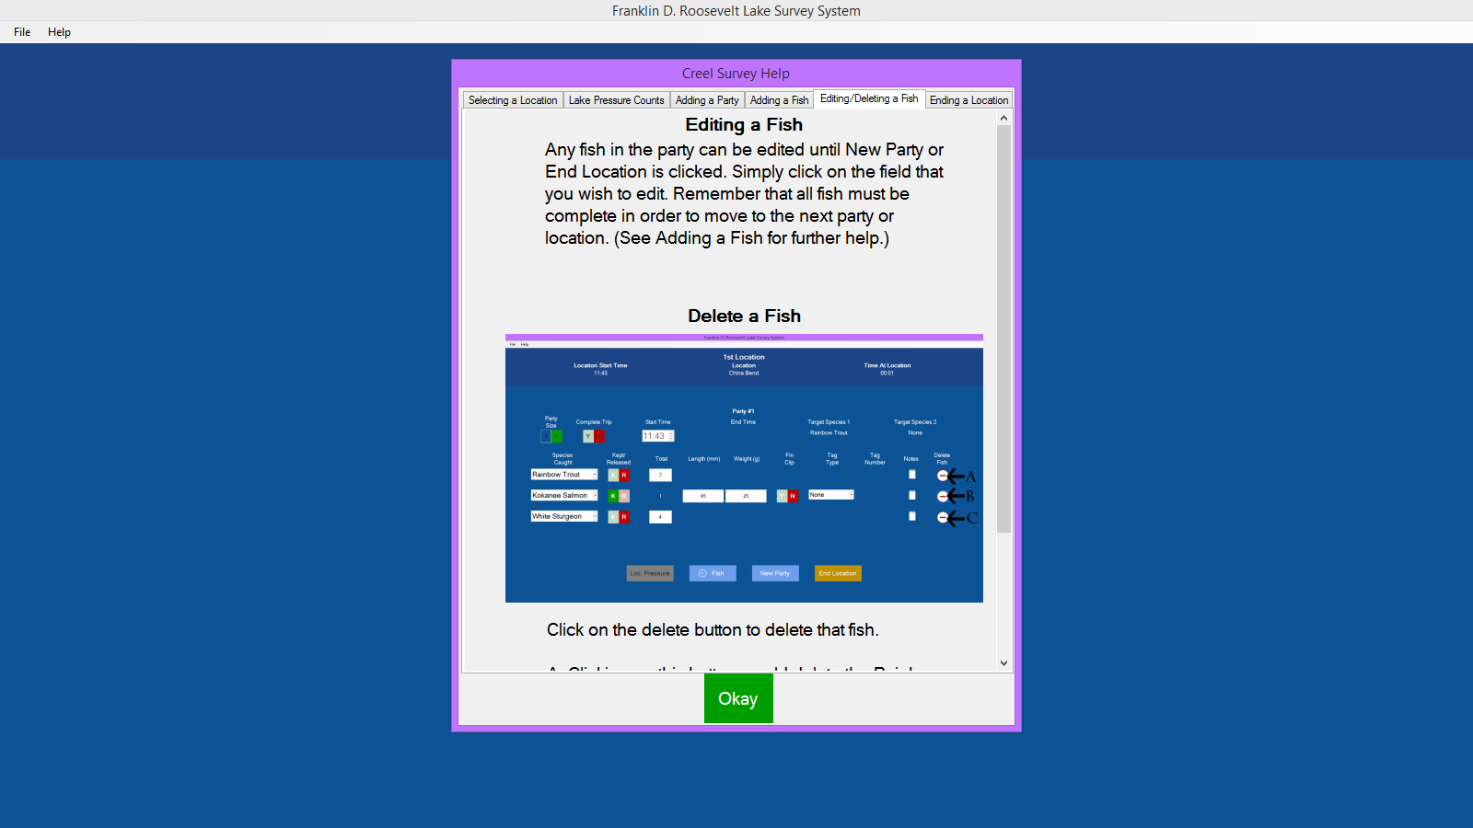
Help Files

