Slide 1
Electronic Field Input System
Team 5
Stacy Carlson, Thomas Flores, and Ralph Parkison

Slide 2
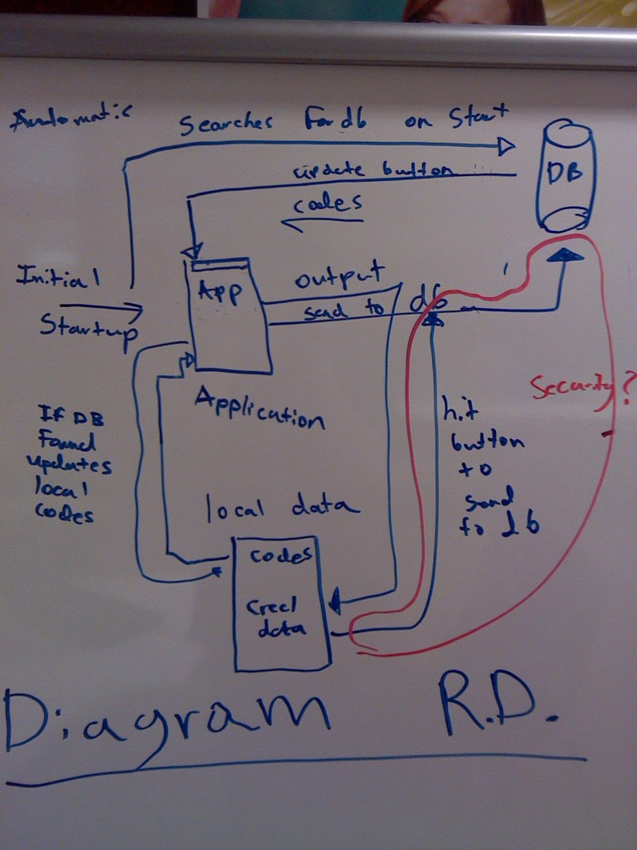
R.D. Diagram of the Design
This is the current rough draft of the basic design of the fish input system.

Slide 3
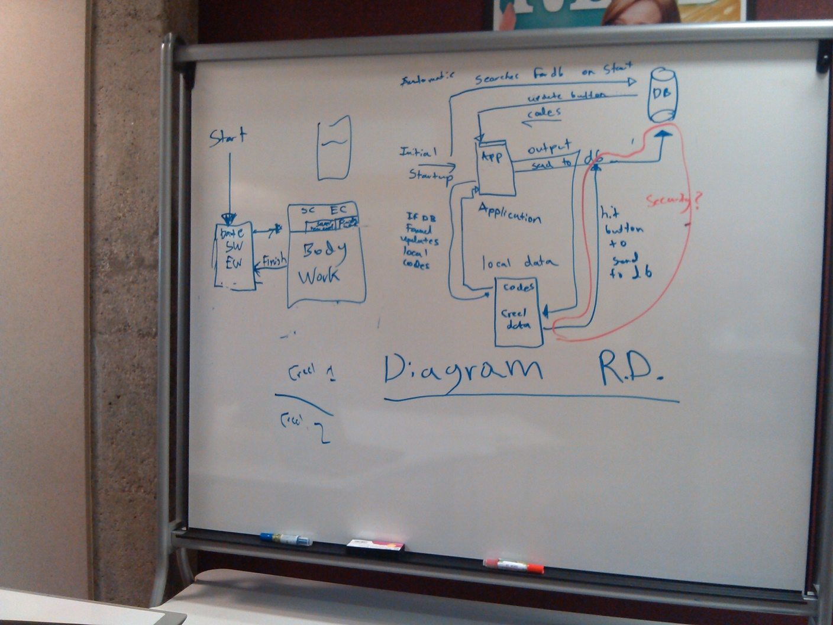
Full Diagram of initial design

Slide 4
SRS is coming along
Currently we have a rough draft of the SRS
We have not yet shown the client this but are in the process of meeting up with them again.
We will send them a copy via email as well.

