Slide 1
Electronic Field Input System
Team 5
Stacy Carlson, Thomas Flores, and Ralph Parkison

Slide 2

The Problem
Paper forms submitted via mail
Potential for loss
Errors during transcription
Long time to access the data

Slide 3
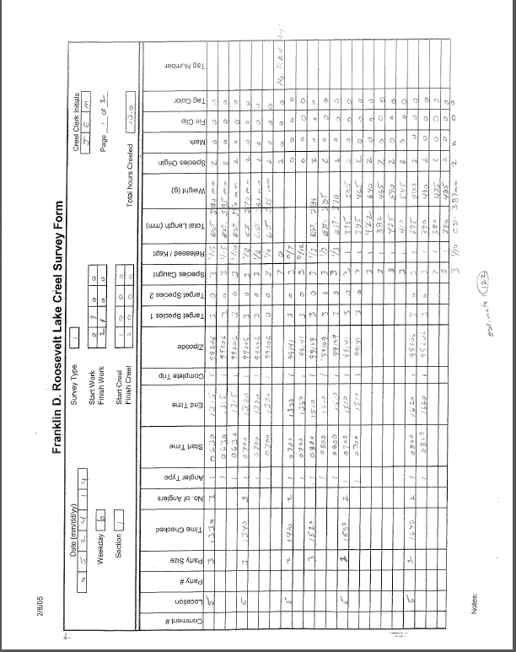

Slide 4
Client Requirements
Electronic Input System
Creel (Top priority)
Raw Fish
FWIN
Easily updatable/maintainable
Study needs change over time
Fully functional with Database
Solution can’t depend on an Internet connection

Slide 5

End User
Creel Clerk
Two types
Stationary
Bus Route
Trained how to do Creel survey
Varying computer skills

Slide 6
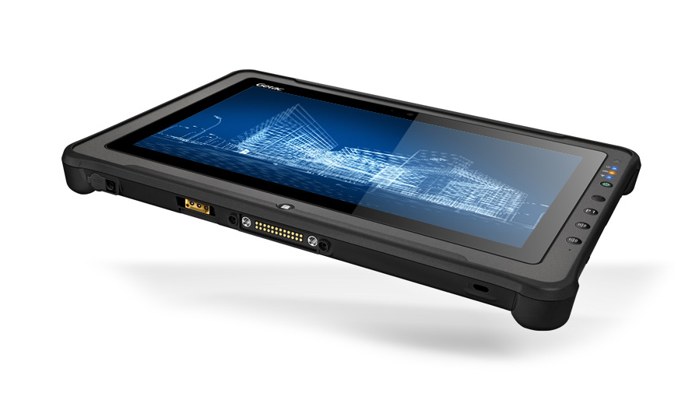
Operating Environment
Getac Tablet
Windows 7 Professional (64 bit)
Stylus/On screen keyboard

Slide 7
Specifications
Windows Application written in C#
Store data locally in log files
Interact with Database via JSON

Slide 8
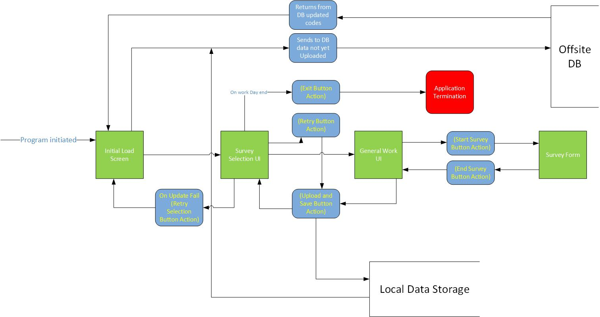
Overview of the System

Slide 9
User Interface Mockups

Slide 10


Slide 11
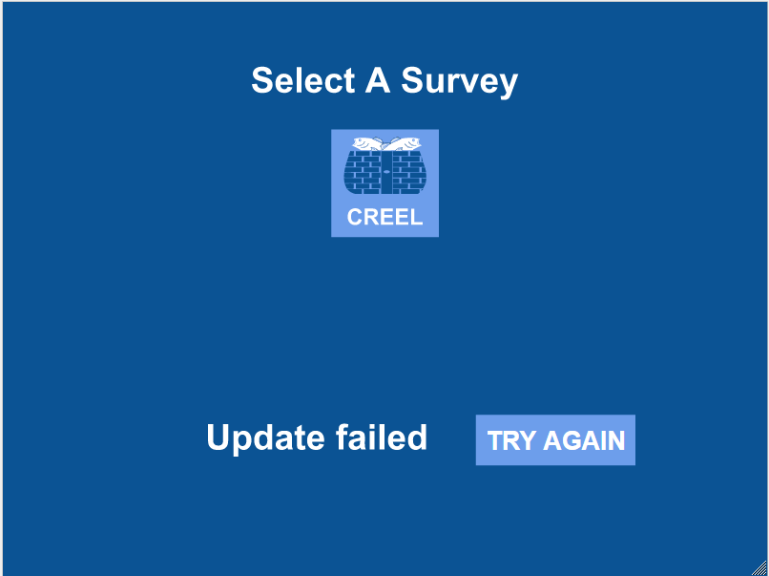

Slide 12
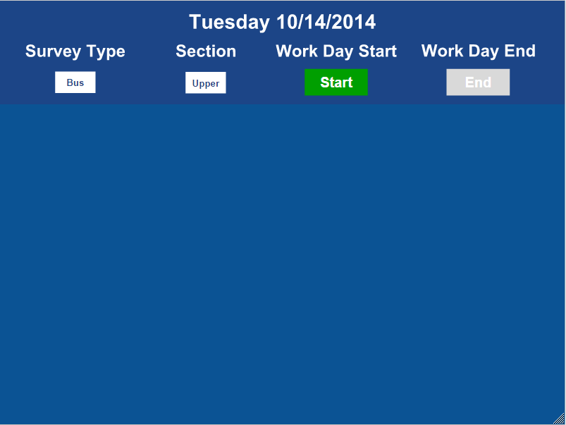

Slide 13
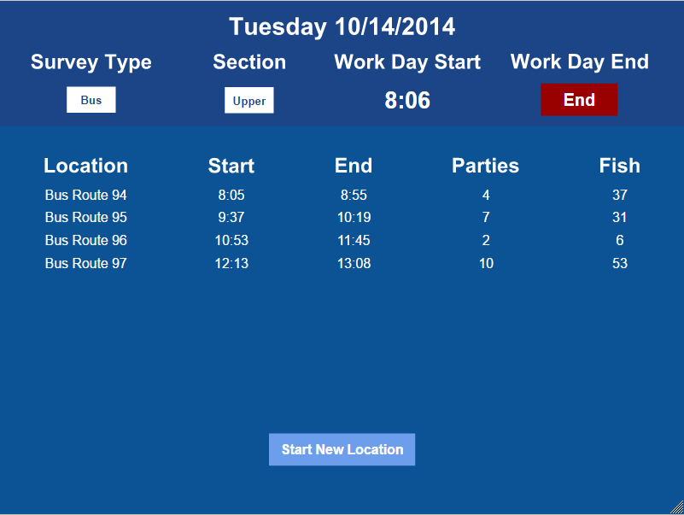

Slide 14
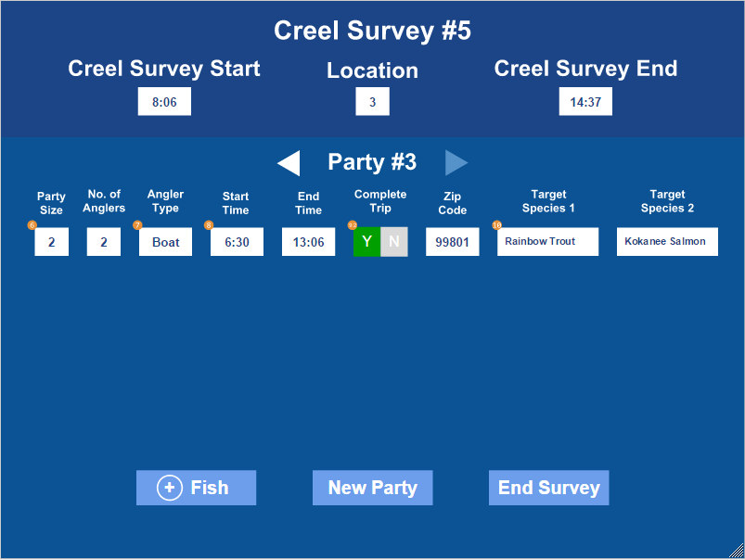

Slide 15
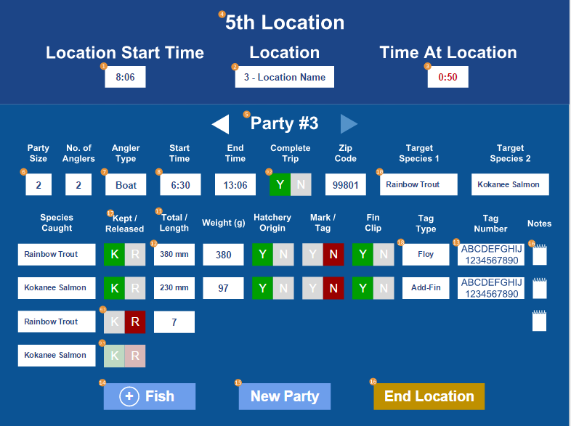

Slide 16

Questions?

