Slide 1
Electronic Field Input System
Team 5
Stacy Carlson, Thomas Flores, and Ralph Parkison

Slide 2
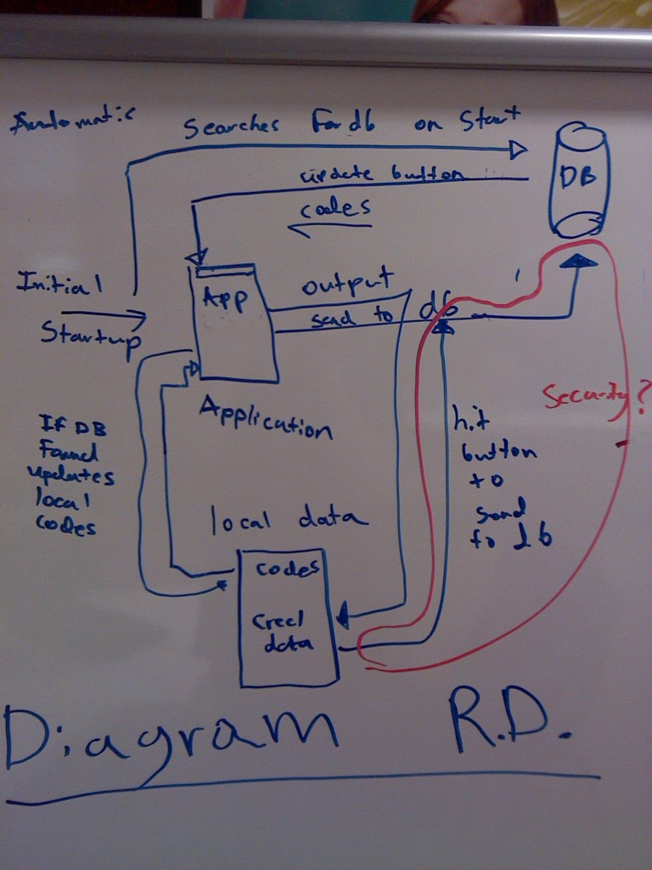
Rough Draft Design
Update fields on start up to allow for easy upgrades
Store creel data internally
Communicate with Team 4’s database via JSON objects sent over the internet

Slide 3
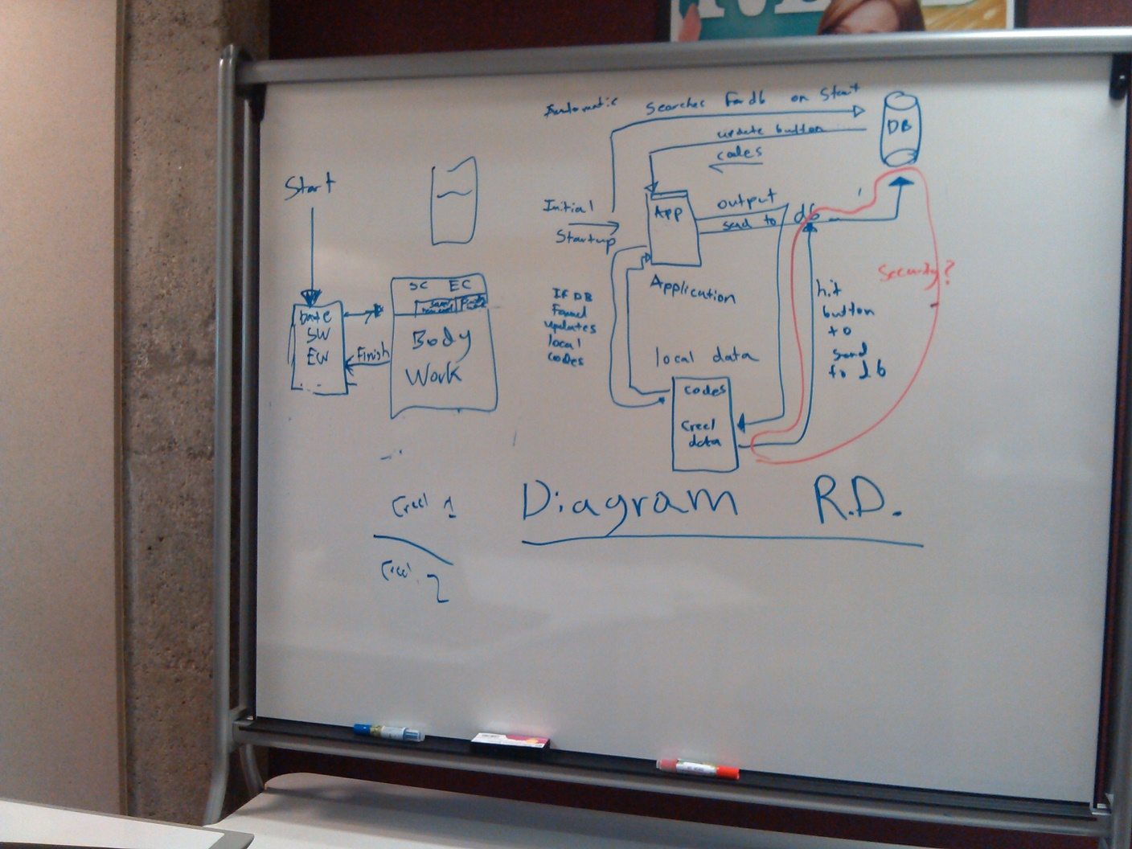
Diagram Including User Interface

Slide 4
User Interface Basics
Client wants the feel of a paper form
3 screens
Intro Screen
Creel Form
Exit Screen

Slide 5
General Software Decisions
Getac Tablets run Windows 7 Professional
Client wants sustainable code
We’re choosing to write our code in C#
Client’s overall goal for software is fewer errors
We’re going to use drop-down lists

Slide 6
SRS Progress
Currently we have a rough draft of the SRS
Contacted client to request a meeting to discuss the SRS
We will send them a copy via email as well

Slide 7
Interface Screen Mock-Ups

Slide 8



Slide 9
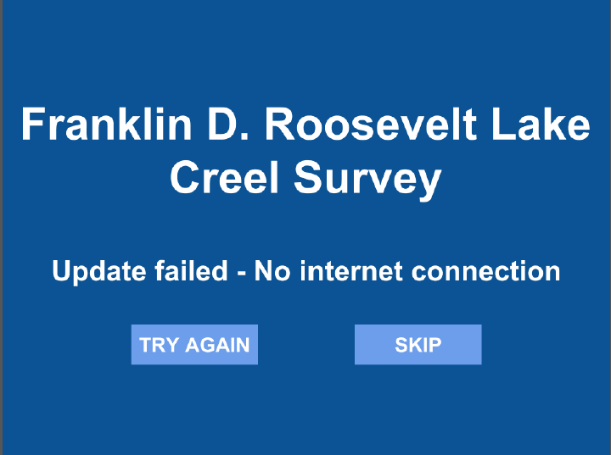

Slide 10
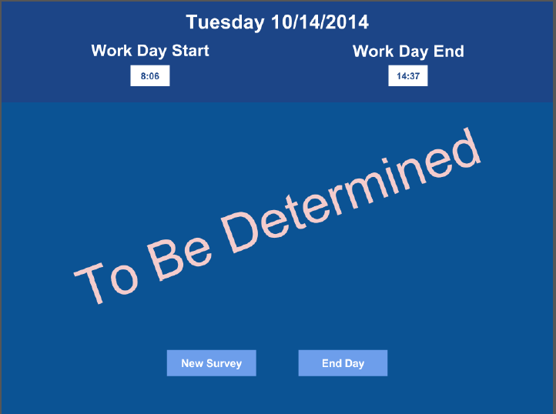

Slide 11
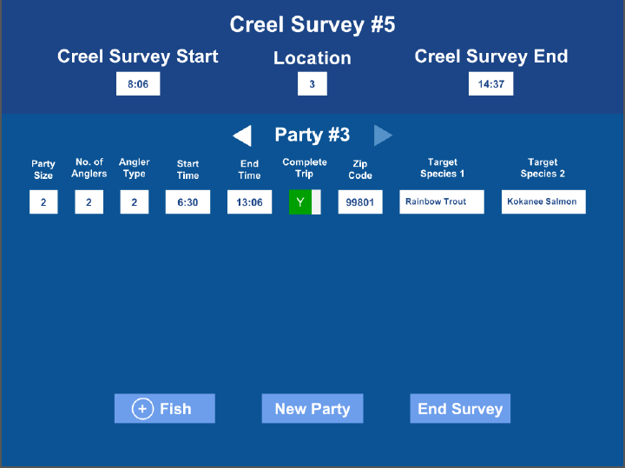

Slide 12
