Slide 1

Electronic Field Input System
Team 5
Stacy Carlson, Thomas Flores, and Ralph Parkison

Slide 2
Client Meeting
Pleased with progress
Requested minor changes
Help files also in pdf form
Angler Type auto-selects after the first angler
Made decisions about data
Waiting to find out about hardcoded usernames/passwords

Slide 3
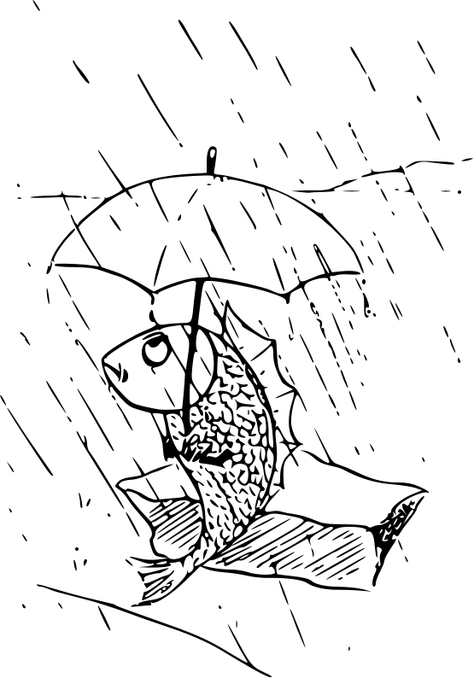
Conflicts With Team 4
Only accepting 1 zip code/angler type per party (Outgoing JSON)
Creel Clerk Initials (Incoming JSON)

Slide 4

Realistic Outlook
We’re not going to have time to do CSV output due to changes that need to be made to the UI, underlying objects, and the JSON

Slide 5
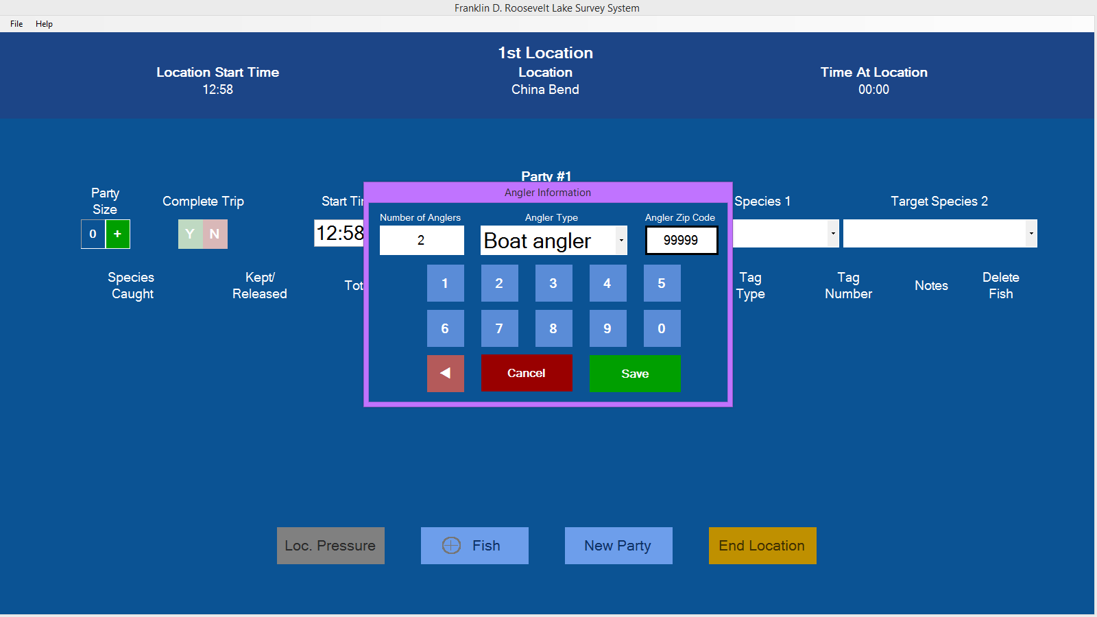
UI Revision

Slide 6

Fixes Applied
Delete Button
Add Fish enabled after deleting the last fish
Buttons enabled based on fish on screen
Exit Menu Option enabled appropriately

Slide 7
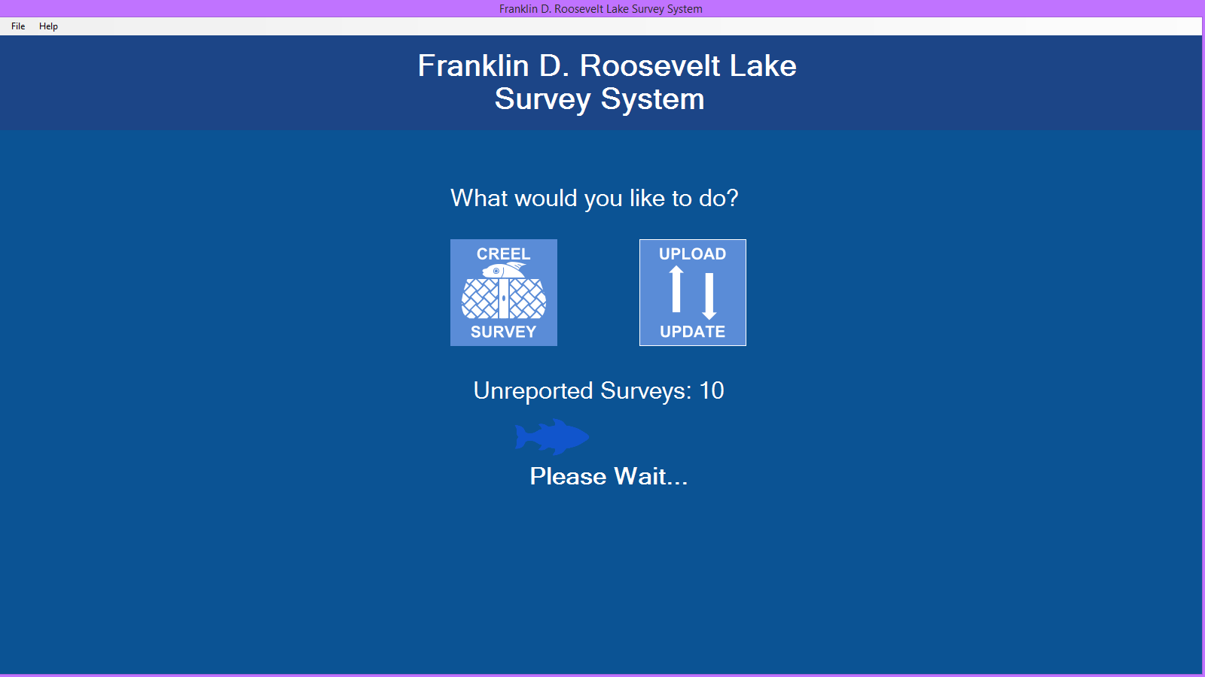
Loading Animation

Slide 8

Where We’re Going
Testing the UI and fixing any problems
Continue work on the input/output JSON
Prepare for final presentation

